Slide 1

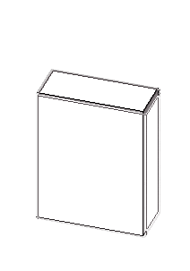
Z-axis
X-axis
Antenna
Y-axis
Incoming signal direction

Slide 3
Z
Y
Horizontal Plan
X

Slide 4
Z
Vertical Plan
Y
Horizontal Plan
X

Slide 5
Z
Vertical
Plan
13.6 inch
Y
Horizontal Plan
X

Slide 6
Z
Vertical
Plan
Y
Horizontal Plan
X

Slide 7
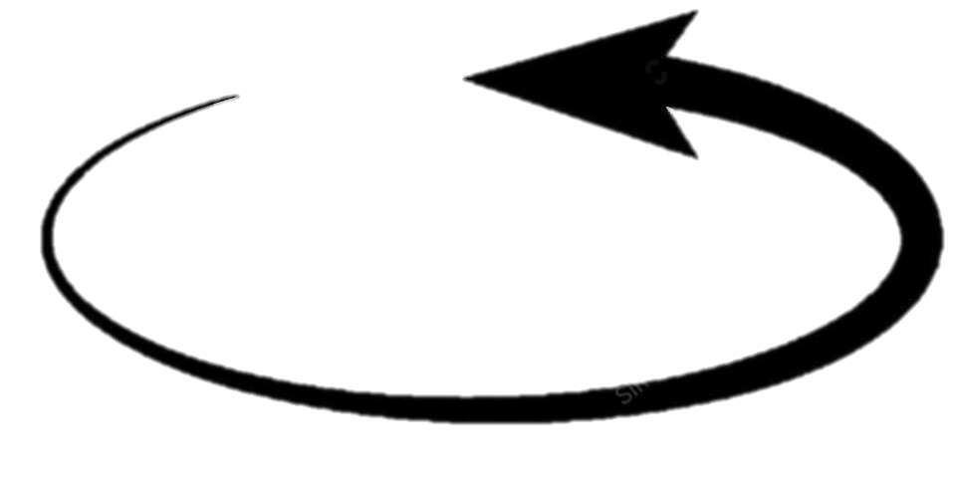
Z-rotate
X-rotate
Incoming signal direction
Y-rotate
Antenna

Slide 8
Z-axis
X-axis
Antenna
Y-axis
Incoming signal direction

Slide 9
