Slide 1
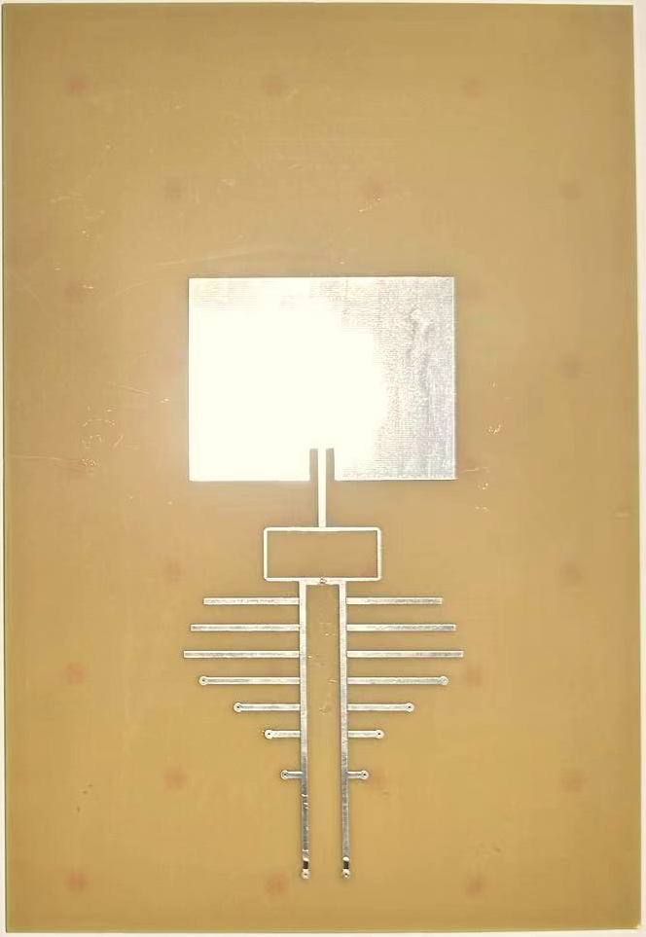

13.6 inch
Macbook
24cm
10cm
Patch antenna
33cm
30.4 cm
Divider
23cm
Button
21.4cm
Chip

Slide 2
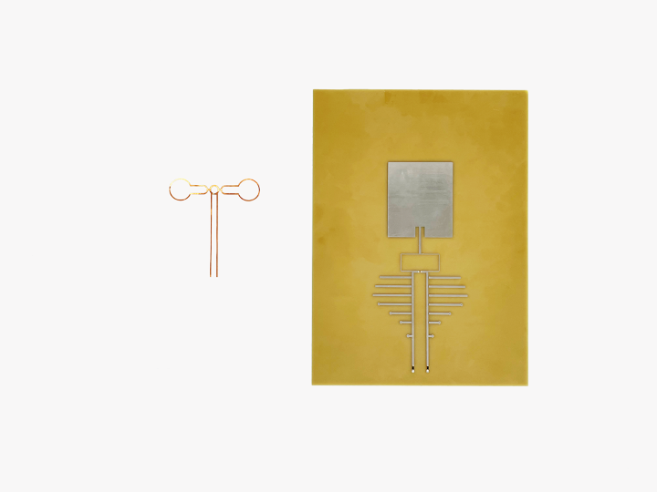
24cm
10cm
10 cm
Patch antenna
11cm
33cm
23cm
Buttons
Stubs
IC
DimSens Tag
KeyStub

Slide 3
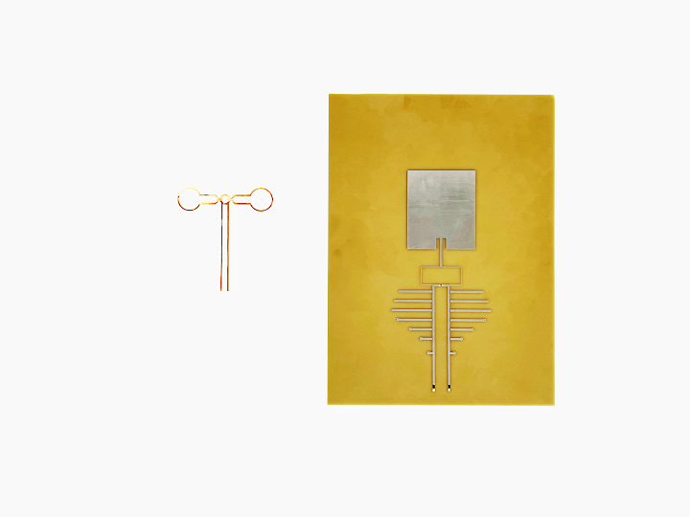
24cm
10cm
10 cm
Patch antenna
11cm
33cm
23cm
Buttons
Stubs
IC
DimSens Tag
KeyStub

Slide 4
24cm
10cm
10 cm
Patch antenna
11cm
33cm
23cm
Buttons
Stubs
IC
DimSens Tag
KeyStub

Slide 5
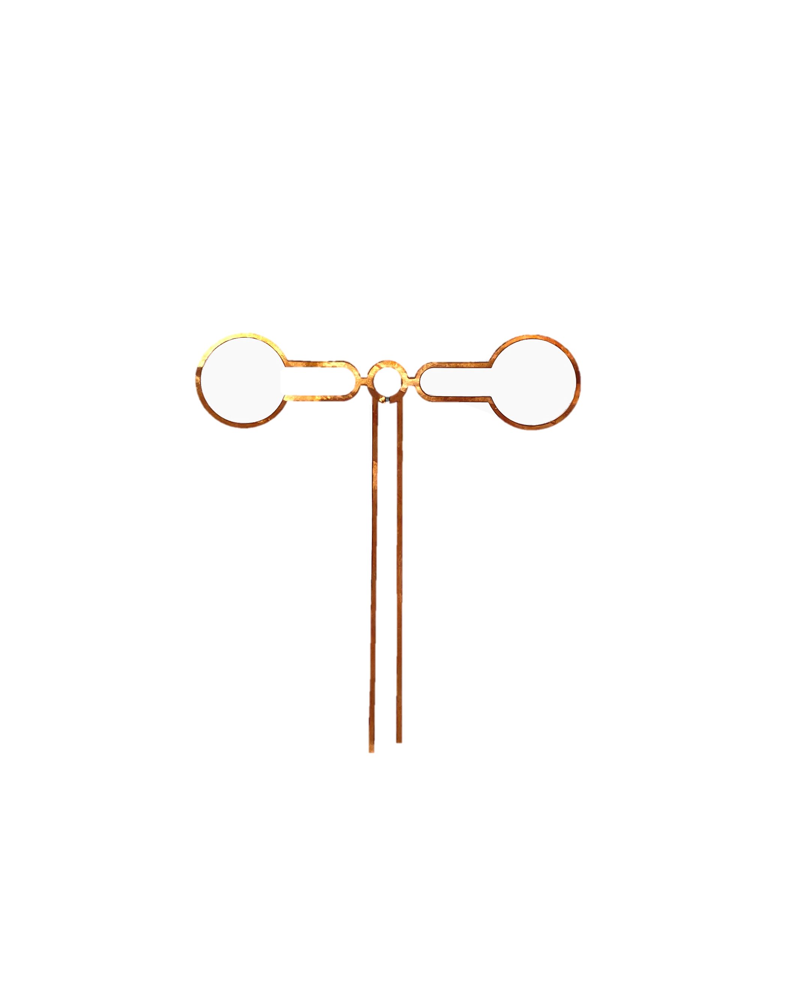
24cm
10cm
10 cm
Patch antenna
11cm
33cm
23cm
Buttons
Stubs
IC
DimSens Tag
KeyStub

Slide 6
24cm
10cm
10 cm
Patch antenna
11cm
33cm
23cm
1
Buttons
Stubs
…
12
IC
DimSens Tag
KeyStub

