Slide 1


Slide 2
Z
Y
Horizontal Plan
X

Slide 3
Z
Vertical Plan
Y
Horizontal Plan
X

Slide 4
Z
Vertical
Plan
13.6 inch
Y
Horizontal Plan
X

Slide 5
Z
Vertical
Plan
Y
Horizontal Plan
X

Slide 6
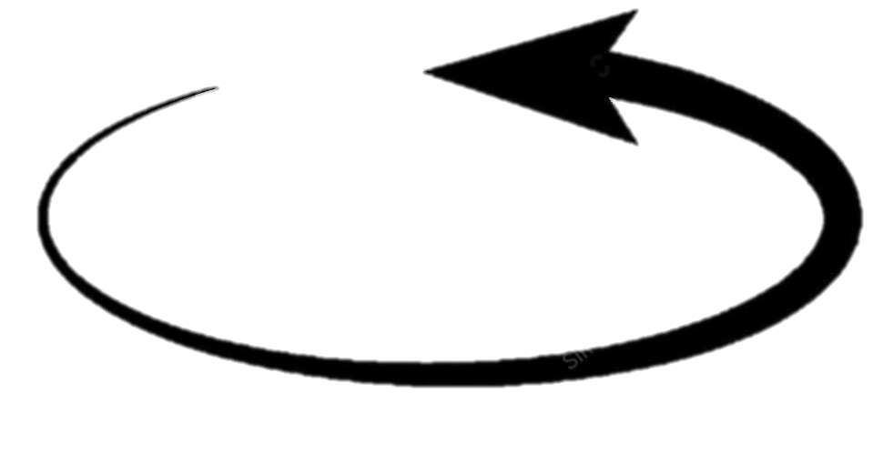
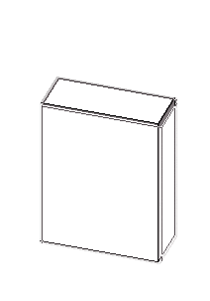
Z-rotate
X-rotate
Incoming signal direction
Y-rotate
Antenna

Slide 7
Z-axis
X-axis
Antenna
Y-axis
Incoming signal direction

Slide 8
Z-axis
X-axis
Antenna
Y-axis
Incoming signal direction

Slide 9
