Slide 1

MCA PROJECT PRESENTATION
Drug Recommendation
System
An AI-driven, symptom-based medicine recommendation platform with sentiment-analysed reviews and real-time doctor consultation
Presented by Liyona Johny (Reg. No. 2004425347)
Guide Jisha Soman, Dept. of Computer Applications
Python
Django 4.0
MySQL
NLTK · Sentiment Analysis

Slide 2




INTRODUCTION
Why a Drug Recommendation System?
Personalised Recommendations
The Problem
Tailor drug suggestions to patient-specific symptoms and review sentiment, not generic listings.
Choosing the right medication is complex — it depends on a patient's condition, history and side-effects. Physicians face an overwhelming volume of clinical data, while patients' own reviews go largely unused because reading them by hand doesn't scale.
Machine-Learning Driven Accuracy
Score real patient reviews with NLP so higher-rated medicines surface first.
Telemedicine Support
Let patients consult specialised doctors in real time through built-in chat.
During emergencies — pandemics, floods, disasters — patients often can't reach a doctor at all. A data-driven system can recommend safe medication instantly, and still connect them to a real doctor by chat when they need one.
Data Integrity & Security
Keep patient, doctor and company records reliable and access-controlled.
Drug Recommendation System — Project Presentation
2

Slide 3
SYSTEM ANALYSIS
Existing Systems vs. the Proposed Approach
EXISTING SYSTEMS
PROPOSED SYSTEM
WebMD / Drugs.com
Symptom + sentiment driven
Static drug information — no personalisation to the patient.
NLTK-based analysis of patient reviews computes a live 1–5 star rating per medicine.
1mg / Netmeds
Instant, always-available
Online ordering only; still requires an existing prescription.
Recommendations don't wait on physician availability — critical during emergencies.
Ada Health (symptom checkers)
Built-in doctor chat
Assesses conditions but never suggests actual medication.
Patients still reach real specialists for cases the algorithm shouldn't decide alone.
Practo-style telemedicine
Role-based access
Fully depends on a live doctor — no help when one isn't reachable.
Separate, approval-gated portals for Admin, Company, Doctor and Patient.
Drug Recommendation System — Project Presentation
3

Slide 4




SYSTEM DESIGN
Architecture & Technology Stack
Presentation Layer
Role-specific dashboards for Admin, User, Company & Doctor
Django Templates + Bootstrap 5
Application Layer
Routing, session-based auth, business logic per actor
Django 4.0.4 Views (Python 3.9)
Intelligence Layer
Converts free-text reviews into a sentiment-based star rating
NLTK — tokenising, POS-tagging, stemming
Data Layer
Patients, companies, doctors, medicines, reviews & chat history
MySQL
Drug Recommendation System — Project Presentation
4

Slide 5




SYSTEM MODULES
Four Actors, One Platform
Admin
Patient (User)
Pharma Company
Doctor
Approves / rejects company & doctor sign-ups
Registers freely, browses & searches medicines
Registers, held pending until admin-approved
Registers with specialisation & qualification
Oversees medicines, users & feedback
Posts reviews — auto-rated by sentiment analysis
Adds & maintains medicine catalogue entries
Answers patient chat consultations
Single control point for platform integrity
Chats live with doctors, files feedback
Manages its own company profile
Maintains a professional profile
Drug Recommendation System — Project Presentation
5

Slide 6
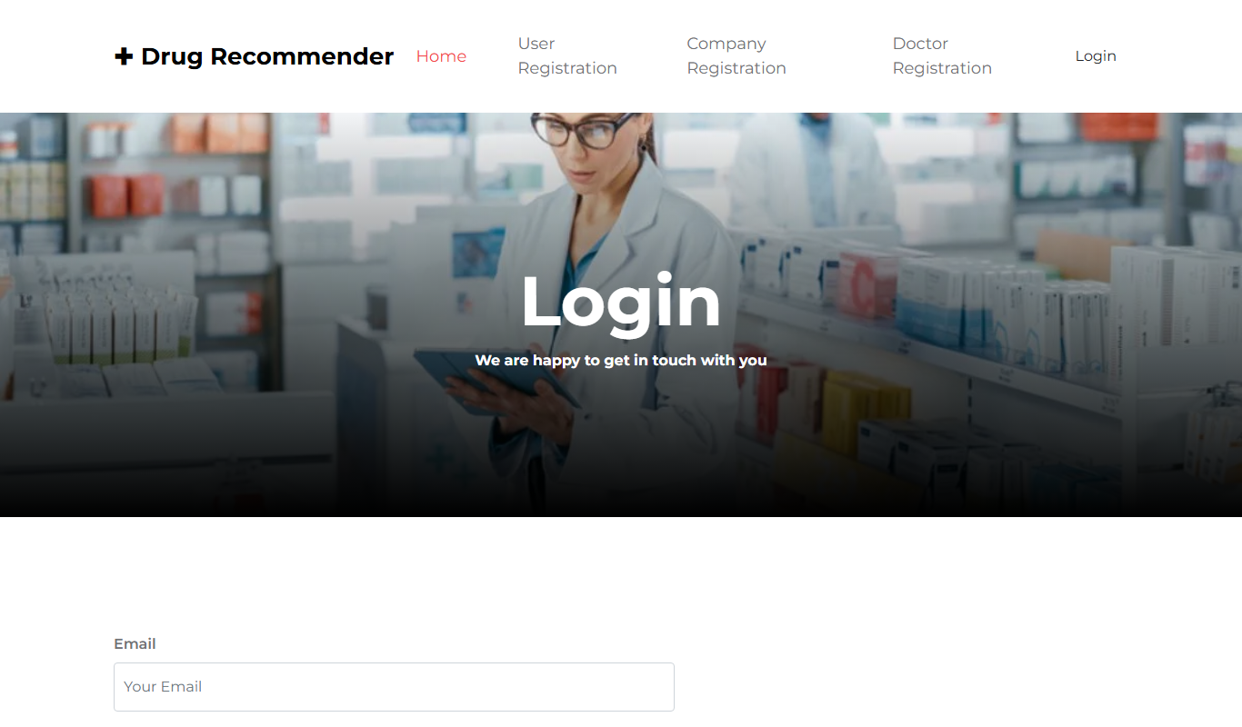
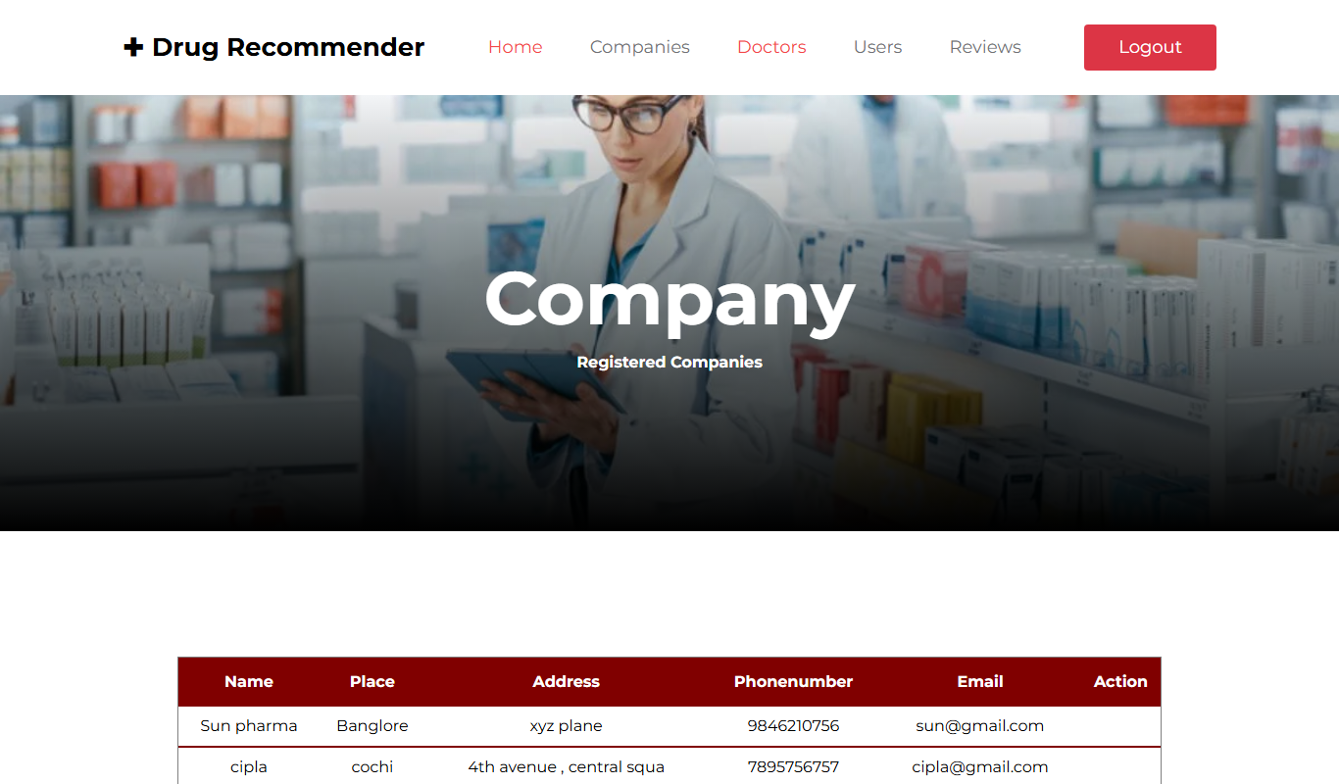
KEY FLOW ·1
Registration, Approval & Role-Based Login
1
Register
Patient / Company / Doctor signs up
2
Pending
Company & Doctor start as unapproved
3
Admin Reviews
Approves or rejects from the admin panel
4
Login
Single form authenticates every role
5
Role Dashboard
Routed straight to the matching home screen
Login form → Admin's company-approval screen (real application screenshots)
Drug Recommendation System — Project Presentation
6

Slide 7



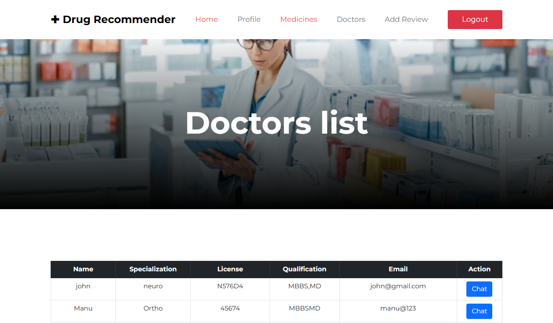
KEY FLOW ·2 — CORE INNOVATION
AI-Driven, Sentiment-Based Recommendation
→
→
→
→
→
Patient Review
Tokenise & POS-Tag
Stem (Porter Stemmer)
Match vs. Lexicon
Sentiment Score
1–5 Star Rating
Every review is tokenised and POS-tagged with NLTK, reduced to root words with a Porter Stemmer, then matched word-by-word against curated positive / negative lexicons. The resulting sentiment score is bucketed into a 1–5 star rating — stored automatically, without the patient ever picking a star themselves.
Recommendation rule: search results are ranked by AVG(rating) DESC — medicines rated above 3 surface first, exactly as the report specifies.
Drug Recommendation System — Project Presentation
7

Slide 8
KEY FLOW ·3
Real-Time Patient ↔ Doctor Chat
Patient
Doctor
/doctorlist/
/userlist/
chatm table
One row per (patient, doctor, day) — opens a daily thread
chats table
Every message, tagged typ = 'user' or 'doctor'
Live thread view
Both sides re-join and read the full history back
Drug Recommendation System — Project Presentation
8

Slide 9

PROJECT PLANNING
Cost Estimation — Basic COCOMO Model
The project is classified as an Organic-type system per Boehm's COCOMO model — small team, well-understood problem domain. Applying the Basic COCOMO formulas to the application's own measured source size gives:
1.4
3.4
4
1
KLOC
PERSON-MONTHS
MONTHS
DEVELOPER
Application source size (Python)
Effort = 2.4 × (KLOC)^1.05
Schedule = 2.5 × (Effort)^0.38
Team size = Effort ÷ Schedule
Direct Monetary Cost
Nil software licensing cost — the stack (Python, Django, MySQL) is entirely free & open-source. Only depreciation on existing development hardware applies, per the report's Economic Feasibility analysis.
Drug Recommendation System — Project Presentation
9

Slide 10




WRAPPING UP
Testing, Future Scope & Conclusion
TESTING PERFORMED
FUTURE ENHANCEMENTS
Unit Testing
Deeper ML Personalisation
Each view tested in isolation during coding
Learn individual patient preference over time
Integration Testing
NLP-Powered Chatbot
User, admin, company & doctor modules combined
Instant automated support alongside live doctors
Security & Recovery
E-Pharmacy Integration
Login, session and failure-recovery checks
Seamless ordering directly from a recommendation
The Drug Recommendation System demonstrates a working, role-based healthcare platform that turns unstructured patient reviews into ranked, actionable medicine recommendations — while keeping a real doctor one chat away.
Thank You

