Slide 1
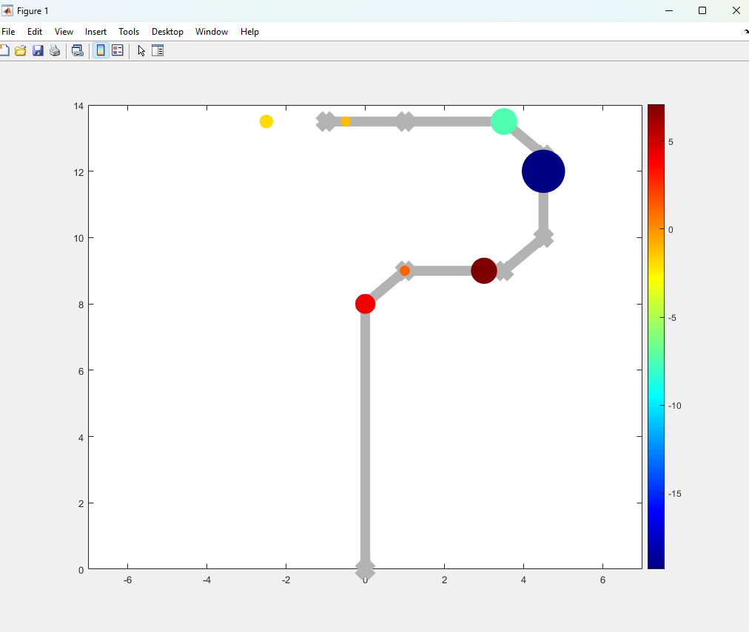
11.75
10.75
10
9.5
9
-1.07s
8.5trs
5
6
6.25
7.25
7
0-4trs
+1.237s

