Slide 1
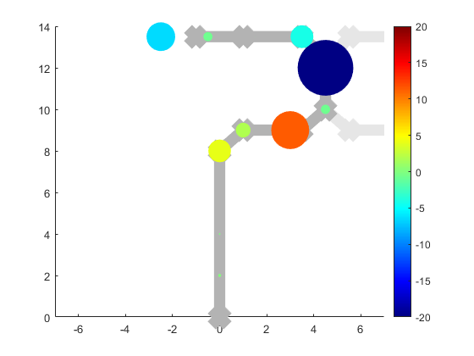
Map of code base for OLNOLTimecourse study
Flow chart legend:
code.m
Output_of_code.mat
You edit+run this
The code generates this
Located in OLNOLTimecourses github repo
The dataframe or “feature set” that MVPA uses: all timecourses for all subjects in one matrix
Preprocess fMRI data
convert_fir_data_for_MVPA.m
FeatSet_01.mat
FeatSet_01_namesfile.mat
The “model file” for the “feature set”. Note, this is different from the individual subject model file we used for FIR estimation, but it’s technically the same TYPE of file – SPM (and MVPA) use this to assign condition names to patterns with different “onsets” (here not actually “time” but just a numerical index for each pattern
Takes indiv_timecourses.mat and
reformats them into a feature set MVPA can use
Creates a new “model file” corresponding to those patterns for MVPA to use
Create a “model file”
With names, onsets, durations for the events you want to estimate a timecourse from
*note: more events (names) = more timecourses, with the timecourses for each event type being “the timecourse for this event that isn’t explained by the other events”
MVPA (multivariate pattern classification)
Run 1st-level analysis in SPM for each subject using the model file
Located in plMVPALite github repo. Should not need editing EXCEPT at top to call on mvpa_params_general_OLNOLTimecourses.m and not one of my other mvpa_params…m files in the repo
Located in OLNOLTimecourses github repo under “MVPA_helper_code” folder. Both must be edited for your specific analysis
TIB_MVPA_run_general.m
generate_conditionlabels_forpatterns.m
mvpa_params_general_OLNOLTimecourses.m
SPM.mat
8080test_2way_nf_ws1_Featset01.mat
The “results” file contains a complex “res” variable: a structural array that contains all the MVPA performance data you want
Liz FIR timecourse script(s).m
Located in OLNOLTimecourses github repo – a pain to set up, but it can generate pretty illustrations of the MVPA weights for different timepoints in the maze overlaid on a map of the maze
plot_weights_map.m
Excel, R-Studio, whatever you like – you can crunch numbers on the data in the “res” structure for publication and other plots
indiv_timecourses.mat
Notes:
The call is in the params file, line 10.

