Slide 1
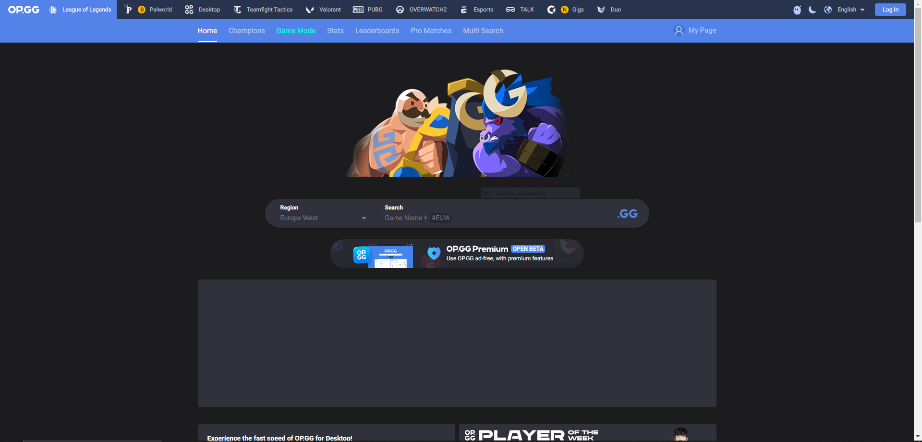
https://www.op.gg/

