Slide 1
Analyzing the Impact of
Advertising Spend on Sales
CMSE 202 Project Update — Machine Learning with the Advertising Dataset

Slide 2
Project Overview
Dataset
Goal
200 observations with TV, Radio, and Newspaper advertising budgets (in $thousands) and corresponding Sales values.
Predict sales from advertising spend using machine learning and identify which channel has the strongest impact.
Models
Evaluation
Linear Regression (interpretable baseline) vs. Random Forest Regressor (ensemble, captures non-linear patterns).
Models scored using R² and MSE on an 80/20 train-test split with random_state=42.

Slide 3
02
Exploratory Data Analysis
Distributions, scatter plots & correlations

Slide 4
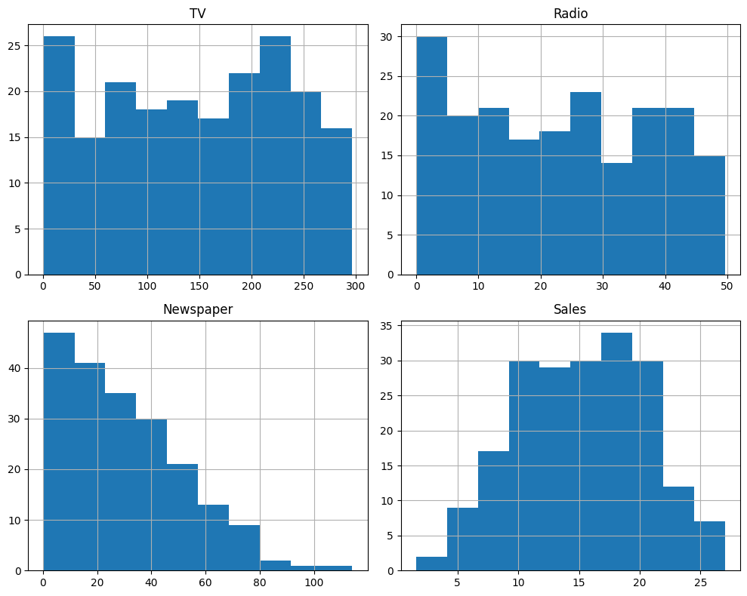
Feature Distributions
Histograms of all four variables: TV spend, Radio spend, Newspaper spend, and Sales.
TV spending is roughly uniform with a slight right skew — many markets use moderate to high TV budgets.
Newspaper spend is heavily right-skewed, concentrated at lower values.
Sales shows a roughly normal distribution, centered around 12–15 units.

Slide 5
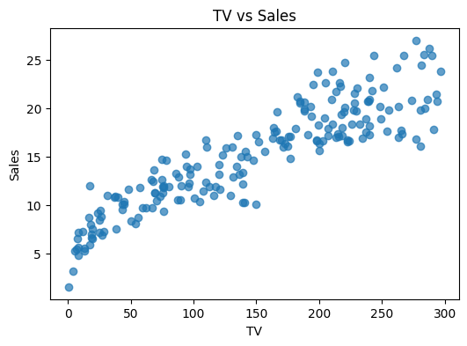
TV vs Sales
Strong positive linear relationship.
TV advertising spend is the most correlated channel with sales, showing a clear upward trend across the full spend range (0–300).
This near-linear pattern suggests that TV spend directly and consistently drives sales. It also signals that TV will likely be the dominant feature in both models.

Slide 6
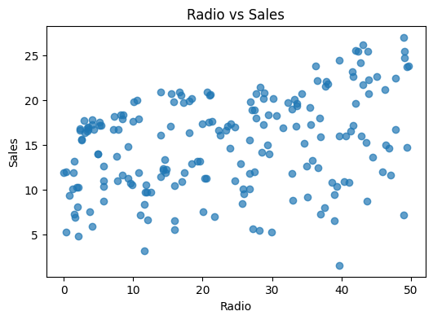
Radio vs Sales
Moderate positive relationship.
Radio spend shows a meaningful but weaker correlation with sales compared to TV. Points are more scattered across spend values.
The spread suggests Radio's effect is less consistent — other factors likely interact with it, and its impact is harder to isolate from TV's stronger influence.

Slide 7
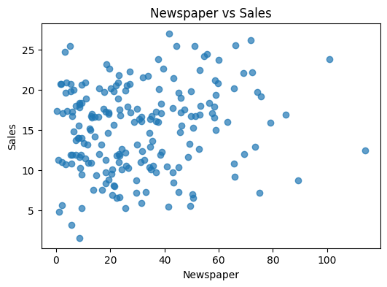
Newspaper vs Sales
Weak relationship.
Newspaper spend shows the weakest correlation with sales among the three channels. The scatter is nearly random with no clear upward trend.
This already hints that Newspaper will not be a useful predictor — a finding later confirmed by Random Forest feature importance (score: 0.019).

Slide 8
03
Model Training
Linear Regression vs. Random Forest Regressor

Slide 9
Model Training
Linear Regression
Random Forest Regressor
Type: Parametric, interpretable Assumption: Linear relationship between features and target Strengths: Fast, interpretable coefficients Weakness: Cannot capture non-linear patterns Split: 80% train / 20% test (random_state=42)
Type: Ensemble of 200 decision trees Assumption: None — learns structure from data Strengths: Captures non-linear relationships, robust to outliers Weakness: Less interpretable than linear regression Split: 80% train / 20% test (random_state=42)

Slide 10
04
Model Comparison

Slide 11
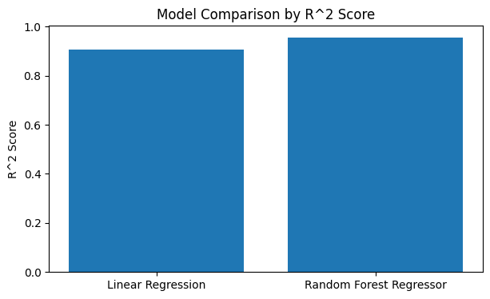
Model Comparison: R² Score
Random Forest (R² = 0.955) outperforms Linear Regression (R² = 0.906).
Both models perform well, but Random Forest captures non-linear relationships more effectively.
An R² of 0.955 means the model explains 95.5% of the variance in sales — a very strong result that confirms advertising spend is a powerful predictor.

Slide 12
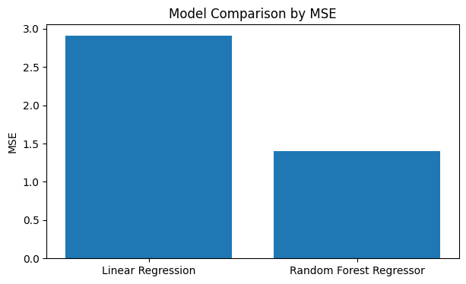
Model Comparison: MSE
Random Forest achieves a lower Mean Squared Error (1.40) compared to Linear Regression (2.91), confirming it as the better-performing model.
Random Forest's errors are roughly half the size — its predictions are on average much closer to actual sales values.
Together, both metrics consistently point to Random Forest as the stronger model for this dataset.

Slide 13
05
Results & Evaluation
Predictions, residuals & feature importance

Slide 14
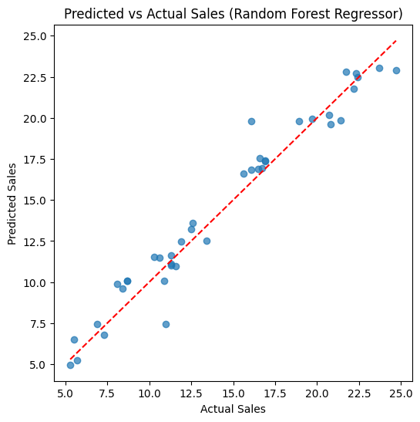
Predicted vs Actual Sales
Random Forest predictions closely follow the diagonal reference line (perfect prediction), indicating strong model accuracy.
Points near the line confirm the model generalizes well to unseen data.
The few points slightly off-diagonal represent modest over- or under-predictions, which are expected and small in magnitude, consistent with MSE = 1.40.

Slide 15
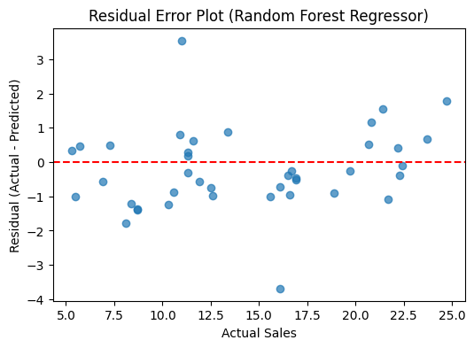
Residual Error Plot
Residuals are randomly scattered around zero with no clear pattern — this is ideal model behavior.
A systematic pattern (funnel shape or curve) would indicate bias or heteroscedasticity. The random scatter here confirms the model fits well across all sales ranges.
Most residuals fall within ±2 units, with only a few outliers at the extremes.

Slide 16
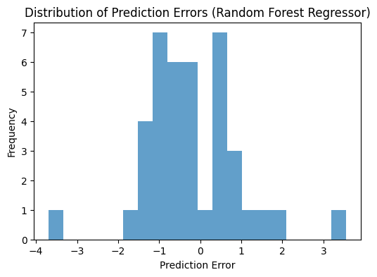
Distribution of Prediction Errors
Prediction errors are roughly centered at zero and bell-shaped, confirming consistent model performance.
A few larger errors exist at the tails (around ±3–4 units), but the vast majority of predictions are within ±1.5 units.
This near-normal error distribution indicates the model's mistakes are random rather than systematic — another sign of a well-fitted model.

Slide 17
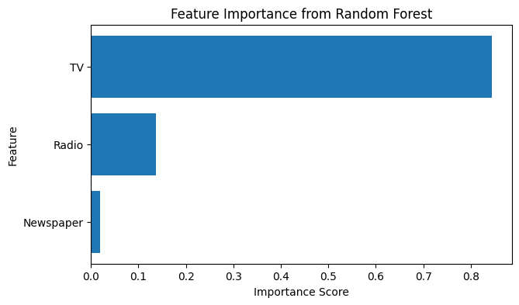
Feature Importance (Random Forest)
TV advertising has by far the highest importance score (0.844), followed by Radio (0.136) and Newspaper (0.019).
TV contributes over 84% of the model's predictive power and is the dominant predictor of sales.
Newspaper's near-zero importance confirms what the scatter plot suggested: it adds almost no predictive value and could be dropped without significantly affecting performance.

Slide 18
Discussion
Why does Random Forest outperform Linear Regression?
The advertising-to-sales relationship has non-linear elements (e.g., diminishing returns at high TV spend, channel interaction effects). Random Forest captures these patterns while Linear Regression assumes a fixed linear effect per dollar.
Why is TV the dominant feature?
TV advertising reaches the broadest audience and shows the strongest correlation (r ≈ 0.78). Radio has a moderate secondary effect. Newspaper shows almost no independent predictive value once TV is accounted for.
Limitations
Dataset is small (200 observations). No time effects, seasonality, or channel interaction terms. Results may not generalize beyond this dataset to other industries or markets.
Future Work
Cross-validation for more robust estimates, interaction features (TV × Radio), Gradient Boosting comparison, and feature selection to test whether dropping Newspaper hurts performance.

Slide 19
Conclusions
1
TV advertising is the strongest predictor of sales (feature importance: 0.844). It should be prioritized when allocating advertising budgets.
2
Random Forest (R² = 0.955, MSE = 1.40) significantly outperforms Linear Regression (R² = 0.906, MSE = 2.91), indicating non-linear patterns in the data.
3
Newspaper advertising has negligible predictive value (importance: 0.019) and likely does not justify its spend relative to TV or Radio.
4
Residual analysis confirms no systematic model bias — errors are randomly distributed and centered near zero across all sales ranges.
5
Machine learning methods (Random Forest) offer meaningful accuracy gains over a linear baseline for advertising spend prediction tasks.

Slide 20
Thank You
CMSE 202 Honors Project — Machine Learning with the Advertising Dataset

