Slide 1
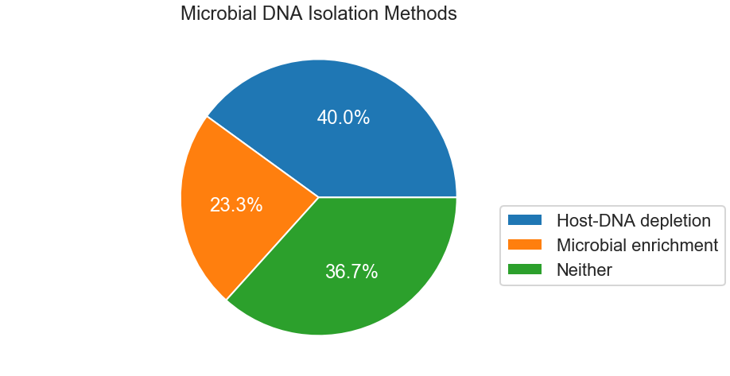
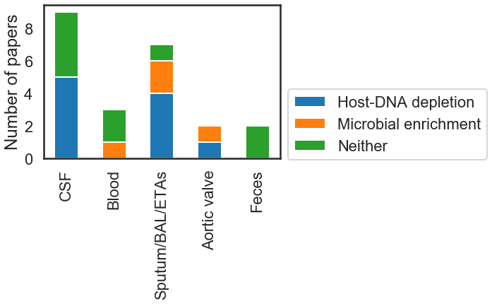
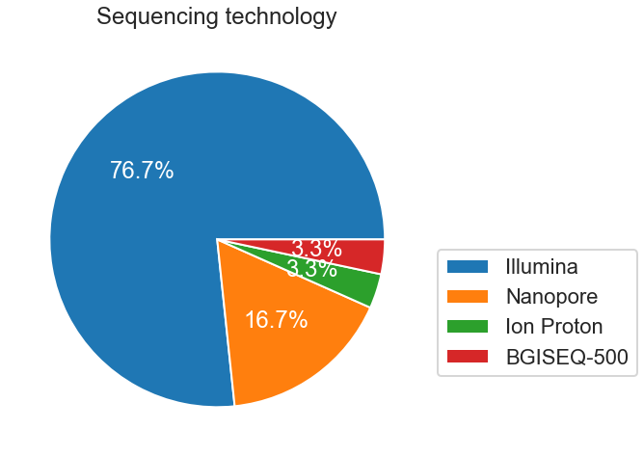
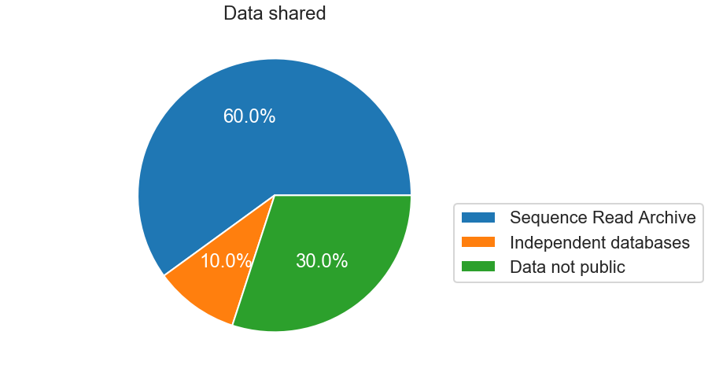
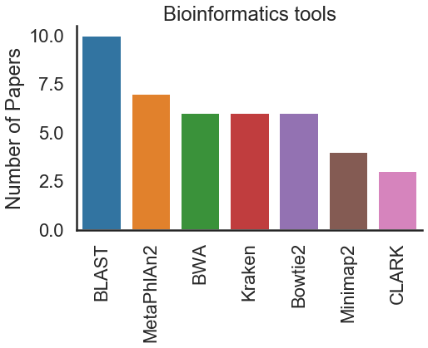
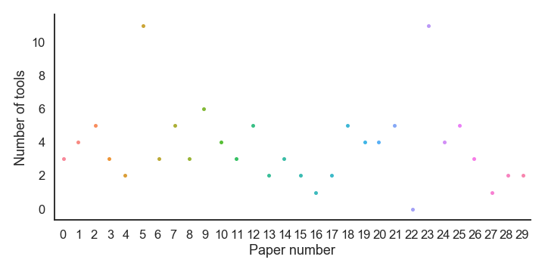
a
b
c
d
e
f

Slide 2
Bioinformatics tools | BLAST | MetaPhlAn2 | Kraken | Bowtie2 | BWA | Minimap2 | Canu | CLARK | GSNAPL | Prokka | mothur | BioBloom | LMAT | Pilon | Geneious | RepeatMasker | SPAdes | cd-hit-dup | USEARCH | UBLAST | ESOM | Snippy | IDBA-UD | ABRicate | mlst | BBMap | WIMP | Porechop
Tissue
Aortic valve | 1 | 2 | 0 | 0 | 1 | 0 | 0 | 2 | 0 | 0 | 1 | 0 | 0 | 0 | 0 | 0 | 0 | 0 | 1 | 1 | 0 | 0 | 0 | 0 | 0 | 0 | 0 | 0
Blood | 0 | 0 | 0 | 0 | 0 | 1 | 0 | 0 | 0 | 0 | 0 | 0 | 0 | 0 | 0 | 0 | 0 | 0 | 0 | 0 | 0 | 0 | 0 | 0 | 0 | 0 | 0 | 0
Bone and joint | 0 | 1 | 1 | 1 | 0 | 0 | 0 | 0 | 0 | 0 | 0 | 0 | 0 | 0 | 0 | 0 | 0 | 0 | 0 | 0 | 0 | 0 | 0 | 0 | 0 | 0 | 0 | 0
Cerebrospinal fluid | 2 | 1 | 1 | 5 | 1 | 0 | 0 | 0 | 2 | 0 | 0 | 0 | 0 | 0 | 1 | 2 | 0 | 2 | 0 | 0 | 0 | 0 | 0 | 0 | 0 | 0 | 0 | 0
Interface of dead and living tissues | 1 | 0 | 0 | 0 | 0 | 0 | 0 | 0 | 0 | 0 | 0 | 0 | 0 | 0 | 0 | 0 | 0 | 0 | 0 | 0 | 0 | 0 | 0 | 0 | 0 | 0 | 0 | 0
Feces | 2 | 0 | 2 | 0 | 0 | 0 | 2 | 0 | 0 | 2 | 0 | 0 | 0 | 2 | 0 | 0 | 2 | 0 | 0 | 0 | 2 | 2 | 2 | 2 | 2 | 0 | 0 | 0
Liver | 0 | 0 | 1 | 0 | 1 | 0 | 0 | 0 | 0 | 0 | 1 | 0 | 0 | 0 | 0 | 0 | 0 | 0 | 0 | 0 | 0 | 0 | 0 | 0 | 0 | 0 | 0 | 0
Lung biopsy tissues | 0 | 0 | 0 | 0 | 1 | 0 | 0 | 0 | 0 | 0 | 0 | 0 | 0 | 0 | 0 | 0 | 0 | 0 | 0 | 0 | 0 | 0 | 0 | 0 | 0 | 0 | 0 | 0
Resected prostheses | 0 | 1 | 0 | 0 | 1 | 0 | 0 | 0 | 0 | 0 | 0 | 1 | 0 | 0 | 0 | 0 | 0 | 0 | 0 | 0 | 0 | 0 | 0 | 0 | 0 | 1 | 0 | 0
Sonication fluid or synovial fluid | 0 | 1 | 0 | 0 | 1 | 1 | 0 | 0 | 0 | 0 | 0 | 1 | 2 | 0 | 0 | 0 | 0 | 0 | 0 | 0 | 0 | 0 | 0 | 0 | 0 | 1 | 0 | 0
Sputum, BAL or ETAs* | 3 | 1 | 1 | 0 | 0 | 2 | 2 | 1 | 0 | 0 | 0 | 0 | 0 | 0 | 0 | 0 | 0 | 0 | 1 | 1 | 0 | 0 | 0 | 0 | 0 | 0 | 2 | 2
Urine | 1 | 0 | 0 | 0 | 0 | 0 | 0 | 0 | 0 | 0 | 0 | 0 | 0 | 0 | 1 | 0 | 0 | 0 | 0 | 0 | 0 | 0 | 0 | 0 | 0 | 0 | 0 | 0

Slide 3
Disease | Broad |  |  |  |  |  |  |  |  | Targeted
 | Infective endocarditis | Bloodstream infection | Lower respiratory infections | Polymicrobial infections in cystic fibrosis | Central nervous system infections | Prosthetic joint infections | Necrotising soft-tissue infections | Bone and joint infections | Urinary tract infections | KPC-producing Klebsiella pneumoniae and vancomycin-resistant, Enterococcus faecium | Klebsiella pneumoniae | Stenotrophomonas maltophilia, Pneumonia | Toscana virus | Chronic hepatic brucelloma | Capnocytophaga canimorsus septic shock | Acute West Nile Virus Meningoencephalitis | Chronic Propionibacterium acnes meningitis
Tissue
Aortic valve | 2 | 0 | 0 | 0 | 0 | 0 | 0 | 0 | 0 | 0 | 0 | 0 | 0 | 0 | 0 | 0 | 0
Blood | 0 | 1 | 0 | 0 | 0 | 0 | 0 | 0 | 0 | 0 | 0 | 1 | 0 | 0 | 1 | 0 | 0
Bone and joint | 0 | 0 | 0 | 0 | 0 | 0 | 0 | 1 | 0 | 0 | 0 | 0 | 0 | 0 | 0 | 0 | 0
Cerebrospinal fluid | 0 | 0 | 0 | 0 | 6 | 0 | 0 | 0 | 0 | 0 | 0 | 0 | 1 | 0 | 0 | 1 | 1
Interface of dead and living tissues | 0 | 0 | 0 | 0 | 0 | 0 | 1 | 0 | 0 | 0 | 0 | 0 | 0 | 0 | 0 | 0 | 0
Feces | 0 | 0 | 0 | 0 | 0 | 0 | 0 | 0 | 0 | 1 | 1 | 0 | 0 | 0 | 0 | 0 | 0
Liver | 0 | 0 | 0 | 0 | 0 | 0 | 0 | 0 | 0 | 0 | 0 | 0 | 0 | 1 | 0 | 0 | 0
Lung biopsy tissues | 0 | 0 | 1 | 0 | 0 | 0 | 0 | 0 | 0 | 0 | 0 | 0 | 0 | 0 | 0 | 0 | 0
Resected prostheses | 0 | 0 | 0 | 0 | 0 | 1 | 0 | 0 | 0 | 0 | 0 | 0 | 0 | 0 | 0 | 0 | 0
Sonication fluid or synovial fluid | 0 | 0 | 0 | 0 | 0 | 3 | 0 | 0 | 0 | 0 | 0 | 0 | 0 | 0 | 0 | 0 | 0
Sputum, BAL or ETAs* | 0 | 0 | 4 | 1 | 0 | 0 | 0 | 0 | 0 | 0 | 0 | 0 | 0 | 0 | 0 | 0 | 0
Urine | 0 | 0 | 0 | 0 | 0 | 0 | 0 | 0 | 1 | 0 | 0 | 0 | 0 | 0 | 0 | 0 | 0
* BAL: bronchoalveolar lavage; ETAs: endotracheal aspirates
Tissue | Cerebrospinal fluid | Blood | Sputum/BAL/ETAs | Aortic valve | Feces
Microbial DNA isolation methods
Host-DNA depletion | 5 | 0 | 4 | 1 | 0
Microbial enrichment | 0 | 1 | 2 | 1 | 0
Neither | 4 | 2 | 1 | 0 | 2

Slide 4
Bioinformatics tools | BLAST | MetaPhlAn2 | Kraken | Bowtie2 | BWA | Minimap2 | Canu | CLARK | GSNAPL | Prokka | mothur | BioBloom | LMAT | Pilon | Geneious | RepeatMasker | SPAdes | cd-hit-dup | USEARCH | UBLAST | ESOM | Snippy | IDBA-UD | ABRicate | mlst | BBMap | WIMP | Porechop
Paper number
0 | 0 | 1 | 1 | 1 | 0 | 0 | 0 | 0 | 0 | 0 | 0 | 0 | 0 | 0 | 0 | 0 | 0 | 0 | 0 | 0 | 0 | 0 | 0 | 0 | 0 | 0 | 0 | 0
1 | 0 | 1 | 0 | 0 | 0 | 0 | 0 | 1 | 0 | 0 | 1 | 0 | 0 | 0 | 0 | 0 | 0 | 0 | 0 | 1 | 0 | 0 | 0 | 0 | 0 | 0 | 0 | 0
2 | 1 | 1 | 0 | 0 | 1 | 0 | 0 | 1 | 0 | 0 | 0 | 0 | 0 | 0 | 0 | 0 | 0 | 0 | 1 | 0 | 0 | 0 | 0 | 0 | 0 | 0 | 0 | 0
3 | 0 | 0 | 0 | 0 | 0 | 0 | 0 | 0 | 0 | 0 | 0 | 0 | 0 | 0 | 0 | 0 | 0 | 0 | 0 | 0 | 0 | 0 | 0 | 0 | 0 | 0 | 0 | 0
4 | 1 | 0 | 0 | 0 | 0 | 0 | 0 | 0 | 0 | 0 | 0 | 0 | 0 | 0 | 0 | 0 | 0 | 0 | 0 | 0 | 0 | 0 | 0 | 0 | 0 | 0 | 0 | 0
5 | 1 | 0 | 1 | 0 | 0 | 0 | 1 | 0 | 0 | 1 | 0 | 0 | 0 | 1 | 0 | 0 | 1 | 0 | 0 | 0 | 1 | 1 | 1 | 1 | 1 | 0 | 0 | 0
6 | 0 | 0 | 1 | 0 | 1 | 0 | 0 | 0 | 0 | 0 | 1 | 0 | 0 | 0 | 0 | 0 | 0 | 0 | 0 | 0 | 0 | 0 | 0 | 0 | 0 | 0 | 0 | 0
7 | 0 | 1 | 1 | 0 | 0 | 0 | 0 | 1 | 0 | 0 | 0 | 0 | 0 | 0 | 0 | 0 | 0 | 0 | 1 | 1 | 0 | 0 | 0 | 0 | 0 | 0 | 0 | 0
8 | 0 | 0 | 0 | 0 | 0 | 0 | 0 | 0 | 0 | 0 | 0 | 0 | 0 | 0 | 0 | 0 | 0 | 0 | 0 | 0 | 0 | 0 | 0 | 0 | 0 | 0 | 0 | 0
9 | 1 | 0 | 0 | 0 | 0 | 1 | 1 | 0 | 0 | 0 | 0 | 0 | 0 | 0 | 0 | 0 | 0 | 0 | 0 | 0 | 0 | 0 | 0 | 0 | 0 | 0 | 1 | 1
10 | 0 | 1 | 0 | 0 | 1 | 0 | 0 | 0 | 0 | 0 | 0 | 1 | 0 | 0 | 0 | 0 | 0 | 0 | 0 | 0 | 0 | 0 | 0 | 0 | 0 | 1 | 0 | 0
11 | 1 | 0 | 1 | 1 | 0 | 0 | 0 | 0 | 0 | 0 | 0 | 0 | 0 | 0 | 0 | 0 | 0 | 0 | 0 | 0 | 0 | 0 | 0 | 0 | 0 | 0 | 0 | 0
12 | 1 | 0 | 0 | 0 | 0 | 0 | 0 | 0 | 0 | 0 | 0 | 0 | 0 | 0 | 1 | 0 | 0 | 0 | 0 | 0 | 0 | 0 | 0 | 0 | 0 | 0 | 0 | 0
13 | 1 | 0 | 0 | 0 | 0 | 0 | 0 | 0 | 0 | 0 | 0 | 0 | 0 | 0 | 0 | 0 | 0 | 0 | 0 | 0 | 0 | 0 | 0 | 0 | 0 | 0 | 0 | 0
14 | 0 | 1 | 0 | 1 | 0 | 0 | 0 | 0 | 0 | 0 | 0 | 0 | 0 | 0 | 1 | 0 | 0 | 0 | 0 | 0 | 0 | 0 | 0 | 0 | 0 | 0 | 0 | 0
15 | 0 | 0 | 0 | 1 | 0 | 0 | 0 | 0 | 0 | 0 | 0 | 0 | 0 | 0 | 0 | 0 | 0 | 0 | 0 | 0 | 0 | 0 | 0 | 0 | 0 | 0 | 0 | 0
16 | 0 | 0 | 0 | 0 | 0 | 0 | 0 | 0 | 0 | 0 | 0 | 0 | 0 | 0 | 0 | 0 | 0 | 0 | 0 | 0 | 0 | 0 | 0 | 0 | 0 | 0 | 1 | 0
17 | 0 | 0 | 0 | 0 | 0 | 0 | 0 | 0 | 0 | 0 | 0 | 0 | 0 | 0 | 0 | 0 | 0 | 0 | 0 | 0 | 0 | 0 | 0 | 0 | 0 | 0 | 0 | 0
18 | 0 | 0 | 0 | 1 | 0 | 0 | 0 | 0 | 1 | 0 | 0 | 0 | 0 | 0 | 0 | 1 | 0 | 1 | 0 | 0 | 0 | 0 | 0 | 0 | 0 | 0 | 0 | 0
19 | 0 | 1 | 0 | 0 | 1 | 0 | 0 | 0 | 0 | 0 | 0 | 0 | 1 | 0 | 0 | 0 | 0 | 0 | 0 | 0 | 0 | 0 | 0 | 0 | 0 | 1 | 0 | 0
20 | 0 | 0 | 0 | 1 | 0 | 0 | 0 | 0 | 1 | 0 | 0 | 0 | 0 | 0 | 0 | 1 | 0 | 1 | 0 | 0 | 0 | 0 | 0 | 0 | 0 | 0 | 0 | 0
21 | 1 | 0 | 0 | 0 | 0 | 1 | 1 | 0 | 0 | 0 | 0 | 0 | 0 | 0 | 0 | 0 | 0 | 0 | 0 | 0 | 0 | 0 | 0 | 0 | 0 | 0 | 0 | 1
22 | 0 | 0 | 0 | 0 | 0 | 0 | 0 | 0 | 0 | 0 | 0 | 0 | 0 | 0 | 0 | 0 | 0 | 0 | 0 | 0 | 0 | 0 | 0 | 0 | 0 | 0 | 0 | 0
23 | 1 | 0 | 1 | 0 | 0 | 0 | 1 | 0 | 0 | 1 | 0 | 0 | 0 | 1 | 0 | 0 | 1 | 0 | 0 | 0 | 1 | 1 | 1 | 1 | 1 | 0 | 0 | 0
24 | 0 | 0 | 0 | 0 | 1 | 0 | 0 | 0 | 0 | 0 | 0 | 0 | 0 | 0 | 0 | 0 | 0 | 0 | 0 | 0 | 0 | 0 | 0 | 0 | 0 | 0 | 0 | 0
25 | 0 | 0 | 0 | 0 | 0 | 1 | 0 | 0 | 0 | 0 | 0 | 0 | 0 | 0 | 0 | 0 | 0 | 0 | 0 | 0 | 0 | 0 | 0 | 0 | 0 | 0 | 0 | 0
26 | 0 | 0 | 0 | 0 | 0 | 1 | 0 | 0 | 0 | 0 | 0 | 0 | 0 | 0 | 0 | 0 | 0 | 0 | 0 | 0 | 0 | 0 | 0 | 0 | 0 | 0 | 0 | 0
27 | 0 | 0 | 0 | 0 | 1 | 0 | 0 | 0 | 0 | 0 | 0 | 0 | 0 | 0 | 0 | 0 | 0 | 0 | 0 | 0 | 0 | 0 | 0 | 0 | 0 | 0 | 0 | 0
28 | 0 | 0 | 0 | 0 | 0 | 0 | 0 | 0 | 0 | 0 | 0 | 1 | 1 | 0 | 0 | 0 | 0 | 0 | 0 | 0 | 0 | 0 | 0 | 0 | 0 | 0 | 0 | 0
29 | 1 | 0 | 0 | 0 | 0 | 0 | 0 | 0 | 0 | 0 | 0 | 0 | 0 | 0 | 0 | 0 | 0 | 0 | 0 | 0 | 0 | 0 | 0 | 0 | 0 | 0 | 0 | 0

