Slide 1


To What Extent are Relative Age Effects and Birthplace Effects Present in the Recruitment of Adolescent Track and Field Athletes onto England Athletics’ Youth Talent Programme Between 2021 and 2022?
Liz Marsh

Slide 2
Introduction to Project
Dataset from England Athletics (EA) with information on applicants to a Youth Talent Programme (YTP)
For talented 16–18-year-old athletes in England
Data from a standardised application form; variables relating to socio-demographics, sport-specific questions, and selection outcome
Data from two cohorts: 2021-2023 and 2022-2024
Relative age effect (RAE)
Young sportspeople born towards the start of a selection year more likely to be selected due to increased maturity (e.g. Sedeaud et al., 2025)
Birthplace effects
Refers to the impact of birthplace/home address on participation in sports, generally medium-sized cities see the best sports participation rates (CITE), factors like distance to sports centres influence this
Notes:
So, for this project I was presented with a dataset from England Athletics which has lots of information on applicants to a Youth Talent programme. This program is designed for 16-18 year old athletes in England from a range of track and field disciplines. To apply, each of them had to fill out an application form with questions relating to socio-demographics as well as more sport-specific questions. the dataset itself has all this information in addition to selection outcome.
Eventually I should be getting data from each application year from 2021-2025 but currently I’m only working with 2021 and 2022.
The question proposed to me was whether there is any evidence of systematic biases that could impact an applicant's chance of selection to the programme. However, this data is very new and currently completely unused so there is a strong emphasis on the reproducibility and readability of my code for use in future projects and research. But it does also means that any finding is interesting especially to EA.

Slide 3
Research Question One: Does birth quarter impact the likelihood of being selected for the YTP?
Logistic regression analysis to investigate the presence of RAE
Specifically, to see whether birth quarter (Q1 – Sep, Oct, Nov and Q4 – Jun, July, Aug) influenced the odds of selection to the YTP
Results revealed that compared to Q1, quarters 3 and 4 were not significant predictors of selection
Q2 was significantly
Notes:
Initially I was given a very long list of selection biases but due to scope and time constraints I had to narrow this down. From my own interests, I was most interested in the socio-demographic side of things rather than the sport-performance side. So I settled on this set of biases here.
The first of these is relative age effect which is highly studied in the literature. It refers to a pervasive effect where children born towards the start of a selection year are significantly more likely to be picked for high-level sports teams due to increased maturity which results in them typically being stronger, faster, taller, and more emotionally mature, all of which are desirable for sports. In the Uk, our academic system is set up with the year starting in September, so we tend to see an overrepresentation of kids born in September, October, and November in high levels sports teams.
Geographical representativeness was particularly of interest to EA, largely due to the changing number of centres where the programme takes place. They want to see whether the distribution of applicants' changes based on what centres are available at the time, and just generally if there is patterning to applicants’ locations. Given the newness of this dataset, I’m not expecting anything, as literature is not really present here.
Finally, gender bias. Given that sports teams are typically separated by sex, gender bias is not really studied in talent identification, and there’s also a significant underrepresentation of girls in the literature. In the case of EA’s programme, the sexes are not split, and anyone is encouraged to apply, so it will be interesting to see both whether there is a bias in who applies and who is selected.

Slide 4
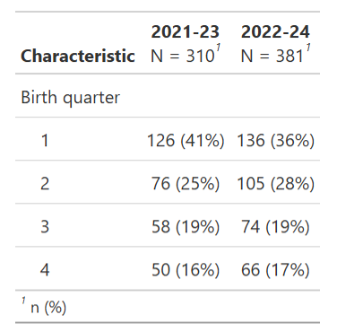
Do the proportions of applicants’ birth quarters differ significantly from that of the general population?
Logistic regression models
Outcome variable – Selection
Prediction variables – Birth quarter, gender, and other relevant variables
Possibly including interaction terms with year-group
Chi-square tests of independence using data from the general population to see whether birth month distribution in applicants reflects that of the real world
Notes:
To investigate relative age effect and gender bias, I’m primarily using logistic regression with selection as my binary outcome variable; with applicants either being selected or not. The predictors of interest will be birth month, specifically birth quarter and gender. Other relevant predictors will also be included but not focused on and I will possibly include interaction terms with year-group to see if relationships change depending on the year.
The table on the right shows the breakdown of applicants’ birth quarter with quarter 1 comprising September, October and November. And you can clearly see, even without incorporating the selection variable there is some patterning to this. To test this more statistically I’m going to be comparing these proportions to that of the general population using chi-square tests.

Slide 5
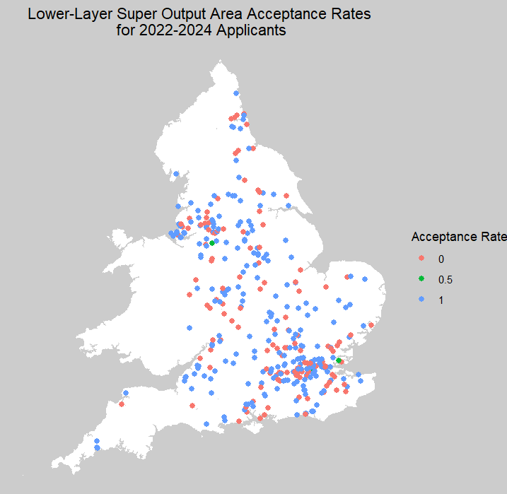
Is there any spatial patterning to applications and successful applications to the YTP?
Mapping of proportions of selected applicants in each Lower-Layer Super Output Area (LSOA) code
Issues with the fact that most LSOA codes only one applicant and at most two
Upscaling to Local Authority Districts and then Counties/Unitary Districts
Visually checking for patterns
Will possibly aim to incorporate population density data later
Notes:
Finally, to investigate geographical representativeness, I have been working extensively on mapping the locations of successful applicants. You can see an example of one of my earlier maps where I mapped using LSOA codes which are one of the smallest census areas available and were the only location data available in the dataset. The issue that arises from this, as you can, is that because the areas are so small, most codes only have one applicant, and a few have at most two. This results in acceptance rates only taking three values which is quite uninformative when mapped.
I’m therefore working on upscaling to local authority districts and then counties and unitary districts which are the next two steps up in census area size. These maps will be checked visually for patterns, and I will possibly aim to use population density data in analysis later.

