Slide 1
Customer Service
Bank of Baroda Hackathon 2024
Team Name: Quad_Squad
Team – Bio:
B-Tech students at
Thapar Institute of Eng. And Tech, Patiala
Date : 29th June, 2024

Slide 2
Problem Statement: Customer Service
Enhancing customer service in banks is not just a nicety—it's a necessity. In today's competitive financial landscape, exceptional customer service is the foundation upon which banks build trust, loyalty, and long-term relationships with their clients. Here are some key reasons why our team decided to enhance ‘Customer Service’:
Customer Retention
Competitive Advantage
Increased Revenue
Customer Experience
Technological Integration
Regulatory Compliance and Risk Management

Slide 3

Pre-Requisite
Banks are increasingly adopting and integrating advanced technologies to enhance customer service, streamline operations, and provide a secure and efficient banking experience. By leveraging below technologies, these banks are able to meet the evolving demands and expectations of their customers in a competitive market.Chatbots and Virtual Assistants
Mobile Banking Apps
AI and Machine Learning
Robotic Process Automation (RPA)
Voice Banking
Blockchain
Biometrics
Video Banking

Slide 4

Tools or resources
For proper implementation of our idea, we would require the following Microsoft Azure tools:
Azure Bot Service
Azure Cognitive Services
Azure Sentinel
Azure SQL database
Azure Data Factory

Slide 5
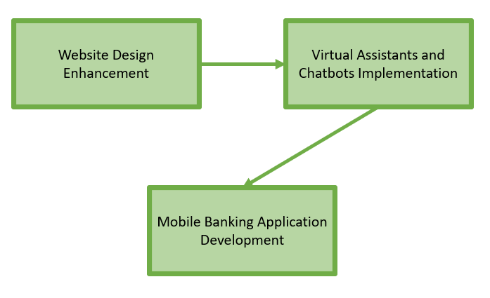
Methodology and Architecture
Website Design Enhancement:
Approach: Our UI/UX experts and web developers will analyze the current website usability.
Method: Conduct user research, gather feedback, and implement design improvements
Outcome: Aim to create a visually appealing, intuitive, and responsive website
Virtual Assistants and Chatbots Implementation:
Approach: Employ AI and machine learning techniques to train models for chatbot
Enhancements: Integrate escalation paths to human backend bank service agents for complex queries beyond the chatbot's capabilities.
Benefits: Improve response times, provide consistent service, and increase customer satisfaction through personalized interactions.
Mobile Banking Application Development:
Approach: Prioritize essential functionalities and user experience enhancements.
Method: Utilize cloud-based infrastructure by Azure for security , reliability and scalability.
Features: Include UPI integration and offline capabilities.

Slide 6

Key Differentiators & Adoption Plan
To address the issues commonly faced by the users upon our survey, our idea serves the following problems:
Enhance Website Performance: Many banking websites and mobile applications experience slow loading times.
Improve Design Aesthetics and Usability: : There is often a lack of visually appealing and user-friendly design.
Incorporate Direct Communication Channels: Person-to-person communication options are frequently unavailable.
Refine Chatbot Functionalities:: Chatbots, while offering multiple options, often fail to address user queries outside of predefined selections.
Implement Application Tracking Systems: There is a lack of tracking systems to monitor application progress, making it difficult for users to determine when to visit the bank.

Slide 7
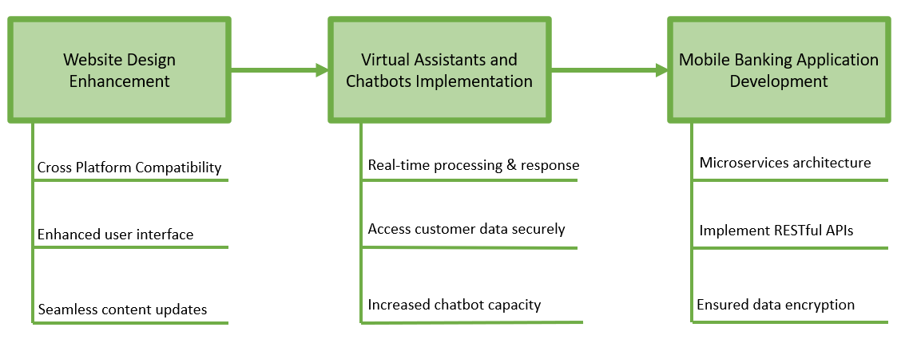
GitHub Repository Link & supporting diagrams, screenshots, if any
GitHub Repository Link: https://github.com/Liza-Sareen/Bob_Hackathon
Supporting Diagrams:

Slide 8

Business Potential and Relevance
Our idea for developing a comprehensive digital banking solution can be applied across various business applications within the banking and financial services industry. Here are some key areas where your solution can be implemented:
Retail Banking Services
Insurance Companies
E-commerce
Telecommunications
Healthcare
Travel and Hospitality
Education
Government and Public Sector
Consumer Goods and Retail
Energy and Utilities
Transportation and Logistics

Slide 9

Uniqueness of Approach and Solution
The idea for developing a comprehensive digital banking solution can stand out in several ways that highlight its uniqueness and potential competitive advantages:
Integrated User Experience: This includes features such as UPI integration, document access, and loan applications, all accessible through a unified mobile banking application.
Personalization and AI-driven Insights: By analyzing user data in real-time, the system can anticipate customer needs, offer relevant products or services, and enhance overall user satisfaction.
Scalable and Secure Infrastructure:BY emphasizing Azure, this solution ensures that the mobile banking application can handle increasing user loads while maintaining high levels of reliability, security, and data privacy
Enhanced Customer Engagement:By offering a user-friendly interface, proactive customer service, and transparent communication channels, banks can build stronger relationships with customers and improve retention rates.
Innovation and Competitive Advantage:This proactive approach not only meets current customer expectations but also prepares the bank to adapt to evolving market trends and customer preferences effectively.

Slide 10
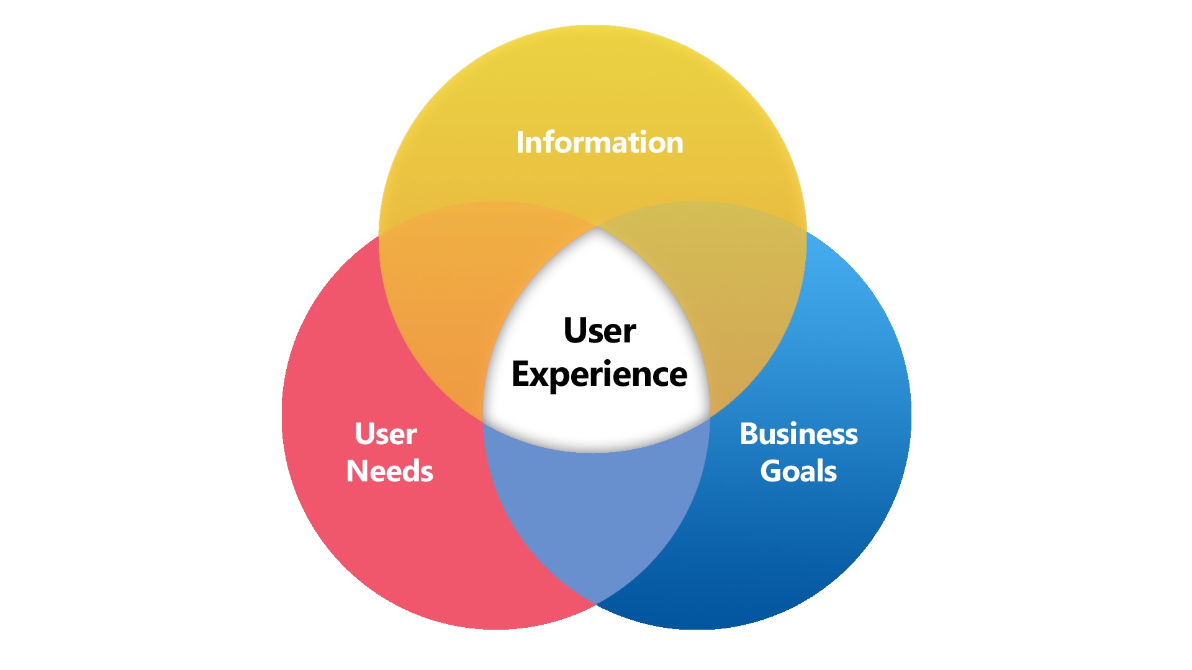
User Experience
The idea aims :
Transform the traditional banking experience into a modern, user-centric digital experience.
Prioritizing convenience, personalization, efficiency, security, and interactive support
The digital banking solution exceeds user expectations
Positioning the bank as a leader in customer-centric financial services.
Iterative enhancements to the app's features and functionalities based on user input
Enables users to receive immediate responses to inquiries and issues, 24/7

Slide 11
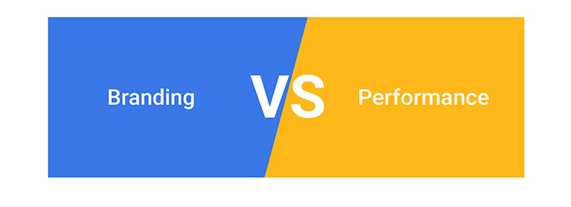
Scalability
The scalability of our digital banking solution is designed to effectively accommodate growth while maintaining optimal performance across several key strategies:
Cloud Infrastructure:The mobile banking application can handle surges in traffic and transaction volumes without experiencing performance degradation.
Load Balancing: Implementing load balancing techniques distributes incoming traffic evenly across multiple servers or instances.
Database Scalability: Utilizing scalable database solutions, such as NoSQL databases or sharded relational databases, ensures that our system can efficiently manage growing volumes of data without sacrificing query performance or data integrity.
Monitoring and Optimization: Continuous monitoring of system performance metrics, including response times, throughput, and resource utilization, allows us to proactively identify bottlenecks or performance issues

Slide 12

Ease of Deployment and Maintenance
Implementing and maintaining our digital banking solution is designed to be straightforward and efficient, focusing on simplicity and sustainability throughout its lifecycle:
Modular Design: Our solution is structured with a modular architecture, making it easier to develop, deploy, and maintain individual components independently.
Pre-built Components: Leveraging pre-built components and frameworks, such as open-source libraries and APIs for functionalities
Scalable Infrastructure: Utilizing cloud-based infrastructure providers, such as Azure, streamlines deployment and scalability.
Automated Testing and Deployment: Implementing continuous integration and deployment automates the testing, validation, and deployment of code changes.
Monitoring and Analytics: Integrating robust monitoring and analytics tools allows for real-time performance monitoring, proactive issue detection, and actionable insights into system behavior.
User-friendly Interfaces: Designing intuitive user interfaces (UI) and user experiences (UX) ensures that both end-users and administrators can navigate the application effortlessly.

Slide 13

Security Considerations
Ensuring the security and integrity of our digital banking solution is paramount, and we have implemented several measures to safeguard sensitive information, protect user data, and maintain system reliability:
Data Encryption: All sensitive data, including user credentials, financial transactions, and personal information, is encrypted using Azure Bot Service and Azure Sentinel.
Secure Authentication: Implementing multi-factor authentication (MFA) and strong password policies enhances user authentication security.
Regular Audits and Monitoring: Conducting regular security audits, vulnerability assessments, and penetration testing helps identify and mitigate potential security weaknesses or vulnerabilities in our system.
Incident Response Plan: Maintaining an incident response plan outlines protocols for identifying, responding to, and recovering from security incidents or data breaches promptly.

Slide 14
Thank You
Team Members:
Amrinder Singh
Ishan Grover
Liza Sareen
Sanchit Sahni

