Slide 1



JetSim
Accelerated 3D Flight Simulation

Slide 2

Problem Statement
1
CPU Simulations struggle to deliver real-time performance when executing complex 3D vector physics computations.
2
Increasing aircraft model complexity and high-resolution physics calculations cause significant computational delays on CPUs.
3
Developers lack a simple, portable implementation that demonstrates how vector physics-based flight dynamics perform differently on CPU and GPU.
4
There is a need to quantify the computational benefits of GPU parallelization by comparing CPU and GPU execution time for identical simulation workloads.

Slide 3

Objectives
Graphical Analysis of CPU and GPU simulations
Demonstrate the impact of parallelization
Analyze execution time, efficiency based on different N
Develop CPU Based & GPU accelerated simulations

Slide 4
Methodology
Develop a 3D vector physics model using equations of motion.
The methodology followed in this project involves designing a physics-based aircraft simulation system and evaluating its computational performance on both CPU and GPU architectures. The simulation is built using 3D vector physics, where each aircraft’s motion is computed using position, velocity, acceleration, and additional physics functions defined in C++ and CUDA.
Implement a CPU-based simulation where aircraft states are updated iteratively.
Design a CUDA-based GPU parallel simulation
Ensure both CPU and GPU versions use the same physics logic for consistent comparison
Execute simulations for different input sizes
Measure execution time for both CPU and GPU
Calculate performance metrics including GPU speedup over CPU.
Visualize results using graphs for execution time and speedup trends.

Slide 5
Step By Step Guide
We made a aircraft simulation file in C++ which was used to calculate the motion of the aircraft, using:
  Aircraft's position in 3D plane (x,y,z)
  Aircraft velocity wrt position (vx,vy,vz)
  Force: gravity, drag, thrust
  Time step dt
  This is done for N aircrafts
Same simulation is run in three different ways:
  One CPU (sequential run)
  Multicore CPU (parallel run)
  CUDA GPU Implementation
3. Performance compared

Slide 6
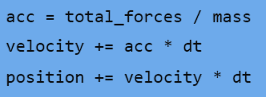
Step By Step Guide
CPU:
  One aircraft processed at once
  Sequential Run
  Time taken: ~39 ms for 100,000 aircraft
Multicore CPU:
  Same code used #pragma omp parallel to run in parallel
  Multiple aircrafts updated at once
  No of Threads = No of CPU cores/ Manual Setting
  Time reduced to ~15 ms
  2.5× faster
CUDA GPU Implementation:
  CUDA Kernal was made
  Every airplane is updated by one GPU thread
  Thousands of threads run together
  Time for 2 million: ~7.3 ms
  GPU also becomes5× faster than CPU sequential.
  GPU also becomes 2× faster than OpenMP.

Slide 7
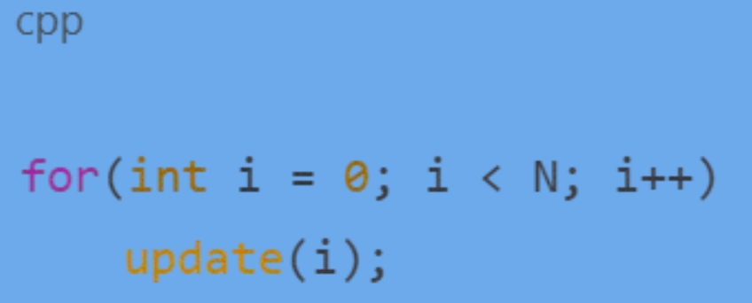
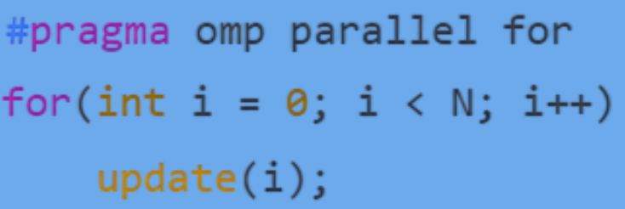
#pragma omp parallel for
Preprocessor directive for Open Multi Programming (Open MP)
This line asks the compiler to execute the loop in parallel.
If 4 cores in cpu, loop 4x faster
For 8 cores, loop 8x faster
Without OpenMP
With OpenMP

Slide 8
CUDA Contribution
Compute Unified Device Architecture
When we write our programs to run on GPU, we write then in __global__ void kernel(...) { ... } form.
This function definition allows the function to run on GPU
GPU has multiple cores, Kernals divide the work among different cores
Every core performs same function with different input data.
This function is called CUDA Kernal.
We set a unique id for every aircraft in this function using int i = blockIdx.x * blockDim.x + threadIdx.x;
The ID helps GPU threads know which aircraft it should update and which index in array it handles.

Slide 9
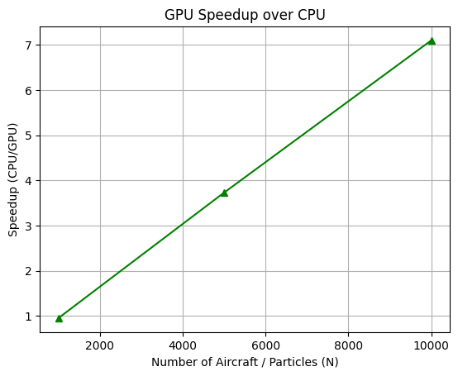
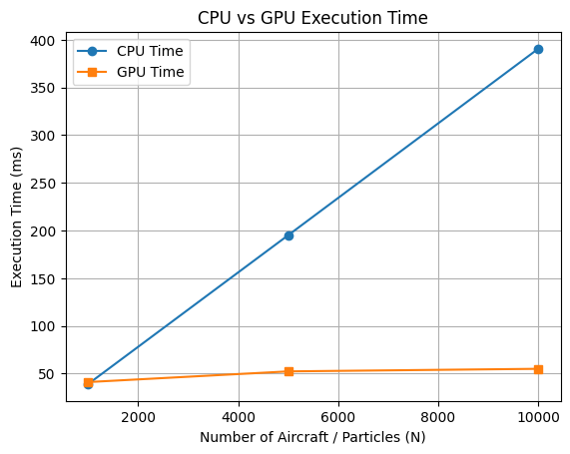
Results

Slide 10
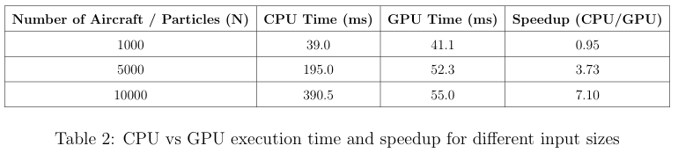
Results

Slide 11
Thank You

