Slide 1
Java Server Pages

Slide 2
What is JSP?
Mostly HTML page, with extension .jsp
Include JSP tags to enable dynamic content creation
Translation: JSP → Servlet class
Compiled at Request time
(first request, a little slow)
Execution: Request → JSP Servlet's service method

Slide 3
Why JSP?
Goal: Create dynamic web content (HTML) for a Web Application
Goal: Make it easier/cleaner to mix static HTML parts with dynamic Java servlet code

Slide 4
JSP vs Servlets
Servlets -- Mostly Code with some HTML via print & out.println
JSP -- Mostly HTML, with code snippets thrown in
  No explicit recompile
  Great for small problems
  Easier to program
  Not for large computations

Slide 5
Model-View-Controller
A Design Pattern
Controller -- receives user interface input, updates data model
Model -- represents state of the world (e.g. shopping cart)
View -- looks at model and generates an appropriate user interface to present the data and allow for further input

Slide 6


Model-View-Controller
JSP
View
Bean
Servlet
Controller
Model

Slide 7


JSP Big Picture
Hello.jsp
GET /hello.jsp
HelloServlet.java
<html>Hello!</html>
Server with
JSP Container
HelloServlet.class

Slide 8
Basic Syntax
Directives
Messages for JSP engine
Do not directly produce any visible output
Format :
<%@ Directive %>
Two primary directives are ---
Page – import, extends etc
include – to include another file

Slide 9
Basic Syntax
Declarations
To define page level variables or methods
Format :
<%! declaration %>
Example :
<%! int i=20; %>
<%! public String do() {
return “Hello; }
%>

Slide 10
Basic Syntax
Expressions
Results of the expression converted into string
which is included in the output page
Format :
<%= expression %>
Example :
<%= a + b %>
<%= do() %>

Slide 11
Basic Syntax
Scriptlets
Code fragments included in the service method
which is included in the output page
Format :
<% code %>
Example :
<% for (int i=0;i<10;i++) { %>
This is line Number <%= i + 1 %>
<% } %>

Slide 12
Basic Syntax
Comments
Comments in the code
Format :
<%-- comment --%>

Slide 13
<%@ Directive %>
<%@ page contentType="text/html" %>
<%@ taglib prefix="c" uri=http://java.sun.com/jstl/core %>
<html>
<head>
<title>JSP is Easy</title>
</head>
<body bgcolor="white">
<%! int x=5, y=30, z=2; %>
<h1>JSP is as easy as ...</h1>
<%-- Calculate the sum of 1 + 2 + 3 dynamically --%>
Sum is <%= x + y + z %>
</body>
</html>

Slide 14
<%-- JSPComment -->
<%@ page contentType="text/html" %>
<%@ taglib prefix="c" uri=http://java.sun.com/jstl/core %>
<html>
<head>
<title>JSP is Easy</title>
</head>
<body bgcolor="white">
<%! int x=5, y=30, z=2; %>
<h1>JSP is as easy as ...</h1>
<%-- Calculate the sum of 1 + 2 + 3 dynamically --%>
Sum is <%= x + y + z %>
</body>
</html>

Slide 15
Template Text
<%@ page contentType="text/html" %>
<%@ taglib prefix="c" uri=http://java.sun.com/jstl/core %>
<html>
<head>
<title>JSP is Easy</title>
</head>
<body bgcolor="white">
<%! int x=5, y=30, z=2; %>
<h1>JSP is as easy as ...</h1>
<%-- Calculate the sum of 1 + 2 + 3 dynamically --%>
Sum is <%= x + y + z %>
</body>
</html>

Slide 16
<%! Declarations %>
<%@ page contentType="text/html" %>
<%@ taglib prefix="c" uri=http://java.sun.com/jstl/core %>
<html>
<head>
<title>JSP is Easy</title>
</head>
<body bgcolor="white">
<%! int x=5, y=30, z=2; %>
<h1>JSP is as easy as ...</h1>
<%-- Calculate the sum of 1 + 2 + 3 dynamically --%>
Sum is <%= x + y + z %>
</body>
</html>

Slide 17
<%! Expression %>
<%@ page contentType="text/html" %>
<%@ taglib prefix="c" uri=http://java.sun.com/jstl/core %>
<html>
<head>
<title>JSP is Easy</title>
</head>
<body bgcolor="white">
<%! int x=5, y=30, z=2; %>
<h1>JSP is as easy as ...</h1>
<%-- Calculate the sum of 1 + 2 + 3 dynamically --%>
Sum is <%= x + y + z %>
</body>
</html>

Slide 18
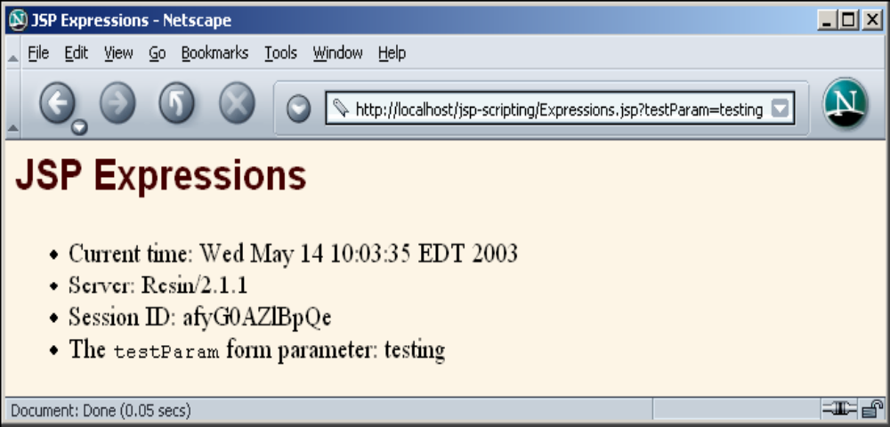
Expression Example
<H2>JSP Expressions</H2>
<UL>
<LI>Current time: <%= new java.util.Date() %>
<LI>Server: <%= application.getServerInfo() %>
<LI>Session ID: <%= session.getId() %>
<LI>The <CODE>testParam</CODE> form parameter:
<%= request.getParameter("testParam") %>
</UL>
</BODY></HTML>

Slide 19
JSP Example 1
<%
java.util.Date dateToday = new java.util.Date();
%>
<html>
<body>
<p>Todays date is <%= dateToday %> </p>
</body>
</html>

Slide 20
JSP Example 2
<html>
<head>
<title>JSP Test Page</title>
</head>
<body>
<h1>JSP Test</h1>
<% for(int c = 1; c < 10; c++) {
out.println("<P>Iteration " + c + "</P>");
}
%>
</body>
</html>

Slide 21
JSP Example 3
<html>
<head>
<title>JSP Course - Hello World Workshop</title>
</head>
<body>
<h2>Hello World Workshop</h2>
<hr>
<% for(int i=1; i <= 7; i++) { %>
<p><font size="<%= i %>">Hello World</font></p>
<% } %>
</body>
</html>

Slide 22
JSP Example 4
<html>
<head>
<%!
private static int PI = 3.1415;
private int addNumbers(int a, int b) {
return a + b;
}
%>
</head>
<body>
<p>10 plus 12 is <%= addNumbers(10, 12) %></p>
<p>A circle of width 10cm has <%= PI * 10 %> cm circumference.</p>
</body>
</html>

Slide 23
JSP Example 5
<html>
<body>
<table border=2>
<% for(int i=1;i<10;i++) { %>
<tr>
<td> <%= i %> </td>
</tr>
<% } %>
</table>
</body>
</html>

Slide 24
Declaratives
<%
@ page import = "package1.*, package2,*,..."
%>
<%@ include file="URL" %>
<%@ page errorPage="relativeURL" %>

Slide 25
Exception handling
JSP provides a rather elegant mechanism for handling runtime exceptions.
It may not be possible to handle all possible exceptions through code. By making use of the page directive's errorPage attribute, it is possible to forward an uncaught exception to an error handling JSP page
Example :
<%@ page isErrorPage="false" errorPage="errorHandler.jsp" %>
This informs the JSP engine to forward any uncaught exception to the JSP page errorHandler.jsp.
It is then necessary for errorHandler.jsp to flag itself as a error processing page using the directive:
<%@ page isErrorPage="true" %>

Slide 26
Declaratives Example
File 1: "main.jsp:“
<html>
<head>
<title>An Include Test</title>
</head>
<body>
<p> The current date and time is <BR>
<%@ include file="date.jsp" %>
</p>
</body>
</html>
File 2: "date.jsp:“
<%@ page import="java.util.*" %>
<%= (new java.util.Date() ).toLocaleString() %>
resultant display :
The current date and time is
Aug 30, 1999 2:38:40

Slide 27
Implicit objects
a set of Java objects that the JSP Container makes available to developers in each page.
These objects may be accessed as built-in variables via scripting elements
can also be accessed programmatically by JavaBeans and Servlets.

Slide 28
Implicit objects
Object Corresponding class/interface
config ServletConfig
request http.HttpServletRequest
response http.HttpServletResponse
out jsp.JspWriter
session http.HttpSession
application ServletContext

Slide 29
Standard Actions
<jsp:useBean>
Makes a JavaBeans component available in a page
<jsp:getProperty>
Gets a property value from a JavaBeans component and adds it to the response
<jsp:setProperty>
Set a JavaBeans property value
<jsp:plugin>
Generates HTML that contains the appropriate client browser-dependent elements (OBJECT or EMBED) needed to execute an applet with the Java Plug-in software

Slide 30
Java Beans
We now have three ways of writing code to be used by a JSP
  Place the code at the start of a JSP in a declaration,
  Use an include statement to reference another file which contains the code
  Package the code in a JavaBean
By using JavaBeans we can fully separate the business logic from the generation of the display
Other advantage of using JavaBeans is that the business logic can be used by more than one application

Slide 31
Java Beans
JavaBean is just a Java class that adheres to the following rules,
  it is a public class
  it has a public constructor with no arguments
  it has public get and set methods to read and write to properties
class file to be put in web-inf/classes
if packaged in a jar file, put the jar file in lib folder

Slide 32
Java Bean example
// MagicBean.java
public class MagicBean {
private String magic;
public MagicBean(String string) {
magic = string;
}
public MagicBean() {
magic = "Woo Hoo"; // default magic string
}
public String getMagic() {
return(magic);
}
public void setMagic(String magic) {
this.magic = magic;
}
}

Slide 33
Java Beans – Action tags
<jsp:useBean/> - find or instantiate a JavaBean
<jsp:setProperty/> - sets the property of a JavaBean
<jsp:getProperty/> - gets the value of a JavaBean property
The first tag is used to specify which JavaBean we want to use in our page
The next two actions are used to set and get values of properties of the JavaBean

Slide 34
Java Beans – useBean action
Syntax
<jsp:useBean id="beanID" scope="beanScope"
class="package.beanName" />
beanScope Description
page lasts until the page completes
request lasts for the client request and so will remain if the
request is forwarded
session lasts as long as the client session
application is instantiated with the application and remains in use
until the application ends
default scope : page

Slide 35
setProperty and getProperty
Syntax
<jsp:setProperty name="beanID" property="propertyName" value="val" />
<jsp:getProperty name="beanID"
property="propertyName" />

Slide 36
setProperty and getProperty
Example
<jsp:useBean id="empBean" scope="page" class="mybean.EmployeeBean" />
<jsp:setProperty name="empBean" property="firstName" value="Robert" /> <jsp:setProperty name="empBean" property="lastName" value="<%=last%>" />
<jsp:getProperty name="employeeBean" property="fullName" /> </P>
Also we can use
empBean.setFirstName("Robert");
empBean.setLastName("Burns");
String name = empBean.getFullName();

Slide 37
setProperty and getProperty
Property values can be mapped to parameters
<jsp:setProperty name="entry" property="*" />

Slide 38
Expression Language
Limitations of MVC
  <%= ... %>, <% ... %>, <%! ... %>
  jsp:useBean, jsp:getProperty
  verbose
  clumsy scripting & expression elements to do more complicated Java things
With Expression Language
  ${expression}
  Short and readable and fluid, like JavaScript

Slide 39
Accessing Scoped variables
${varName}
Means to search the
PageContext,
HttpServletRequest,
HttpSession,
ServletContext,
in that order, and output the object with that attribute name.

Slide 40
Accessing Bean Properties
${varName.propertyName}
Means to find scoped variable of given name and output the specified bean property

Slide 41
JSTL
JSP Standard Tag Library

Slide 42
What is JSTL?
JSTL (JSP Standard Tag Libraries) is a collection of JSP custom tags developed by Java Community Process, www.jcp.org. The reference implementation is developed by the Jakarta project, jakarta.apache.org.
Full JSTL
  – Contains many common and useful JSP custom tags
JSTL allows you to program your JSP pages using tags, rather than the scriptlet code that most JSP programmers are already accustomed to. JSTL can do nearly everything that regular JSP scriptlet code can do.

Slide 43
THE JSTL TAG LIBRARIES
The JSTL tags can be classified, according to their functions,
into following JSTL tag library groups that can be used when
creating a JSP page:
      Core Tags
      Formatting tags
      SQL tags
      XML tags
      JSTL Functions

Slide 44
THE JSTL TAG LIBRARIES
Core Tag Library—Contains tags that are essential to nearly any Web application. Examples of core tag libraries include looping, expression evaluation, and basic input and output.
Formatting/Internationalization Tag Library—Contains tags that are used to parse data. Some of these tags will parse data, such as dates, differently based on the current locale.
Database Tag Library—Contains tags that can be used to access SQL databases. These tags are normally used only to create prototype programs. This is because most programs will not handle database access directly from JSP pages. Database access should be embedded in EJBs that are accessed by the JSP pages.
XML Tag Library—Contains tags that can be used to access XML elements. Because XML is used in many Web applications, XML processing is an important feature of JSTL.
JSTL Functions --JSTL includes a number of standard functions, most of which are common string manipulation functions.

Slide 45
Core Tags
The core group of tags are the most frequently used JSTL tags. Following is
the syntax to include JSTL Core library in your JSP:
<%@ taglib prefix="c" uri="http://java.sun.com/jsp/jstl/core" %>
Tag | Description
<c:out > | Like <%= ... >, but for expressions.
<c:set > | Sets the result of an expression evaluation in a 'scope'
<c:remove > | Removes a scoped variable (from a particular scope, if specified).
<c:catch> | Catches any Throwable that occurs in its body and optionally exposes it.
<c:if> | Simple conditional tag which evalutes its body if the supplied condition is true.
<c:choose> | Simple conditional tag that establishes a context for mutually exclusive conditional operations, marked by <when> and <otherwise>
<c:when> | Subtag of <choose> that includes its body if its condition evalutes to 'true'.
<c:otherwise > | Subtag of <choose> that follows <when> tags and runs only if all of the prior conditions evaluated to 'false'.
<c:import> | Retrieves an absolute or relative URL and exposes its contents to either the page, a String in 'var', or a Reader in 'varReader'.
<c:forEach > | The basic iteration tag, accepting many different collection types and supporting subsetting and other functionality .
<c:forTokens> | Iterates over tokens, separated by the supplied delimeters.
<c:param> | Adds a parameter to a containing 'import' tag's URL.
<c:redirect > | Redirects to a new URL.
<c:url> | Creates a URL with optional query parameters

