Slide 1

BINF2111 – Introduction to Bioinformatics
Computing
BASH 101 – Loops part duex
Richard Allen White III, PhD
RAW Lab
Lecture 10 – Tuesday Sep 21st, 2023

Slide 2
Learning Objectives
- Review quiz/bonus (SAM files)
- File conversions (awk/perl)
- Specific lines UNIX/BASH
- Review Bash for loops (C-style/Regular)
- Quiz 10

Slide 3
Quiz 9 answers
Write a one-liner that counts the number of times Steven is left of Jose?
more file.csv
Steven,Jose
Steven,Jose
Steven,Jose
awk 'Jose*Steven' file.csv | wc -l
awk '/jose\tSteven' file.csv | wc -l
egrep -o 'Steven.Jose' file.csv | wc -l
egrep -o 'Steven\tJose' file.csv | wc -l

Slide 4
Quiz 9 answers
Write a one-liner that counts the number of times Steven is left of Jose?
more file.csv
Steven,Jose
Steven,Jose
Steven,Jose
awk 'Jose*Steven' file.csv | wc -l
awk '/jose\tSteven' file.csv | wc -l
egrep -o 'Steven.Jose' file.csv | wc -l
egrep -o 'Steven\tJose' file.csv | wc -l
How would we do this in AWK?

Slide 5
Quiz 9 answers
Write a one-liner that counts the number of times Steven is left of Jose?
more file.csv
Steven,Jose
Steven,Jose
Steven,Jose
awk -F ',' 'BEGIN { count=0 } $1 == "Steven" && $2 == "Jose" { count++ } END { print count }' file.csv
How would we do this in AWK?

Slide 6
Quiz 9 answers
Which command doesn't convert tsv to csv?
Command 1
sed 's/\t/,/g' file.tsv >file.csv
Command 2
cat file.tsv | tr -s '\t' ',' >file.csv
Command 3
awk -F '\t' -vOFS=’,’ '{$1=$1}1' file.tsv >file.csv
Command 4
awk -F '\t' -vOFS=’,’ '{$1= $1}1' file.tsv >file.csv
All convert tsv to csv

Slide 7
Quiz 9 answers
Which command doesn't convert tsv to csv?
Command 1
sed 's/\t/,/g' file.tsv >file.csv
Command 2
cat file.tsv | tr -s '\t' ',' >file.csv
Command 3
awk -F '\t' -vOFS=’,’ '{$1=$1}1' file.tsv >file.csv
Command 4
awk -F '\t' -vOFS=’,’ '{$1= $1}1' file.tsv >file.csv
All convert tsv to csv

Slide 8
The file conversation problem
Provide unique commands to convert a tsv to csv?
awk '{gsub("\t", ","); print}' file.tsv
Try the name_game.tsv and tsv file.
Also, it works similar to sed and similar syntax to tr (translate):
awk '{gsub(“original”, "replace"); print}' file.txt
OR
awk '{gsub(/original/, "replace"); print}' file.txt
Another way?

Slide 9
The file conversation problem
Provide unique commands to convert a tsv to csv?
perl -pi -e 's/\t/,/g' name_game.tsv (replaces original -i)
perl -p -e 's/\t/,/g' name_game.tsv (doesn’t replace original)
Try the name_game.tsv and csv file.
Also, it works just like sed try this!
sed 's/\t/,/' name_game.tsv
OR
perl -p -e 's/\t/,/' name_game.tsv

Slide 10
Quiz 9
- Write a one-liner that counts the number of times Steven is left of Jose?
more file.tsv
Steven Jose
Steven Jose
Steven Jose
Steven Jose

Slide 11
Quiz 9
- Write a one-liner that counts the number of times Steven is left of Jose?
more file.tsv
Steven Jose
Steven Jose
Steven Jose
Steven Jose
What is a tsv?

Slide 12
Quiz 9
- Write a one-liner that counts the number of times Steven is left of Jose?
more file.tsv
Steven Jose
Steven Jose
Steven Jose
Steven Jose
What is a tsv? Tab separated file
Tabs are different from spaces

Slide 13
Quiz 9
- Write a one-liner that counts the number of times Steven is left of Jose?
more file.tsv
Steven Jose
Steven Jose
Steven Jose
Steven Jose
egrep -o 'Steven.Jose' file.tsv | wc -l

Slide 14
Quiz 9
- Write a one-liner that counts the number of times Steven is left of Jose?
more file.txt
Steven Jose
Steven Jose
Steven Jose
Steven Jose
egrep -o 'Steven. Jose' file.tsv | wc -l

Slide 15
Quiz 9
- Write a one-liner that counts the number of times Steven is left of Jose?
more file.txt
Steven Jose
Steven Jose
Steven Jose
Steven Jose
How do you check? With sed.

Slide 16
Quiz 9
- Write a one-liner that counts the number of times Steven is left of Jose?
more file.txt
Steven Jose
Steven Jose
Steven Jose
Steven Jose
Sed ‘s/ /,/g’ file.txt | more (converts to csv)

Slide 17
Quiz 9
- Write a one-liner that counts the number of times Steven is left of Jose?
more file.txt
Steven Jose
Steven Jose
Steven Jose
Steven Jose
sed ‘s/\t/,/g’ file.txt | more (converts to csv)

Slide 18
Quiz 9
I have this file:
>chr1_geneA
ATGCTAAGGCTATCTTGACAACTGACTGCCTAG
>chr1_geneB
ATGCTAAGGCTATGTTGGCAACTGACTCCCTAG
How do I extract this sequence with grep?

Slide 19
Quiz 9
I have this file:
>chr1_geneA
ATGCTAAGGCTATCTTGACAACTGACTGCCTAG
>chr1_geneB
ATGCTAAGGCTATGTTGGCAACTGACTCCCTAG
How do I extract this sequence with grep?
grep 'ATG.*ATG' file.fna
Another way?

Slide 20
Quiz 9
I have this file:
>chr1_geneA
ATGCTAAGGCTATCTTGACAACTGACTGCCTAG
>chr1_geneB
ATGCTAAGGCTATGTTGGCAACTGACTCCCTAG
>chr1_geneC
ATGCTAAGGCTATGTTGGCAACTGACTCCCTAGATG
How do I extract this sequence with grep?
grep '\(.*ATG\)\{3\}' test.fna | more

Slide 21
Bonus 8
- Use grep to convert sam file to a fastq file?

Slide 22
Bonus 8
- Use grep to convert sam file to a fastq file?
What is a SAM file?
The Sequence Alignment/Map (SAM) is a file format to save alignment information of short reads mapped against reference sequences. It usually starts with a header section followed by alignment information as tab separated lines for each read.

Slide 23
Bonus 8
- Use grep to convert sam file to a fastq file?
Header section
@HD VN:1.3 SO:coordinate
Tab-delimited read alignment information lines
readID43GYAX15:7:1:1202:19894/1 256 contig43 613960 1 65M * 0 0 CCAGCGCGAACGAAATCCGCATGCGTCTGGTCGTTGCACGGAACGGCGGCGGTGTGATGCACGGC EDDEEDEE=EE?DE??DDDBADEBEFFFDBEFFEBCBC=?BEEEE@=:?::?7?:8-6?7?@??# AS:i:0 XS:i:0 XN:i:0 XM:i:0 XO:i:0 XG:i:0 NM:i:0 MD:Z:65 YT:Z:UU

Slide 24
Bonus 8
- Use grep to convert sam file to a fastq file?
cat samplename.nomapping.sam | grep -v ^@ | awk '{print "@"$1"\n"$10"\n+\n"$11}' > unmapped/samplename.fastq

Slide 25
Lab bonus 1
Write a BASH code to iterate through the amino acid array. Methionine Leucine Cysteine Alanine Valine Tyrosine Proline

Slide 26
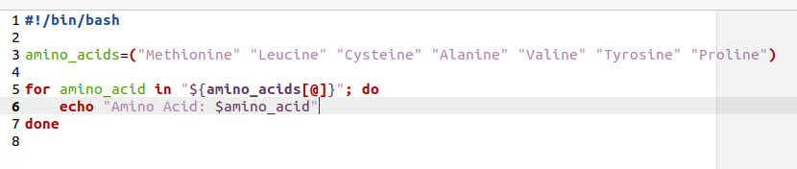
Lab bonus 1
Write a BASH code to iterate through the amino acid array. Methionine Leucine Cysteine Alanine Valine Tyrosine Proline

Slide 27
Lab bonus 2 – C and C++
Write a BASH code to iterate through the amino acid array. Methionine Leucine Cysteine Alanine Valine Tyrosine Proline in another language?

Slide 28
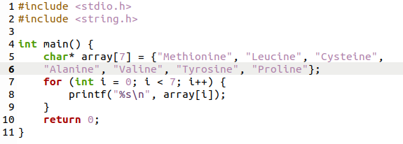
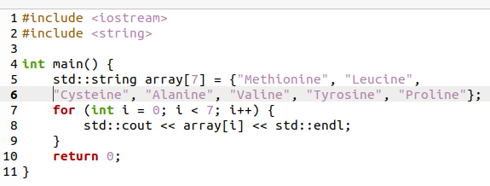
Lab bonus 2 – C and C++
Write a BASH code to iterate through the amino acid array. Methionine Leucine Cysteine Alanine Valine Tyrosine Proline in another language?
C
C++
gcc bonusar2.c -o bonusar2c
./bonussar2c
g++ -o bonusar2cp bonusar2.cpp
./bonusar2cp

Slide 29
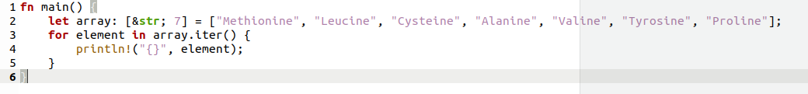
Lab bonus 2 - Rust
Write a BASH code to iterate through the amino acid array. Methionine Leucine Cysteine Alanine Valine Tyrosine Proline in another language?
RUST
rustc bonus2rust.rs
./bonus2rust

Slide 30
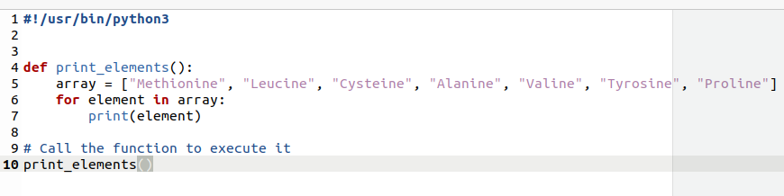
Lab bonus 2 - Python
Write a BASH code to iterate through the amino acid array. Methionine Leucine Cysteine Alanine Valine Tyrosine Proline in another language?
Python

Slide 31
Specific lines in UNIX/BASH
- How do I print line numbers?
- What if you need specific lines in a file?
- What how do you do a range of specific lines?

Slide 32
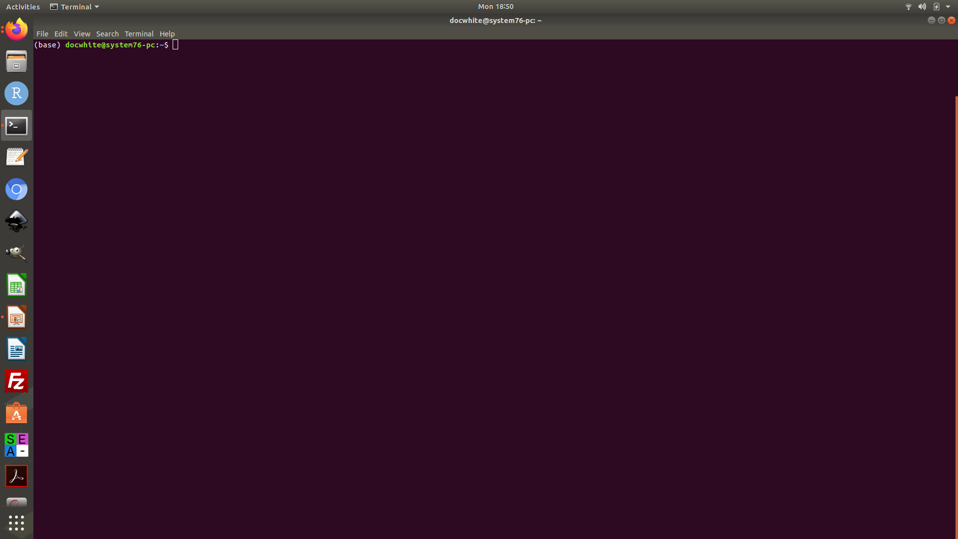
Specific lines
Print line numbers
cat --number doppelganger_names.txt (linux)
OR
cat -n doppleganger_names.txt (mac/linux)
How do I grab lines with David and color them?

Slide 33
Specific lines
Print line numbers
cat -n doppelganger_names.txt
How do I grab lines with David and color them?
cat -n doppelganger_names.txt | grep "david" --color

Slide 34
Specific lines
How do I grab line one only?

Slide 35
Specific lines
How do I grab line one only?
sed -n ‘1p’ doppelganger_names.txt
OR
head -1 doppelganger_names.txt | tail +1

Slide 36
Specific lines
How do I grab line one and two only?
sed -n ‘1p;2p’ doppelganger_names.txt
OR
head -2 doppelganger_names.txt | tail +1

Slide 37
Specific lines
How do print the line number 1 only and grab david with color?

Slide 38
Specific lines
How do print the line number 1 only and grab david with color?
cat -n doppelganger_names.txt | sed -n '1p' | grep "david" --color
How do I do it with head/tail command?

Slide 39
Specific lines
How do print the line number 1 only and grab david with color?
cat -n doppelganger_names.txt | sed -n '1p' | grep "david" --color
How do I do it with head/tail command?
cat -n doppelganger_names.txt | head -1 | tail +1 | grep "david" --color

Slide 40
Specific lines
How do print a range of lines?

Slide 41
Specific lines
How do print a range of lines?
sed -n ‘3,7p’ doppelganger_names.txt
awk ‘NR>=3 && NR<=7’ doppelganger_names.txt
head -7 doppelganger_names.txt | tail +3

Slide 42
Specific lines
How do print a range of lines with line numbers?

Slide 43
Specific lines
How do print a range of lines with line numbers?
cat --number doppelganger_names.txt | awk 'NR>=3 && NR<=7'
cat --number doppelganger_names.txt | sed -n '3,7p’
cat --number doppelganger_names.txt | head -7 | tail +3
What if I do?
cat --number doppelganger_names.txt | head -7 | tail +3 | grep "david" --color

Slide 44
Specific lines
What if I do?
cat --number doppelganger_names.txt | head -7 | tail +3 | grep "david" –color
4 david abdul chi bill
5 mary david bill abdul
7 david abdul chi bill

Slide 45
Write a bash script (conditionals)
Write a bash script conditional where if two numbers match, the script states numbers match or if it doesn’t say they don’t?

Slide 46
Write a bash script (conditionals)
#!/bin/bash
num1=$1
num2=$2
if [ $num1 -eq $num2 ]; then
echo "the numbers match"
else
echo "the numbers dont match"
fi
Write a bash script conditional where if two numbers match, the script states numbers match or if it doesn’t say they don’t?

Slide 47
Write a bash script (conditionals)
Write four conditionals:
1) Two numbers are equal to each other
2) Two numbers are not equal to each other
3) Two numbers are less than or equal to each other
4) Two numbers are greater than or equal to each other

Slide 48
Write a bash script (conditionals, first)
#!/bin/bash
num1=$1
num2=$2
if [ $num1 == $num2 ]; then
echo "Are equal"
else
echo "Not equal"
fi
Write a bash script conditional where if two numbers match, the script states numbers match or if it doesn’t say they don’t?

Slide 49
Write a bash script (conditionals, second)
#!/bin/bash
num1=$1
num2=$2
if [ $num1 != $num2 ]; then
echo "Not equal"
else
echo "Are equal"
fi
Write a bash script conditional where if two numbers match, the script states numbers match or if it doesn’t say they don’t?

Slide 50
Write a bash script (conditionals, third)
#!/bin/bash
num1=$1
num2=$2
if [ $num1 -le $num2 ]; then
echo "Less than or equal"
else
echo "Not Less than or equal"
fi
Write a bash script conditional where if two numbers match, the script states numbers match or if it doesn’t say they don’t?

Slide 51
Write a bash script (conditionals, third)
#!/bin/bash
num1=$1
num2=$2
if [ $num1 -ge $num2 ]; then
echo "greater than or equal"
else
echo "Not greater than or equal"
fi
Write a bash script conditional where if two numbers match, the script states numbers match or if it doesn’t say they don’t?

Slide 52
Conditional script
bash conditional.sh 20 15

Slide 53
Conditional script
bash conditional.sh 20 15
Output:
Not equal
Not equal
Not Less than or equal
Greater than or equal

Slide 54
Conditional script
bash conditional.sh 15 15
Output:

Slide 55
Conditional script
bash conditional.sh 15 15
Output:
Are equal
Are equal
Less than or equal
Greater than or equal

Slide 56
Read command
bash
read
type Hello World! [enter]

Slide 57
Read command
bash
read
type Hello World! [enter]
echo $REPLY

Slide 58
Read command
bash
read var1 var2
type Hello World! [enter]
echo $var1
echo $var2

Slide 59
Read command
#!/bin/bash
echo "enter first number"
read num1
echo "enter second number"
read num2
if [ $num1 -ge $num2 ]; then
echo "greater than or equal"
else
echo "Not greater than or equal"
fi
Write a bash script conditional where if two numbers match, the script states numbers match or if it doesn’t say they don’t?

Slide 60
BASH - for loop
for i in file.*;do
command $i
done
c

Slide 61
BASH - for loop (C-style)
for ((i = 0 ; i < 100 ; i++)); do command $i
done

Slide 62
BASH - for loop
#!/bin/bash
for i in {1..5}
do
echo "Welcome $i times"
done
#!/bin/bash
for (( c=1; c<=5; c++ ))
do
echo "Welcome $i times"
done

Slide 63
BASH - for loop
Hashbang line
#!/bin/bash
for i in {1..5}
do
echo "Welcome $i times"
done
#!/bin/bash
for (( c=1; c<=5; c++ ))
do
echo "Welcome $i times"
done

Slide 64
BASH - for loop
Hashbang line
#!/bin/bash
for i in {1..5}
do
echo "Welcome $i times"
done
#!/bin/bash
for (( c=1; c<=5; c++ ))
do
echo "Welcome $i times"
done
for i in {1..5}: This line starts a for loop. Here's what each part does: for i in ...:
This defines a loop where the variable i will take on values from a specified range.
{1..5}: This is a brace expansion that generates a sequence of numbers from 1 to 5 (inclusive). It will be assigned each of these numbers in each iteration of the loop.

Slide 65
BASH - for loop
Hashbang line
#!/bin/bash
for i in {1..5}
do
echo "Welcome $i times"
done
#!/bin/bash
for (( c=1; c<=5; c++ ))
do
echo "Welcome $i times"
done
Begin loop
for i in {1..5}: This line starts a for loop. Here's what each part does: for i in ...:
This defines a loop where the variable i will take on values from a specified range.
{1..5}: This is a brace expansion that generates a sequence of numbers from 1 to 5 (inclusive). It will be assigned each of these numbers in each iteration of the loop.

Slide 66
BASH - for loop
Hashbang line
#!/bin/bash
for i in {1..5}
do
echo "Welcome $i times"
done
#!/bin/bash
for (( c=1; c<=5; c++ ))
do
echo "Welcome $i times"
done
Begin loop
End loop
for i in {1..5}: This line starts a for loop. Here's what each part does: for i in ...:
This defines a loop where the variable i will take on values from a specified range.
{1..5}: This is a brace expansion that generates a sequence of numbers from 1 to 5 (inclusive). It will be assigned each of these numbers in each iteration of the loop.

Slide 67
BASH - for loop
Hashbang line
#!/bin/bash
for i in {1..5}
do
echo "Welcome $i times"
done
#!/bin/bash
for (( c=1; c<=5; c++ ))
do
echo "Welcome $i times"
done
Begin loop
End loop
for i in {1..5}: This line starts a for loop. Here's what each part does: for i in ...:
This defines a loop where the variable i will take on values from a specified range.
{1..5}: This is a brace expansion that generates a sequence of numbers from 1 to 5 (inclusive). It will be assigned each of these numbers in each iteration of the loop.
for (( c=1; c<=5; c++ )): This line starts a for loop. Here's what each part does:
(( ... )): This is an arithmetic evaluation construct in Bash.
c=1: Initializes a variable c to 1. This variable will be used as the loop counter.
c<=5: This is the condition for the loop. The loop will continue executing as long as c is less than or equal to 5.
c++: This is the increment statement. It increases the value of c by 1 in each iteration.

Slide 68
BASH - for loop
#include <stdio.h>
int main() {
for (int c = 1; c <= 5; c++) {
printf("Welcome %d times\n", c);
}
return 0;
}
#!/bin/bash
for (( c=1; c<=5; c++ ))
do
echo "Welcome $i times"
done
C code

Slide 69
BASH - for loop (C vs. C++)
#include <stdio.h>
int main() {
for (int c = 1; c <= 5; c++) {
printf("Welcome %d times\n", c);
}
return 0;
}
#include <iostream>
int main() {
for (int c = 1; c <= 5; c++) {
std::cout << "Welcome " << c << " times" << std::endl;
}
return 0;
}
C code
C++ code

Slide 70
BASH - for loop (C vs. C++)
#include <stdio.h>
int main() {
for (int c = 1; c <= 5; c++) {
printf("Welcome %d times\n", c);
}
return 0;
}
#include <iostream>
int main() {
for (int c = 1; c <= 5; c++) {
std::cout << "Welcome " << c << " times" << std::endl;
}
return 0;
}
C code
C++ code
c = 1 is the Variable
c <= 5 is Conditional
c++ is Increment statement

Slide 71
For loop (Java)
c
for (i = 0 ; i < 100 ; i++){ command (i);
}

Slide 72
for loop (Python)
c
for x in file: command (x)

Slide 73
for loop (Python)
#!/bin/usr/python3
for c in range(1, 6):
print(f"Welcome {c} times")
c

Slide 74
for loop (Rust)
for element in iterable {
// Code to be executed for each element
}
c

Slide 75
for loop (Rust)
fn main() {
for c in 1..=5 {
println!("Welcome {} times", c);
}
}
Compile -> rustc forloop.rs
c

Slide 76
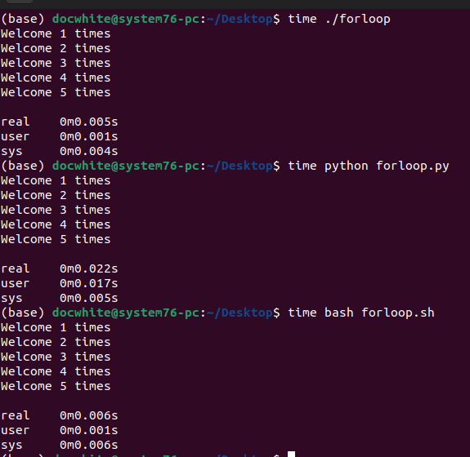
for loop - Rust vs. Python vs. Bash
c

Slide 77
Quiz 10
- On canvas now

Slide 78
Bonus 10
- Write a bash script that prints the working directory, counts all the sequences within a fasta files within the working directory, and prints the first five lines of the file into std_out.txt?

