Slide 1
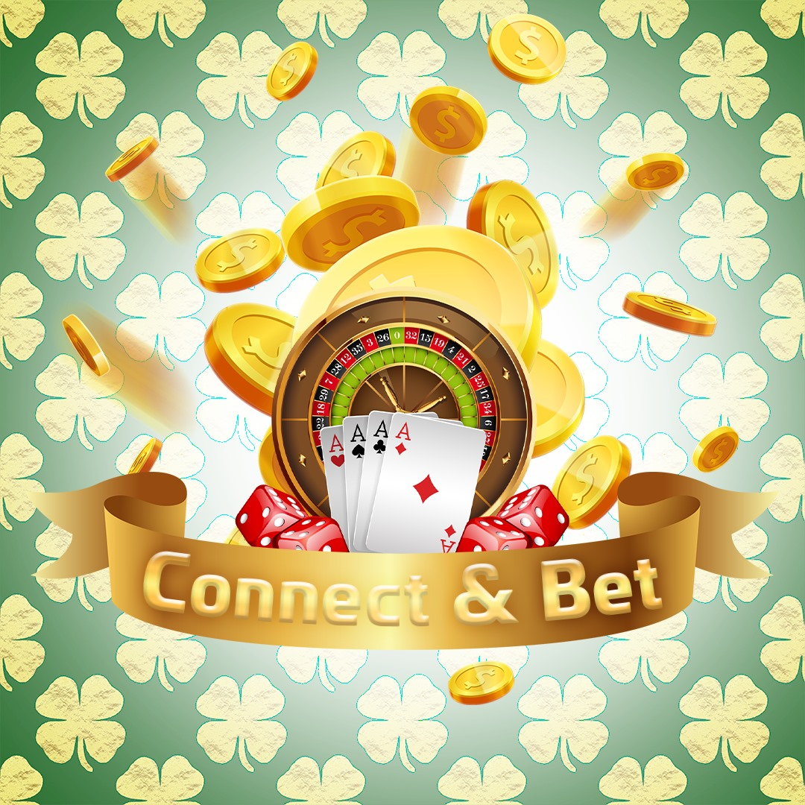
Notes:
Hello, we are Ohad, Elizaveta, Snir. We are pleased to present our game: connect and bet.
Ohad was doing the Networking, Snir was doing frontend part, and i was doing the backend part of the project.

Slide 2
The Connect & Bet game lets you play casino games with your friends by simply connecting from the same room.
All you need to do, is to enter your username, and join the party.
Together, you will play our diverse casino games
Notes:
The Connect & Bet game lets you play casino games with your friends by simply connecting from the same room.
All you need to do, is to enter your username, and join the party.
Together, you will play our diverse casino games.
Our game offers an Innovative multiplayer experience where players can see their own point of view from their device, and in a shared screen, the casino table.
This platform facilitates collaborative gameplay, allowing users to feel the excitement of a real casino game.

Slide 3
Networking…
Through our location detection feature, all members join the lobby, to communication with each other.
By being nearby the host, it will let you play offline, smooth, and fast!
Notes:
The Location detection feature enables all users to join the hosts' lobby.
The host creates a server behind the scenes,
That allows all users to connect with each other.
This unique functionality removes the necessity of adding friends to a list; instead, players can effortlessly join the game together simply by being in close proximity.
The server advertising allows all clients to access data through the host.

Slide 4
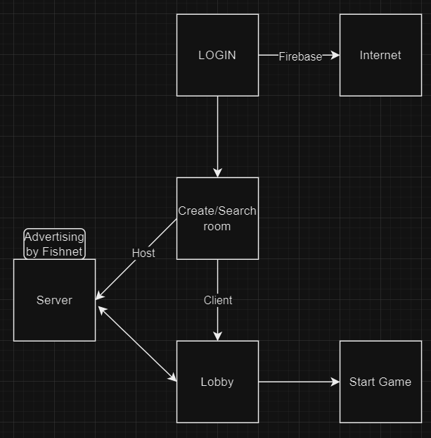
Architecture
Notes:
In this diagram we can see our project’s high level architecture.
Now lets see a demonstration of the game flow.
In the login screen, users can sign up to our game with new usernames automatically.
Or to login with their past username.
In the next screen, users can create a room and advertise their device as server.
And the other users can join.
In the next screen users gather, and wait for host to start the game.
Now the magic starts: Users joined the hosts room without any friend-list, or internet connection needed.
Liza: After host started the game, i can play a complete BlackJack game.

Slide 5
Architecture

Slide 6
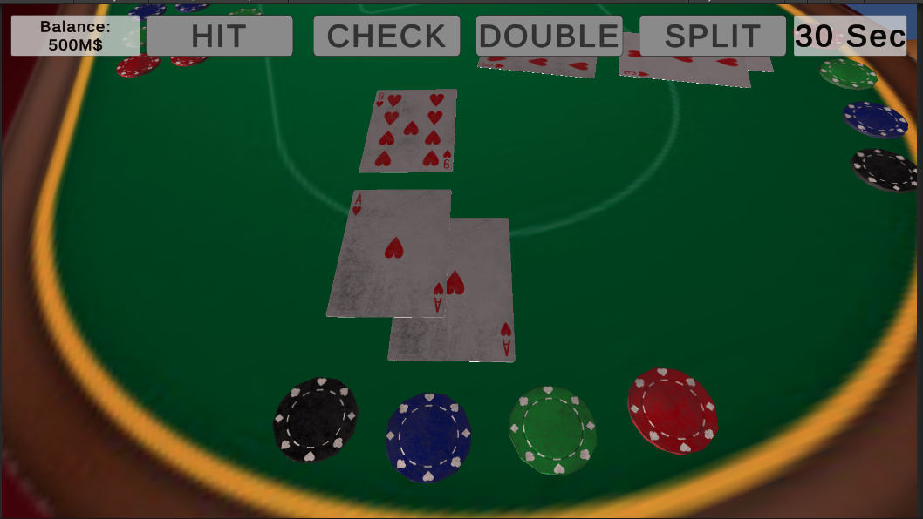
Real casino experience
Each player has his own spot near the table, which will be displayed (as the player’s character point of view) on the player’s own device.
During the game, only the player that currently has the turn, will be shown the “play menu”, while the other players will only see the “turn timer” and their own user account’s balance.

Slide 7
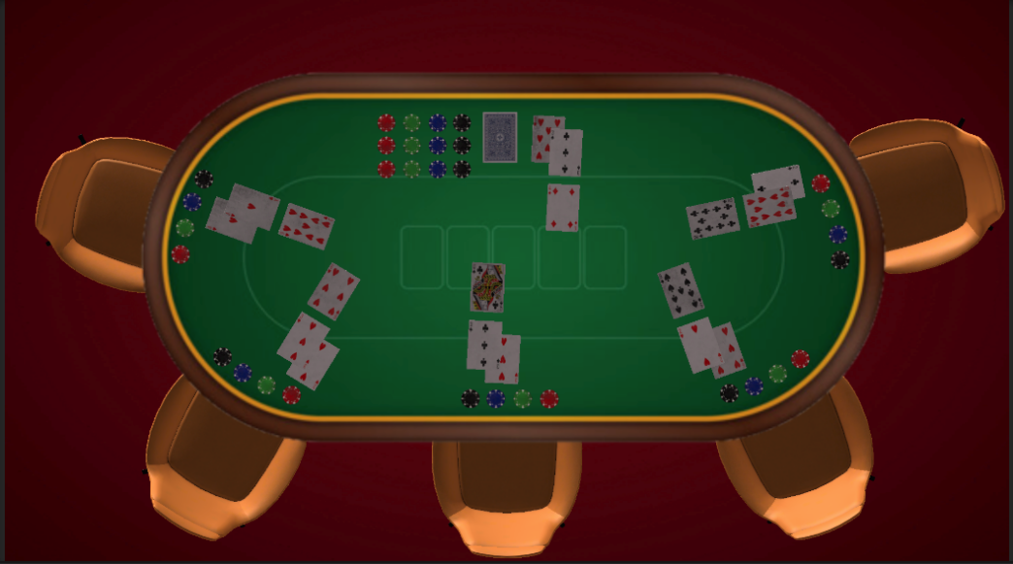
Blackjack
Our casino games contains a Blackjack game, which demonstrate a real feeling of playing blackjack in a casino.
While each player will see their character’s point of view, the device that owned by the host will show the whole table’s currant state, so every player can see the other players (and the dealer’s) cards, characters, and moves in real time, just like in a real-life casino’s Blackjack table.

Slide 8

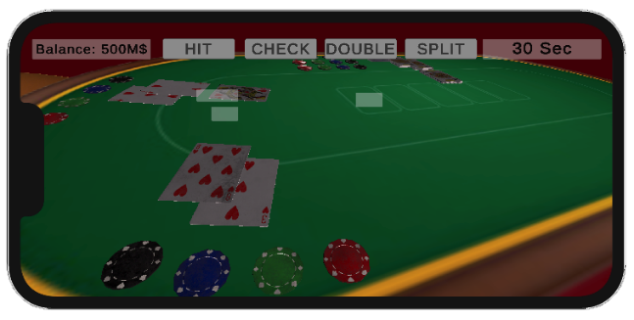
Real casino experience
Notes:
Here is a demonstration of the mobile devices playing BlackJack, and the host’s shared screen.
This is our UI demonstration. This is not yet implemented with our backend.

Slide 9
Summary
Authentic casino experience
Swiftly connect and enjoy the excitement of the casino with friends
Notes:
In conclusion, our game offers casino games including Blackjack and a future Poker game.
Using our location detection feature, players can swiftly join games with their nearby friends, providing an authentic casino experience as they play alongside others at the same table/ same screen, without the need for complex friend lists or cumbersome invitations.
Now we are ready for questions.

