Slide 1

Notes:
Hello, we are Ohad Badhav, Elizaveta Sidorova, Snir Ben Nissim. We are pleased to present the progress in our project.
Ohad and I are working on a backend part of the project and Snir is working on a frontend part. Ohad also do networking for our project.

Slide 2
The Connect & Bet game lets you play casino games with your friends by simply connecting from the same room.
All you need to do, is to enter your username, and join the party.
Together, you will play our diverse casino games
Notes:
Hello, we are pleased to present the progress in our project.
The Connect & Bet game lets you play casino games with your friends by simply connecting from the same room.
All you need to do, is to enter your username, and join the party.
Together, you will play our diverse casino games
Our game offers an Innovative multiplayer experience where players can create their own gaming rooms or join existing ones. This platform facilitates collaborative gameplay, allowing users to come together and enjoy a variety of engaging casino games. Through seamless connectivity and innovative features, players can experience the thrill of the casino from the comfort of their own devices.

Slide 3
Networking…
Through our network detection feature, all members join the lobby, to communication with each other.
By being nearby the host, it will let you play offline, smooth, and fast!
Notes:
The network detection feature enables all users to join the hosts' lobby.
The lobby creating actually creates a server port in the hosts’ device.
That allows all users to connect to that server.
This unique functionality removes the necessity of adding friends to a list; instead, players can effortlessly join the game together simply by being in close proximity.
Our data about each user is stored in firebase cloud service.
The server advertising allows all clients to access that database through the host.

Slide 4
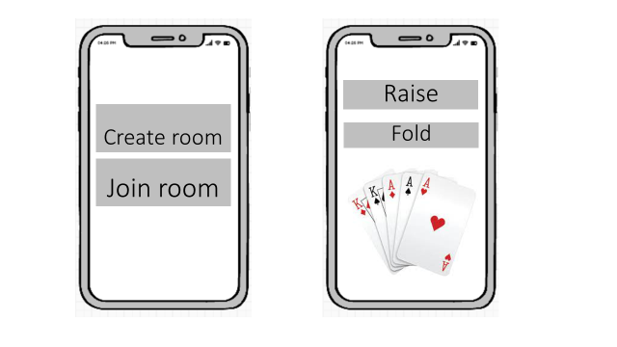
Networking…

Slide 5
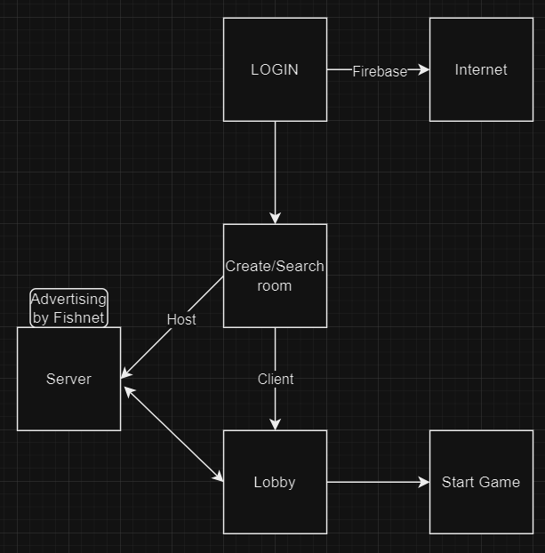
Architecture

Slide 6
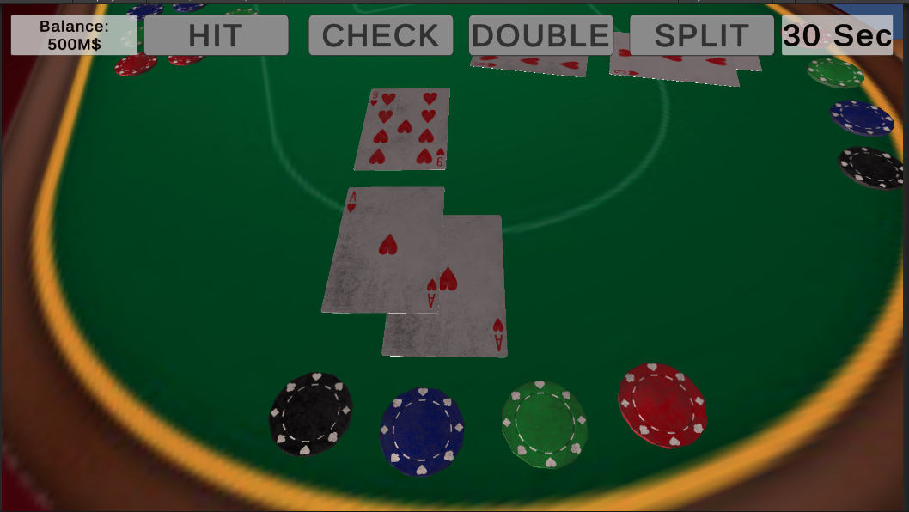
Real casino experience
Each player has his own spot near the table, which will be displayed (as the player’s character point of view) on the player’s own device.
During the game, only the player that currently has the turn, will be shown the “play menu”, while the other players will only see the “turn timer” and their own user account’s balance.

Slide 7
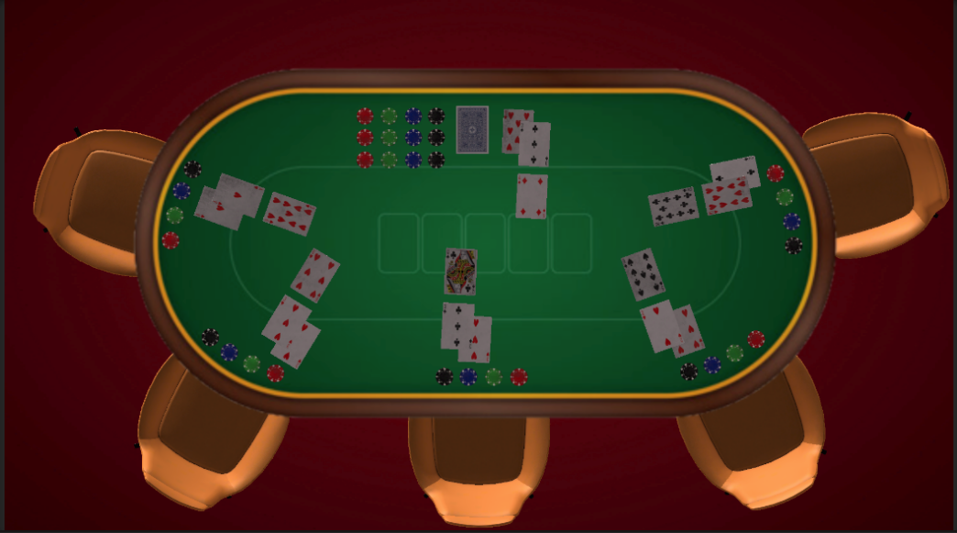
Blackjack
Our casino games contains a Blackjack game, which demonstrate a real feeling of playing blackjack in a casino.
While each player will see their character’s point of view, the device that owned by the host will show the whole table’s currant state, so every player can see the other players (and the dealer’s) cards, characters, and moves in real time, just like in a real-life casino’s Blackjack table.

Slide 8
Summary
Authentic casino experience
Swiftly connect and enjoy the excitement of the casino with friends
Notes:
Our game offers casino games including Poker and Blackjack. Using our location detection feature, players can swiftly join games with their nearby friends, providing an authentic casino experience as they play alongside others at the same table/ same screen.
Our game utilizes nearby detection technology to create a unique and seamless gaming experience, enabling players to swiftly connect and enjoy the excitement of the casino with their nearby friends, without the need for complex friend lists or cumbersome invitations.
Now we are ready for questions.

