Slide 1

By:
Sijmen Huizenga, Hardit Singh, Vincent kenbeek, Liza de Graaf

Slide 2

What is the challenge

Slide 3
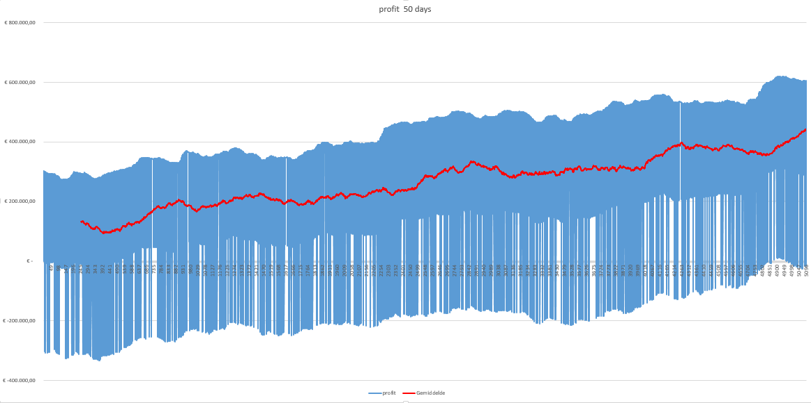
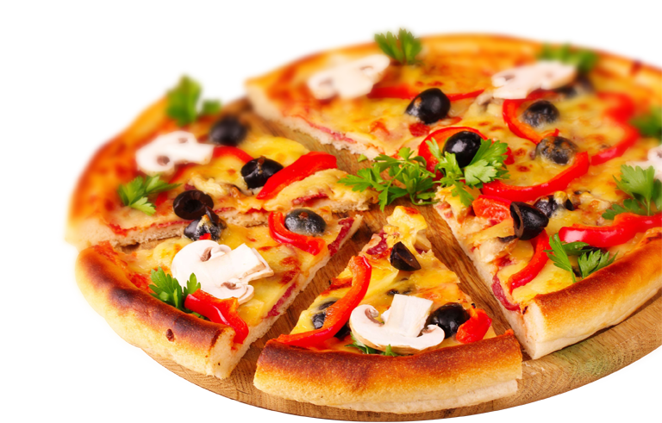
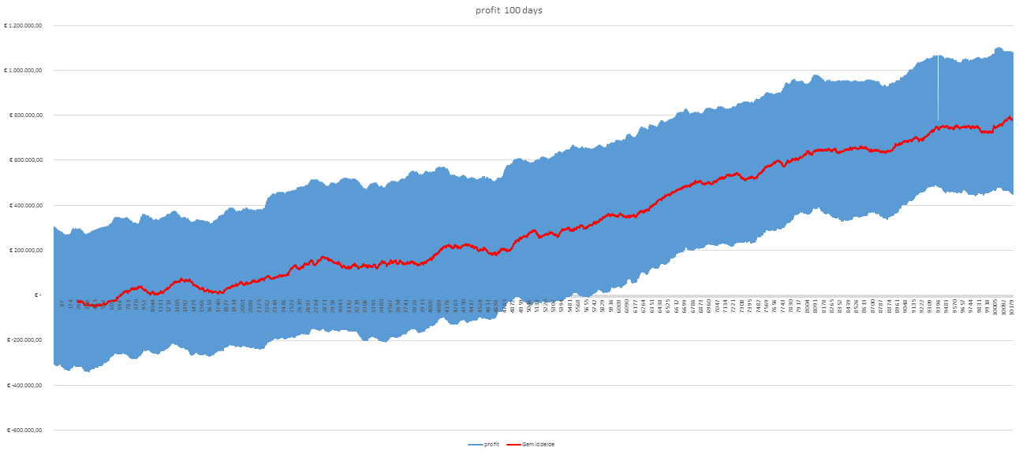
The Product
€762.230,-
= 152.446 pizza’s
That’s 417 years!!

Slide 4

Thank you!
Sijmen Huizenga, Hardit Singh, Vincent Kenbeek, Liza de Graaf

