Slide 1
Quantum Routing Optimization
Liza Darwesh
15th of February

Slide 2
Table of contents
01
Integer Linear Programming
02
Algorithms in OpenQASM
03
PYZX
04
Quantum Teleportation

Slide 3



Integer Linear programming
01
Minimizing error rate
$$\sum_{t∈T}{}\sum_{g=(p,q)∈G^{t}}{}\sum_{(i,j)∈A}{\log\left(𝒫^{∗}\left(g,\left(i,j\right)\right)\right)}\left[y_{\left(p,q\right),(i,j)}^{t} − \frac{x_{p,i,j}^{t}+x_{q,j,i}^{t}}{2}\right]+\sum_{t∈T}{}\sum_{g=(p,q)∈G^{t}}{}\sum_{(i,j∈A)}{\log\left(𝒫_{SWAP}^{∗}\left(g,\left(i,j\right)\right)\right)\left[\frac{x_{p,i,j}^{t}+x_{q,j,i}^{t}}{2}\right] }+\sum_{t∈T}{}\sum_{q∈{Q\backslash Q}^{t}}{}\sum_{(i,j∈A)}{\log\left(β_{ij}^{3/2}\right)}x_{q,i,j}^{t}$$
Cost function based on:
An approximation of the fidelity
Total circuit depth
Measure of cross-talk
Minimizing circuit depth
$$\min{\sum_{t∈T^{swap time steps}}{z^{t}}}$$
Minimizing crosstalk
$$\min{\sum_{t∈T^{}}{}\sum_{e_{1}e_{2}∈X}{u_{e_{1}}^{t}u_{e_{2}}^{t}}}$$

Slide 4
2. Algorithms
Grover
Walk Search
Simon
Solving unstructured search problems with Toffoli gates
Finding elements in a graph with Toffoli gates
Finding hidden bitstrings with CNOT and Toffoli gates
Source: https://quantum-computing.ibm.com/composer/files/f9bdd2d75c7cb6af3e9e48642f36f870

Slide 5
3. PYZX
α
ᵦ
pyZX
Circuit ZX-Diagram Optimised Circuit
Encode
Extract
Reduce
Source: https://www.youtube.com/watch?v=iC-KVdB8pf0

Slide 6
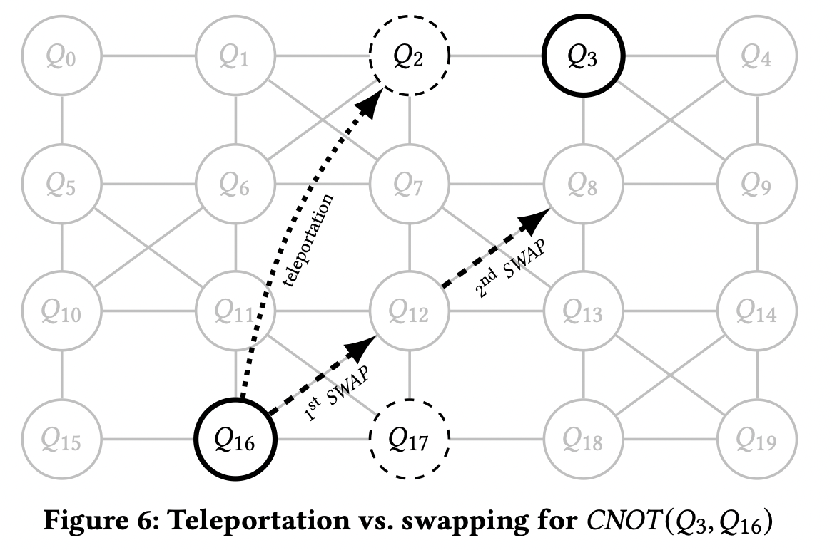
4. Quantum Teleportation
Source: https://arxiv.org/pdf/2011.07314.pdf

