Slide 1
Cost of living across the globe

Slide 2
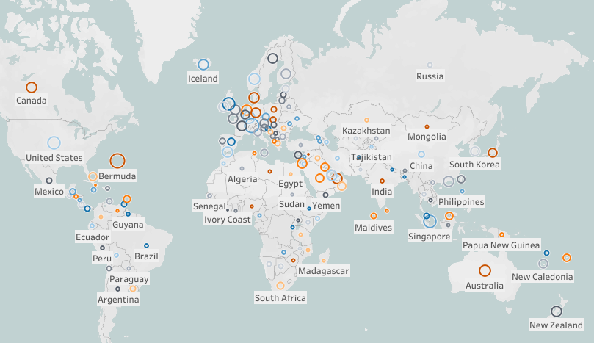
Net salaries across the countries, $
Top countries that perform highest income are Bermuda, Switzerland, Isle Of Man, Singapore, United States with salaries from 4500$ up till 6000$net/month whereas in countries like Cuba and Siria net montly income is not higher than 50$.

Slide 3
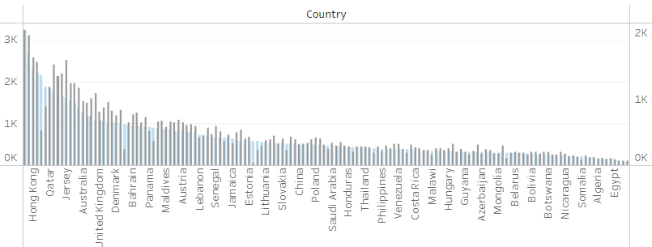
Cost of rent 1bedroom apartment, $
in the center
outside the center
Average cost of rent 1bedroom apartment in the city center with utilities and internet ranges from 145$ in Bangladesh to 3663$ in Bermuda.

Slide 4
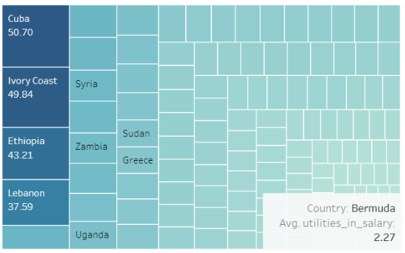
Utilities in net salary, %
The percentage in net salary which each person should give for paying utilities for ~40-45m2 flat varies from 2,27% in Bermuda to 51% in Cuba, which means that countries with higher salaries pay less in percentage for utilities than those who earn less.

Slide 5
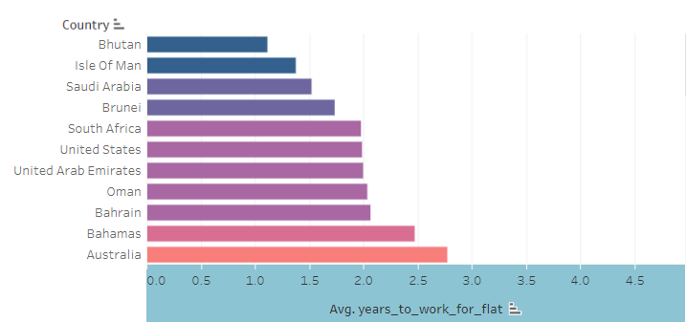
How many years a person should work to buy a 40m2 flat outside the center?
It is interesting fact that people in South Africa can save up for 2 years to buy a 40m2 flat outside the center if they put all they monthly salary to flat savings.

Slide 6
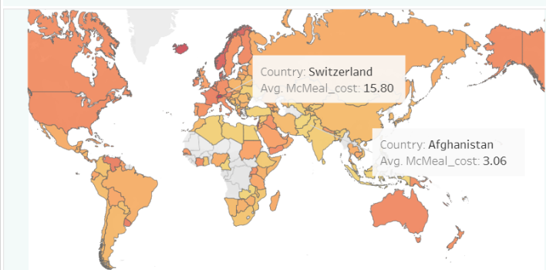
Cheap/expensive fast food, $
The cheapest fast food we can find in Afganistan and Bhutan while the most expensive is in Switzerland.

Slide 7
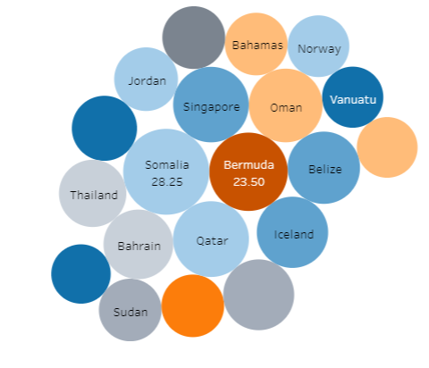
Cost of average bottle of wine from supermarkets, $
In Somalia and Bermuda you will find the most expensive bottle of wine in the supermarket.

Slide 8
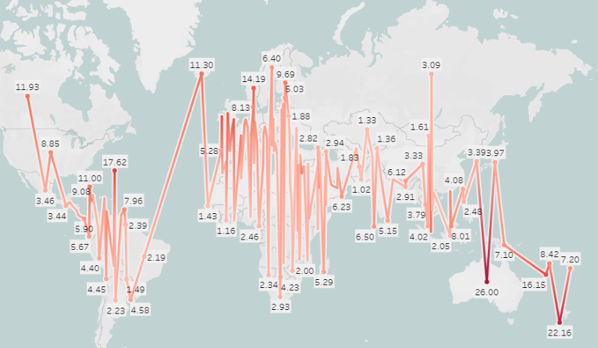
Is it expensive to smoke here?
It is intriguing to find out that countries for no-smokers where the package of cigarettes costs on average around 25$ are Australia and New Zealand.

Slide 9
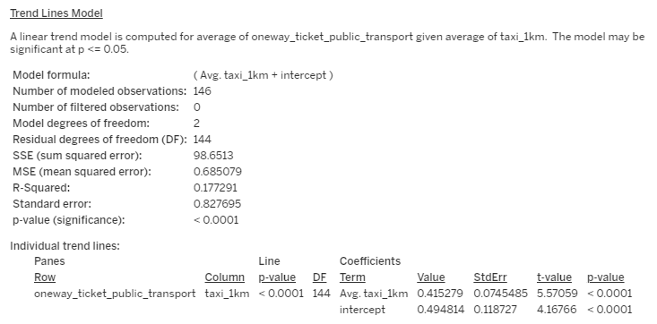
Taxi VS Public Transport, $
Overall, these results indicate that there is a significant linear relationship between the average cost of a one-way ticket for local transport and the average cost of a taxi per kilometer, with the latter influencing the predicted values of the former.

