Slide 1
Online education on Udemy

Slide 2
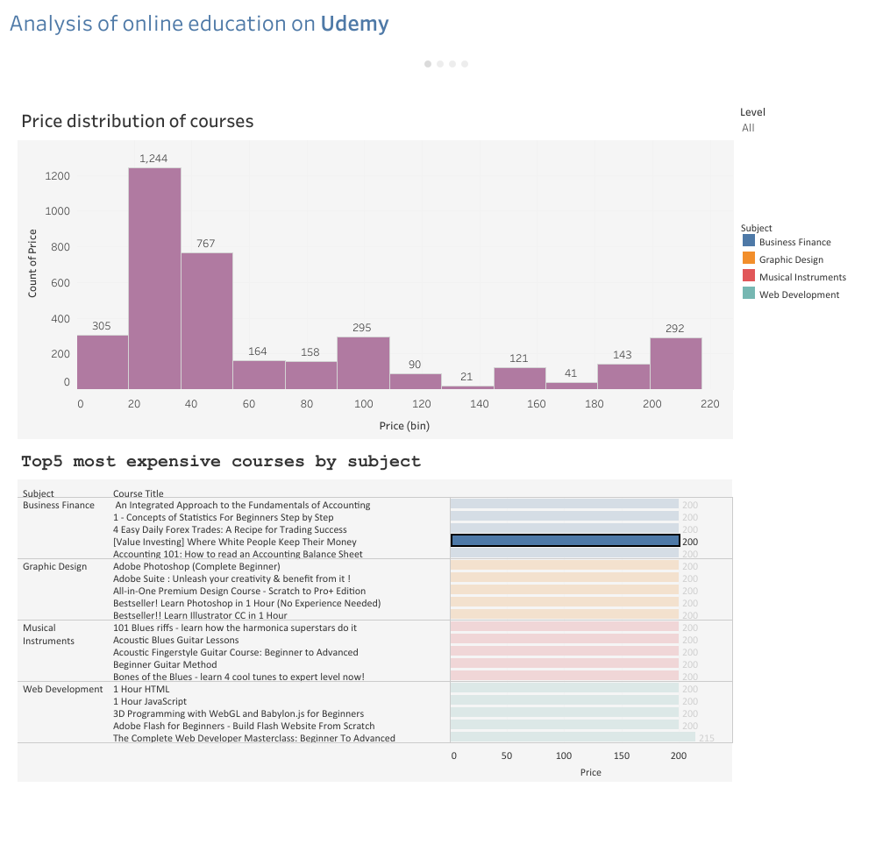
Price VS Subject
As we can see the most courses on Udemy are at price range from 20 to 60$.

Slide 3
Top5 expensive courses by subject

Slide 4
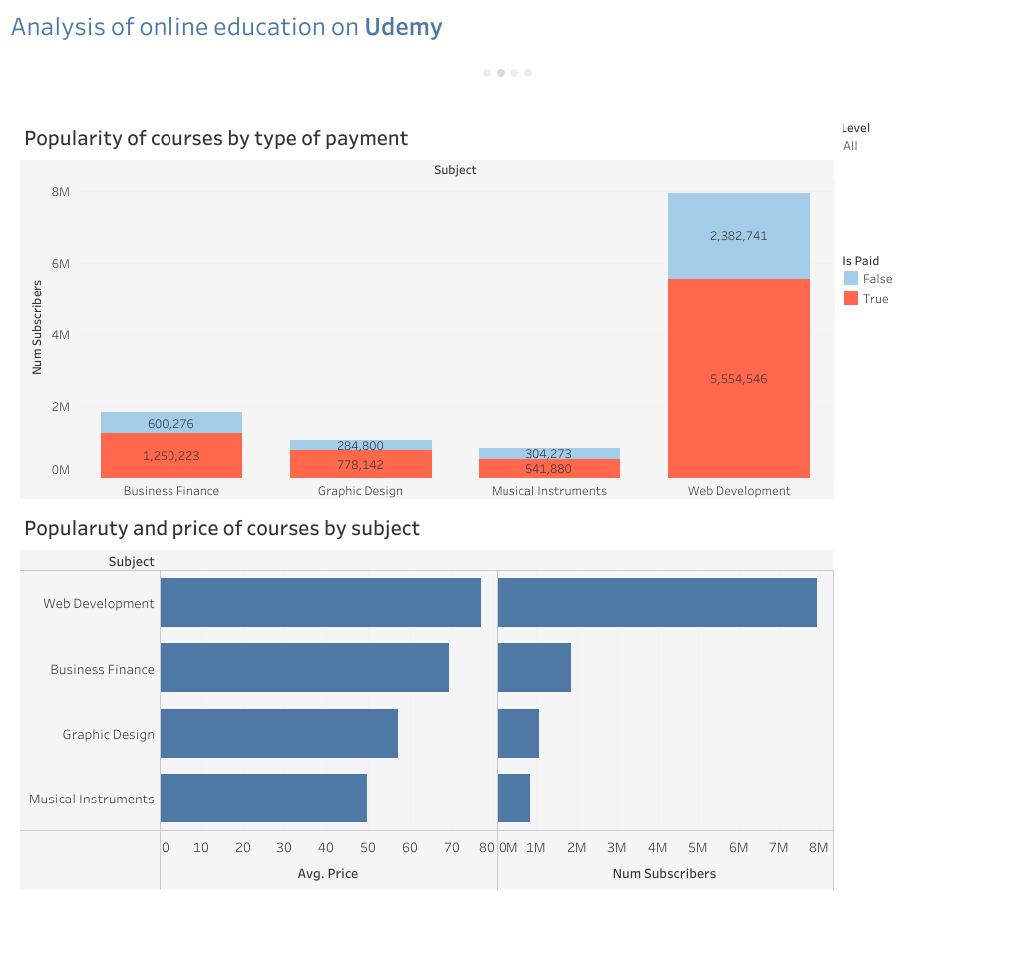
Popularity VS Type of payment
The bar chart displays that most courses on Udemy is paid, but overall percentage of free courses
by subject is around 50% from paid courses.

Slide 5
Popularity VS Price
The graph shows that Web development courses are the most in demand and the most
expensive as well, Business and Finance courses go next in terms of popularity by a wide
margin, but the average price doesn’t differ much.

Slide 6
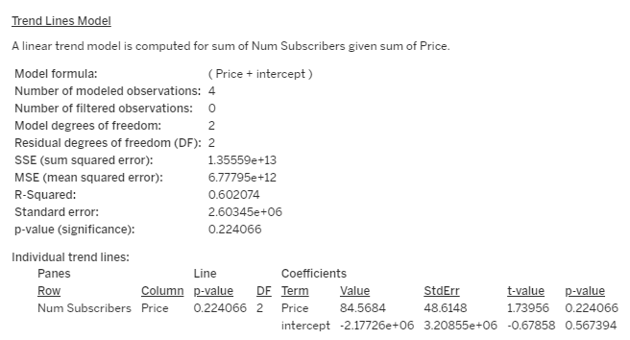
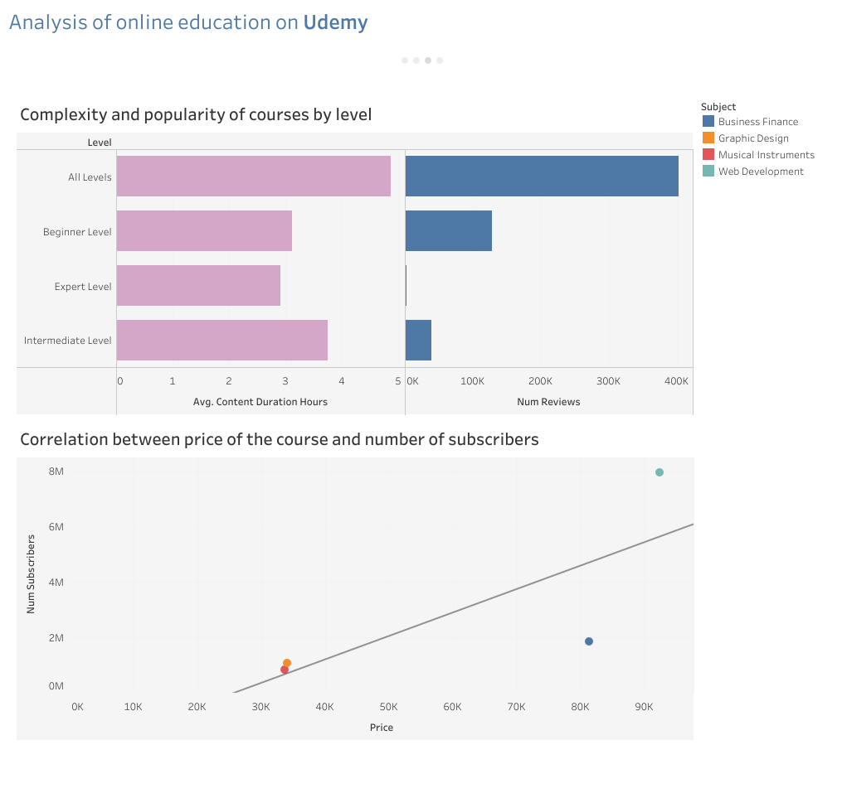
Price VS Subscribers
In this case, the p-value is greater than 0.05, which means that the observed relationship between the number of subscribers and the course price could be due to chance.
The model shows that 60.2% of the variability in the number of subscribers can be explained by the course price.

Slide 7
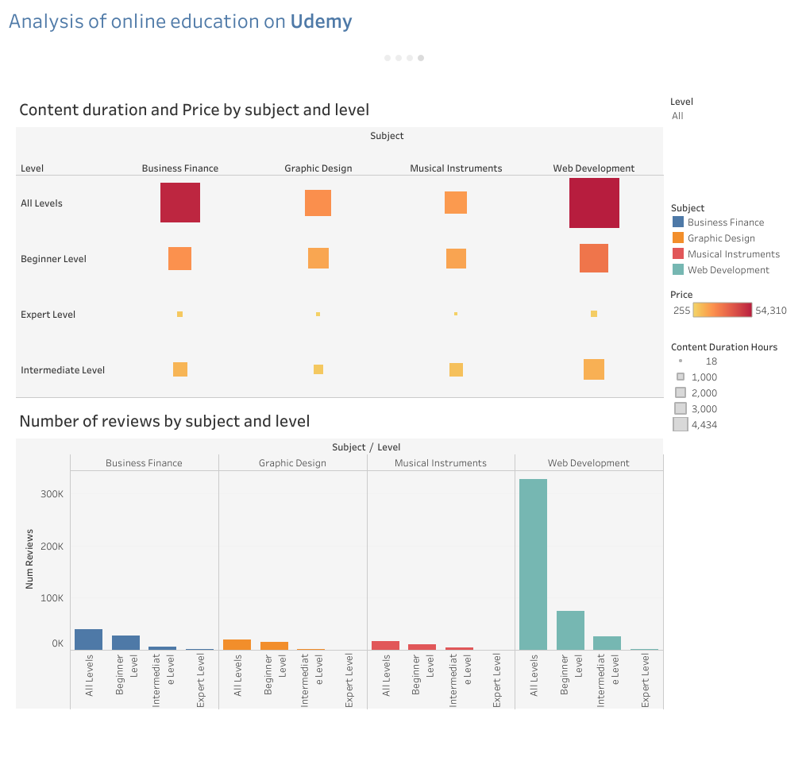
Duration VS Price
Based on the chart, we can infer that courses with level of preparation ‘All levels’ have the highest prices and duration. On the other hand, the Expert level courses have the smallest prices and duration.

Slide 8
Reviews
The bar chart demonstrates that Web development courses have the biggest number of reviews in comparison with other courses.

