Slide 1

UNSUPERVISED LEARNING Predict
Team_JHB_RM4_TheFlixters
Lizette Loubser
Bulelani Nkosi
Noluthando Khumalo
Nompilo Nhlabathi
Sizwe Bhembe
Nelisiwe Phiwe Mabanga

Slide 2
Table of contents
Introduction
Exploratory Data Analysis
Data Preprocessing and Feature Engineering
Modeling
Performance Evaluation
Model Analysis
Conclusion
References

Slide 3
Introduction
In today’s technology driven world, recommenders stems are socially and economically critical for ensuring that individuals can make appropriate choices surrounding the content they engage with on a daily basis.
Providing an accurate and robust solution to this challenge has immense economic potential, with users of the system being exposed to content they would like to view or purchase - generating revenue and platform affinity.

Slide 4
Problem statement
Construct a recommendation algorithm based on content or collaborative filtering, capable of accurately predicting how a user will rate a movie they have not yet viewed, based on their historical preferences.

Slide 5

EXPLORATORY DATA ANALYSIS

Slide 6
Checking
Checking
Checking
Checking summary statistics of all data.
Checking the percentage of the missing data.
Ratings of all the movies.

Slide 7
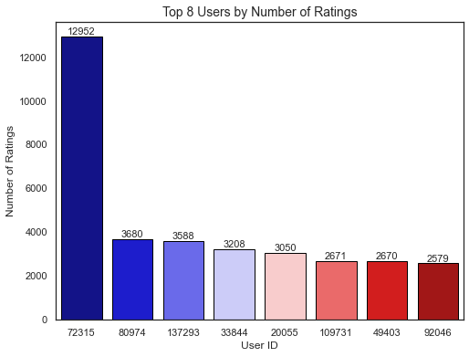
COUNTS of ratings for top 8 users

Slide 8
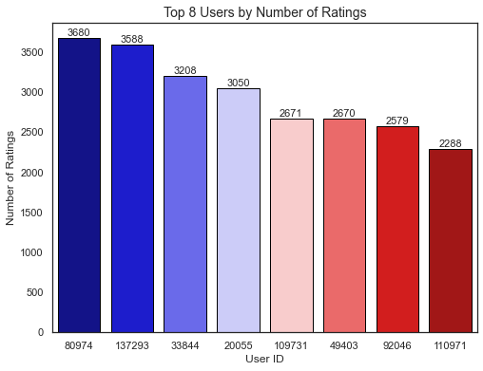
To make interpretation easier REMOVE user that HAS RATED AN EXTREME NUMBER OF MOVIES RELATIVE TO OTHER USERS.

Slide 9
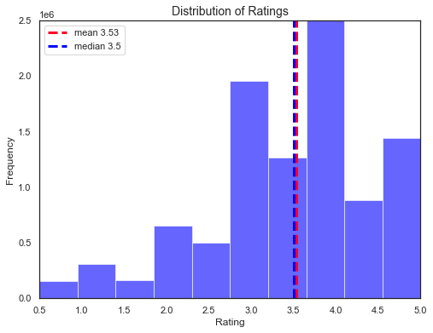
This is how users tend to rate the movies

Slide 10
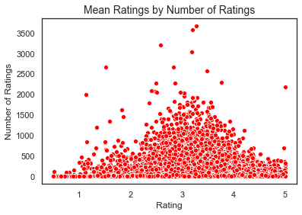
relationship between the number of movies a user has rated and the rating that they give.

Slide 11
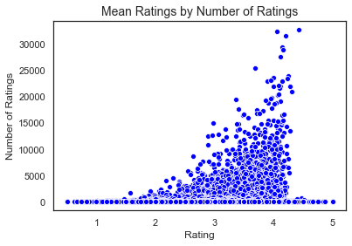
relationship between the number of ratings a movie has and how highly it is rated

Slide 12
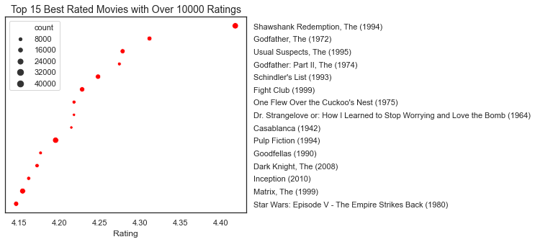
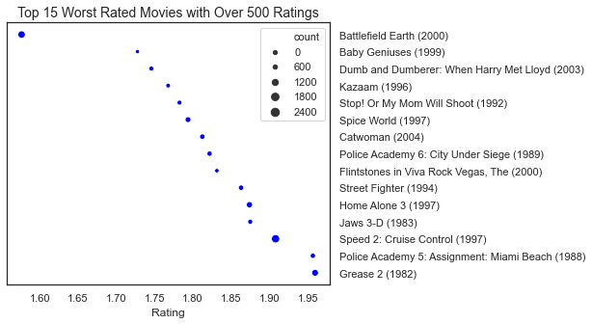
the best and worst rated movies.

Slide 13
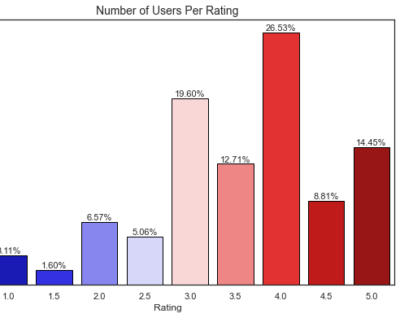
Percentage of users per rating, most movies get a rating of 4.0.

Slide 14
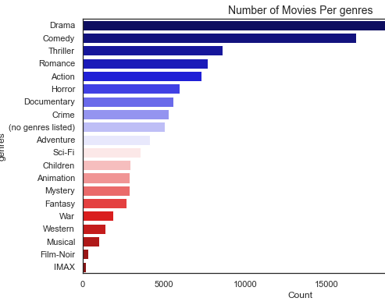
the most commonly observed genres

Slide 15
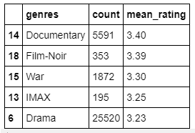
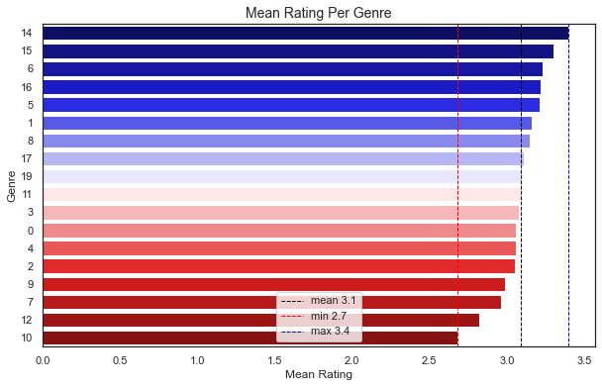
Mean rating per genres

Slide 16
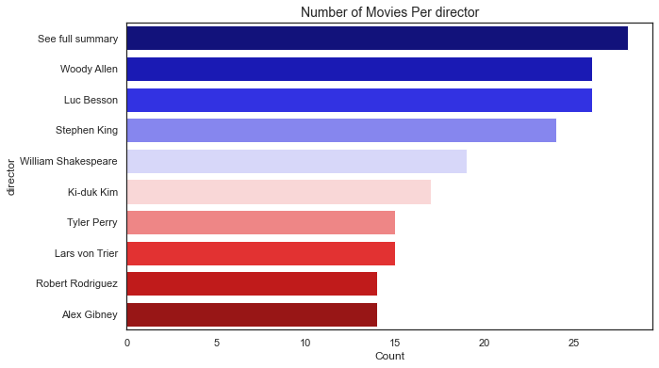
the most common directors

Slide 17
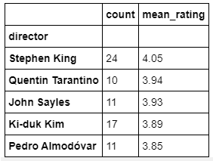
Mean rating per directors

Slide 18
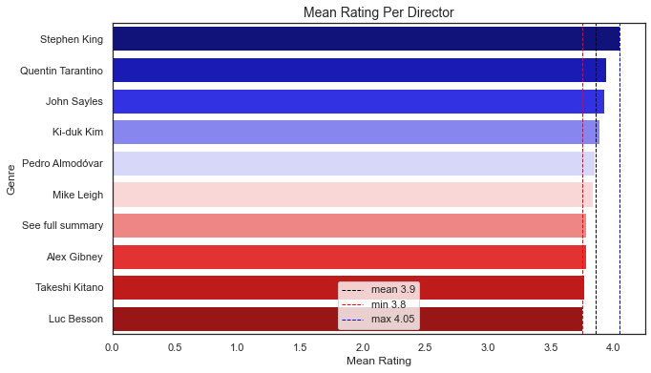
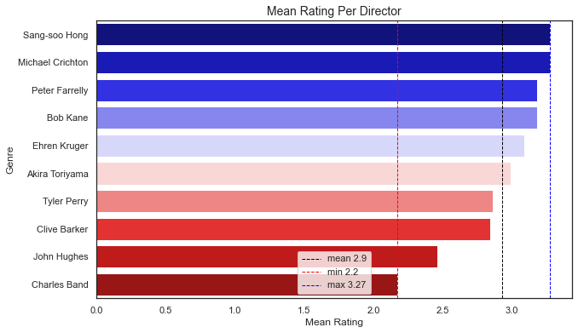

Slide 19

DATA PREPROCESSING

Slide 21
Conclusions

Slide 22
Future work and improvements

Slide 23
Acknowledgements and references
EXPLORE DS Academy
Project supervisor
Ridha
Pod leaders
Ebrahim Noormahomed
https://www0.gsb.columbia.edu/mygsb/faculty/research/pubfiles/385/Internet
https://nycdatascience.com/blog/student-works/yelp-recommender-part-1/
https://sifter.org/simon/journal/20061211.html

Slide 24

Questions?

