Slide 1

UNSUPERVISED LEARNING Predict
Team_RM4_TheFlixters
Lizette Loubser
Bulelani Nkosi
Noluthando Khumalo
Nompilo Nhlabathi
Sizwe Bhembe
Nelisiwe Phiwe Mabanga

Slide 2
Table of contents
Introduction
Exploratory Data Analysis
Data Preprocessing and Feature Engineering
Modeling
Performance Evaluation
Model Analysis
Conclusion
References

Slide 3
Introduction
In today’s technology driven world, recommenders stems are socially and economically critical for ensuring that individuals can make appropriate choices surrounding the content they engage with on a daily basis.
Providing an accurate and robust solution to this challenge has immense economic potential, with users of the system being exposed to content they would like to view or purchase - generating revenue and platform affinity.

Slide 4
Problem statement
Construct a recommendation algorithm based on content or collaborative filtering, capable of accurately predicting how a user will rate a movie they have not yet viewed, based on their historical preferences.

Slide 5

EXPLORATORY DATA ANALYSIS

Slide 6
Checking
Checking
Checking
Checking summary statistics of all data.
Checking the percentage of the missing data.
Ratings of all the movies.

Slide 7
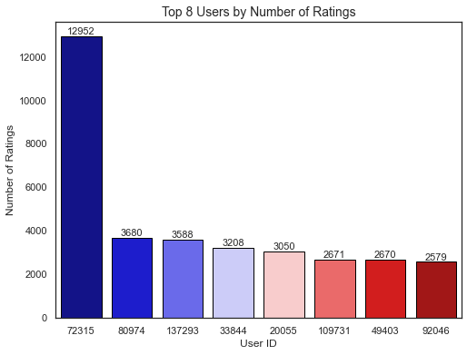
COUNTS of ratings for top 8 users

Slide 8
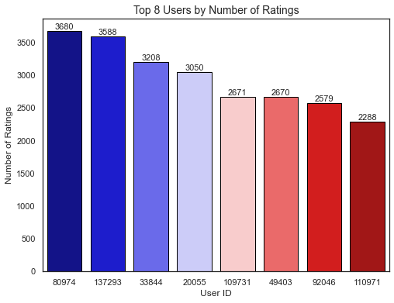
To make interpretation easier REMOVE user that HAS RATED AN EXTREME NUMBER OF MOVIES RELATIVE TO OTHER USERS.

Slide 9
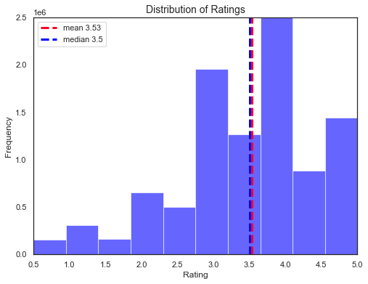
This is how users tend to rate the movies

Slide 10
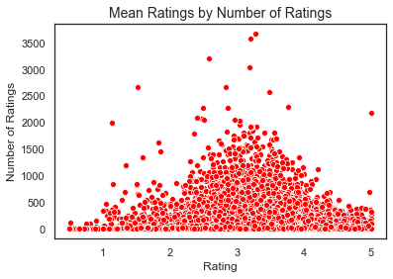
relationship between the number of movies a user has rated and the rating that they give.

Slide 11
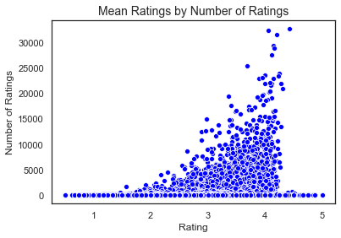
relationship between the number of ratings a movie has and how highly it is rated

Slide 12
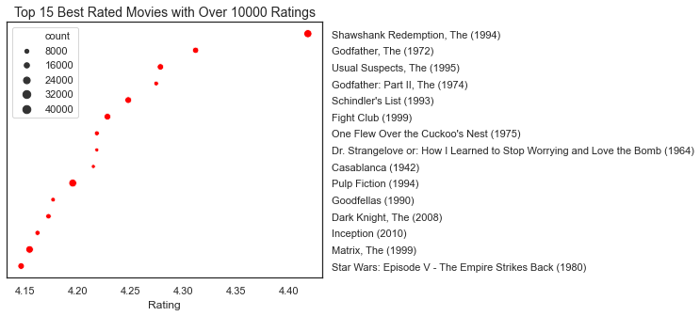
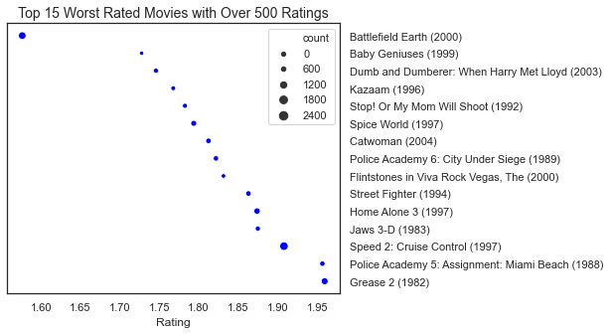
the best and worst rated movies.

Slide 13
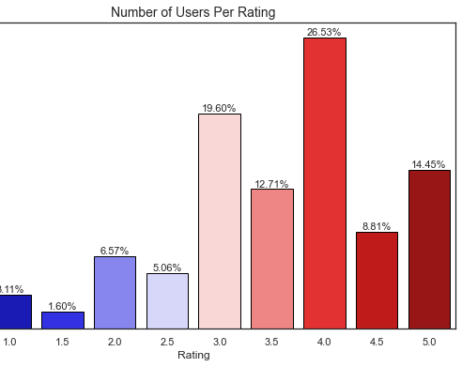
Percentage of users per rating, most movies get a rating of 4.0.

Slide 14
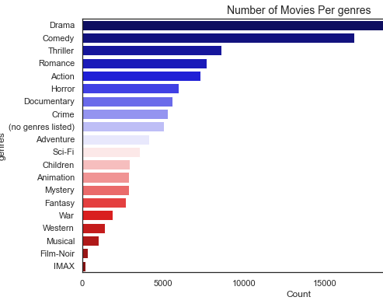
the most commonly observed genres

Slide 15
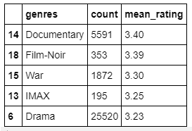
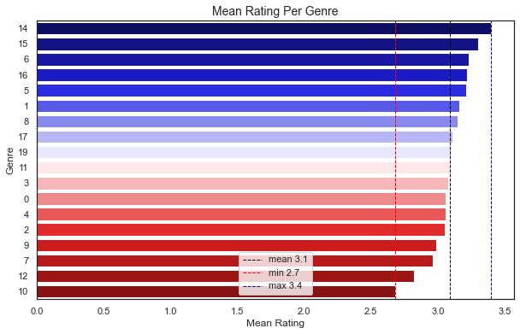
Mean rating per genres

Slide 16
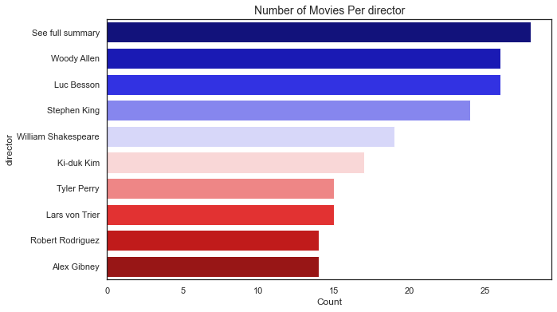
the most common directors

Slide 17
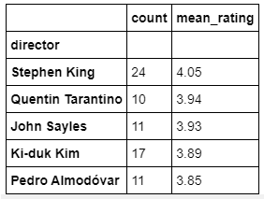
Mean rating per directors

Slide 18
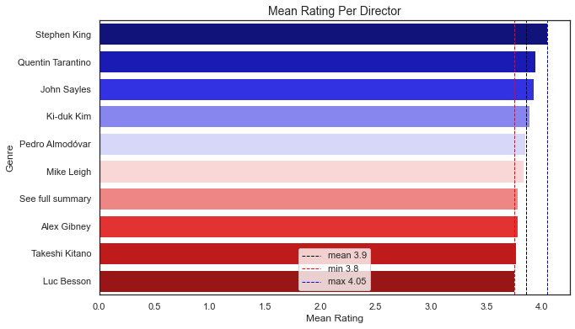
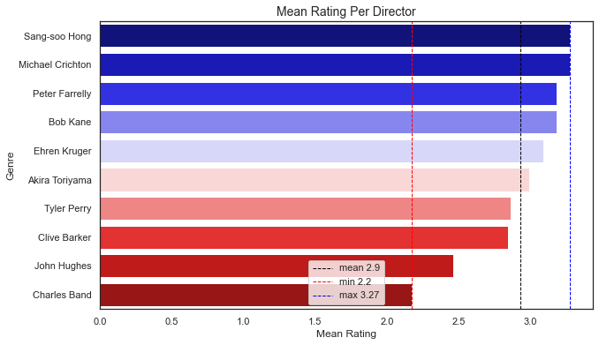

Slide 19

DATA PREPROCESSING

Slide 20
Multi Dimensional Scaling
Gausian Mixture
Principal Component Analysis
Scales of measurement
Cluster Analysis

Slide 21
modelling
We train and evaluate the following models on a 100k subset of the data
SVD (Singular Value Decomposition)
NormalPredictor
BaselineOnly
NMF (Non-negative Matrix Factorization)
SlopeOne
CoClustering

Slide 22
PERFOMANCE EVALUATION
We built and tested six different collaborative filtering models and compared their performance using a statistical measure known as the root mean squared error (RMSE), which determines the average squared difference between the estimated values and the actual value. A low RMSE value indicates high model accuracy.

Slide 23
SVD and BaselineOnly got a lower Rmse values
Models | RMSE
SVD | 0.97
NormalPredictor | 1.45
BaselineOnly | 0.97
NMF | 1.16
SlopeOne | 1.16
CoClustering | 1.15

Slide 24
Cross validation
We tested the accuracy of a model's prediction on unseen data (validation sets)
To check issues such as over/underfitting and selection bias.
We used the K-fold technique to perform cross validation on our two best performing models which are SVD and Baseline Only

Slide 25

Conclusion
When tested our best performing models on the whole dataset, we concluded that SVD is the best performing model with RMSE value of 0.78

Slide 26
Future work and improvements

Slide 27
Acknowledgements and references
EXPLORE DS Academy
Project supervisor
Ridha
Pod leaders
Ebrahim Noormahomed

Slide 28
References
https://www0.gsb.columbia.edu/mygsb/faculty/research/pubfiles/385/Internet
https://nycdatascience.com/blog/student-works/yelp-recommender-part-1/
https://sifter.org/simon/journal/20061211.html
https://sifter.org/simon/journal/20061211.html
http://recommender-systems.org/content-based-filtering/

Slide 29

Questions?

