Slide 1
Python Data Structures
STAT201
Winter 2025

Slide 2
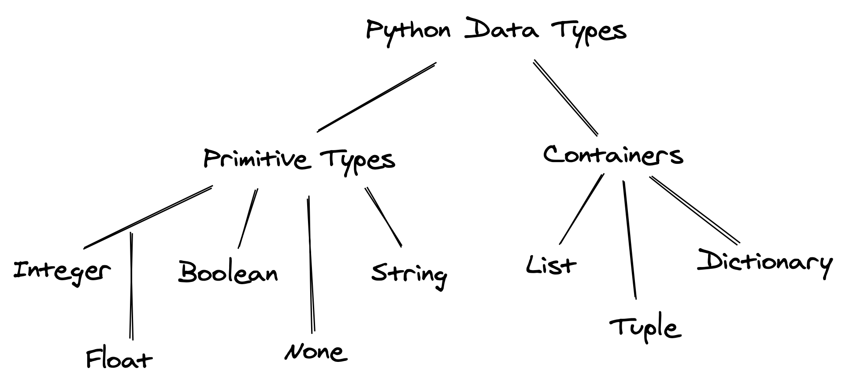
So far: Primitive Data Type in Python

Slide 3
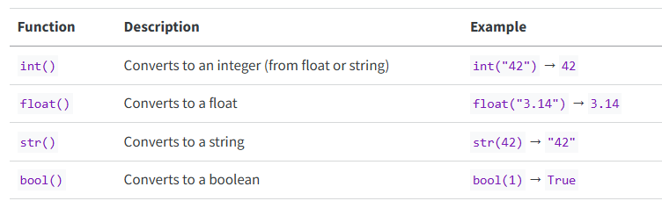
So far: Commonly Used Built-in methods associated with each data type
Always keep in mind what kind of data you work on, if unsure, use type( ) to check!
https://lizhen0909.github.io/Intro_to_programming_for_data_sci_wi25/Variable_expressions_statements.html#data-types
string
integers
floats
bool

Slide 4
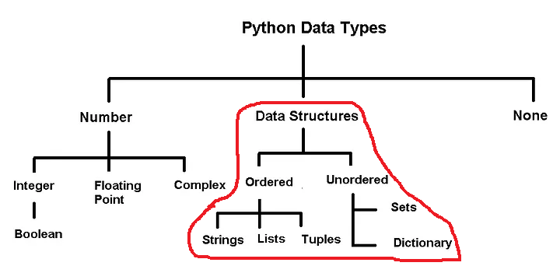
This week: Data Structures in Python
We will focus on each data structure's characteristics and how to use them, without going into the performance implications for each! STAT304 will cover their Time complexity

Slide 5
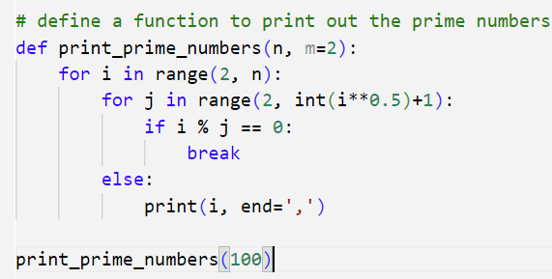
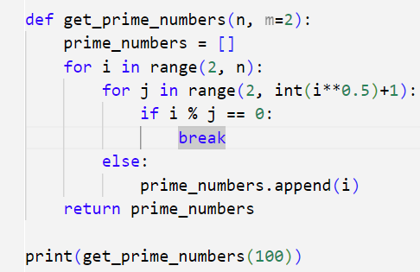
What is data structure
Collections that can hold multiple primitive values (and even other data structures).

Slide 6
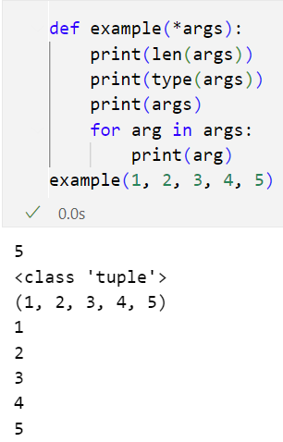
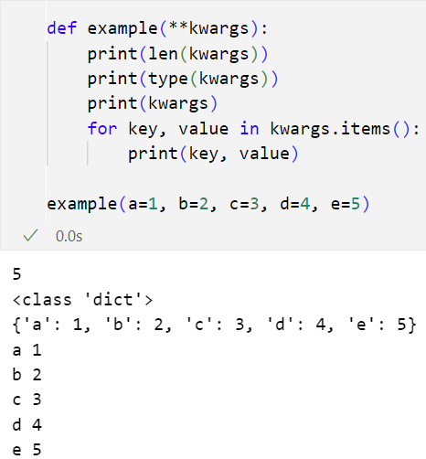
*args and **kwargs in function defination

Slide 7
What is data structure
Collections that can hold multiple primitive values (and even other data structures).
These structures allow more complex operations—such as iterating, inserting, removing, or mapping between keys and values—making it easier to work with collections of data efficiently.
Always keep in mind what kind of data you work on, if unsure, use type( ) to check!

Slide 8
Key Characteristics
Ordered or not
Mutable or not
Indexing or not

Slide 9
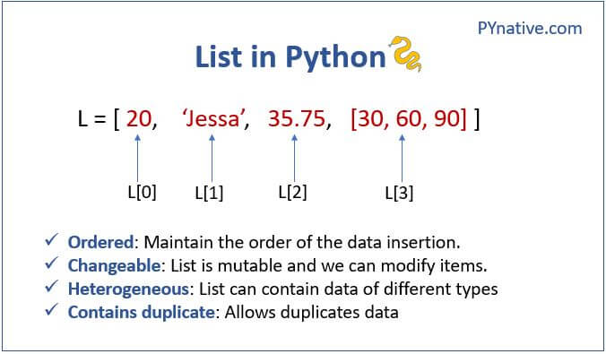
https://docs.python.org/3/tutorial/datastructures.html

Slide 10
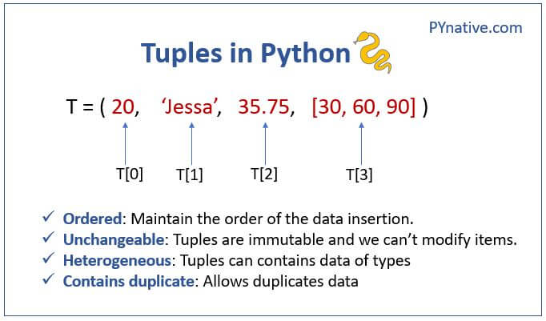
Tuple
https://pynative.com/python-tuples/

Slide 11
Things to note: Midterm
Exam is next Friday (coding questions) and next Saturday (multiple choice questions), up to python iterables (inclusive).
It contains coding questions ( 4 coding questions)
Multiple choice questions (like small quizzes)
Saturday (< 45 mins), multiple choice question (send me the recording link afterward)
You are NOT permitted to use AI, search engines, or collaborate with others
ANUs take exam at testing center
Make sure you know how to generate an HTML file. No late accommodations, and only notebook files will be accepted!
Do not forget to save your work before generating html file

Slide 12
Last class
Ordered or not
Mutable or not
Indexing or not
Always keep in mind what kind of data you work on, if unsure, use type( ) to check!

Slide 13
Today
Sets
Dictionary
Friday’s coding

Slide 14
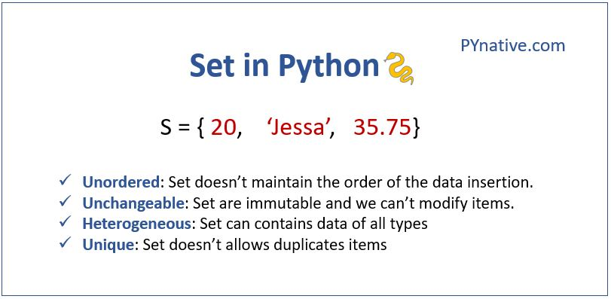
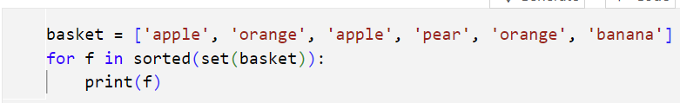
Set
When to use set?
Eliminating duplicate entries
Membership testing
Performing mathematical sets like union,
intersection, finding the difference between two sets
https://pynative.com/python-sets/

Slide 15
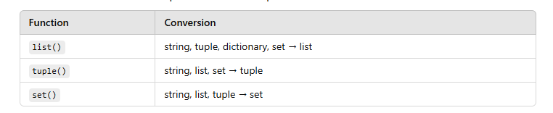
Data Type conversion

Slide 16
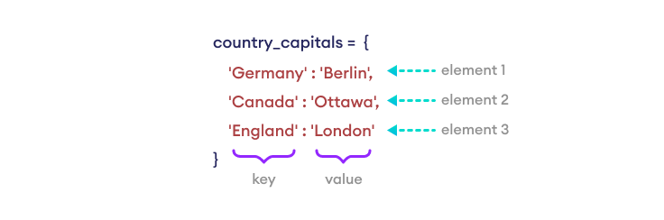

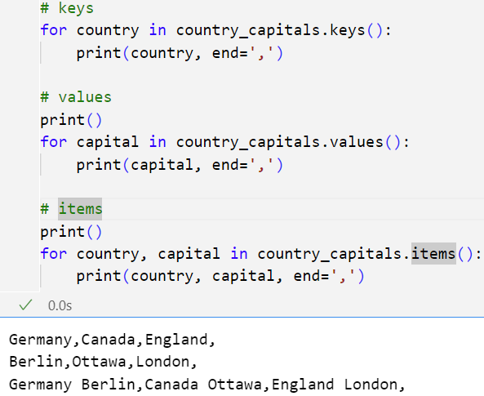
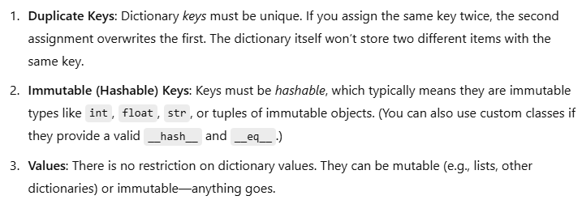
Dictionary (key-value pairs)
https://pynative.com/python-dictionaries/

Slide 17
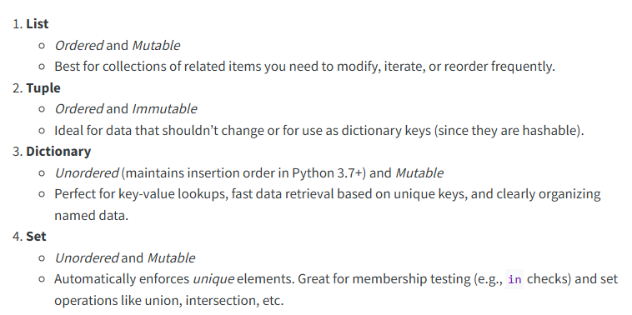
Choose the right data structure

