Slide 1
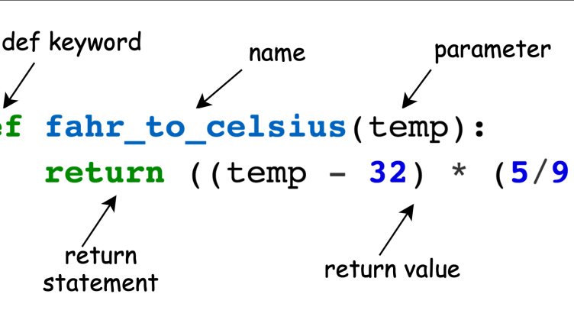
Python Functions
Predefined Functions
User-defined Functions
Python Standard Library
Third-Party Library

