Slide 1
Weinberg College of Arts and Sciences
Project Environments,
Packages, and File Paths
STAT 303-1 · Chapter 2
Lizhen Shi
Notes:
Today we connect the terminal, a project Python environment, and local data. Students should have completed Chapter 1 and downloaded the setup practice kit.
Design sources: https://www.northwestern.edu/brand/visual-identity/color-palettes/ ; original Northwestern white wordmark from https://weinberg.northwestern.edu/css/styles.css . This is a course lecture deck styled for Weinberg College.
Source: Chapter 2, overview
/Users/lizhenshi/mydev/nu-stat303-1-sec20-coursebook-clean/docs/python_venv.html
Coursebook: https://lizhen0909.github.io/nu-stat303-1-sec20-coursebook-clean/python_venv.html

Slide 2
STAT 303-1 / CHAPTER 2
Continue in the same project folder
TODAY’S WORK
stat303-setup/
├── activity01.ipynb
├── activity02.ipynb
└── data/
└── station_readings.csv
Navigate folders
Create and verify .venv
Install packages and find data
Weinberg College of Arts and Sciences
GET READY
02
Notes:
Open the extracted stat303-setup folder in VS Code, then activity02.ipynb. Do not work inside the ZIP viewer. The environment and requirements file will be added later. Complete Chapter 1 first.
Source: Chapter 2, overview
/Users/lizhenshi/mydev/nu-stat303-1-sec20-coursebook-clean/docs/python_venv.html
Coursebook: https://lizhen0909.github.io/nu-stat303-1-sec20-coursebook-clean/python_venv.html

Slide 3
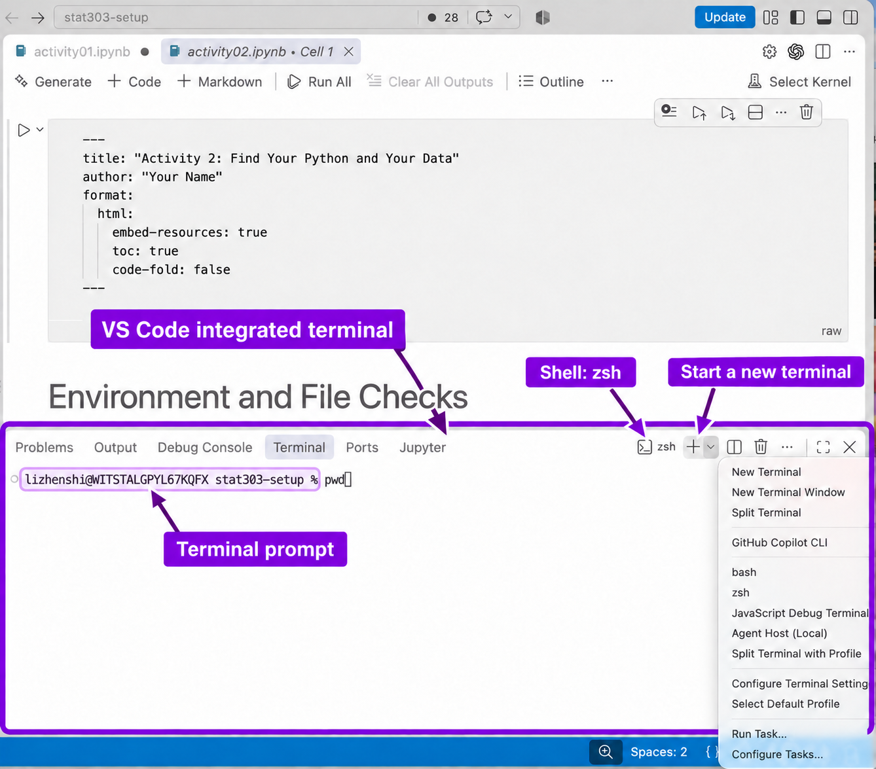
STAT 303-1 / CHAPTER 2
The terminal and the shell
OPEN IN VS CODE
Terminal → New Terminal
Type a command.
Press Enter.
Read the output.
Wait for the next prompt.
Weinberg College of Arts and Sciences
2.1–2.2
03
Notes:
A terminal is the text interface. The shell interprets commands: zsh or Bash on macOS; PowerShell or Command Prompt on Windows. Open Terminal → New Terminal. Use the terminal to prepare the project, install packages, and render reports. Image: chapter Figure 2.1.
Source: Chapter 2, what-is-a-terminal
/Users/lizhenshi/mydev/nu-stat303-1-sec20-coursebook-clean/docs/python_venv.html#what-is-a-terminal
Coursebook: https://lizhen0909.github.io/nu-stat303-1-sec20-coursebook-clean/python_venv.html#what-is-a-terminal

Slide 4
STAT 303-1 / CHAPTER 2
Read the prompt before typing
SHELL PROMPTS
student@laptop stat303-setup %
PS C:\Users\student\stat303-setup>
Type after the prompt.
Do not copy it.
INTERACTIVE PYTHON
>>>
Use exit() to return to the shell.
Weinberg College of Arts and Sciences
2.1
04
Notes:
Ask students which prompt accepts shell commands. Answer: the first two; >>> is interactive Python. Type exit() to return to the shell. In notebooks, Python belongs in a code cell. A successful shell command may produce no output.
Source: Chapter 2, read-the-prompt-and-enter-a-command
/Users/lizhenshi/mydev/nu-stat303-1-sec20-coursebook-clean/docs/python_venv.html#read-the-prompt-and-enter-a-command
Coursebook: https://lizhen0909.github.io/nu-stat303-1-sec20-coursebook-clean/python_venv.html#read-the-prompt-and-enter-a-command

Slide 5
STAT 303-1 / CHAPTER 2
Navigate with the commands for your shell
Action | macOS: zsh / Bash | PowerShell | Command Prompt
Show current folder | pwd | Get-Location | cd
List contents | ls | Get-ChildItem | dir
Enter data | cd data | cd data | cd data
Go to parent | cd .. | cd .. | cd ..
Try it: inspect → enter data → list files → return with cd ..
Weinberg College of Arts and Sciences
2.3
05
Notes:
Run one command at a time. pwd/Get-Location/cd reports the current working directory; ls/Get-ChildItem/dir lists contents. A dot means current directory; two dots mean parent. Quote paths with spaces. In Command Prompt, cd /d changes drives as well as folders.
Source: Chapter 2, navigate-in-the-terminal
/Users/lizhenshi/mydev/nu-stat303-1-sec20-coursebook-clean/docs/python_venv.html#navigate-in-the-terminal
Coursebook: https://lizhen0909.github.io/nu-stat303-1-sec20-coursebook-clean/python_venv.html#navigate-in-the-terminal

Slide 6
STAT 303-1 / CHAPTER 2
Ask three questions before a command
01
Where am I typing?
Notebook code cell, shell, or interactive Python?
02
Which Python am I using?
Check sys.executable in the notebook and terminal.
03
Which folder is current?
Check the working directory in each place.
Weinberg College of Arts and Sciences
2.4
06
Notes:
These checks distinguish syntax context, interpreter identity, and working directory. Navigation commands do not use Python, so the environment check is unnecessary for cd or ls. Selecting a kernel does not necessarily change the terminal environment.
Source: Chapter 2, ask-three-questions-before-a-command
/Users/lizhenshi/mydev/nu-stat303-1-sec20-coursebook-clean/docs/python_venv.html#ask-three-questions-before-a-command
Coursebook: https://lizhen0909.github.io/nu-stat303-1-sec20-coursebook-clean/python_venv.html#ask-three-questions-before-a-command

Slide 7
STAT 303-1 / CHAPTER 2
Give each project its own environment
PROJECT A
PROJECT B
Python 3.11
Shared library: version 1
Python 3.12
Shared library: version 2
Each project keeps its own package set.
For STAT303, the practice notebooks share one project .venv.
Weinberg College of Arts and Sciences
2.5
07
Notes:
A virtual environment connects an already installed Python interpreter with its own installed packages. Different projects may need incompatible package versions. Isolation separates projects; it does not make incompatible dependencies work together inside one environment. The examples are hypothetical. A Python version describes the interpreter release; a kernel is the running notebook process.
Source: Chapter 2, why-use-a-python-virtual-environment
/Users/lizhenshi/mydev/nu-stat303-1-sec20-coursebook-clean/docs/python_venv.html#why-use-a-python-virtual-environment
Coursebook: https://lizhen0909.github.io/nu-stat303-1-sec20-coursebook-clean/python_venv.html#why-use-a-python-virtual-environment

Slide 8
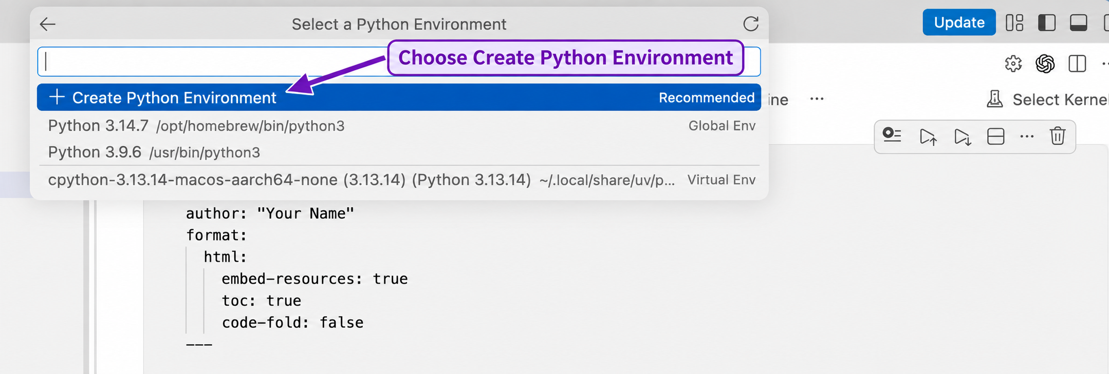
STAT 303-1 / CHAPTER 2
Create .venv from the notebook
Select Kernel → Python Environments → Create Python Environment
Choose Venv, then the working Python installation from Chapter 1.
Weinberg College of Arts and Sciences
2.6 · GUI METHOD
08
Notes:
Use a built-in venv environment for this course. venv is the module; .venv is the conventional folder name. Keep notebooks and data outside it. Select Create Python Environment, Venv, and the working Python used in Chapter 1. If menus differ, use Python: Create Environment in the Command Palette. If .venv already exists, select and verify it instead of creating another. Accept ipykernel installation for the selected environment if prompted. Image: chapter Figure 2.4.
Source: Chapter 2, method-1-create-.venv-from-the-notebook-kernel-picker
/Users/lizhenshi/mydev/nu-stat303-1-sec20-coursebook-clean/docs/python_venv.html#method-1-create-.venv-from-the-notebook-kernel-picker
Coursebook: https://lizhen0909.github.io/nu-stat303-1-sec20-coursebook-clean/python_venv.html#method-1-create-.venv-from-the-notebook-kernel-picker

Slide 9
STAT 303-1 / CHAPTER 2
Or create .venv in the terminal
START IN stat303-setup
python -c "import sys; print(sys.executable)"
python -m venv .venv
Then select the new .venv in the notebook kernel picker.
macOS: use python3 in both commands if python is unavailable.
Weinberg College of Arts and Sciences
2.6 · TERMINAL METHOD
09
Notes:
Use one creation method. Start in stat303-setup. The first command prints the interpreter path. -m venv runs Python’s environment-creation module. Creation does not download a different Python version or install the course packages. On macOS use python3 for both commands if python is unavailable. Afterward select this environment in the notebook kernel picker.
Source: Chapter 2, method-2-create-.venv-in-the-terminal
/Users/lizhenshi/mydev/nu-stat303-1-sec20-coursebook-clean/docs/python_venv.html#method-2-create-.venv-in-the-terminal
Coursebook: https://lizhen0909.github.io/nu-stat303-1-sec20-coursebook-clean/python_venv.html#method-2-create-.venv-in-the-terminal

Slide 10
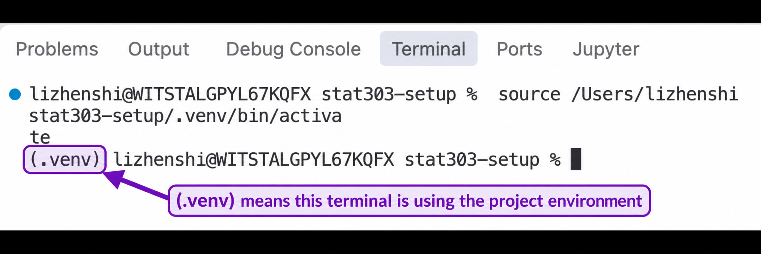
STAT 303-1 / CHAPTER 2
Activate the terminal environment
Shell | Activation command
macOS: zsh / Bash | source .venv/bin/activate
Windows PowerShell | .\.venv\Scripts\Activate.ps1
Windows Command Prompt | .venv\Scripts\activate.bat
Weinberg College of Arts and Sciences
2.6
10
Notes:
Select the project using Python: Select Interpreter, then open a new terminal. Automatic activation may occur; these are the manual commands if needed. The (.venv) marker is helpful, but compare full executable paths before installing. Notebook kernel selection is separate. Image: chapter Figure 2.5.
Source: Chapter 2, restart-the-terminal-and-verify-both-places
/Users/lizhenshi/mydev/nu-stat303-1-sec20-coursebook-clean/docs/python_venv.html#restart-the-terminal-and-verify-both-places
Coursebook: https://lizhen0909.github.io/nu-stat303-1-sec20-coursebook-clean/python_venv.html#restart-the-terminal-and-verify-both-places

Slide 11
STAT 303-1 / CHAPTER 2
Verify Python in both places
TERMINAL
python -c "import sys; print(sys.executable)"
NOTEBOOK CODE CELL
import sys
print(sys.executable)
The same project.
The same .venv.
Weinberg College of Arts and Sciences
2.6
11
Notes:
Both paths should point into the same project’s .venv. macOS usually ends in .venv/bin/python and Windows in .venv\Scripts\python.exe. Two separate projects may both name their environment .venv: compare the entire project portion. Correct activation or kernel selection and repeat when they differ.
Source: Chapter 2, restart-the-terminal-and-verify-both-places
/Users/lizhenshi/mydev/nu-stat303-1-sec20-coursebook-clean/docs/python_venv.html#restart-the-terminal-and-verify-both-places
Coursebook: https://lizhen0909.github.io/nu-stat303-1-sec20-coursebook-clean/python_venv.html#restart-the-terminal-and-verify-both-places

Slide 12
STAT 303-1 / CHAPTER 2
Check: the same Python environment?
TERMINAL
/Users/student/stat303-setup/.venv/bin/python
NOTEBOOK
/Users/student/other-project/.venv/bin/python
What would you change before installing packages?
Weinberg College of Arts and Sciences
DISCUSS · 60 SECONDS
12
Notes:
Answer: No. Both end in .venv/bin/python, but the project folders differ. Select stat303-setup/.venv in the notebook kernel picker, then repeat the executable check. This is an illustrative macOS example. Do not install packages until the intended environment is verified.
Source: Chapter 2, restart-the-terminal-and-verify-both-places
/Users/lizhenshi/mydev/nu-stat303-1-sec20-coursebook-clean/docs/python_venv.html#restart-the-terminal-and-verify-both-places
Coursebook: https://lizhen0909.github.io/nu-stat303-1-sec20-coursebook-clean/python_venv.html#restart-the-terminal-and-verify-both-places

Slide 13
STAT 303-1 / CHAPTER 2
Install packages in the intended environment
TERMINAL · VERIFIED .venv
pip install ipykernel numpy pandas matplotlib
NOTEBOOK · SELECTED .venv KERNEL
%pip install seaborn
Installation puts packages in the environment.
Weinberg College of Arts and Sciences
2.7
13
Notes:
After activation and full interpreter verification, use the terminal to install the four listed packages. Then use %pip in a notebook code cell to install Seaborn into that kernel’s environment. Restart if prompted. ipykernel supports notebook execution; NumPy supplies numerical tools, Pandas table tools, Matplotlib plotting, and Seaborn statistical graphics. A Requirement already satisfied response is not an error. Pip may also install dependencies.
Source: Chapter 2, install-packages-in-the-intended-environment
/Users/lizhenshi/mydev/nu-stat303-1-sec20-coursebook-clean/docs/python_venv.html#install-packages-in-the-intended-environment
Coursebook: https://lizhen0909.github.io/nu-stat303-1-sec20-coursebook-clean/python_venv.html#install-packages-in-the-intended-environment

Slide 14
STAT 303-1 / CHAPTER 2
Install once; import in each notebook
import numpy as np
import pandas as pd
import matplotlib
import seaborn as sns
print(np.__version__)
print(pd.__version__)
print(matplotlib.__version__)
print(sns.__version__)
ON DISK
.venv and packages remain.
IN THE KERNEL SESSION
Rerun imports after restarting.
Weinberg College of Arts and Sciences
2.7
14
Notes:
Installation persists on disk after closing the notebook. Imports and variables belong to the running kernel and must be restored after a restart. as creates a shorter name. __version__ has two underscores on both sides. If imports fail after installation, compare executable paths before reinstalling. If paths match, inspect the package name, installation result, and whether a kernel restart is needed.
Source: Chapter 2, install-once-import-in-every-notebook
/Users/lizhenshi/mydev/nu-stat303-1-sec20-coursebook-clean/docs/python_venv.html#install-once-import-in-every-notebook
Coursebook: https://lizhen0909.github.io/nu-stat303-1-sec20-coursebook-clean/python_venv.html#install-once-import-in-every-notebook

Slide 15
STAT 303-1 / CHAPTER 2
Record installed packages
macOS / WINDOWS COMMAND PROMPT
python -m pip freeze > requirements.txt
WINDOWS POWERSHELL
python -m pip freeze | Out-File -Encoding utf8 requirements.txt
Open requirements.txt and check the entries. Share the Python version too.
Weinberg College of Arts and Sciences
2.8
15
Notes:
Run after installing and checking all course tools, including Seaborn. Confirm the terminal folder and Python first. These commands replace requirements.txt if it exists. > writes output to a file. PowerShell uses an explicit UTF-8 encoding to avoid Windows PowerShell 5.1 defaults. Open and inspect the result. Entries include dependencies, so expect more packages than directly installed.
Source: Chapter 2, save-the-package-record
/Users/lizhenshi/mydev/nu-stat303-1-sec20-coursebook-clean/docs/python_venv.html#save-the-package-record
Coursebook: https://lizhen0909.github.io/nu-stat303-1-sec20-coursebook-clean/python_venv.html#save-the-package-record

Slide 16
STAT 303-1 / CHAPTER 2
Recreate the environment from its record
01
Create and activate a new .venv
Use an installed, compatible Python version.
02
Install the recorded requirements
Run from the folder containing requirements.txt.
python -m pip install -r requirements.txt
Select the new kernel and repeat the import checks.
Weinberg College of Arts and Sciences
2.8
16
Notes:
Create a new environment on the destination computer using a compatible installed Python; activate it and verify the executable. Then run the command in the folder containing requirements.txt. -r reads requirements from the file. Choose the recreated environment as the notebook kernel and test imports. Do not copy .venv between computers. Package version matching helps reproducibility, but Python and OS compatibility still matter. Ask: Does freeze install anything? Answer: No; it reports installed packages.
Source: Chapter 2, use-the-record-in-a-new-environment
/Users/lizhenshi/mydev/nu-stat303-1-sec20-coursebook-clean/docs/python_venv.html#use-the-record-in-a-new-environment
Coursebook: https://lizhen0909.github.io/nu-stat303-1-sec20-coursebook-clean/python_venv.html#use-the-record-in-a-new-environment

Slide 17
STAT 303-1 / CHAPTER 2
Absolute and relative paths
ABSOLUTE · STARTS AT THE FILESYSTEM ROOT
/Users/student/stat303-setup/data/station_readings.csv
RELATIVE · STARTS AT THE CURRENT WORKING DIRECTORY
data/station_readings.csv
The relative example expects the current folder to be stat303-setup.
Weinberg College of Arts and Sciences
2.9
17
Notes:
An absolute path starts at the filesystem root with the drive on Windows. These examples are illustrative user paths. A relative path is interpreted from the actual current working directory of the process using it. Forward slashes alone do not make an absolute path portable. Windows absolute example: C:/Users/student/stat303-setup/data/station_readings.csv.
Source: Chapter 2, find-local-data-with-paths
/Users/lizhenshi/mydev/nu-stat303-1-sec20-coursebook-clean/docs/python_venv.html#find-local-data-with-paths
Coursebook: https://lizhen0909.github.io/nu-stat303-1-sec20-coursebook-clean/python_venv.html#find-local-data-with-paths

Slide 18
STAT 303-1 / CHAPTER 2
Build a path, then check the file
from pathlib import Path
print(Path.cwd())
data_path = Path("data") / "station_readings.csv"
print("Resolved path:", data_path.resolve())
print("File found:", data_path.is_file())
resolve() shows the location. is_file() checks for a file.
Weinberg College of Arts and Sciences
2.9
18
Notes:
Path comes from Python’s built-in pathlib module; no package installation is needed. The / operator joins folder and file names and handles platform separators. Path.cwd() checks the notebook’s current directory. resolve() produces an absolute path without proving the file exists. is_file() specifically checks for a file. Keep the notebook’s working folder at stat303-setup for this kit.
Source: Chapter 2, find-local-data-with-paths
/Users/lizhenshi/mydev/nu-stat303-1-sec20-coursebook-clean/docs/python_venv.html#find-local-data-with-paths
Coursebook: https://lizhen0909.github.io/nu-stat303-1-sec20-coursebook-clean/python_venv.html#find-local-data-with-paths

Slide 19
STAT 303-1 / CHAPTER 2
Preview the supplied CSV
NOTEBOOK CODE CELL
print(data_path.read_text(encoding="utf-8").splitlines()[:3])
EXPECTED OUTPUT FOR THIS FILE
['station_id,temperature_c', 'S01,18', 'S02,20']
These are text lines. A later chapter will load tables with Pandas.
Weinberg College of Arts and Sciences
2.9
19
Notes:
Proceed only after the real file check returns True. read_text reads this small supplied file as UTF-8; splitlines separates lines; [:3] selects the first three. It reads the text file before slicing. The result is a list of strings, not a Pandas table. The displayed output was checked against the supplied station_readings.csv.
Source: Chapter 2, find-local-data-with-paths
/Users/lizhenshi/mydev/nu-stat303-1-sec20-coursebook-clean/docs/python_venv.html#find-local-data-with-paths
Coursebook: https://lizhen0909.github.io/nu-stat303-1-sec20-coursebook-clean/python_venv.html#find-local-data-with-paths

Slide 20
STAT 303-1 / CHAPTER 2
A different working directory changes the path
example-project/
├── notebooks/
│ └── analysis.ipynb
└── data/
└── station_readings.csv
If the current directory is
example-project/notebooks,
go up one level first.
Path("..") / "data" / "station_readings.csv"
Weinberg College of Arts and Sciences
2.9.1
20
Notes:
This is a hypothetical project, not a request to move files or create a notebooks folder in the practice kit. Assume the notebook actually runs from example-project/notebooks. Its sibling data directory requires going up one level. The path depends on actual cwd, not merely where a file is saved. Do not repeatedly add .. until something works.
Source: Chapter 2, what-changes-when-the-working-directory-changes
/Users/lizhenshi/mydev/nu-stat303-1-sec20-coursebook-clean/docs/python_venv.html#what-changes-when-the-working-directory-changes
Coursebook: https://lizhen0909.github.io/nu-stat303-1-sec20-coursebook-clean/python_venv.html#what-changes-when-the-working-directory-changes

Slide 21
STAT 303-1 / CHAPTER 2
Check: the terminal moved into data
The notebook’s current directory is stat303-setup.
In the terminal, you run cd data.
PREDICT BEFORE RUNNING
# In the notebook
print(Path.cwd())
Will the notebook’s
current folder change?
Weinberg College of Arts and Sciences
DISCUSS · 60 SECONDS
21
Notes:
Answer: The notebook remains in stat303-setup. cd affects that terminal, not an already running notebook. In the notebook, Path("data") / "station_readings.csv" still refers to the intended file under the stated assumptions. Verify with Path.cwd() rather than assuming. Optional detail: notebook %cd changes that kernel session’s cwd; !cd generally runs in a temporary shell and does not persist.
Source: Chapter 2, what-changes-when-the-working-directory-changes
/Users/lizhenshi/mydev/nu-stat303-1-sec20-coursebook-clean/docs/python_venv.html#what-changes-when-the-working-directory-changes
Coursebook: https://lizhen0909.github.io/nu-stat303-1-sec20-coursebook-clean/python_venv.html#what-changes-when-the-working-directory-changes

Slide 22
STAT 303-1 / CHAPTER 2
When is_file() returns False
01
Check the current directory
Read Path.cwd() and the resolved path.
02
Check the name and layout
Confirm capitalization, extraction, and the data folder.
03
Correct the path using the folder relationship
Keep a separate wrong_path for the deliberate failure test.
Weinberg College of Arts and Sciences
2.9
22
Notes:
Check the printed current directory, resolved location, exact filename and capitalization, and extracted layout. A Path expression only describes a location; resolve does not search for misplaced files. exists can also be true for a folder, so is_file is the relevant check. In the activity, use a separate wrong_path to demonstrate False; do not alter supplied data.
Source: Chapter 2, find-local-data-with-paths
/Users/lizhenshi/mydev/nu-stat303-1-sec20-coursebook-clean/docs/python_venv.html#find-local-data-with-paths
Coursebook: https://lizhen0909.github.io/nu-stat303-1-sec20-coursebook-clean/python_venv.html#find-local-data-with-paths

Slide 23
STAT 303-1 / CHAPTER 2
When you return to the project
01
Open stat303-setup
Select its .venv as the notebook kernel.
02
Check the terminal
Confirm the folder and activate .venv if needed.
03
Run the notebook from the top
Restore imports and variables; repeat the data-path check.
Weinberg College of Arts and Sciences
RESUME WORK
23
Notes:
Creating the environment and installing packages are setup steps, not daily steps. Reopen the same project and select the intended environment. Check terminal activation and cwd. Restarting only the kernel clears imports and variables but leaves files and packages on disk.
Source: Chapter 2, when-you-return-to-the-project
/Users/lizhenshi/mydev/nu-stat303-1-sec20-coursebook-clean/docs/python_venv.html#when-you-return-to-the-project
Coursebook: https://lizhen0909.github.io/nu-stat303-1-sec20-coursebook-clean/python_venv.html#when-you-return-to-the-project

Slide 24
STAT 303-1 / CHAPTER 2
Activity 2: collect the evidence
Part | Evidence to retain in activity02.ipynb
A · Tools and starting folder | Name, shell, explanation, terminal folder and file listing
B · Environment and packages | Matching executable paths; installation and version checks
C · Locations | Terminal navigation beside notebook directory checks
D · Data paths | Predictions, resolved path, True / False checks, CSV preview
E · Dependencies | Export command, two package entries, fresh-run note
Keep explanations in Markdown and label copied terminal output.
Weinberg College of Arts and Sciences
2.10
24
Notes:
The chapter is the authoritative source for complete instructions. A: name in Raw and Markdown cells, terminal shell, explanation of terminal/environment roles, current folder and listing. B: create/verify .venv, record three checks, terminal installs plus temporary %pip seaborn cell, remove installation cell afterward and record command in Markdown, include NumPy/version and full executable checks. C: change terminal directory while observing unchanged notebook cwd, then return. D: predict real and wrong file checks, retain resolved path and first three CSV lines, explain relative base. E: export requirements, include two actual package/version entries, restart/run all/save and record completion.
Source: Chapter 2, practice-activity-find-your-python-and-your-data
/Users/lizhenshi/mydev/nu-stat303-1-sec20-coursebook-clean/docs/python_venv.html#practice-activity-find-your-python-and-your-data
Coursebook: https://lizhen0909.github.io/nu-stat303-1-sec20-coursebook-clean/python_venv.html#practice-activity-find-your-python-and-your-data

Slide 25
STAT 303-1 / CHAPTER 2
Render, inspect, and submit activity02.html
Restart kernel → Run all cells → Save
quarto render activity02.ipynb --to html
Inspect the HTML and a copy opened outside the project folder.
SUBMIT THE HTML IN THE CHAPTER 2 CANVAS QUIZ
Weinberg College of Arts and Sciences
2.10
25
Notes:
Restart the kernel, run all cells from top to bottom, resolve unexpected errors, and save. Render from stat303-setup. Inspect the HTML and a copy outside the project for name, explanations, code, and current outputs. Submit only activity02.html through the final file-upload question in the Chapter 2 Canvas quiz. Retain notebooks, data, and requirements locally; do not upload .venv. Grading: tools/context 2, environment/packages 4, navigation 3, paths 3, dependencies 2, readable HTML 2 = 16 points. Assignment B is separate, with its own kit and 100-point Canvas assignment.
Source: Chapter 2, make-the-html-for-submission
/Users/lizhenshi/mydev/nu-stat303-1-sec20-coursebook-clean/docs/python_venv.html#make-the-html-for-submission
Coursebook: https://lizhen0909.github.io/nu-stat303-1-sec20-coursebook-clean/python_venv.html#make-the-html-for-submission

Slide 26
Before the next command
Where am I typing?
Which Python am I using?
Which folder is current?
Next: Assignment B — Setting Up a Reproducible Python Project
Notes:
Ask students to name one check for each question. Answers: identify shell versus notebook cell; compare sys.executable; check cwd using notebook Path.cwd() and the appropriate shell command. Proceed to Assignment B after the two chapter activities. Assignment B uses a separate kit and separate Canvas submission.
Source: Chapter 2, next-assignment-b
/Users/lizhenshi/mydev/nu-stat303-1-sec20-coursebook-clean/docs/python_venv.html#next-assignment-b
Coursebook: https://lizhen0909.github.io/nu-stat303-1-sec20-coursebook-clean/python_venv.html#next-assignment-b

