Slide 1
Tshlab
Li Zhuo

Slide 2
Outline
Analyze
Fix Bug
Update
To-do List

Slide 3
Analyze

Slide 4
Work
Accomplish a tiny shell
eval()
signal handler
To become more familiar with process control and signaling

Slide 5
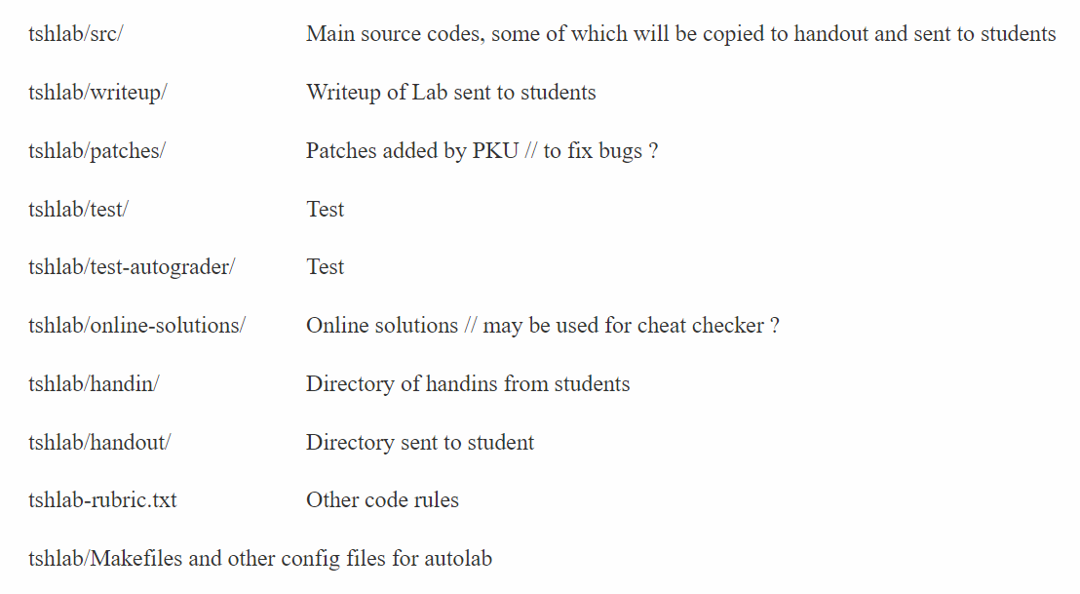
File hierarchy

Slide 6
Main part – tshlab/src
Driver program & traces to test tsh
sdriver.c
runtrace.c
trace*.txt
fork.c myspin.c myxx.c … helper routines

Slide 7
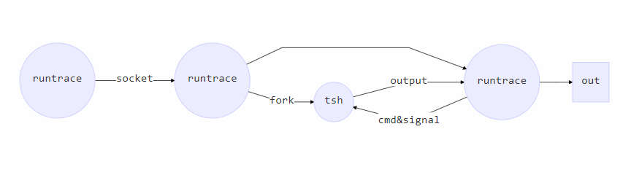
Runtrace

Slide 8
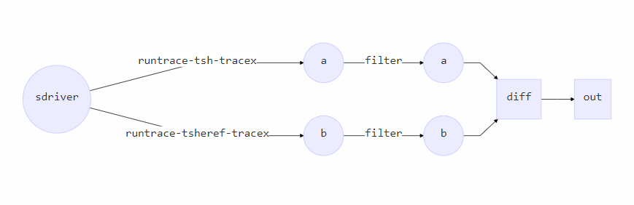
Sdriver

Slide 9
Bugs

Slide 10
File descriptor
重定向时，打开文件得到新的描述符 – builtin_cmd()
返回给eval()函数，使用后在eval()中关闭
Bug：只有非builtin_cmd时才修改fd

Slide 11
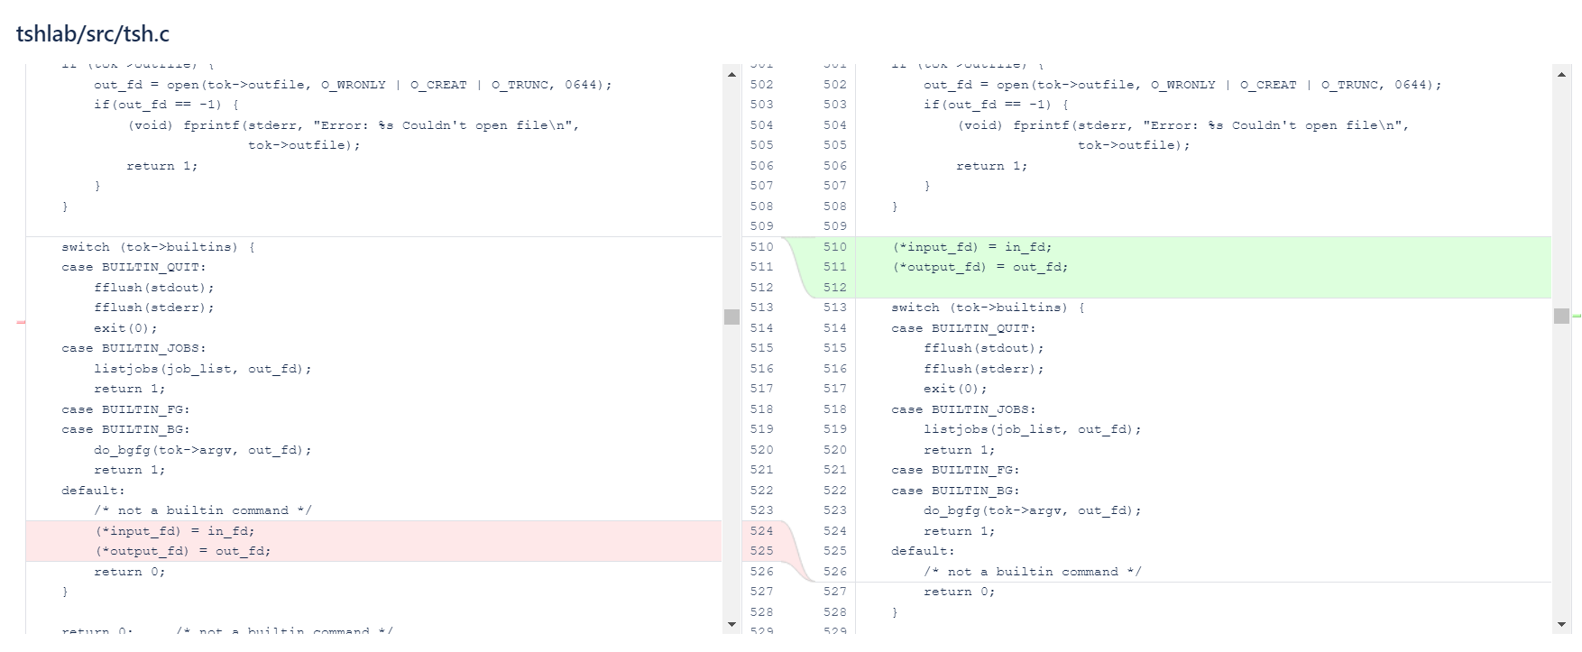
File descriptor

Slide 12
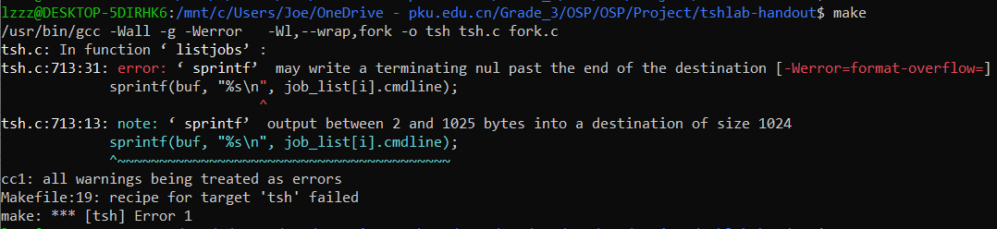
Gcc error
缓冲区太小
sprintf(buf, “%s\n”, cmdline);
char buf[MAXLINE + 1];

Slide 13
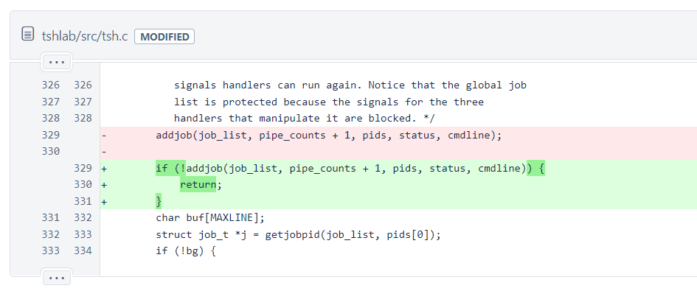
“Too many jobs”
当job数目大于MAXJOBS时
addjob失败，后续操作导致 segmentation fault
直接返回

Slide 14
pkill
trace10.txt: /usr/bin/pkill myspin1
kill所有用户的myspin1进程，operation not permitted
-u 参数指定用户 $USER
/usr/bin/pkill –u $USER myspin1
需要实现环境变量
Notes:
Implemented by cs

Slide 15
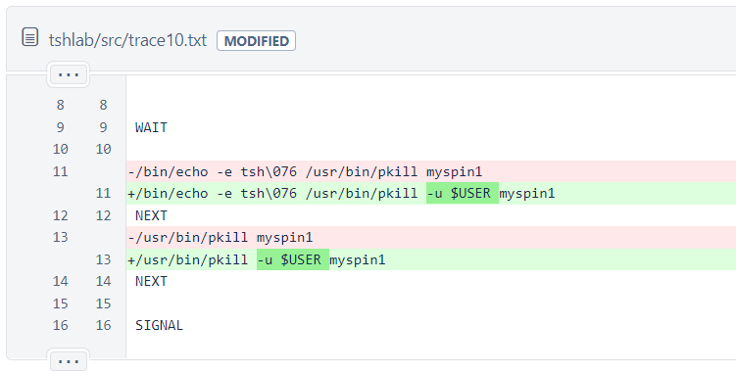
pkill

Slide 16
Updates

Slide 17
Pipes
pipe(int *fd[2])函数创建管道
管道的读写端在fd中
fork()子进程继承父进程的管道

Slide 18
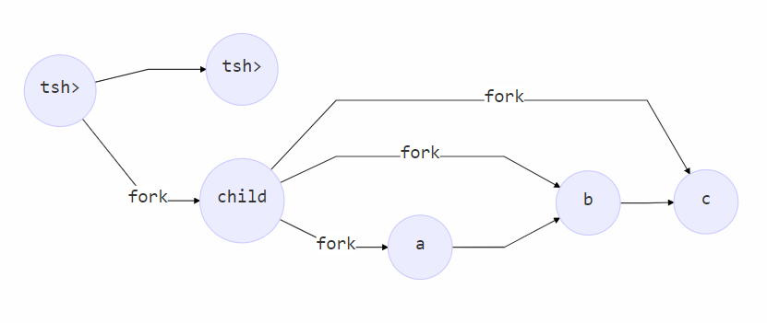
Pipes
Notes:
Deal_pipe()

Slide 19
Pipes -- problem
子进程由child产生
Tsh无法收到SIGCHLD
不能跟踪

Slide 20
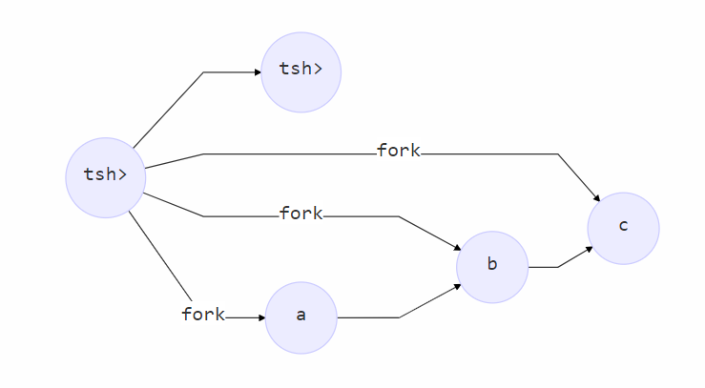
Pipes
所有的子进程都应该由Tsh创建
且a,b,c在不同于tsh的同一进程组
Notes:
略过细节

Slide 21
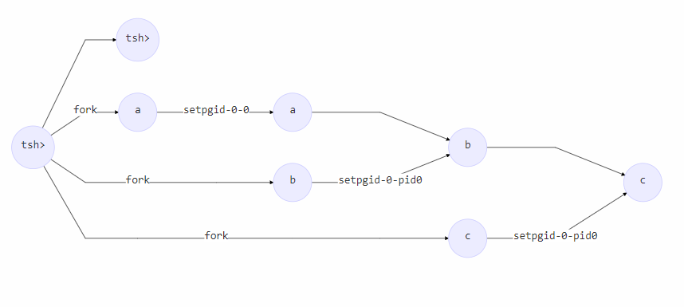
Pipes
所有的子进程都应该由Tsh创建
且a,b,c在不同于tsh的同一进程组

Slide 22
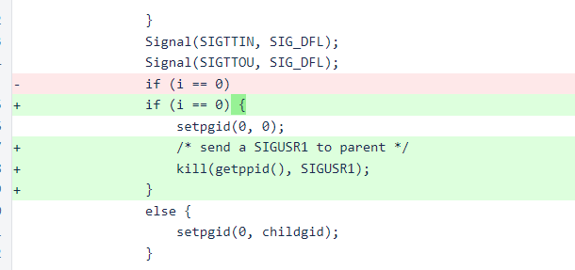
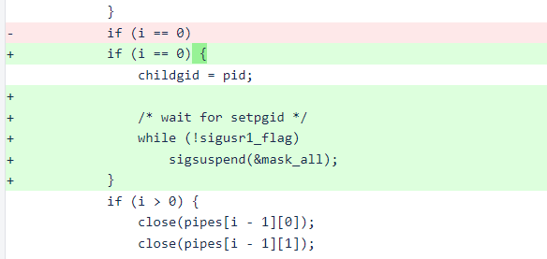
Pipes
Race – b,c调用setpgid必须在a之后
Add SIGUSR1 to synchronize

Slide 23
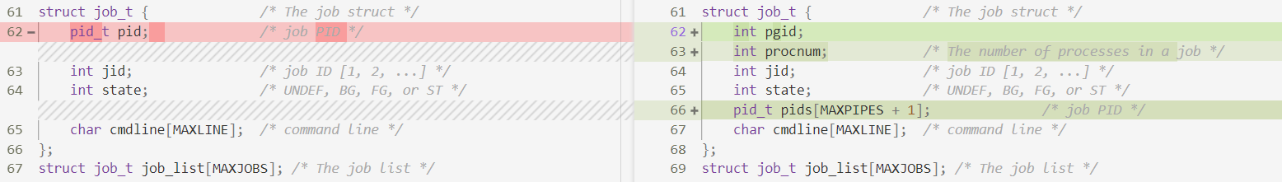
Job struct
修改Job结构和相关的处理

Slide 24
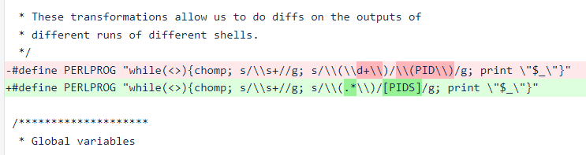
Sdriver
Sdriver比对输出，忽略(PID)
更改之后 – (PID, PID, PID…)
修改sdriver的正则表达式忽略括号中的内容

Slide 25
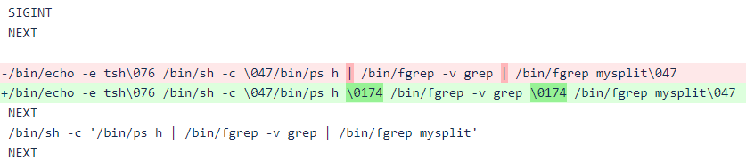
Traces
用\0174代替 |

Slide 26
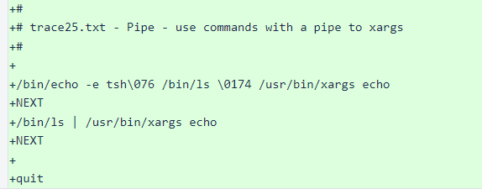
Traces
trace25.txt – Pipe – use commands with a pipe to xargs

Slide 27
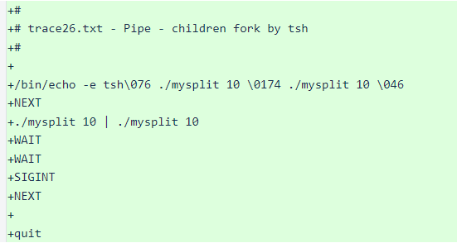
Traces
trace26.txt - Pipe - children fork by tsh

Slide 28
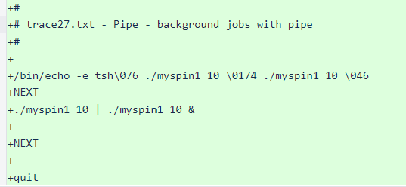
Traces
trace27.txt - Pipe - background jobs with pipe

Slide 29
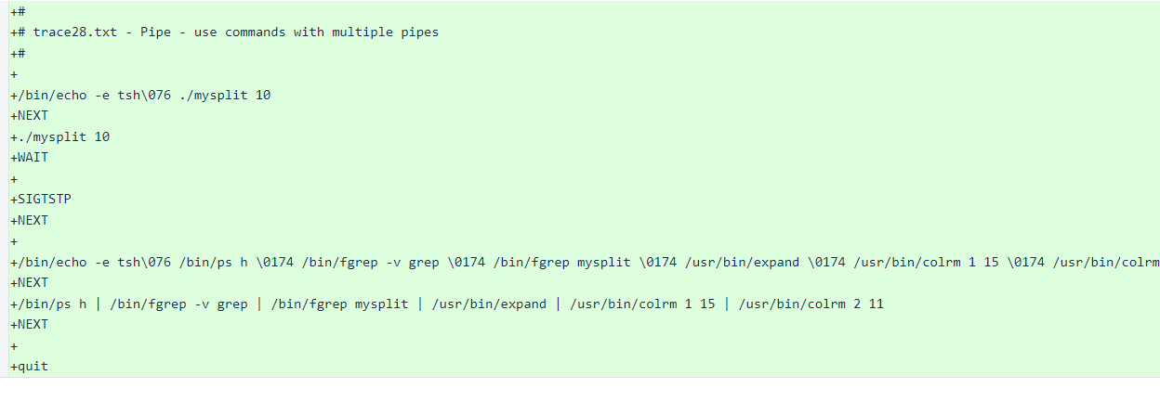
Traces
trace28.txt - Pipe - use commands with multiple pipes

Slide 30
Writeup
Update writeup

Slide 31
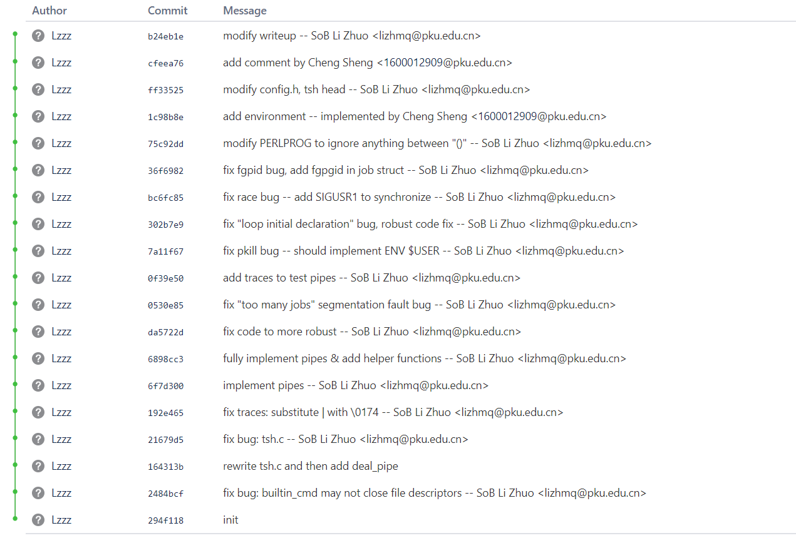

Slide 32
To-do List

Slide 33
Builtin-cmd & pipes
Current tsh doesn’t support this for simplicity.

Slide 34
Multi-processes control
Tsh wait for all processes in a job to terminate.
Send signals to all processes in a job.
Job的多个进程处于不同状态时，job的状态如何定义

Slide 35
Background job read/write
Raise SIGTTIN & SIGTTOUT

Slide 36
Evaluation
Evaluate by output

Slide 37
Thanks

