Slide 1

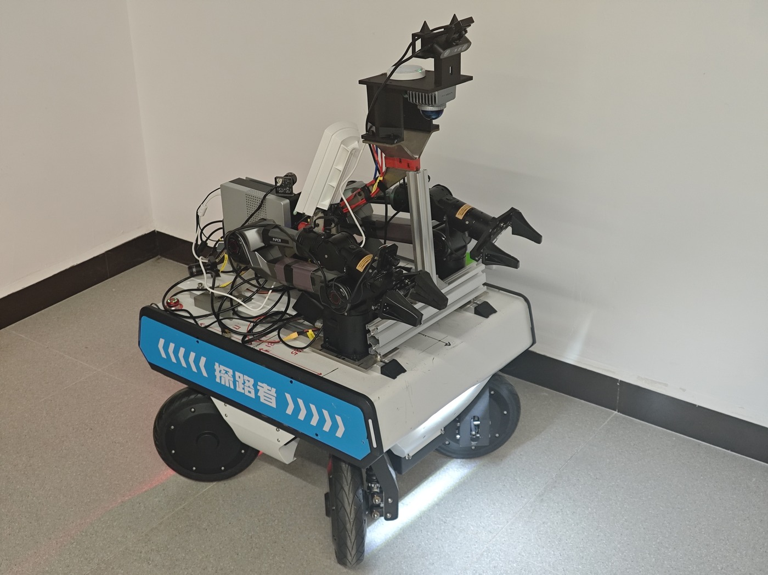

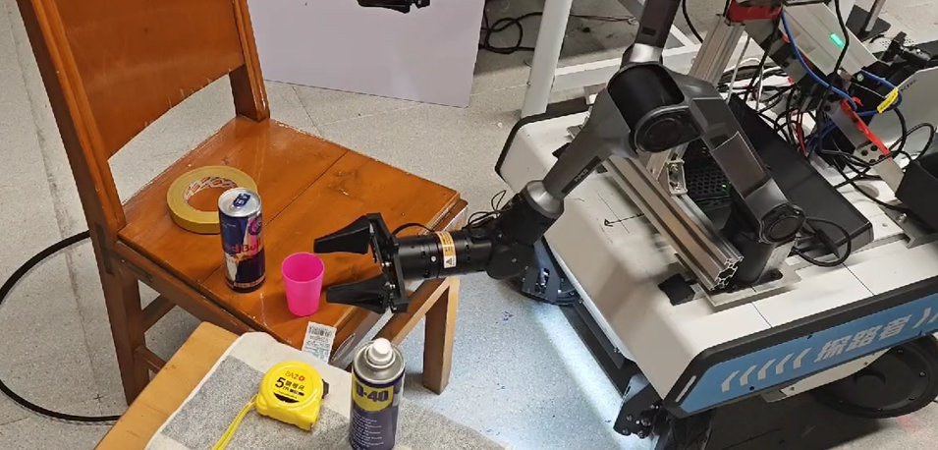
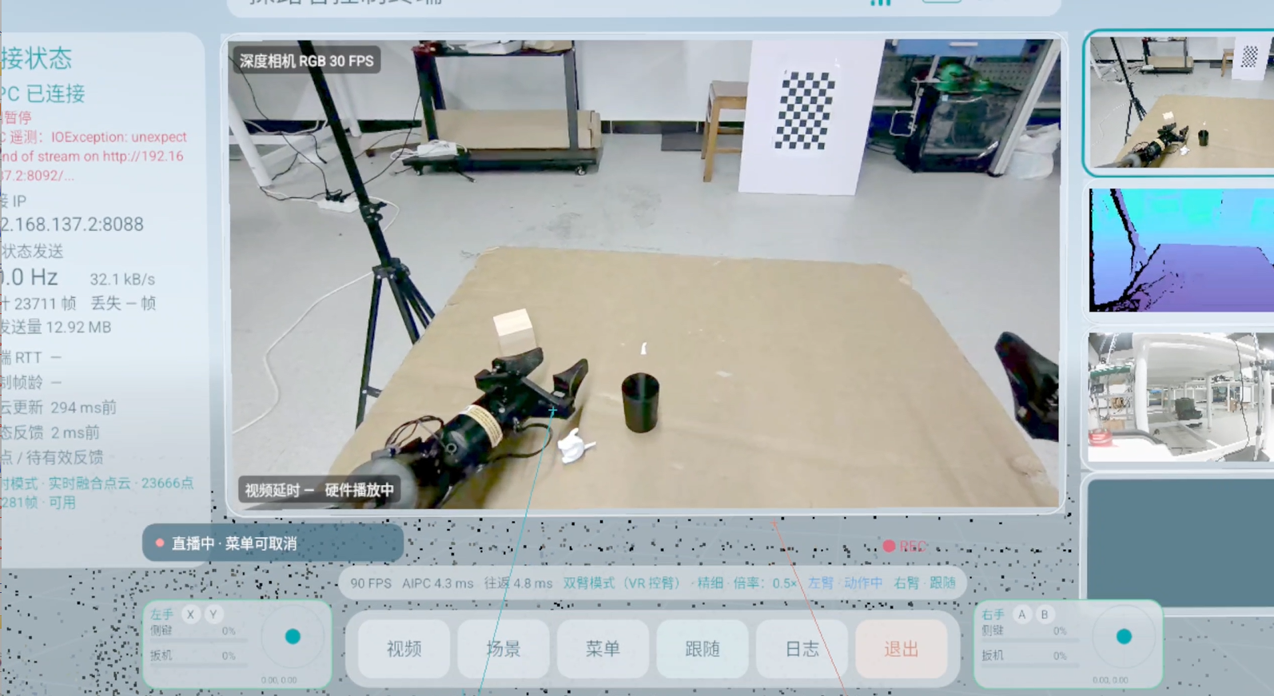
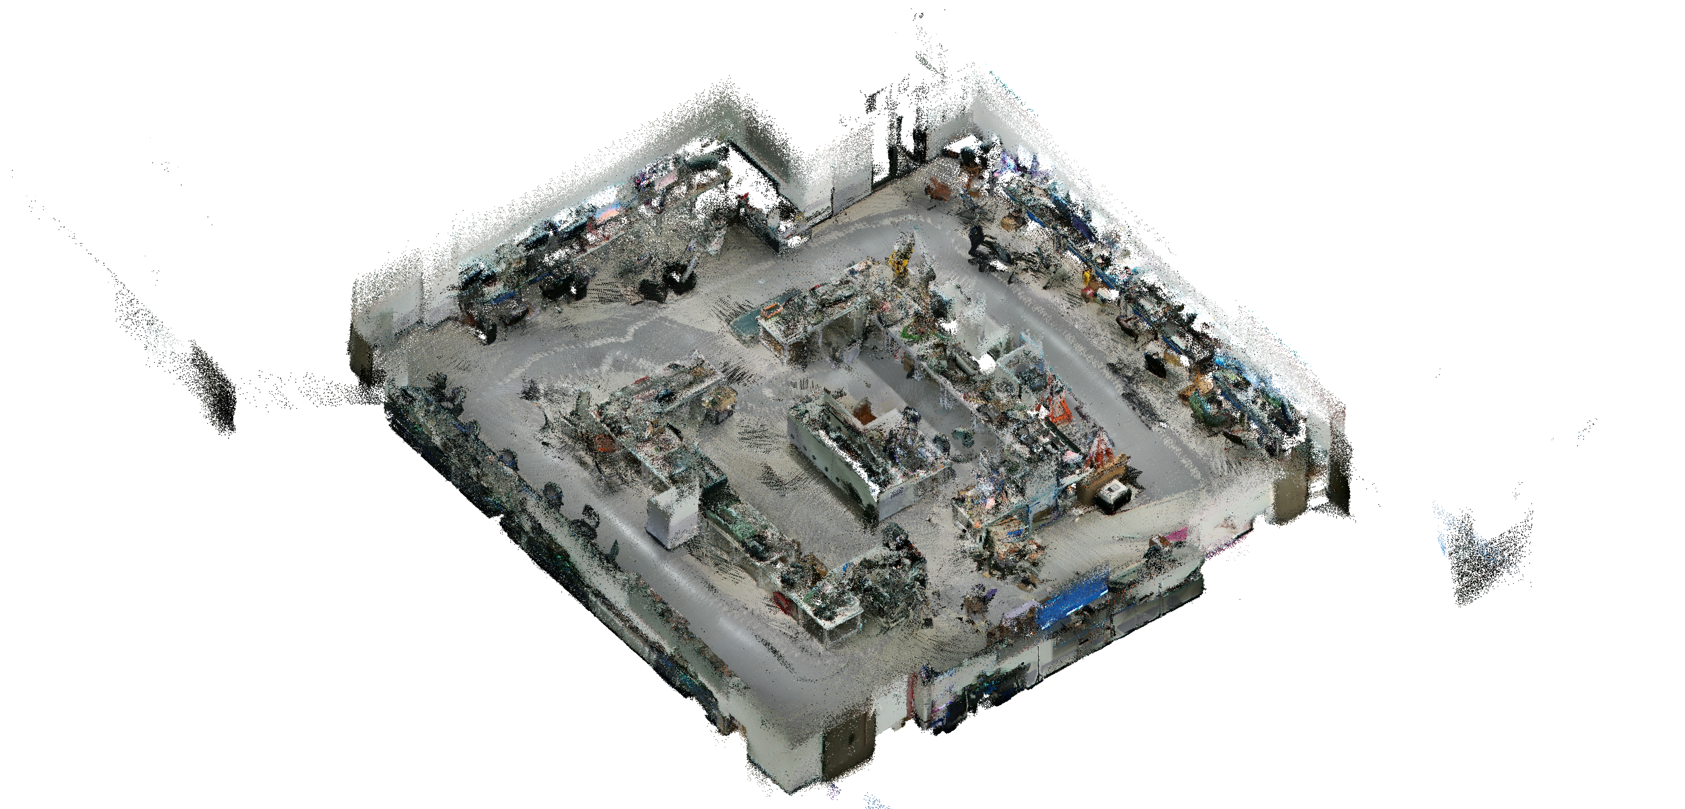

2026
成员：李子昂 丁成宸 周琨鹏
探路者：虚实融合数智具身平台
指导教师：周立青
VR 沉浸式遥操作 · VLA 任务规划与预检 · FAST-LIO2 建图导航
学校：武汉大学
01
项目简介
02
创新设计
03
结果与展望
PROJECT OVERVIEW
系统架构与共享执行底座
VR 控制采样至编码器反馈
面向远程人机协作与移动操作，将 VR 沉浸式遥操作、本地语言任务规划和雷达惯性建图集成于移动双臂机器人。
148.08 ms
P50 · N=54
Quest 3
相机与雷达
工作台
P95 175.46 ms · P99 191.81 ms
AMD Ryzen AI Max+ 395
语言抓取 · 限定工作区
92%
46 / 50
典型应用与场景反馈
VR 映射与 IK
千问 + YOLO
FAST-LIO2
导航地图 · 语义证据 · 全量／轻量场景
50 次完成 46 次
建图定位与导航执行
5.14 / 5.90 cm
离线 RMSE
KR260 · PS / PL
硬件队列 · CAN · 双以太网 · 反馈快照 · ILA
2 个留出扫描；导航 19 条：10 条到达，3 条人工停止
KR260 执行底座与 FPGA 实现
双六轴机械臂
四转四驱底盘
20 ms
PS 反馈周期
双路恢复后 3 s：9,120／9,130 条 CAN 帧
LUT 41.28% · 寄存器 31.79% · BRAM 89.24% · DSP 0%
遥操作抓取 · 多路视频 · 三维点云 · 本地大模型
AI PC 推理决策与任务调度
WNS +0.082 ns · DRC 错误 0
本地推理：千问与 YOLO 完成语言解析、目标定位及动作候选生成。
规划预检：轨迹生成、关节限位与碰撞检查，人工授权后下发。
感知调度：VR 映射、FAST-LIO2 建图导航与彩色点云异步协同。
彩色场景与计算
关键技术
全量 3994 万点，轻量 57.96 万点（5 cm）。
8 图像着色任务：ROCm 双进程相对 CPU 四进程加速 1.864×。
01
VR 沉浸式交互
双手离合增量映射、One Euro 滤波与分层解析 IK
TCP 通信
02
FAST-LIO2 点云建图
KR260 控制安全中枢
双向各 20.00 Mbit/s × 60 s，SHA-256 校验通过。
雷达惯性融合、几何定位与彩色／轻量场景生成
校验执行： PS/Linux 完成目标校验、限速插值、会话管理与软件停止。
硬件下发： PL 组织硬件命令队列、反馈快照及双路 CAN／以太网接口。
通路保护：通路切换、端口恢复与 ILA 在线观测支撑安全执行。
03
大模型语言任务
拓展：自主探索 · 长时 VR · 双臂协作 · 指令泛化
本地千问、YOLO 目标定位、轨迹预检与人工授权

Slide 2
2026
Members: Ziang Li · Chengchen Ding · Kunpeng Zhou
PathFinder: Embodied Intelligence Platform
Advisor: Liqing Zhou
Immersive VR Teleoperation · VLA Planning & Prechecks · FAST-LIO2 Mapping & Navigation
Institution: Wuhan University
01
Project Overview
02
System & Innovation
03
Results & Outlook
For remote human–robot collaboration and mobile manipulation, PathFinder integrates immersive VR teleoperation, on-device language task planning, and LiDAR-inertial mapping on a mobile dual-arm robot.
System Architecture & Shared Execution Platform
VR Command Sample to Encoder Feedback
148.08 ms
P50 · N=54
Quest 3
Camera & LiDAR
Workstation
P95 175.46 ms · P99 191.81 ms
AMD Ryzen AI Max+ 395
Language-guided Grasping · Bounded Workspace
92%
46 / 50
Applications & Scene Feedback
VR Mapping & IK
Qwen + YOLO
FAST-LIO2
Navigation Maps · Semantic Evidence · Full / Lightweight Scenes
46 successful grasps out of 50 trials
Mapping, Localization & Navigation
5.14 / 5.90 cm
Offline RMSE
KR260 · PS / PL
Hardware Queues · CAN · Dual Ethernet · Feedback Snapshots · ILA
2 held-out scans; 19 navigation runs: 10 arrivals, 3 manual stops
KR260 Execution Platform & FPGA Implementation
Dual 6-axis Arms
4-wheel Steer & Drive Base
20 ms
PS Feedback Cycle
3 s after dual-path recovery: 9,120 / 9,130 CAN frames
LUT 41.28% · FF 31.79% · BRAM 89.24% · DSP 0%
Teleoperated Grasping · Multi-view Video ·
3D Point Cloud · On-device AI
AI PC Inference, Decision-making & Task Orchestration
WNS +0.082 ns · 0 DRC Errors
On-device inference: Qwen and YOLO parse commands, localize targets and generate action candidates.
Planning prechecks: Trajectory generation, joint-limit and collision checks before human-authorized dispatch.
Perception scheduling: Asynchronous VR mapping, FAST-LIO2 navigation and point-cloud colorization.
Colorized Scenes & Computing
Key Technologies
Full scene: 39.94M points; lightweight: 579.6k points (5 cm).
8 colorization tasks: dual-process ROCm is 1.864× faster than quad-process CPU.
01
Immersive VR Interaction
Bimanual clutch-based incremental mapping, One Euro filtering & hierarchical analytic IK
TCP Communication
02
FAST-LIO2 Point-cloud Mapping
KR260 Safety-critical Control Hub
20.00 Mbit/s each way for 60 s; SHA-256 verification passed.
LiDAR-inertial fusion, geometric localization, colorized & lightweight scenes
Validated execution: PS/Linux validates targets, interpolates with speed limits, and manages sessions and software stop.
Hardware dispatch: PL implements command queues, feedback snapshots, dual CAN and Ethernet interfaces.
Path protection: Path switching, port recovery and online ILA observation support safe execution.
Language-driven AI Tasks
Next: Autonomous Exploration · Extended VR ·
Dual-arm Collaboration · Instruction generalization
03
On-device Qwen, YOLO localization, trajectory prechecks & human authorization

