Slide 1







SpaceX Falcon 9 first landing prediction
Falko
27-09-2022

Slide 2



OUTLINE
Executive Summary
Introduction
Methodology
Results
Visualization – Charts
Dashboard
Discussion
Findings & Implications
Conclusion
Appendix

Slide 3

EXECUTIVE SUMMARY
In this project, we will predict if the Falcon 9 first stage will land successfully to determine the cost. This information can be used to bid against SpaceX for a rocket launch.
Data is collected from the SpaceX API and webscraping from Wikipedia. After data wrangling, cleaning, exploration and visualization, several classification models are build including:
Support Vector Machine
Logistic Regression
Decision Tree
KNN
All three models have an accuracy of 83.33% on unseen test data

Slide 4

INTRODUCTION
Background
We will predict if Falcon 9 first stage will land successfully. Thereby, we can determine the cost of a launch. An alternative company can use this information to bid against SpaceX for rocket launches.
Research question
What variables and conditions affect the successful landing of a rocket launch?

Slide 5

METHODOLOGY
Outline
Data collection
Data wrangling
Exploratory data analysis (EDA) with visualization and SQL
Interactive visualization in Folium and Plotly
Predictive analysis

Slide 6
Methodology: Data Collection
Getting data from SpaceX Rest API
GET request to REST API
Receiving data (JSON file)
Normalizing data for a CSV file
Cleaning data with functions
Creating a dataframe by coding a dictionary including all columns
Export to CSV file

Slide 7
Methodology: Data Collection
Web scraping Wikipedia
GET HTML Response object from Falcon Heavy Launches Records
Creating a ‘soup’ object using BeautifulSoup
Normalizing data (CSV file)
Assigning column header names from table
Parsing all tables in dictionaries
Creating a Pandas DataFrame from dictionary

Slide 8
Methodology: Data Wrangling
Data wrangling actions
Checking null values
Creating classes (0 = failure, 1 = successful) based on column which identifies whether and why rockets landed successfully
Calculating number of rocket launches on each site
Calculing the number and occurance of each orbit
Mission outcome per orbit type
Handling null values of dataframe

Slide 9
Methodology: Exploratory Data Analysis – Data Visualization
Different type of charts
Scatter charts
Flight_Number vs Launch_Site
Payload vs Launch_Site
Orbit vs Flight_Number
Payload vs Orbit
Bar chart
Success_Rate vs Orbit
Line chart
Success_Rate vs Year

Slide 10
Methodology: Exploratory Data Analysis – SQL Queries
SQL queries to answer following questions
Display the names of the unique launch sites in the space mission
Display 5 records where launch sites begin with the string 'CCA’
Display the total payload mass carried by boosters launched by NASA (CRS)
Display average payload mass carried by booster version F9 v1.1
List the date when the first succesful landing outcome in ground pad was acheived
List the names of the boosters which have success in drone ship and have payload mass greater than 4000 but less than 6000
List the total number of successful and failure mission outcomes
List the names of the booster_versions which have carried the maximum payload mass. Use a subquery
List the records which will display the month names, failure landing_outcomes in drone ship ,booster versions, launch_site for the months in year 2015
Rank the count of successful landing_outcomes between the date 04-06-2010 and 20-03-2017 in descending order

Slide 11
Methodology: Interactive Visualization - Folium
Interactive visualization actions using Folium
Taking the latitude and longitude coordinates
Adding a Circle Marker around all launch sites
Assigning launch_outcomes (success/failure) to classes
Calculating the distance from launch site to other landmarks

Slide 12
Methodology: Interactive Visualization – Plotly Dash
Different types of plots are created
Pie plot:
Showing the total launches by each site (+total)
Scatter plot:
Showing relatingship with outcome and payload mass

Slide 13
Methodology: Predictive analysis
First the data loaded, transformed and standardized
Then the data is split into training and test data
Training different classification models: Support Vector Machine, Classification Decision Tree, Logistic Regression
Each model is evaluated and improved by finding the best hyperparameters using GridSearchCV
The best performing classification model is identified and confusion matrices are plotted for each classification model
Finally, the accuracy of each classification model is calculated

Slide 14
Results
Outline
Exploratory data analysis
EDA with visualization
EDA with SQL
Interactive graphs
Folium
Plotly Dash
Predictive analysis

Slide 15
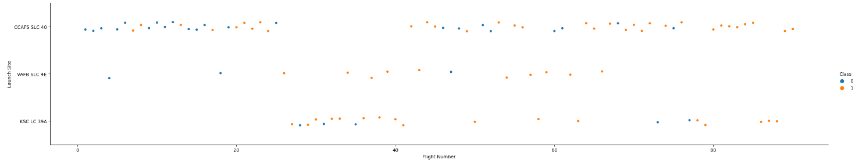
EDA with visualization: Flight number vs. Launch Site

Slide 16
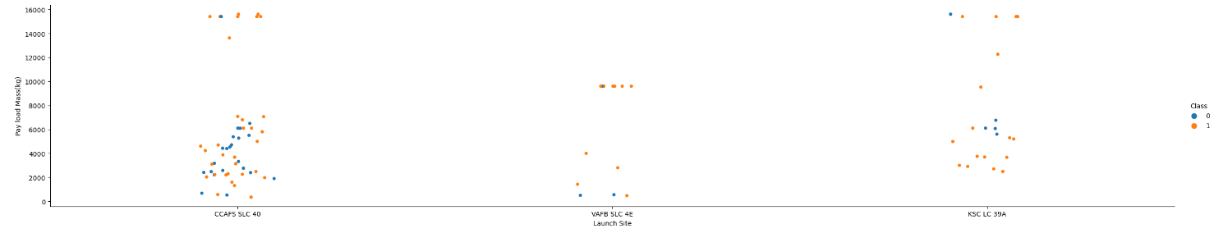
EDA with visualization: Payload vs Launch Site

Slide 17
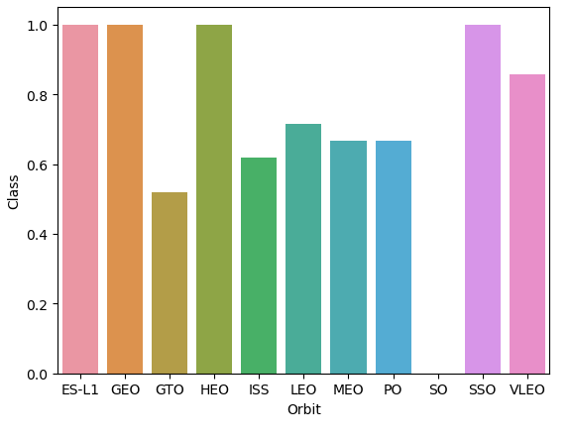
EDA with visualization: Success rate of each Orbit

Slide 18
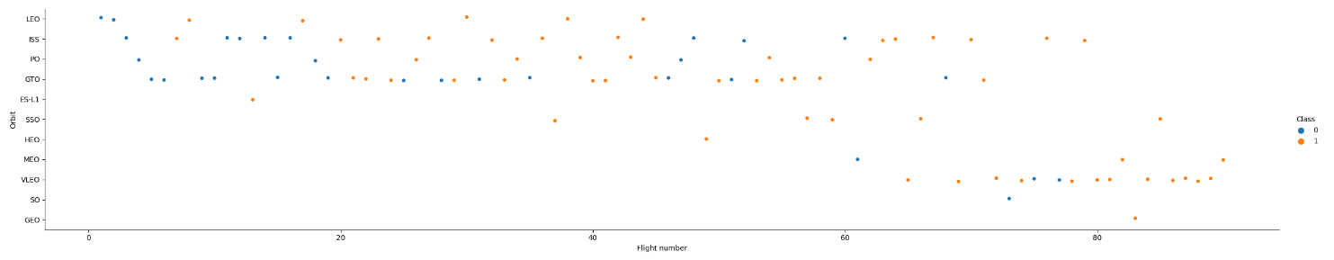
EDA with visualization: Flight number vs Orbit type

Slide 19
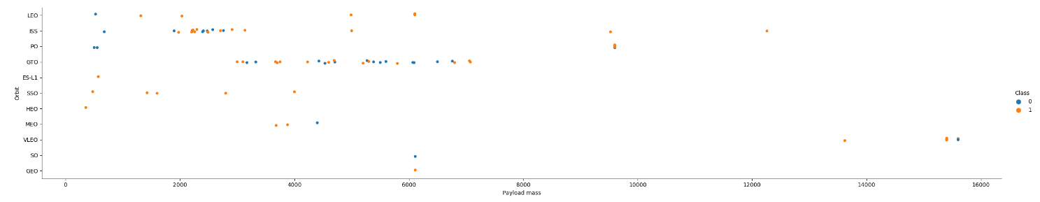
EDA with visualization: Payload vs Orbit type

Slide 20
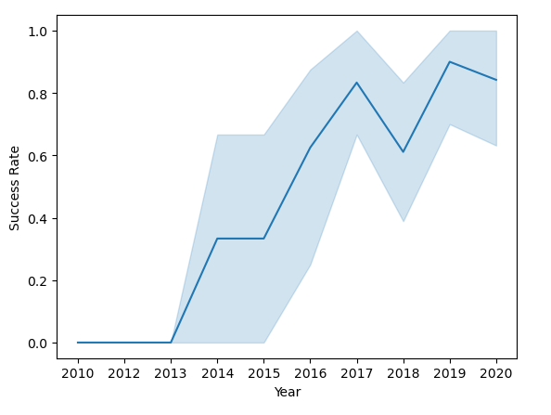
EDA with visualization: Yearly launch success rate

Slide 21
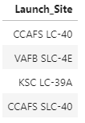
EDA with SQL: Launch site names
%sql SELECT DISTINCT(Launch_Site) FROM SPACEXTBL;

Slide 22
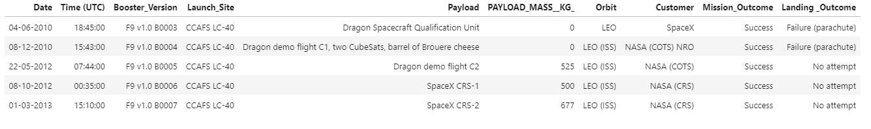
EDA with SQL: 5 launch sites beginning with ‘CCA’
%sql SELECT * FROM SPACEXTBL WHERE Launch_Site LIKE 'CCA%' LIMIT 5;

Slide 23


EDA with SQL: Total payload mass + Average payload mass
%sql SELECT SUM(PAYLOAD_MASS__KG_) AS TOTAL_PAYLOAD_MASS FROM SPACEXTBL WHERE CUSTOMER = 'NASA (CRS)';
%sql SELECT AVG(PAYLOAD_MASS__KG_) AS AVERAGE_PAYLOAD_MASS FROM SPACEXTBL WHERE BOOSTER_VERSION = 'F9 v1.1';

Slide 24

EDA with SQL: Date of first successful landing outcome in ground pad
%sql SELECT MIN(DATE) FROM SPACEXTBL WHERE [Landing _Outcome] = 'Success (ground pad)';

Slide 25
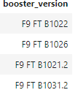
EDA with SQL: Names of boosters with success in drone ship and payload_mass between 4000 and 6000
%sql SELECT BOOSTER_VERSION FROM SPACEXTBL WHERE LANDING__OUTCOME = 'Success (drone ship)' AND PAYLOAD_MASS__KG_ > 4000 AND PAYLOAD_MASS__KG_ < 6000;

Slide 26

EDA with SQL:Total number of successful and failure missions
%sql SELECT COUNT(MISSION_OUTCOME) FROM SPACEXTBL WHERE MISSION_OUTCOME LIKE '%Success%' or MISSION_OUTCOME LIKE '%Failure%'

Slide 27
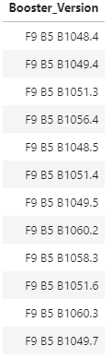
EDA with SQL: Booster versions which carried maximum payload mass
%sql SELECT DISTINCT(BOOSTER_VERSION) FROM SPACEXTBL WHERE PAYLOAD_MASS__KG_ = (SELECT MAX(PAYLOAD_MASS__KG_) FROM SPACEXTBL);

Slide 28

EDA with SQL: Month names, failure landing outcomes in drone ship, booster versions, launch site for months in 2015
%sql SELECT substr(Date, 4,2) as Month_names, [Landing _Outcome], Booster_Version FROM SPACEXTBL WHERE substr(Date, 7, 4) = '2015' AND [Landing _Outcome] = "Failure (drone ship)";

Slide 29
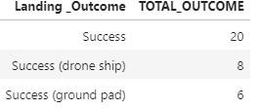
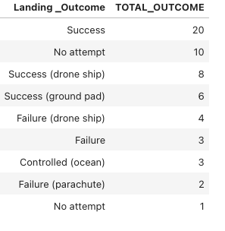
EDA with SQL: Count of successful landing_outcomes in desc order between 04-06-2010 and 20-03-2017
(only successful)
%%sql SELECT [Landing _Outcome], COUNT([Landing _Outcome]) AS TOTAL_OUTCOME FROM SPACEXTBL WHERE DATE BETWEEN '04-06-2010' and '20-03-2017'AND [Landing _Outcome] LIKE "%Success%"GROUP BY [Landing _Outcome] ORDER BY TOTAL_OUTCOME DESC;
All
%%sql SELECT [Landing _Outcome], COUNT([Landing _Outcome]) AS TOTAL_OUTCOME
FROM SPACEXTBL
WHERE DATE BETWEEN '04-06-2010' and '20-03-2017'
GROUP BY [Landing _Outcome]
ORDER BY TOTAL_OUTCOME DESC;

Slide 30
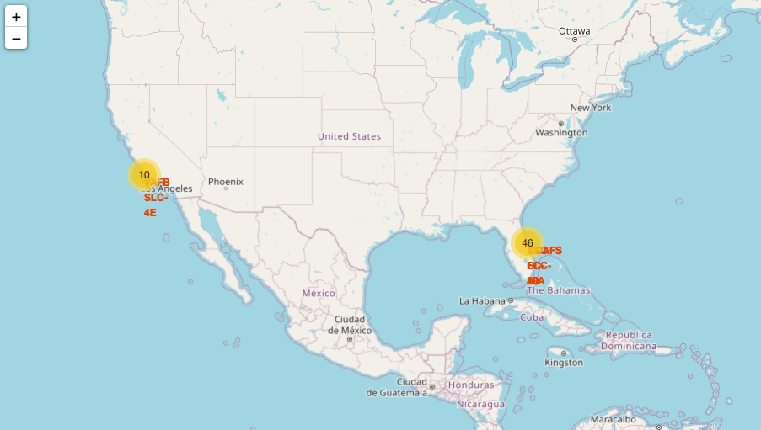
Folium: Launch sites locations

Slide 31
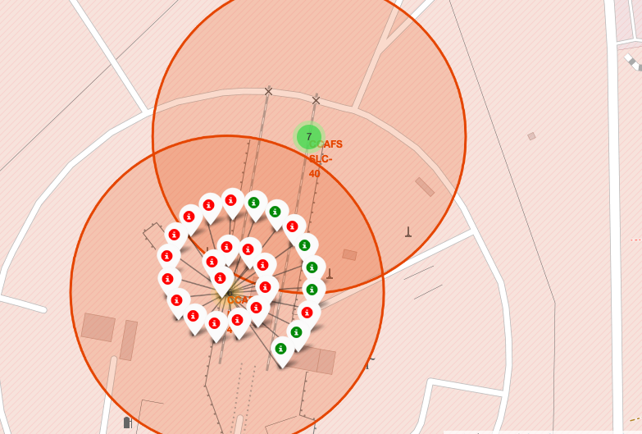
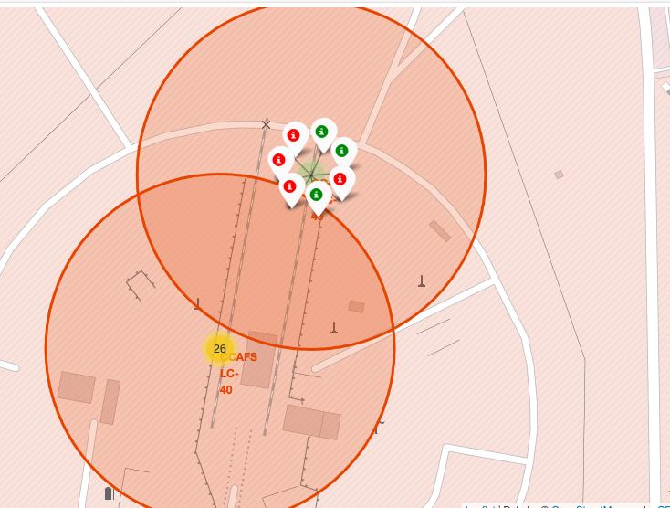
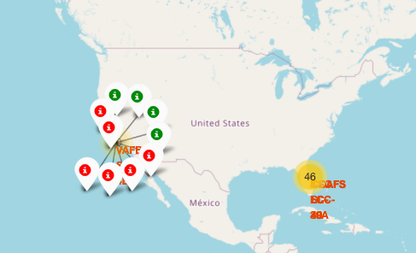
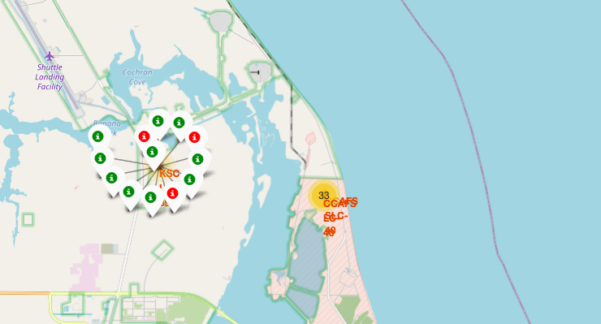
Folium: launch-outcomes

Slide 32
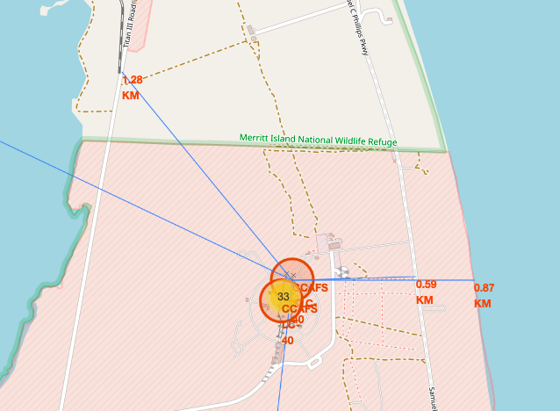
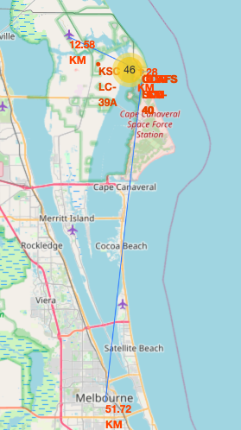
Folium: Proximity of launch sites

Slide 33
Folium: Answer questions
Based on the previous slide we can answer the following questions:
Are launch sites in close proximity to railways? Yes 1.28km
Are launch sites in close proximity to highways? Yes 0.59km
Are launch sites in close proximity to coastline? Yes 0.87km
Are launch sites in close proximity to airports? Yes, 12.58km
Do launch sites keep certain distance away from cities? Yes 51.72km

Slide 34
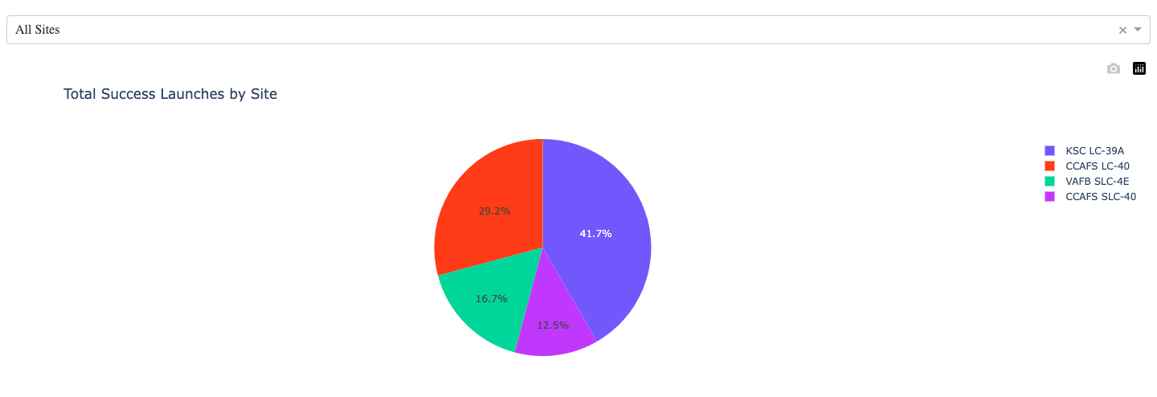
Plotly: Total success of launches

Slide 35
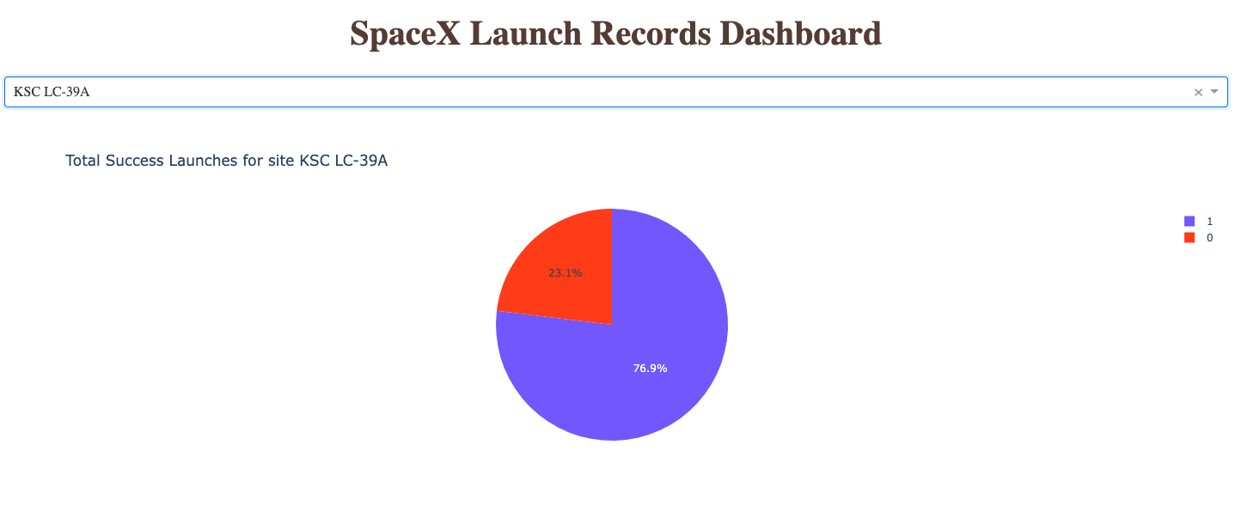
Plotly: Highest scoring launch site

Slide 36
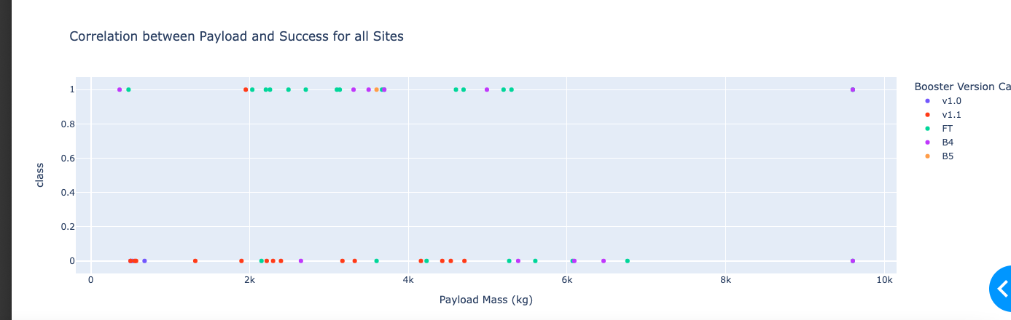
Plotly: Payload mass and Launch Outcome (all sites)

Slide 37
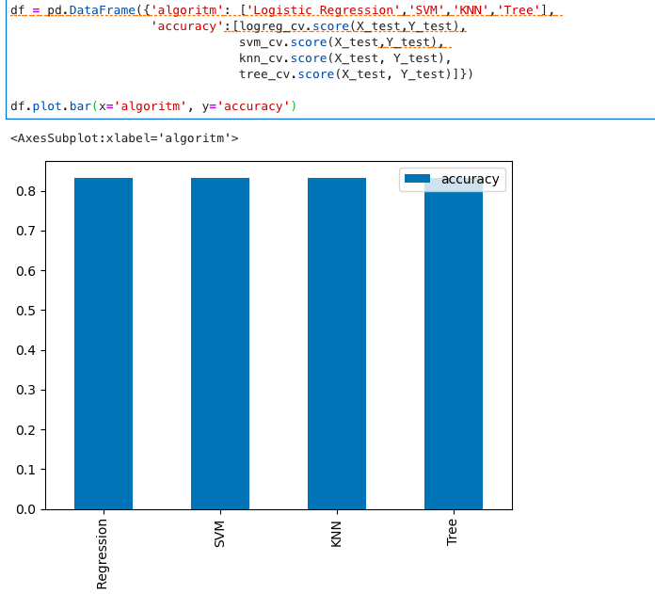
Predictive analysis: ACCURACY OF PREDICTIONS OF THE MODELS ON TEST DATA
All algorithms accuracy on test data are similar (0.833)
But problem is: (!) very small test size (n = 18)

Slide 38
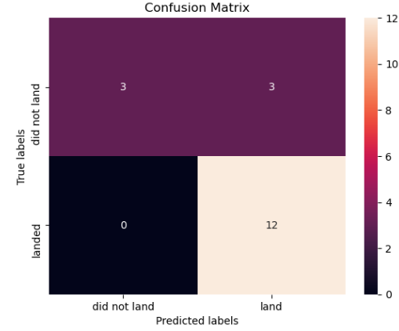
PREDICTIVE ANALYSIS: Confusion matrix
Confusion matrix the same for all models

Slide 39

CONCLUSION
Total number of successful and failure launches: 101
First successful launch: 22-12-2015
Success rate is higher the larger the flight amount at a launch site
Increasing success rates over the years
Orbit types that have highest success rates: ES-L1, GEO, HEO and SSO
Launch sites are close to railway, highway, aiport and coastline, while further away from cities
Launch site KSC LC-39A has most successful launches (76.9%)
Most flights have a payload mass of approx. 2000-6000
All developed models deliver the same accuracy in classifying success rates on unseen test data
→ Note: All preliminary conclusions since the dataset is relatively small

Slide 40
Appendix
Github link to code:

Slide 41
THANK YOU!

