Slide 1

2024 VF CBC COHORT 2
ANALYSIS OF AI, MACHINE LEARNING AND DATA SCIENCE PROFESSIONALS SALARY DATA
Presented by group B

Slide 2
TEAM B LEADERS
OTHER GROUP MEMBERS
Jane W. Wanjiku
Chibuzor Juliet
Caroline Gatwiri
Ejimadu Chioma Juliet
Chisom Nwabugwu
Ihunanya Vivian
Project Lead: Shifa Namata
Project Assistant Lead: Chisom Elizabeth Omegor
Data stakeholders:
Employees
Organizations
Career transitioners

Slide 3
PROBLEM STATEMENT
Recently, there has been a great transition into the world of technology as a career and some of the challenges that comes with this transition are:
Lack of knowledge of the average salary for a particular skill for an entry level professional and the impact of experience level on the salaries paid?
Whether location of a company has impact on how much the salary will be?
Which tech skills are in high demand?
Which is why and how we came up with the questions that guided the analysis using the dataset provided to draw out insights.

Slide 4

DATASET DESCRIPTION
The dataset covers different job titles, work year, experience level, employment type, salary, salary in usd, salary currency, employee residence, remote ratio, company’s location and company’s size.
The size of the dataset was 25760 rows by 11 columns, the data type were integer and objects.
PROJECT WORKFLOW
Data Inspection and Cleaning
Data Analysis
Data Visualization

Slide 5
DATA CLEANING
There was no missing values in the dataset.
11485 duplicated values were dropped. New total value was 14275 rows and 11 columns.
Job titles were mapped into job groups (AI, Machine Learning, Data Science and Others).
Company’s location using the ISO Codes were mapped into: North America, Europe, South America, Asia, Africa, Middle East and Oceania.

Slide 6
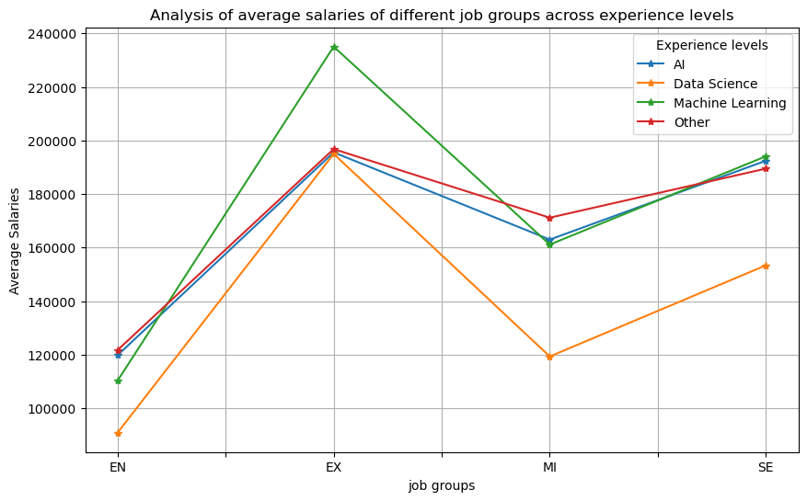
ANALYSIS ON SALARY AND COMPENSATION
Question 1: What is the average salary for AI, ML, and data science professionals worldwide, and how does it compare across different job titles and experience levels? ML and Data Science has a very unstable salary growth with experience while the salary growth for AI and others in job groups is more stable.
Job Group Experience Level | AI | Data Science | Machine | Other
EN (Entry-level) | $119,819 | $90,884 | $110,315 | $121,737
EX (Executive) | $195,580 | $195,016 | $235,065 | $196,800
MI (Mid-level) | $163,016 | $119,360 | $161,148 | $171,186
SE (Senior-level) | $192,452 | $153,393 | $194,097 | $189,508

Slide 7
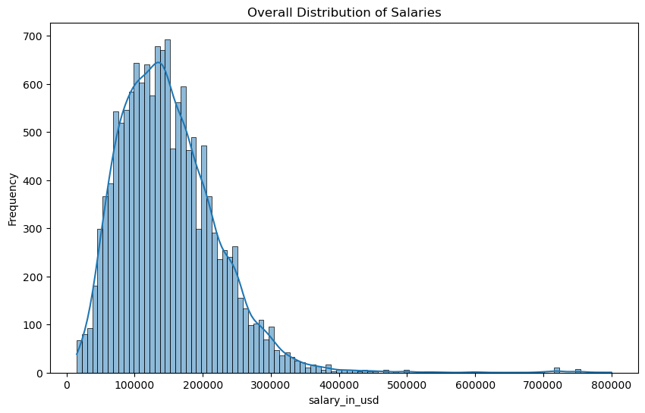
Question 2: What is the overall distribution of salaries? Most people are earning in the 100,000 – 200,000$ range with few people earning high salaries
Question 3: What are the average, median, and mode of salary in USD?
Question 4: (What is the range (minimum and maximum) of salary irrespective of your field or level of experience?)
 | Data
Average Salary | $149,539
Median Salary | $140,000
Mode Salary | $100,000
Salary range | $15,000 - $800,000

Slide 8
ANALYSIS ON GEOGRAPHIC LOCATION
Question: Which regions offer the highest salaries for AI, ML, and data science roles? North America is offering the highest competitive salaries in the tech world while Asia offers the least. The middle East is not hiring some job titles while Africa has a standard salary range across the different job groups. ML is popular in Oceania and AI in the Middle East.
Job group/Region | AI | Data Science | Machine Learning | Other
Africa | $86,859 | $78,131 | $84,516 | $94,047
Asia | $88,780 | $48,727 | $66,615 | $41,809
Europe | $94,022 | $82,045 | $112,322 | $107,695
Middle East | $146,712 | $95,700 | $93,750
North America | $188,114 | $145,270 | $192,286 | $183,994
Oceania | $69,981 | $112,243 | $177,820 | $19,877
South America | $56,616 | $63,154 | $77,930 | $200,000

Slide 9
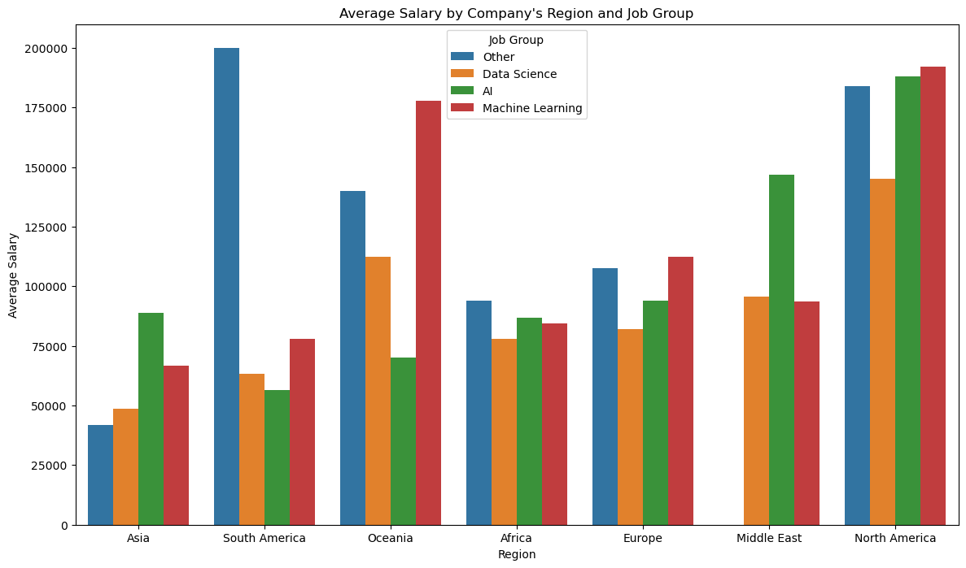
A bar chart showing distribution of salaries according to Company’s Region

Slide 10
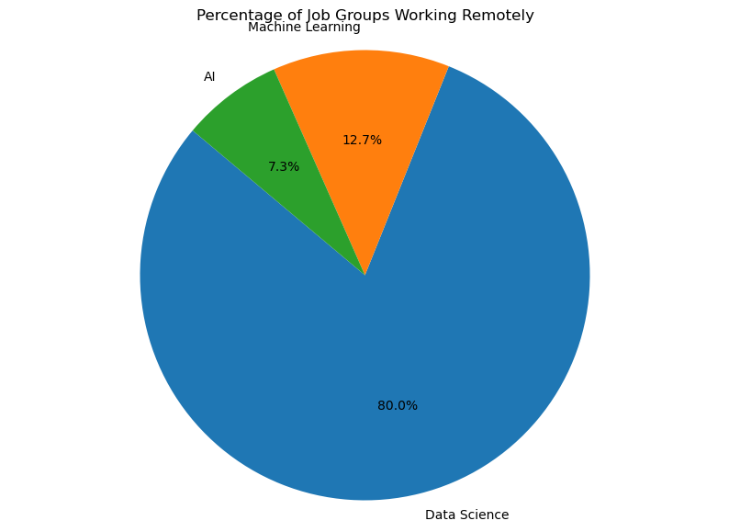
ANALYSIS ON REMOTE WORK TREND
Question 1: (What percentage of AI, ML, and data science professionals are working remotely?)
A pie chart on percentage of AI, Machine Learning and Data Science working remotely showed there are more remote data science employees compared to the other job groups

Slide 11
Question 2: (Average salary of remote workers compared to in-office worker salary?)
Findings: The analysis showed in-office employees are earning almost the same as remote employees with hybrid employees earning significantly less. There are more remote Data Science employees compared to other job groups.
Remote Ratio | Salary in USD
0 (In-office workers) | $153,181
50 (Hybrid workers) | $82,439
100 (Remote Workers) | $145,419

Slide 12
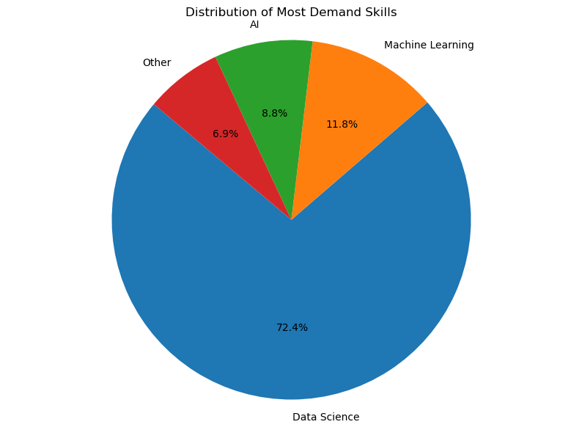
ANALYSIS ON SKILLS AND CAREER PROGRESSION
Question 1: (What are the most in-demand skills in AI, Machine Learning and Data Science?)
Findings: The analysis showed that data science professions are more in-demand compared to the other professions. Their average salary is less due to the high number of employees in this job group.
Job Group | Value Counts
Data Science | 10,340
Machine Learning | 1,682
AI | 1,263
Others | 990

Slide 13
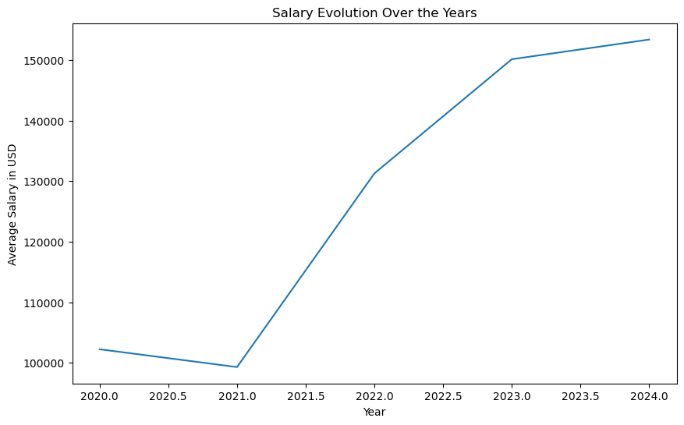
TIME SERIES ANALYSIS
Question 1: (How have salaries for AI, Machine Learning and Data Science professionals evolved over the years?)
A line graph showing the evolution of salaries over the years proving that salaries for professionals in tech have been increasing over the years and more-so between 2021 and 2022 due to the major transition of businesses into the online space following covid period.

Slide 14
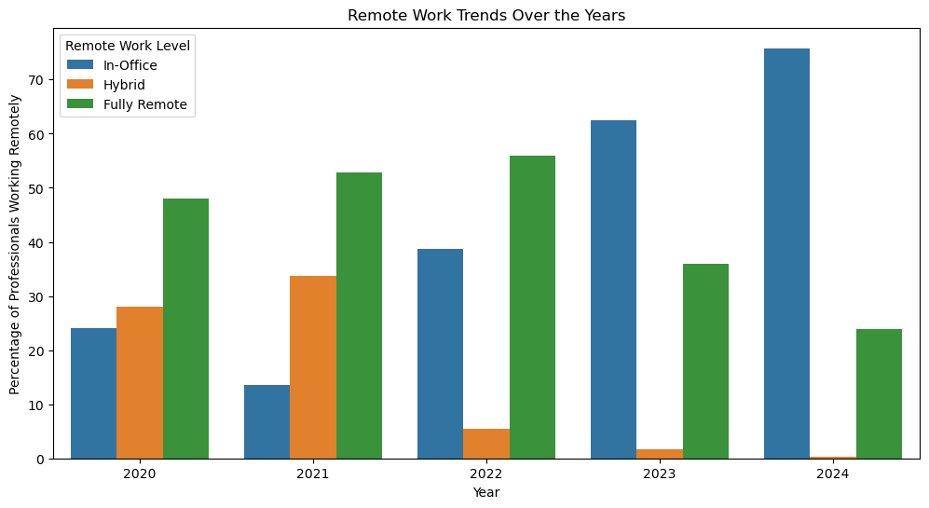
Question 2: (Are there any trends in employment type or remote ratio over time?)
A bar graph showing trend of remote work over years shows the rise of hybrid employment in 2020 and 2021 during the covid years and subsequent decrease after that while in-office work trends increased drastically after 2021.remote workers have decreased after 2022.

Slide 15
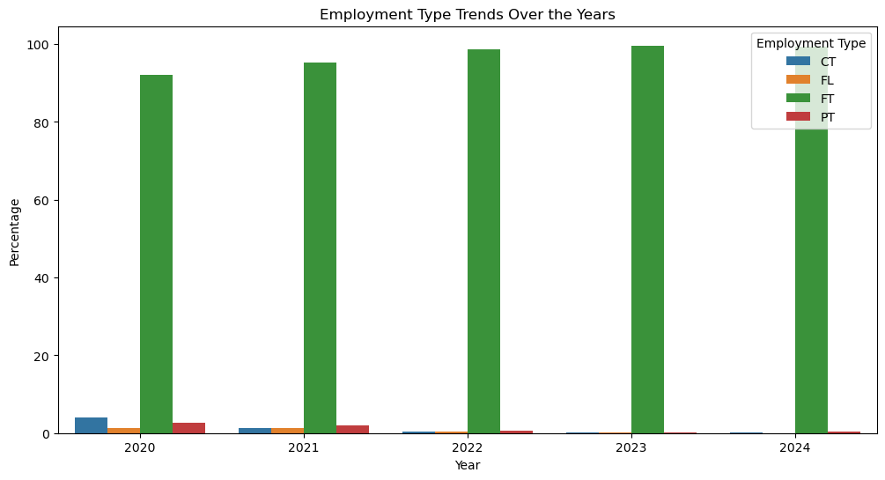
A graph on trend of employment type over years shows that full time employment has had a constant higher share in the employment type over the years with only 2020 and 2021 having notable contract, freelance and part-time employee numbers.

Slide 16
CORRELATION AND ADVANCED ANALYSIS
Question 1: Is there a correlation between experience level and salary?
Question 2: Is there a correlation between experience company’s size and salary?
Question 3: Is there a correlation between experience company’s location and salary?
Correlation between Experience Level and Salary: (0.27) correlation shows a moderate positive correlation meaning higher experience levels tend to be associated with higher salaries.
Correlation between Company Size and Salary: (0.03 )There is a very weak correlation meaning company size has minimal impact on salary
Correlation between Company location and Salary: (0.27) This shows that regional differences have moderate impact on salary

Slide 17
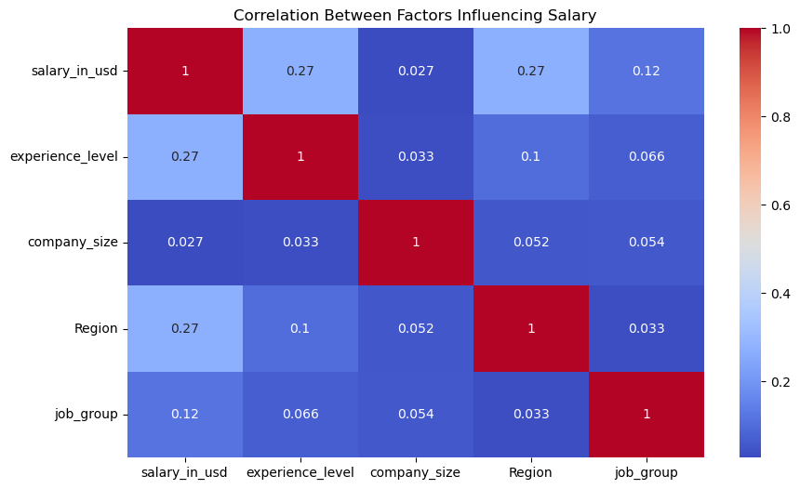
Question 4: (What factors influences salary?)
The graph shows that experience, job groups and company’s location are some factors that determine salary while company size doesn’t necessarily influence salary.

Slide 18
OBSERVATION
From the analysis we have carried out, it has been observed that:
North America offers the highest salary for both AI, Machine Learning and Data Science professions.
Data Science jo group has the highest number of those working remotely, 80% of the remote population are from Data Science.
The dataset shows that Data Science job group are most demand skills in the labor market.
Analysis of salaries over the years shows that there have been high increase over time.
Full-time employment is more practiced than other types of employment and there is more of in-office workers than those working remotely.
Experience , job groups and company’s location are some factors that determine salary while company sizee doesn’t influences salary

Slide 19


