Slide 1

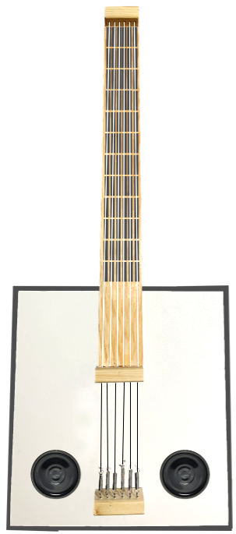
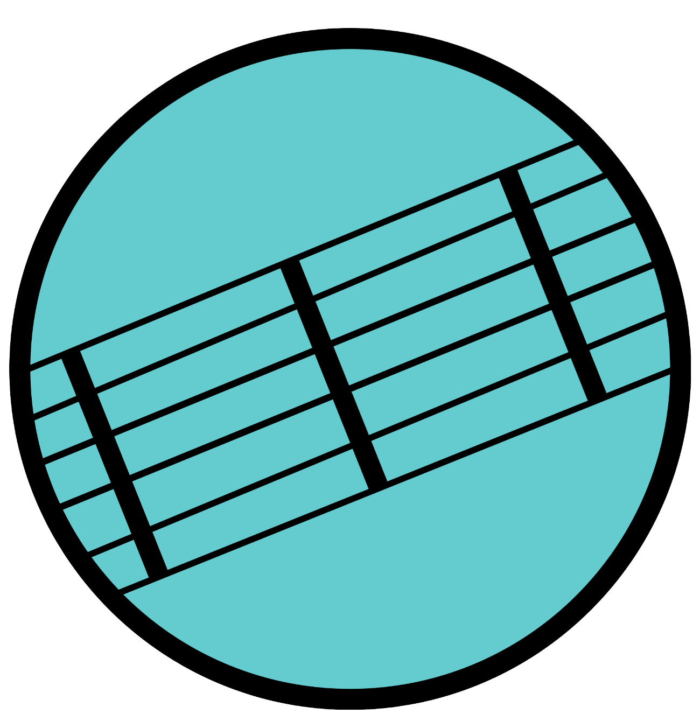
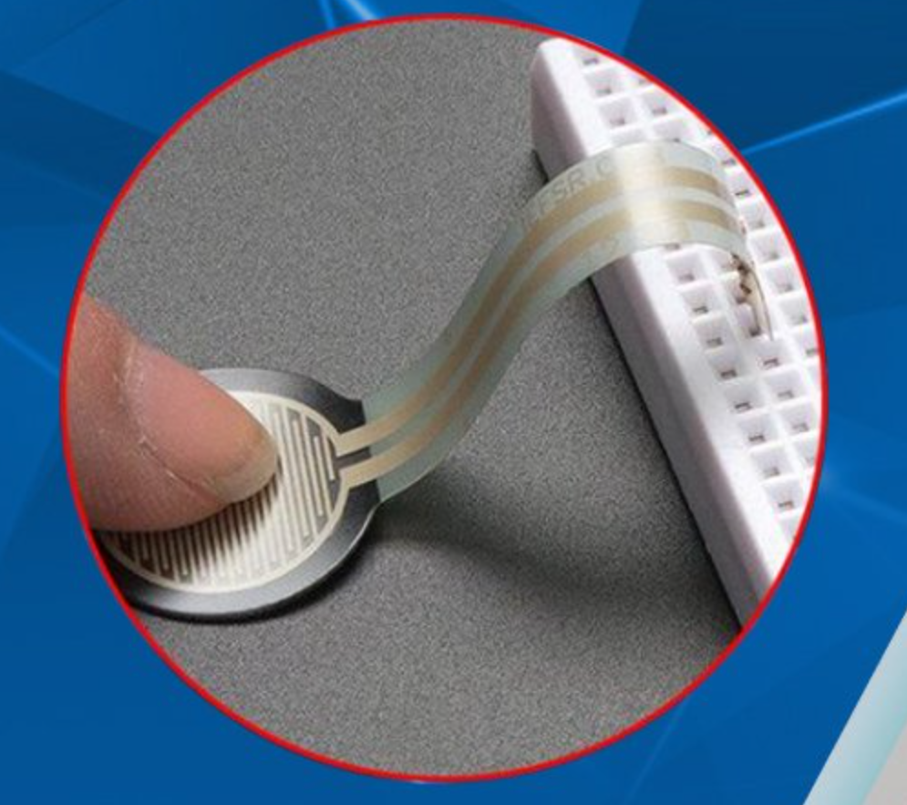
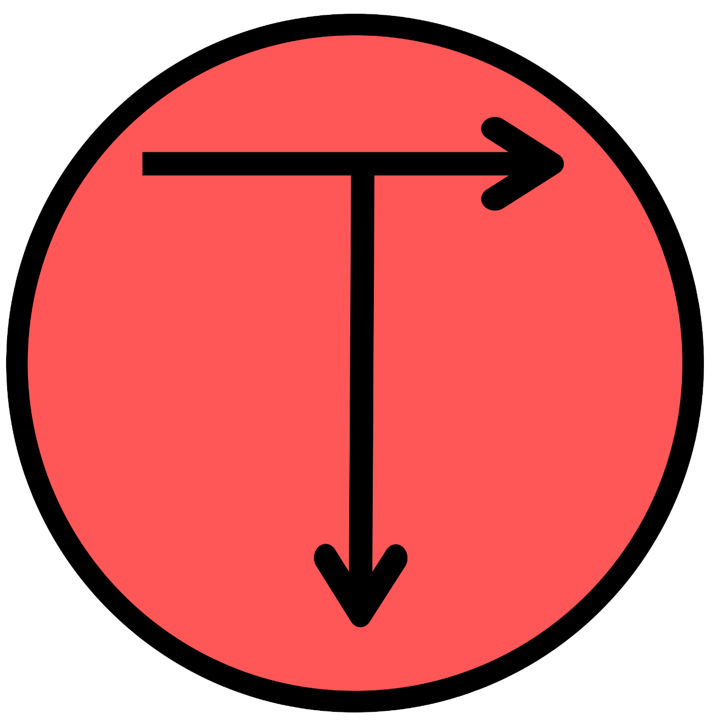
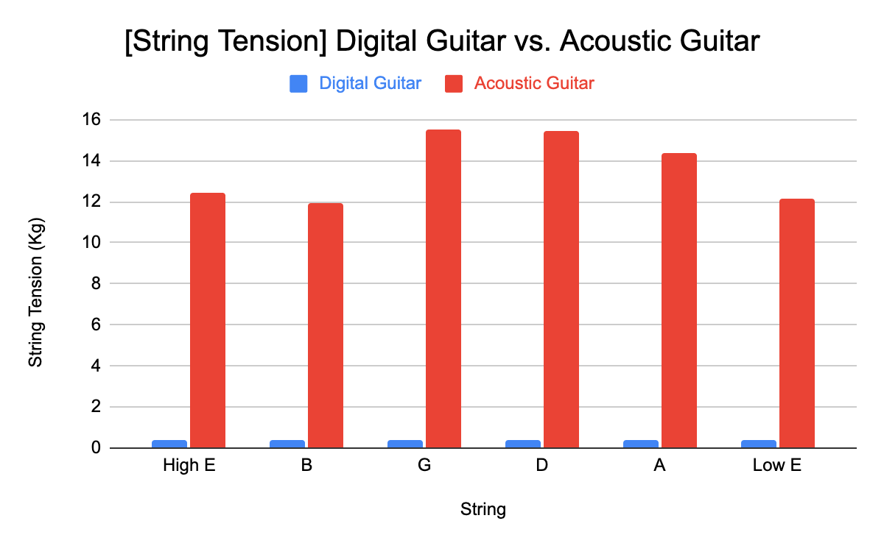

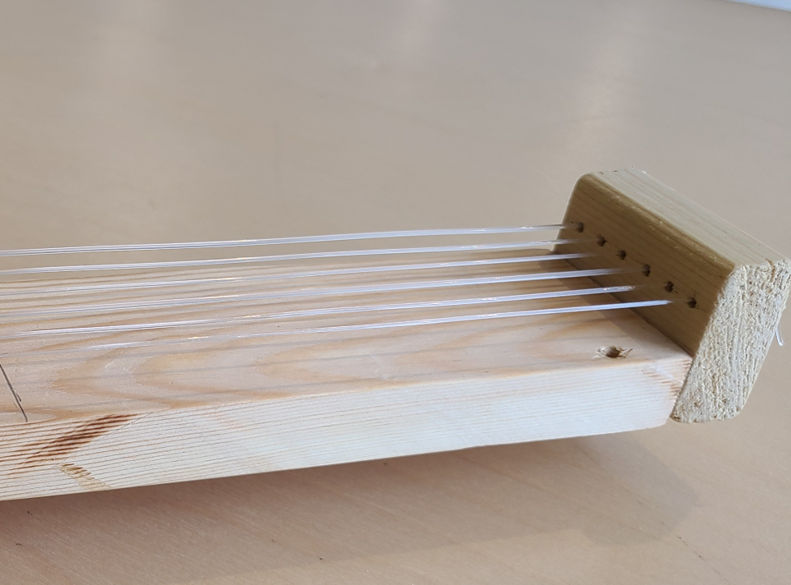
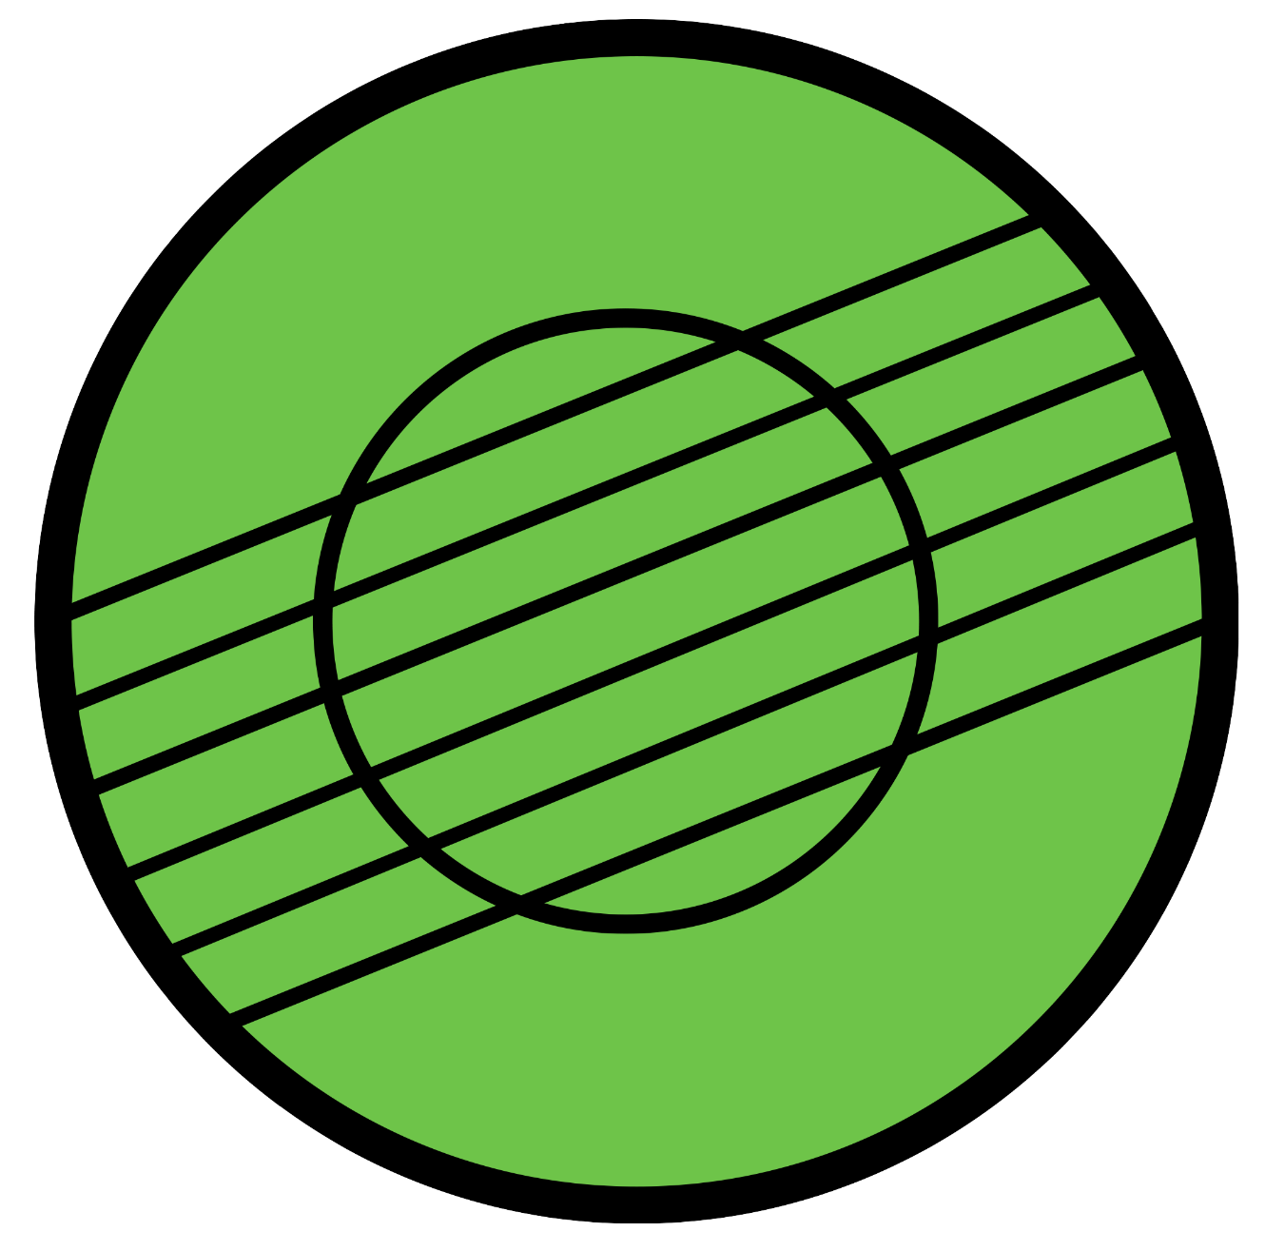
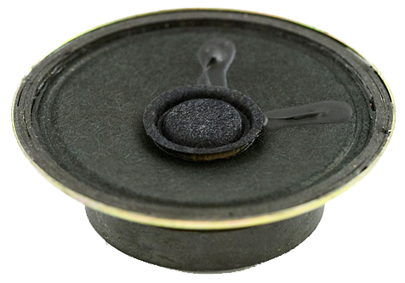
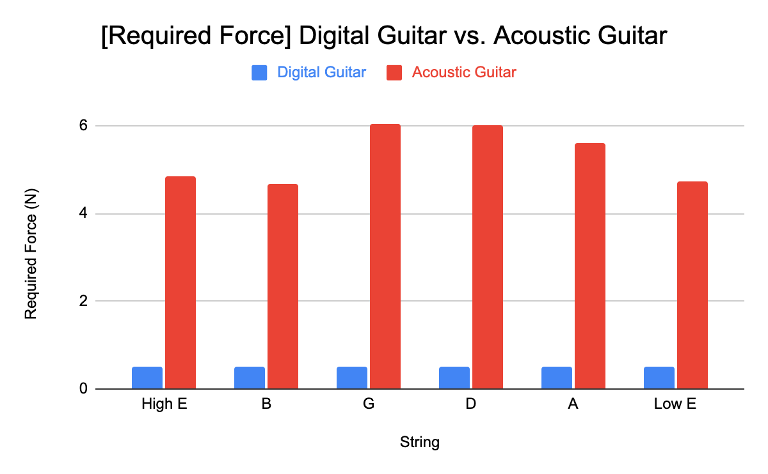
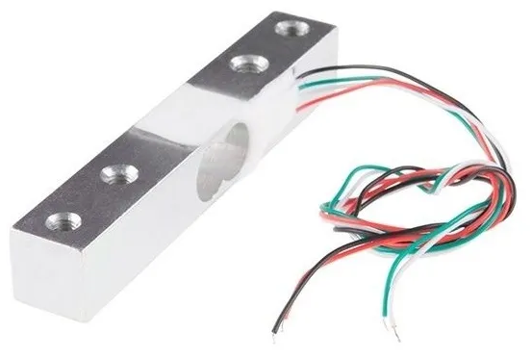
Digital Guitar for Reduced Pinch Strength
Opportunity: Increase the accessibility of the guitar for
individuals with reduced pinch strength (less than 70N maximum pinch strength).
Tactile Sensor
1 Piezoresistive Tactile sensor per fret, creating a 6x12 grid
Detects which fret is being held down
Requires 92% less force to fret than regular guitar
Objectives:
Minimize Fretting Strain
Reduce Necessary Key Pinch Strength
Maximize Number of Keys and Chords Played
Maximize Authenticity
Low Gauge, Untuned, Nylon Strings
How it Works
String Tension Per String
16
Digital Guitar
Acoustic Guitar
12
8
Signal mapped by algorithm
String Tension (kg)
Which fret is pressed down
Which string is strummed
Output desired note
4
0
E
B
G
D
A
E
Required Force to Fret Guitar Per String
Digital Guitar
Acoustic Guitar
6
Strain Sensor
Detect tensile forces in strummed strings
Magnitude of deformation is converted into electrical resistances for mapping output volume
4
4
Required Force (N)
2
0
E
B
G
D
A
E

