Slide 1

Twitter Sentiments
Lizeth Orozco, Robert Findlater, Stephanie Tang, Humberto Leon
Notes:
Lizeth Intro

Slide 2

Objective: Use Natural Language Processing (NLP) to predict hate speech in a tweet.
Twitter Hateful conduct policy
Hateful conduct: You may not promote violence against or directly attack or threaten other people on the basis of race, ethnicity, national origin, caste, sexual orientation, gender, gender identity, religious affiliation, age, disability, or serious disease. We also do not allow accounts whose primary purpose is inciting harm towards others on the basis of these categories.
Twitter Hateful Conduct Policy

Slide 3
Data Insights and Cleaning
Original dataset of 31K plus tweets, labeled 0 (positive), and 1 (negative) considered hate speech.
Cleaning! Drop.duplicates et al combo
Also RegEx ;) (Bye to capitals, numbers, et al)
Nltk, PorterStemmer, stopwords(english with a supplement)

Slide 4
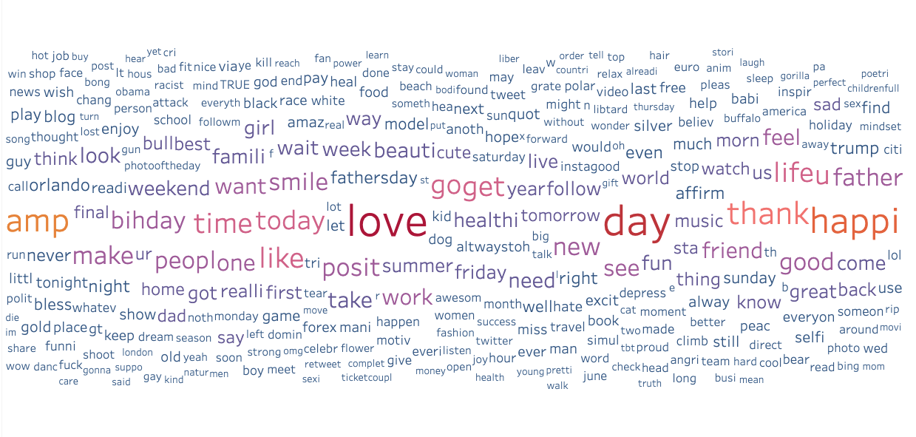
Words!!! Word Cloud*

Slide 5
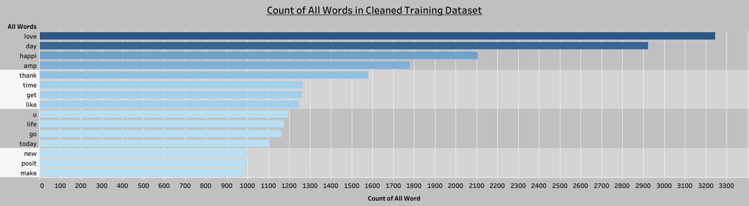
Words!!! The Popular Ones
( PP They/Them)
Link to Tableau App
AMP = “Ain’t My Problem”?

Slide 6
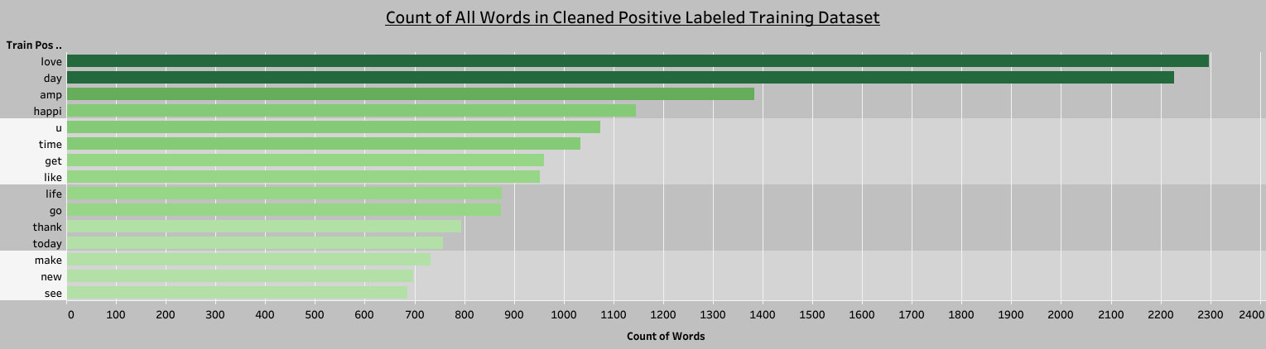
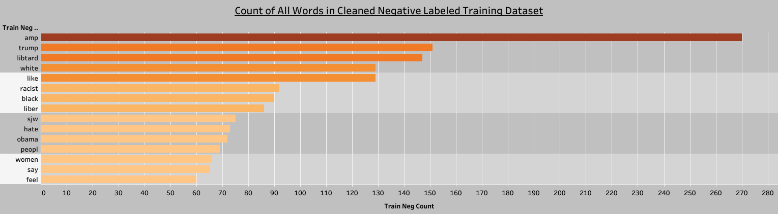

Slide 7

The Plan🔮🧿💡💁🏻
Choose a classifier
Compare scores
Use Model to input into Flask app
Enter tweet and obtain Positive or Negative result (0 or 1 respectively)

Slide 8
Choosing Classifiers⚙️
Classifiers⭕️❌
Random Forest
SVM
Gaussian Naive Bayes
Feature Extractors
Bag of Words (BOW) 🛍
Tf-Idf♎⚖️

Slide 9
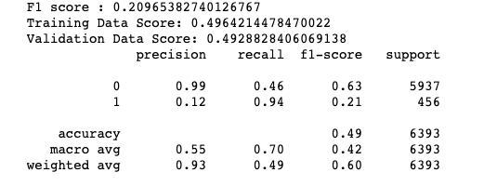
Choosing Metrics 📏📐📈📉

Slide 10
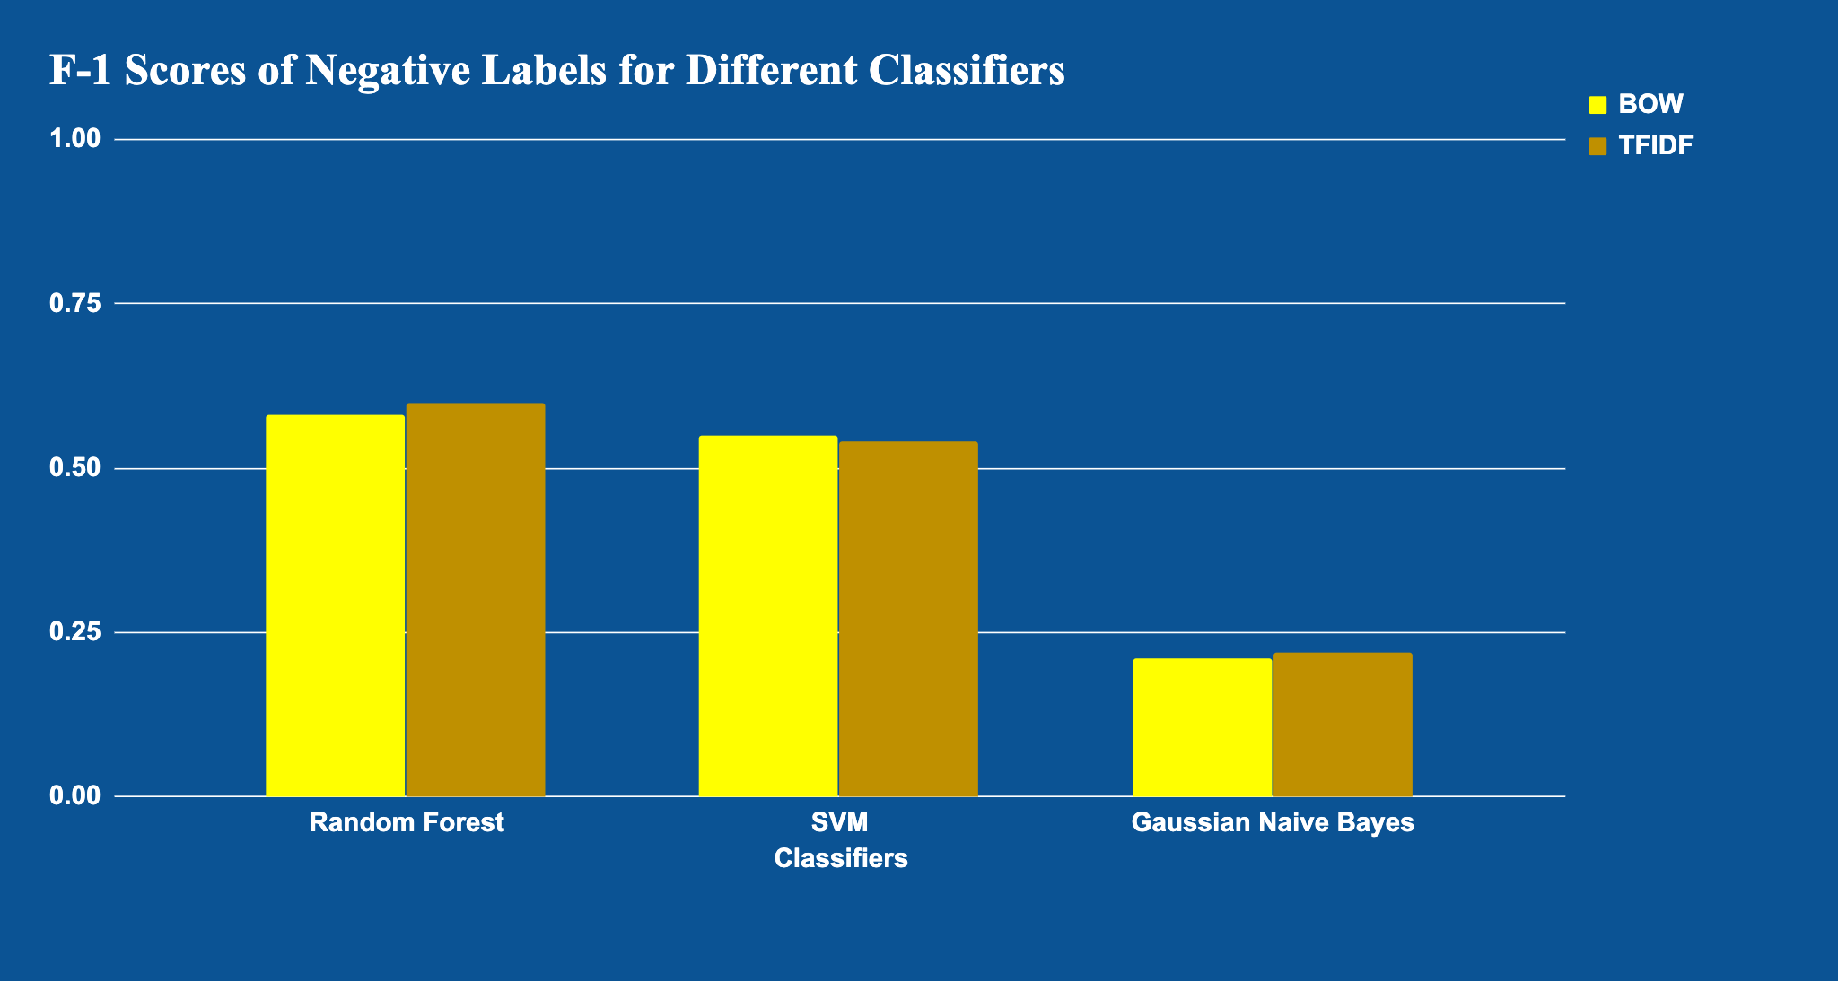
Comparing Classifiers🥴

Slide 11
Going Back to the Source!!!👁
Original dataset labels were
93% positive😇 and 7% negative 😈!
Imbalanced (Biased) Dataset
To balance try: tree family classifiers, resampling, and penalizing classifier.

Slide 12
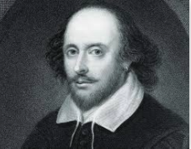
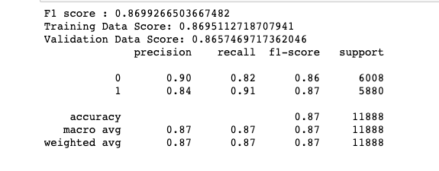
To balance or not to balance?
Non-Balanced Gaussian Naive Bayes:
Balanced Gaussian Naive Bayes:

Slide 13
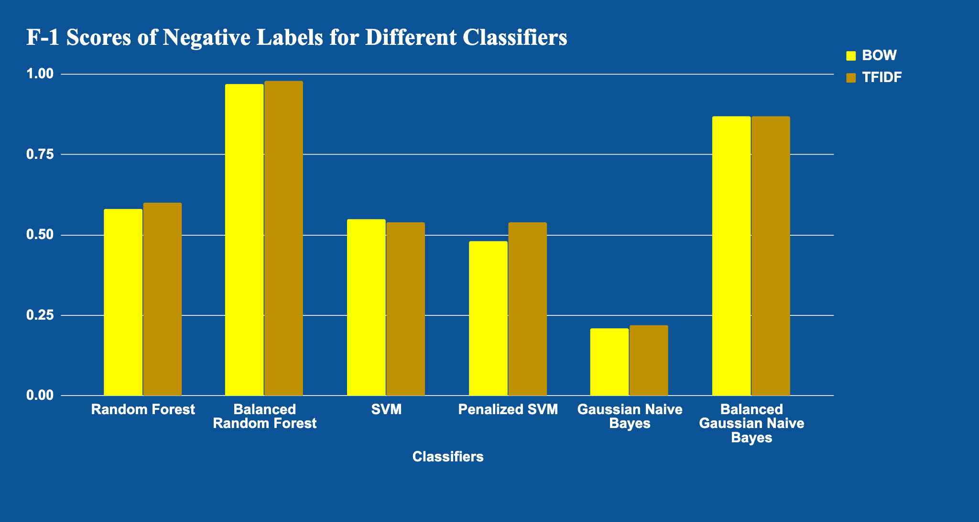
Resample that! 🤯

Slide 14
Chosen Flow is Running !🎛✈️
User Input:
Cleaning:
Vectorizing (CountVectorizer):
Classifying (Gaussian Naive Bayes):
@WSJ Bullies try to intimidate people they see as weak or vulnerable. Here’s how to respond.
wsj bulli tri intimid peopl see weak vulner respond
[[ 0 0 0 … 1 … 0 0 0]]
[ 1 ]

Slide 15
Results
Hate Speech Predictor
How can this be used?
Test your tweet before sending it out.
Politicians, celebrities, etc.

Slide 16
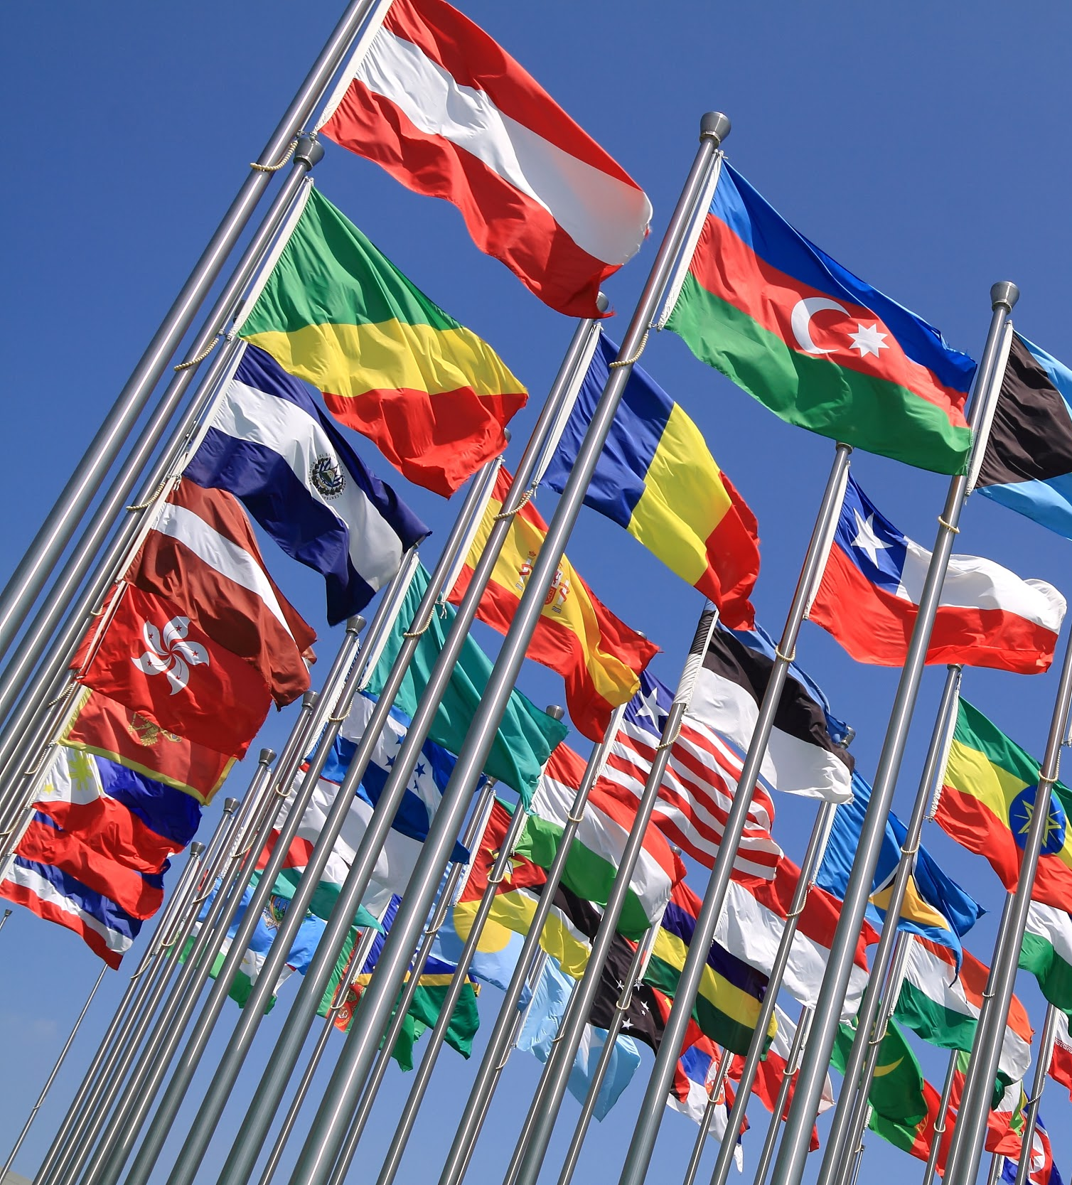
Twitter Data Limitations:
Twitter supports 33 languages
The universal language is emoji’s ?

Slide 17
Natural language processing (NLP) analysis with Tweets
Sentiment is subjective from person to person
Sarcasm and irony: Context matters
Misspelled words
Tweet character limit
Double entendre
Same word can mean different things in different languages
Symbols, @users, #, etc.

Slide 18
Lessons Learned🤓❤️
Words matter! 😍
Review your data!
Classifier, easy to choose 💔 but parameters not!
Sklearn documentation is super helpful.
Use of emoji’s is a hot topic in NLP! We cleaned it out but this could make a big impact when cleaning data🤔👍🏻😇👽🤯👽.
Jupyter Notebook and VS Code was the most efficient for us.

Slide 19
Thank you!

