Slide 1

计算机组成与系统结构 Computer Organization & System Architecture
Huang Kejie (黄科杰) 百人计划研究员
Office: 玉泉校区老生仪楼304
Email address: huangkejie@zju.edu.cn
HP: 17706443800

Slide 2
考试范围
L2-binary
L3a-isa
L3b-machinecode
L4a-DSD
L4c-singlecycle
L5-pipeline
L6-7 Memory
L8-9 Parallelism
L10 Cache Coherence
L11-12 Complex Pipeline

Slide 3
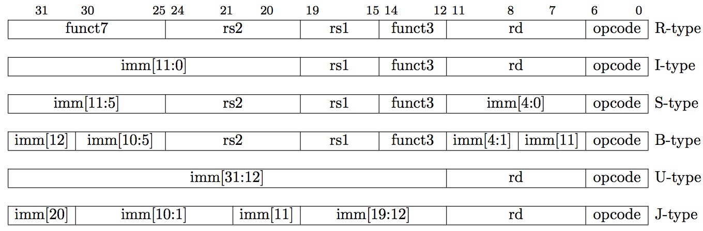
Summary of RISC-V Instruction Formats

Slide 4
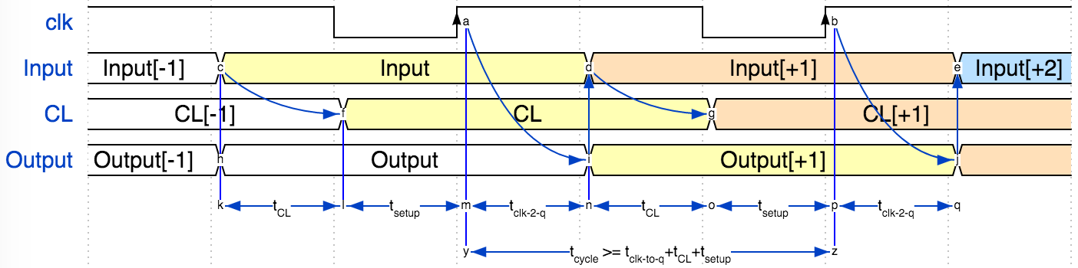
Maximum Clock Speed
t_{CL}
Clock
Input
Combinatorial
Logic
(CL)
Register
(flip-flops)
CL
Output
Optional Feedback

Slide 5
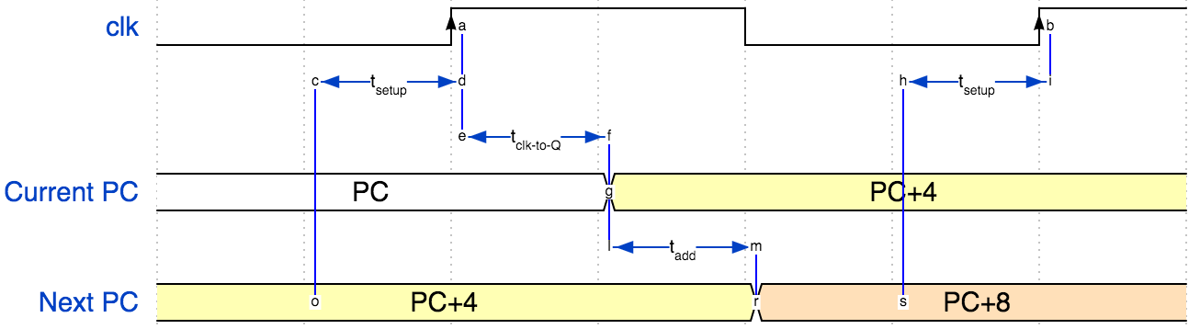
Maximum PC Clock Speed
Minimum cycle time: $t_{min}=t_{setup}+t_{add}+t_{clk−to−Q}$
Maximum clock rate: $f_{clk−max}=\frac{1}{t_{min}}$
Example: t_{setup} ≥ 15ps, t_{add} = 75ps, t_{clk-toQ} ≥ 10ps
t_{min} ≥ 100ps
f_{clk-max} ≤ 10GHz

Slide 6
Timing Diagram for add
clock
time
Clock
PC
1000
1004
PC+4
1004
1008
inst[31:0]
add x1,x2,x3
add x6,x7,x9
Reg[rs1]
Reg[2]
Reg[7]
Reg[rs2]
Reg[3]
Reg[9]
alu
Reg[2]+Reg[3]
Reg[7]+Reg[9]
Reg[1]
???
Reg[2]+Reg[3]

Slide 7
Single-Cycle RISC-V RV32I Datapath

Slide 8
Control Logic Truth Table (incomplete)
Inst[31:0] | BrEq | BrLT | PCSel | ImmSel | BrUn | ASel | BSel | ALUSel | MemRW | RegWEn | WBSel
add | * | * | +4 | * | * | Reg | Reg | Add | Read | 1 | ALU
sub | * | * | +4 | * | * | Reg | Reg | Sub | Read | 1 | ALU
(R-R Op) | * | * | +4 | * | * | Reg | Reg | (Op) | Read | 1 | ALU
addi | * | * | +4 | I | * | Reg | Imm | Add | Read | 1 | ALU
lw | * | * | +4 | I | * | Reg | Imm | Add | Read | 1 | Mem
sw | * | * | +4 | S | * | Reg | Imm | Add | Write | 0 | *
beq | 0 | * | +4 | B | * | PC | Imm | Add | Read | 0 | *
beq | 1 | * | ALU | B | * | PC | Imm | Add | Read | 0 | *
bne | 0 | * | ALU | B | * | PC | Imm | Add | Read | 0 | *
bne | 1 | * | +4 | B | * | PC | Imm | Add | Read | 0 | *
blt | * | 1 | ALU | B | 0 | PC | Imm | Add | Read | 0 | *
bltu | * | 1 | ALU | B | 1 | PC | Imm | Add | Read | 0 | *
jalr | * | * | ALU | I | * | Reg | Imm | Add | Read | 1 | PC+4
jal | * | * | ALU | J | * | PC | Imm | Add | Read | 1 | PC+4
auipc | * | * | +4 | U | * | PC | Imm | Add | Read | 1 | ALU

Slide 9
add Execution
+4
Add
Add
wb
pc
alu
2
alu
1
Inst[11:7]
DataD
Reg[rs1]
1
wb
PC
addr
Inst[19:15]
AddrD
1
alu
0
0
addr
inst
DataA
DataR
pc+4
inst
Inst[24:20]
AddrA
Branch
Comp
0
+
addr
mem
clk
IMEM
AddrB
DataB
0
ALU
DataW
IMEM
Inst [31:7]
Reg [ ]
1
DMEM
Imm.
Gen
clk
Reg[rs2]
clk
Imm[31:0]
PCSel
Inst[31:0]
ImmSel
RegWEn
BrUn
BrLT
Bsel
ALUSel
MemRW
WBSel
=pc+4
=*
=1
=*
=*
=0
=add
=Read
=1
Control logic
BrEq
=*
Asel
=0
Clock
PC
1000
1004
PC+4
1004
1008
inst[31:0]
add x1,x2,x3
add x6,x7,x9
Control logic
add control
add control
Reg[rs1]
Reg[2]
Reg[7]
Reg[rs2]
Reg[3]
Reg[9]
alu
Reg[2]+Reg[3]
Reg[7]+Reg[9]
wb
Reg[2]+Reg[3]
Reg[7]+Reg[9]
Reg[1]
???
Reg[2]+Reg[3]

Slide 10
Peer Instruction(s): Critical Path
+4
Add
Add
pc+4
wb
DataD
pc
alu
2
alu
Inst[11:7]
Reg[rs1]
1
1
PC
addr
AddrD
1
0
wb
0
addr
inst
Inst[19:15]
DataA
alu
DataR
inst
Critical path for a addi
R[rd] = R[rs1]+imm
pc+4
Inst[24:20]
AddrA
Branch
Comp
0
+
addr
mem
clk
AddrB
DataB
0
ALU
DataW
IMEM
IMEM
Reg [ ]
1
DMEM
Inst [31:7]
clk
Reg[rs2]
clk
Imm.
Gen
Imm[31:0]
PCSel
Inst[31:0]
ImmSel
RegWEn
BrUn
BrLT
Bsel
ALUSel
MemRW
WBSel
Control logic
Asel
Control logic
BrEq
t_{clk-q} + t_{Add} + t_{IMEM} + t_{Reg} + t_{BComp} + t_{ALU} + t_{DMEM} + t_{mux} + t_{Setup}
t_{clk-q} + t_{IMEM} + max{t_{Reg}, t_{Imm}} + t_{ALU} + 2t_{mux} + t_{Setup}
t_{clk-q} + t_{IMEM} + max{t_{Reg}, t_{Imm}} + t_{ALU} + 3t_{mux} + t_{DMEM} + t_{Setup}
None of the above

Slide 11







Pipelining with RISC-V
Phase | Pictogram | t_{step} Serial
Instruction Fetch |  | 200 ps
Reg Read |  | 100 ps
ALU |  | 200 ps
Memory |  | 200 ps
Register Write |  | 100 ps
t_{instruction} |  | 800 ps
t_{cycle} Pipelined
200 ps
200 ps
200 ps
200 ps
200 ps
1000 ps
t_{instruction}
add t0, t1, t2
instruction sequence
or t3, t4, t5
sll t6, t0, t3
t_{cycle}

Slide 12
Pipelining with RISC-V
t_{instruction}
add t0, t1, t2
instruction sequence
or t3, t4, t5
sll t6, t0, t3
t_{cycle}
 | Single Cycle | Pipelining
Timing | t_{step} = 100 … 200 ps | t_{cycle} = 200 ps
 | Register access only 100 ps | All cycles same length
Instruction time, t_{instruction} | = t_{cycle} = 800 ps | 1000 ps
Clock rate, f_{s} | 1/800 ps = 1.25 GHz | 1/200 ps = 5 GHz
Relative speed | 1 x | 4 x

Slide 13
Pipelined RISC-V RV32I Datapath
Recalculate PC+4 in M stage to avoid sending both PC and PC+4 down pipeline
Must pipeline instruction along with data, so control operates correctly in each stage

Slide 14
Each stage operates on different instruction
add t0, t1, t2
lw t0, 8(t3)
sw t0, 4(t3)
slt t6, t0, t3
or t3, t4, t5
Pipeline registers separate stages, hold data for each instruction in flight

Slide 15
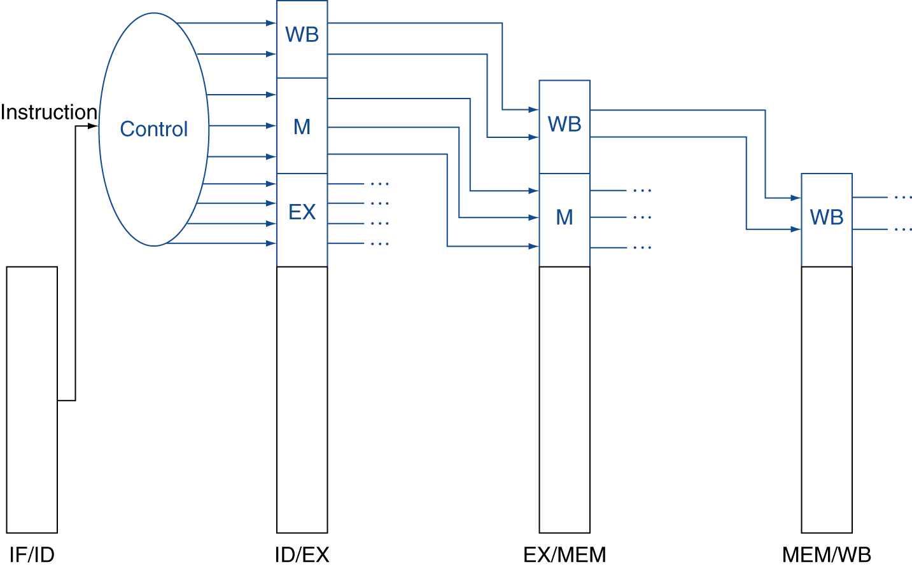
Pipelined Control
Control signals derived from instruction
As in single-cycle implementation
Information is stored in pipeline registers for use by later stages

Slide 16
Instructions interact with each other in pipeline
An instruction in the pipeline may need a resource being used by another instruction in the pipeline → structural hazard (结构冒险)
An instruction may depend on something produced by an earlier instruction
Dependence may be for a data value → data hazard (数据冒险)
Dependence may be for the next instruction’s address → control hazard (控制冒险) (branches, exceptions)
Handling hazards generally introduces bubbles into pipeline and reduces ideal CPI > 1

Slide 17
Structural Hazard
Problem: Two or more instructions in the pipeline compete for access to a single physical resource
Solution 1: Instructions take it in turns to use resource, some instructions have to stall
Solution 2: Add more hardware to machine
E.g., if two instructions both need a port to memory at same time, could avoid hazard by adding second port to memory
Can always solve a structural hazard by adding more hardware
Classic RISC 5-stage integer pipeline has no structural hazards by design
Many RISC implementations have structural hazards on multi-cycle units such as multipliers, dividers, floating-point units, etc., and can have on register writeback ports

Slide 18
Regfile Structural Hazards
Each instruction:
can read up to two operands in decode stage
can write one value in writeback stage
Avoid structural hazard by having separate “ports”
two independent read ports and one independent write port
Three accesses per cycle can happen simultaneously

Slide 19
Structural Hazards – Summary
Conflict for use of a resource
In RISC-V pipeline with a single memory
Load/store requires data access
Without separate memories, instruction fetch would have to stall for that cycle
All other operations in pipeline would have to wait
Pipelined datapaths require separate instruction/data memories
Or separate instruction/data caches
RISC ISAs (including RISC-V) designed to avoid structural hazards
e.g. at most one memory access/instruction

Slide 20
Data Hazard: Register Access
Separate ports, but what if write to same value as read?
Does sw in the example fetch the old or new value?
add t0, t1, t2
or t3, t4, t5
slt t6, t0, t3
instruction sequence
sw t0, 4(t3)
lw t0, 8(t3)

Slide 21
Register Access Policy
Exploit high speed of register file (100 ps)
WB updates value
ID reads new value
Indicated in diagram by shading
add t0, t1, t2
or t3, t4, t5
instruction sequence
slt t6, t0, t3
sw t0, 4(t3)
lw t0, 8(t3)
Might not always be possible to write then read in same cycle, especially in high-frequency designs. Check assumptions in any question.

Slide 22
Data Hazard: ALU Result
5
5
5
5/9
9
Value of s0
5
add s0, t1, t2
sub t2, s0, t5
instruction sequence
or t6, s0, t3
xor t5, t1, s0
sw s0, 8(t3)
Without some fix, sub and or will calculate wrong result!

Slide 23
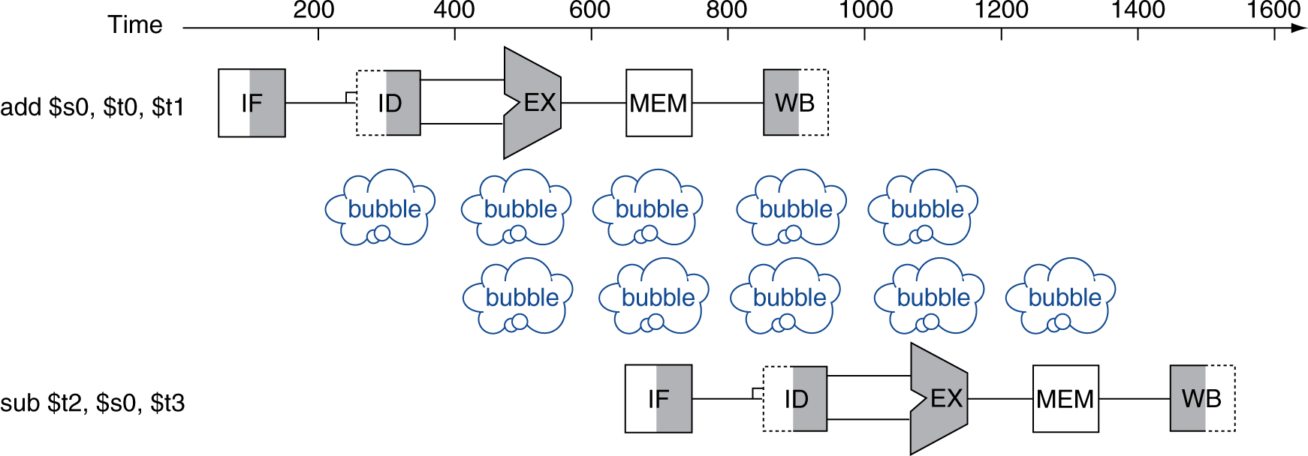
Solution 1: Stalling暂停 (Interlock互锁)
Problem: Instruction depends on result from previous instruction
add s0, t0, t1 sub t2, s0, t3
Bubble:
effectively NOP: affected pipeline stages do “nothing”

Slide 24
Solution 2: Forwarding数据前递(Bypass旁路)
Value of t0
5 | 5 | 5 | 5 | 5/9 | 9 | 9 | 9 | 9
add t0, t1, t2
or t3, t0, t5
sub t6, t0, t3
instruction sequence
xor t5, t1, t0
sw t0, 8(t3)
Forwarding: grab operand from pipeline stage,
rather than register file

Slide 25
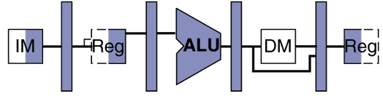
1) Detect Need for Forwarding (example)
Compare destination of older instructions in pipeline with sources of new instruction in decode stage.
Must ignore writes to x0!
D
X
M
W
inst_{X}.rd
add t0, t1, t2
inst_{D}.rs1
or t3, t0, t5
sub t6, t0, t3

Slide 26
Forwarding Path

Slide 27
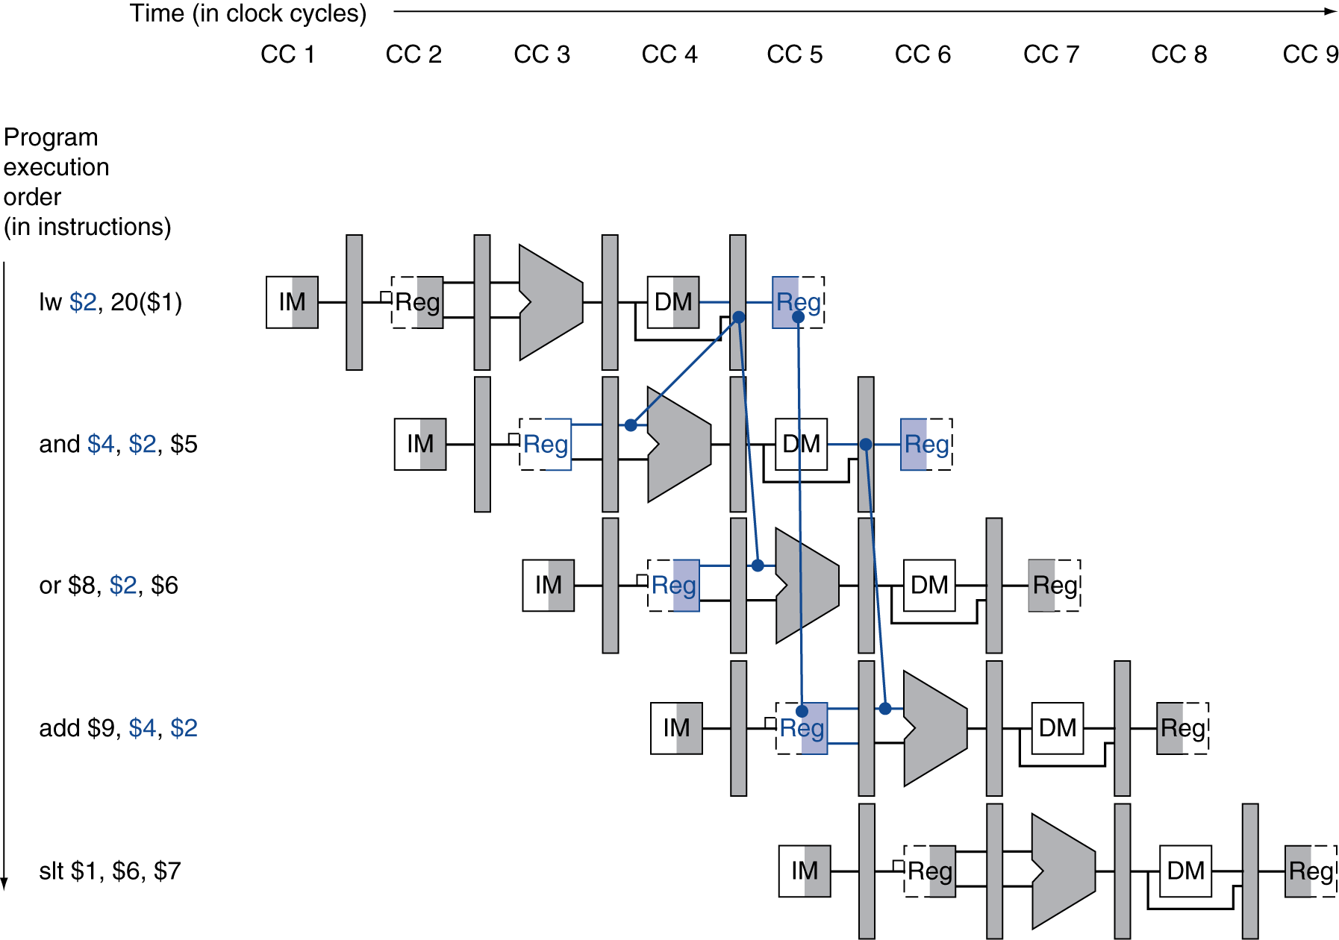
Load Data Hazard
1 cycle stall unavoidable
forward
unaffected

Slide 28
Code Scheduling to Avoid Stalls
Reorder code to avoid use of load result in the next instruction!
RISC-V code for D=A+B; E=A+C;
Original Order:
lw t1, 0(t0)
lw t2, 4(t0)
add t3, t1, t2
sw t3, 12(t0)
lw t4, 8(t0)
add t5, t1, t4
sw t5, 16(t0)
Alternative:
lw t1, 0(t0)
lw t2, 4(t0)
lw t4, 8(t0)
add t3, t1, t2
sw t3, 12(t0)
add t5, t1, t4
sw t5, 16(t0)
Stall!
Stall!
11 cycles
13 cycles

Slide 29
Control Hazards
What do we need to calculate next PC?
For Unconditional Jumps
Opcode, PC, and offset
For Jump Register
Opcode, Register value, and offset
For Conditional Branches
Opcode, Register (for condition), PC and offset
For all other instructions
Opcode and PC ( and have to know it’s not one of above )

Slide 30
Branch Prediction
beq t0, t1, label
Taken branch
label: …..
Guess next PC!
…..
Check guess correct

Slide 31
Solutions
Structural Hazards
Solution 1: Instructions take it in turns to use resource
Solution 2: Add more hardware to machine
Regfile Structural Hazards: 2 read ports and 1 write port
Memory Structural Hazards: dedicated caches
Data Hazards
Register access: write-then-read
ALU results: stalling (interlocking) and forwarding (bypassing)
Load data harzards: stalling and rescheduling
Control Hazards
Kill instructions
Branch prediction

Slide 32
Memory Hierarchy
Big, Slow Memory
(DRAM)
A
Small,
Fast Memory
(RF, SRAM)
B
CPU
holds frequently used data
capacity: Register << SRAM << DRAM
latency: Register << SRAM << DRAM
bandwidth: on-chip >> off-chip
On a data access:
if data ∈ fast memory ⇒ low latency access (SRAM)
if data ∉ fast memory ⇒ high latency access (DRAM)

Slide 33
Big Idea: Locality
Temporal Locality (locality in time)
Go back to same book on desk multiple times
If a memory location is referenced, then it will tend to be referenced again soon
Spatial Locality (locality in space)
When go to book shelf, pick up multiple books on J.D. Salinger since library stores related books together
If a memory location is referenced, the locations with nearby addresses will tend to be referenced soon

Slide 34
Adding Cache to Computer
Processor
Memory
Input
Enable?
Read/Write
Control
Program
Memory (including
cache) organized around blocks, which are typically multiple words
Datapath
Address
Bytes
PC
Cache
Registers
Write Data
Data
Arithmetic & Logic Unit
(ALU)
Read Data
Output
Processor organized around words and bytes
Processor-Memory Interface
I/O-Memory Interfaces

Slide 35
Inside a Cache
Address
Address
Processor
CACHE
Main
Memory
Data
Data
copy of main
memory
location 100
copy of main
memory
location 101
100
Data
Byte
Data
Byte
Line
304
Data
Byte
Address
Tag
6848
416
Data Block

Slide 36
Cache Terminology
hit: data appears in some block
hit rate: the fraction of accesses found in the level
hit time: time to access the level (consists of RAM access time + time to determine hit)
miss: data needs to be retrieved from a block in the lower level (e.g., block Y)
miss rate = 1 - (hit rate)
miss penalty: time to replace a block in the upper level + time to deliver the block to the processor
hit time << miss penalty
Abbreviation: “$” = cache (a Berkeley innovation!)

Slide 37
Average Memory Access Time (AMAT)
Average Memory Access Time (AMAT) is the average time to access memory considering both hits and misses in the cache
AMAT = Time for a hit + Miss rate × Miss penalty
miss penalty: time to fetch a block from lower memory level
access time: function of latency
transfer time: function of bandwidth b/w levels
transfer one “cache line/block” at a time
transfer at the size of the memory-bus width
Important Equation!

Slide 38
Processor Address Fields Used by Cache Controller
Block Offset: Byte address within block
Set Index: Selects which set
Tag: Remaining portion of processor address
Size of Index = log₂(number of sets)
Size of Tag = Address size – Size of Index – log₂(number of bytes/block)
Processor Address (32-bits total)
Tag
Set Index
Block offset

Slide 39
Direct-Mapped Cache
Tag
Index
Block
Offset
t
k
b
V
Tag
Data Block
2^{k}
lines
t
=
HIT
Data Word or Byte

Slide 40
Cache Organization: Simple First Example
Main Memory
0000xx
0001xx
0010xx
0011xx
0100xx
0101xx
0110xx
0111xx
1000xx
1001xx
1010xx
1011xx
1100xx
1101xx
1110xx
1111xx
One word blocks
Two low order bits (xx) define the byte in the block (32b words)
Cache
Index
Valid
Tag
Data
00
01
10
11
Q: Where in the cache is the mem block?
Use next 2 low-order memory address bits – the index – to determine which cache block (i.e., modulo the number of blocks in the cache)
Q: Is the memory block in cache?
Compare the cache tag to the high-order 2 memory address bits to tell if the memory block is in the cache (provided valid bit is set)

Slide 41
Multiword-Block Direct-Mapped Cache
Four words/block, cache size = 1K words
Hit
31 30 . . . 13 12 11. . . 4 . . . 0
Byte offset
Data
Tag
20
8
2
Word offset
Index
Index
Valid
Tag
Data
0
1
2
.
.
.
253
254
255
20
32
What kind of locality are we taking advantage of?

Slide 42
Ping Pong Cache Example: Direct-Mapped Cache w/4 Single-Word Blocks, Worst-Case Reference String
Consider the main memory address reference string of word numbers:
0 4 0 4 0 4 0 4
Start with an empty cache - all blocks initially marked as not valid
0
4
0
4
0
4
0
4

Slide 43
Ping Pong Cache Example: Direct-Mapped Cache w/4 Single-Word Blocks, Worst-Case Reference String
Consider the main memory address reference string of word numbers:
0 4 0 4 0 4 0 4
Start with an empty cache - all blocks initially marked as not valid
0
miss
01
4
miss
4
00
0
miss
0
01
4
miss
4
00 Mem(0)
00 Mem(0)
01 Mem(4)
00 Mem(0)
0
miss
01
4
miss
0
miss
4
miss
00
0
4
00
0
01
4
01 Mem(4)
00 Mem(0)
01 Mem(4)
00 Mem(0)
8 requests, 8 misses
Ping-pong effect due to conflict misses - two memory locations that map into the same cache block

Slide 44
Example: 2-Way Set Associative $ (4 words = 2 sets x 2 ways per set)
Main Memory
0000xx
0001xx
0010xx
0011xx
0100xx
0101xx
0110xx
0111xx
1000xx
1001xx
1010xx
1011xx
1100xx
1101xx
1110xx
1111xx
Cache
One word blocks
Two low order bits define the byte in the word (32b words)
Way
Set
V
Tag
Data
0
0
1
1
0
1
Q: How do we find it?
Use next 1 low order memory address bit to determine which cache set (i.e., modulo the number of sets in the cache)
Q: Is it there?
Compare all the cache tags in the set to the high order 3 memory address bits to tell if the memory block is in the cache

Slide 45
2-Way Set-Associative Cache
Tag
Index
Block
Offset
b
t
k
V
Tag
Data Block
V
Tag
Data Block
t
=
=
Data
Word
or Byte
HIT

Slide 46
Ping Pong Cache Example: 4 Word 2-Way SA $, Same Reference String
Consider the main memory word reference string
0 4 0 4 0 4 0 4
Start with an empty cache - all blocks initially marked as not valid
0
miss
4
miss
0
hit
4
hit
000 Mem(0)
000 Mem(0)
000 Mem(0)
000 Mem(0)
010 Mem(4)
010 Mem(4)
010 Mem(4)
8 requests, 2 misses
Solves the ping-pong effect in a direct-mapped cache due to conflict misses since now two memory locations that map into the same cache set can co-exist!

Slide 47
Alternative Cache Organizations
“Fully Associative”: Block can go anywhere
First design in lecture
Note: No Index field, but one comparator/block
“Direct Mapped”: Block goes one place
Note: Only 1 comparator
Number of sets = number blocks
“N-way Set Associative”: N places for a block
Number of sets = number of blocks / N
N comparators
Fully Associative: N = number of blocks
Direct Mapped: N = 1

Slide 48
Range of Set-Associative Caches
For a fixed-size cache and fixed block size, each increase by a factor of two in associativity doubles the number of blocks per set (i.e., the number of ways) and halves the number of sets
decreases the size of the index by 1 bit and increases the size of the tag by 1 bit
More Associativity (more ways)
Used for tag compare
Selects the set
Selects the word in the block
Tag
Index
Word offset
Byte offset
Decreasing associativity, lower way, more sets
Increasing associativity, higher way, less sets
Fully associative
(only one set)
Tag is all the bits except
block and byte offset
Direct mapped
(only one way)
Smaller tags, only a single comparator

Slide 49
Total Cache Capacity =
Associativity * # of sets * block_size
Bytes = blocks/set * sets * Bytes/block
C = N * S * B
Tag
Index
Byte Offset
address_size = tag_size + index_size + offset_size
= tag_size + log₂(S) + log₂(B)
Double the Associativity: Number of sets?
tag_size? index_size? # comparators?
Double the Sets: Associativity?
tag_size? index_size? # comparators?

Slide 50
Replacement Policy
In an associative cache, which block from a set should be evicted when the set becomes full?
Random
Least-Recently Used (LRU)
LRU cache state must be updated on every access
true implementation only feasible for small sets (2-way)
pseudo-LRU binary tree often used for 4-8 way
First-In, First-Out (FIFO) a.k.a. Round-Robin
used in highly associative caches
Not-Most-Recently Used (NMRU)
FIFO with exception for most-recently used block or blocks
This is a second-order effect. Why?
Replacement only happens on misses

Slide 51
Sources of Cache Misses (3 C’s)
Compulsory (cold start, first reference):
1st access to a block, not a lot you can do about it
If running billions of instructions, compulsory misses are insignificant
misses that would occur even with infinite cache
Capacity:
cache is too small to hold all data needed by the program
Misses that would not occur with infinite cache
misses that would occur even under perfect replacement policy
Conflict (collision):
Misses that occur because of collisions due to line-placement strategy (multiple memory locations mapped to same cache set)
Misses that would not occur with ideal fully associative cache

Slide 52
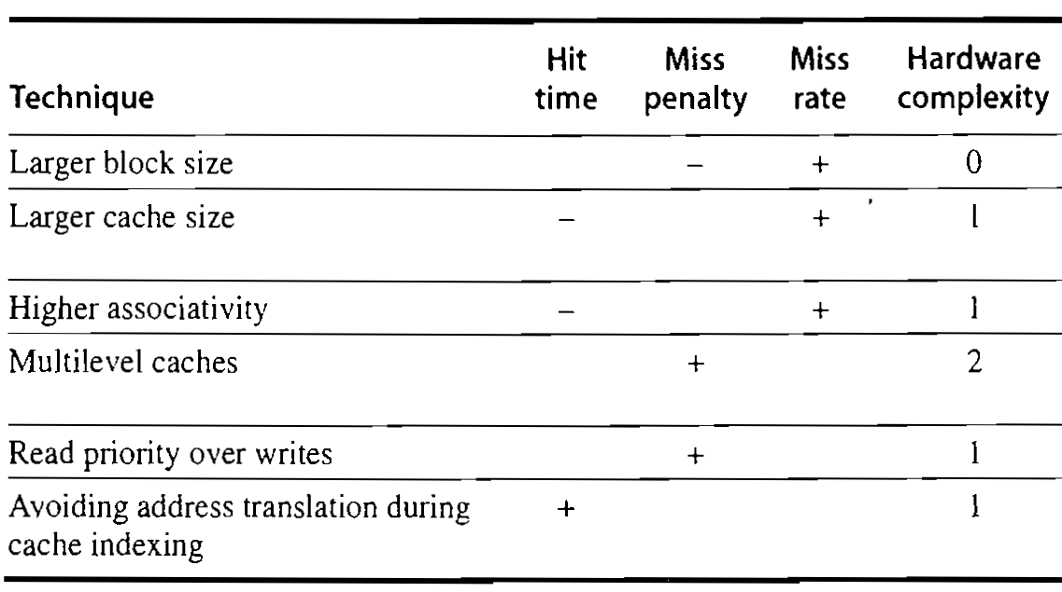
Impact of Cache Performance and Complexity

Slide 53
Local vs. Global Miss Rates
Local miss rate: fraction of references to a given level of a cache that miss
Local Miss rate L2$ = L2$ Misses / L1$ Misses = L2$ Misses / total_L2_accesses
Global miss rate: the fraction of references that miss in all levels of a multilevel cache and go all the way to memory
L2$ local miss rate >> than the global miss rate
Global Miss rate = L2$ Misses / Total Accesses
= (L2$ Misses / L1$ Misses) × (L1$ Misses / Total Accesses)
= Local Miss rate L2$ × Local Miss rate L1$
AMAT = Time for a hit + Miss rate × Miss penalty
AMAT = Time for a L1$ hit + (local) Miss rate L1$ × (Time for a L2$ hit + (local) Miss rate L2$ × L2$ Miss penalty)

Slide 54
Handling Stores with Write-Through
Store instructions write to memory, changing values
Need to make sure cache and memory have same values on writes: two policies
1) Write-Through Policy: write cache and write through the cache to memory
Every write eventually gets to memory
Too slow, so include Write Buffer to allow processor to continue once data in Buffer
Buffer updates memory in parallel to processor

Slide 55
Handling Stores with Write-Back
2) Write-Back Policy: write only to cache and then write cache block back to memory when evict block from cache
Writes collected in cache, only single write to memory per block
Include bit to see if wrote to block or not, and then only write back if bit is set
Called “Dirty” bit (writing makes it “dirty”)

Slide 56
Write-Through vs. Write-Back
Write-Through:
Simpler control logic
More predictable timing simplifies processor control logic
Easier to make reliable, since memory always has copy of data (big idea: Redundancy!)
Write-Back
More complex control logic
More variable timing (0,1,2 memory accesses per cache access)
Usually reduces write traffic
Harder to make reliable, sometimes cache has only copy of data

Slide 57
Write Policy Choices
Cache Hit:
Write through: writes both cache & memory on every access
Generally higher memory traffic but simpler pipeline & cache design
Write back: writes cache only, memory written only when dirty entry evicted
A dirty bit per line reduces write-back traffic
Must handle 0, 1, or 2 accesses to memory for each load/store
Cache Miss:
No write allocate: only write to main memory
Write allocate (aka fetch on write): fetch into cache
Common combinations:
Write through and no write allocate
Write back with write allocate

Slide 58
Write Performance
Tag
Index
Offset
b
t
k
V
Tag
Data
2^{k}
lines
t
=
WE
HIT
Data Word or Byte

Slide 59
Reducing Write Hit Time
Problem: Writes take two cycles in memory stage, one cycle for tag check plus one cycle for data write if hit
Solutions:
Design data RAM that can perform read and write in one cycle, restore old value after tag miss
Fully-associative (CAM Tag) caches: Word line only enabled if hit
Pipelined writes: Hold write data for store in single buffer ahead of cache, write cache data during next store’s tag check

Slide 60
Presence of L2 influences L1 design
Use smaller L1 if there is also L2
Trade increased L1 miss rate for reduced L1 hit time
Backup L2 reduces L1 miss penalty
Reduces average access energy
Use simpler write-through L1 with on-chip L2
Write-back L2 cache absorbs write traffic, doesn’t go off-chip
At most one L1 miss request per L1 access (no dirty victim write back) simplifies pipeline control
Simplifies coherence issues
Simplifies error recovery in L1 (can use just parity bits in L1 and reload from L2 when parity error detected on L1 read)

Slide 61
Cache Hits and Misses
1. 0x04 = 000 00 0100
Block size = 16 bytes
Tag | LRU
000 | *
Unique blocks accessed so far: 1
Compulsory Miss
1. 0x00000004
2. 0x000000D8
3. 0x00000005
4. 0x00000192
5. 0x000000D4
6. 0x000001BA
7. 0x00000083
8. 0x00000004
9. 0x00000191
1. Fully Associative Version:
Tag | LRU
00000 | * 01

Slide 62
Cache Hits and Misses
2. 0xD8 = 011 01 1000
Tag | LRU
000
011 | *
Unique blocks accessed so far: 2
Compulsory Miss
1. 0x00000004
2. 0x000000D8
3. 0x00000005
4. 0x00000192
5. 0x000000D4
6. 0x000001BA
7. 0x00000083
8. 0x00000004
9. 0x00000191
2. Fully Associative Version:
Tag | LRU
00000 | 00
01101 | * 01

Slide 63
Cache Hits and Misses
3. 0x05 = 000 00 0101
Tag | LRU
000 | *
011
Unique blocks accessed so far: 1
Hit (the tag matches, the block is in the cache, we just want a different byte inside the block when compared to the first access)
1. 0x00000004
2. 0x000000D8
3. 0x00000005
4. 0x00000192
5. 0x000000D4
6. 0x000001BA
7. 0x00000083
8. 0x00000004
9. 0x00000191
3. Fully Associative Version:
Tag | LRU
00000 | *01
01101 | 00

Slide 64
Cache Hits and Misses
4. 0x192 = 110 01 0010
Unique blocks accessed so far: 3
Compulsory Miss: note that the block with tag 011 was evicted to make room for the new block with tag 110. This is the first time we are accessing this block from memory and it is therefore a compulsory miss (no way to avoid it)
Tag | LRU
000
110 | *
1. 0x00000004
2. 0x000000D8
3. 0x00000005
4. 0x00000192
5. 0x000000D4
6. 0x000001BA
7. 0x00000083
8. 0x00000004
9. 0x00000191
4. Fully Associative Version:
Tag | LRU
00000 | 00
01101 | 01
11001 | * 10

Slide 65
Cache Hits and Misses
5. 0xD4 = 011 01 0100
Unique blocks accessed so far: 3
Conflict Miss: tag 011 was evicted in the 4th step. Both blocks mapped to the same cache index (01) and there’s only space for 1 block in that index. Use a fully associative cache to avoid evicting the 011 block in step 4. Therefore, it’s a conflict miss.
Tag | LRU
000
011 | *
5. Fully Associative Version:
1. 0x00000004
2. 0x000000D8
3. 0x00000005
4. 0x00000192
5. 0x000000D4
6. 0x000001BA
7. 0x00000083
8. 0x00000004
9. 0x00000191
Tag | LRU
00000 | 01
01101 | *10
11001 | 01

Slide 66
Cache Hits and Misses
6. 0x1BA = 110 11 1010
Tag | LRU
000
011
110 | *
Unique blocks accessed so far: 4
Compulsory Miss
1. 0x00000004
2. 0x000000D8
3. 0x00000005
4. 0x00000192
5. 0x000000D4
6. 0x000001BA
7. 0x00000083
8. 0x00000004
9. 0x00000191
6. Fully Associative Version:
Tag | LRU
00000 | 01
01101 | 10
11001 | 01
11011 | * 11

Slide 67
Cache Hits and Misses
Unique blocks accessed so far: 5
Compulsory Miss: this is the first time we are accessing this block from memory and it is therefore a compulsory miss (no way to avoid it). This could also count as a capacity miss because even if we made the cache fully associative, there was no way to avoid this miss.
7. 0x83 = 010 00 0011
Tag | LRU
010 | *
011
110
7. Fully Associative Version:
1. 0x00000004
2. 0x000000D8
3. 0x00000005
4. 0x00000192
5. 0x000000D4
6. 0x000001BA
7. 0x00000083
8. 0x00000004
9. 0x00000191
Tag | LRU
01000 | * 11
01101 | 01
11001 | 00
11011 | 10

Slide 68
Cache Hits and Misses
8. 0x04 = 000 00 0100
Unique blocks accessed so far: 5
Capacity Miss: this is not classified as a conflict miss because 5 unique blocks have been in/out of the cache so far. The only way to avoid this miss is to increase the cache size and it is therefore a capacity miss.
Tag | LRU
000 | *
011
110
8. Fully Associative Version:
1. 0x00000004
2. 0x000000D8
3. 0x00000005
4. 0x00000192
5. 0x000000D4
6. 0x000001BA
7. 0x00000083
8. 0x00000004
9. 0x00000191
Tag | LRU
01000 | 10
01101 | 00
00000 | * 11
11011 | 10

Slide 69
Cache Hits and Misses
9. 0x191 = 110 01 0001
Unique blocks accessed so far: 5
Capacity Miss: this is not a conflict miss because 5 unique blocks have been in/out of the cache so far. Even if we used a fully associative cache that can store 4 blocks, we could not store all 5 blocks and would still miss this cache access. The only way to avoid this miss is to increase the cache size and it is therefore a capacity miss.
Tag | LRU
000
110 | *
110
9. Fully Associative Version:
1. 0x00000004
2. 0x000000D8
3. 0x00000005
4. 0x00000192
5. 0x000000D4
6. 0x000001BA
7. 0x00000083
8. 0x00000004
9. 0x00000191
Tag | LRU
01000 | 01
01101 | * 11
00000 | 10
11011 | 00

Slide 70
Types of Parallelism in Applications
Instruction-level parallelism (ILP)
Multiple instructions in execution at the same time, e.g., instruction pipelining
Generated and managed by hardware (superscalar) or by compiler (VLIW)
Limited in practice by data and control dependences, i.e., pipeline hazards
Thread-level or task-level parallelism (TLP)
Multiple threads or instruction sequences from the same application can be executed concurrently
Thread: sequence of instructions, with own program counter and processor state (e.g., register file)
Multicore:
Physical CPU: One thread (at a time) per CPU, in software OS switches threads typically in response to I/O events like disk read/write
Logical CPU: Fine-grain thread switching, in hardware, when thread blocks due to cache miss/memory access
Hyperthreading (aka Simultaneous Multithreading--SMT): Exploit superscalar architecture to launch instructions from different threads at the same time!
Limited in practice by communication/synchronization overheads and by algorithm characteristics

Slide 71
Types of Parallelism in Applications
Data-level parallelism (DLP)
Instructions from a single stream operate concurrently on several data
Limited by non-regular data manipulation patterns and by memory bandwidth
Transaction-level parallelism
Multiple threads/processes from different transactions can be executed concurrently
Limited by concurrency overheads

Slide 72




Matrix Multiplication
$$j$$
B
C = A*B
C_{ij} = Σ_{k} (A_{ik} * B_{kj})
$$k$$
$$k$$
A
C
$$i$$

Slide 73
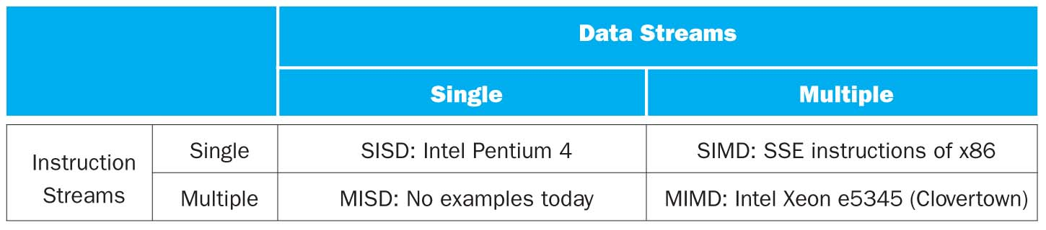
Flynn* Taxonomy, 1966
SIMD and MIMD are currently the most common parallelism in architectures – usually both in same system!
Most common parallel processing programming style: Single Program Multiple Data (“SPMD”)
Single program that runs on all processors of a MIMD
Cross-processor execution coordination using synchronization primitives

Slide 74
Potential Parallel Performance (assuming software can use it)
Year | Cores | SIMD bits /Core | Core * SIMD bits | Total, e.g. FLOPs/Cycle
2003 | 2 | 128 | 256 | 4
2005 | 4 | 128 | 512 | 8
2007 | 6 | 128 | 768 | 12
2009 | 8 | 128 | 1024 | 16
2011 | 10 | 256 | 2560 | 40
2013 | 12 | 256 | 3072 | 48
2015 | 14 | 512 | 7168 | 112
2017 | 16 | 512 | 8192 | 128
2019 | 18 | 1024 | 18432 | 288
2021 | 20 | 1024 | 20480 | 320
MIMD
SIMD
MIMD & SIMD
+2/
2yrs
2X/
4yrs
12
years
2.5X
8X
20X
20 x in 12 years
20^{1/12} = 1.28 x → 28% per year or 2x every 3 years!
IF (!) we can use it

Slide 75
Big Idea: Amdahl’s Law
Speedup = T_{O} / T_{E} = 1 / ((1-F) + F/S_{E})
Part not sped up
Part sped up
Example: The execution time of half of a program can be accelerated by a factor of 2. What is the program speed-up overall?
T_{O} / T_{E} = 1 / ((1-F) + F/S_{E}) = 1/((1- 0.5)+0.5/2) = 1.33 << 2

Slide 76
Maximum “Achievable” Speed-Up
Speedup = 1 / ((1-F) + F/S_{E})
(S_{E}->∞) = 1/(1-F)
Question: What is a reasonable # of parallel processors to speed up an algorithm with F = 95%? (i.e. 19/20th can be sped up)
a) Maximum speedup: S_{max} = 1/(1-0.95) = 20
but needs S_{E}=∞!
Reasonable “engineering” compromise:
Equal time in sequential and parallel code: (1-F) = F/S_{E}
S_{E} = F/(1-F) = 0.95/0.05 = 20
S = 1/(0.05+0.05) = 10

Slide 77
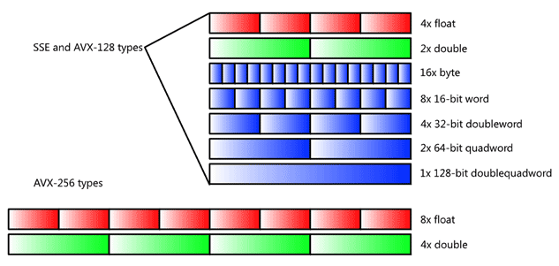
SIMD Data Types
(Now also AVX-512 available)

Slide 78
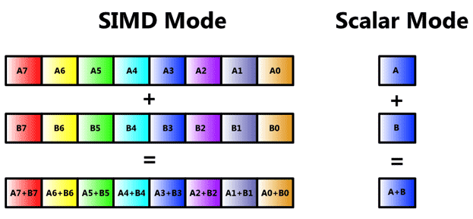
SIMD Vector Mode

Slide 79
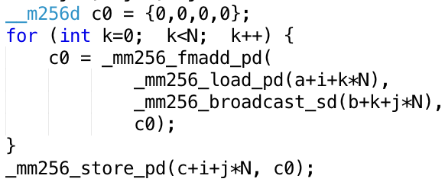




Vectorized Matrix Multiplication
for i …; i+=4
for j ...
$$j$$
Inner Loop:
$$k$$
$$k$$
i += 4
$$i$$

Slide 80
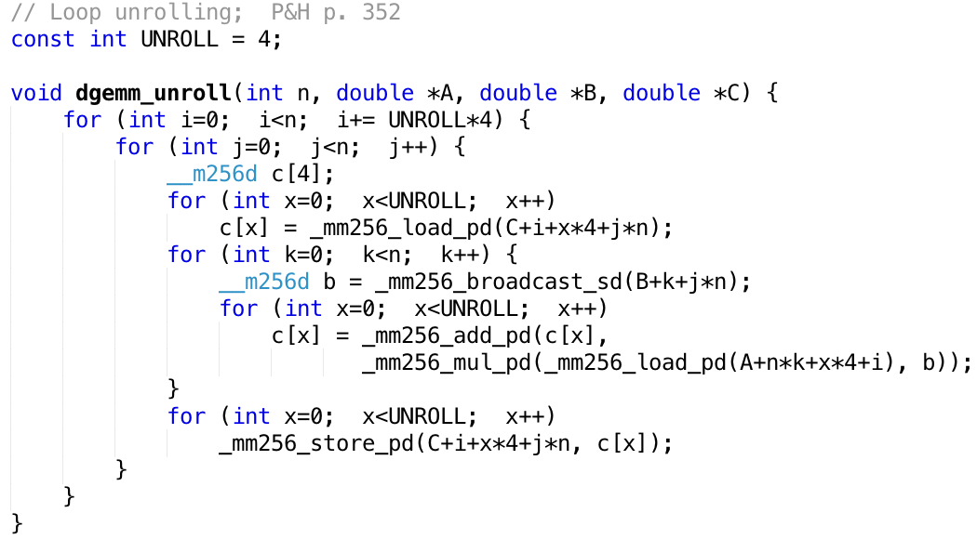
Loop Unrolling
4 registers
Compiler does the unrolling
How do you verify that the generated code is actually unrolled?

Slide 81
FPU versus Memory Access
How many floating-point operations does matrix multiply take?
F = 2 x N³ (N³ multiplies, N³ adds)
How many memory load/stores?
M = 3 x N² (for A, B, C)
Many more floating-point operations than memory accesses
q = F/M = 2/3 * N
Good, since arithmetic is faster than memory access
Let’s check the code …

Slide 82
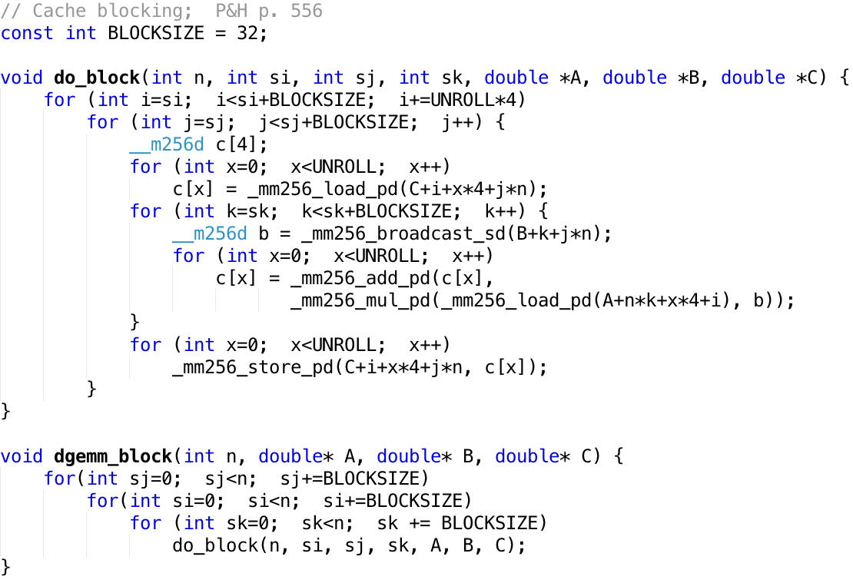
Memory Access Blocking

Slide 83
Performance
N | Gflops
 | scalar | avx | unroll | blocking
32 | 1.30 | 4.56 | 12.95 | 13.80
160 | 1.30 | 5.47 | 19.70 | 21.79
480 | 1.32 | 5.27 | 14.50 | 20.17
960 | 0.91 | 3.64 | 6.91 | 15.82

Slide 84
Simple Multithreaded Pipeline
X
PC
1
GPR1
PC
1
I$
IR
GPR1
PC
1
GPR1
PC
1
GPR1
D$
Y
+1
2
Thread select
2
Have to carry thread select down pipeline to ensure correct state bits read/written at each pipe stage
Appears to software (including OS) as multiple, albeit slower, CPUs

Slide 85
Multithreading Costs
Each thread requires its own user state
PC
GPRs
Also, needs its own system state
Virtual-memory page-table-base register
Exception-handling registers
Other overheads:
Additional cache/TLB conflicts from competing threads
(or add larger cache/TLB capacity)
More OS overhead to schedule more threads (where do all these threads come from?)

Slide 86
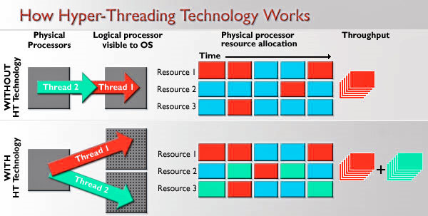
Hyperthreading
SMT (HT): Logical CPUs > Physical CPUs
Run multiple threads at the same time per core
Each thread has own architectural state (PC, Registers, etc.)
Share resources (cache, instruction unit, execution units)
Improves Core CPI (clock ticks per instruction)
May degrade Thread CPI (Utilization/Bandwidth v. Latency)
See http://dada.cs.washington.edu/smt/

Slide 87
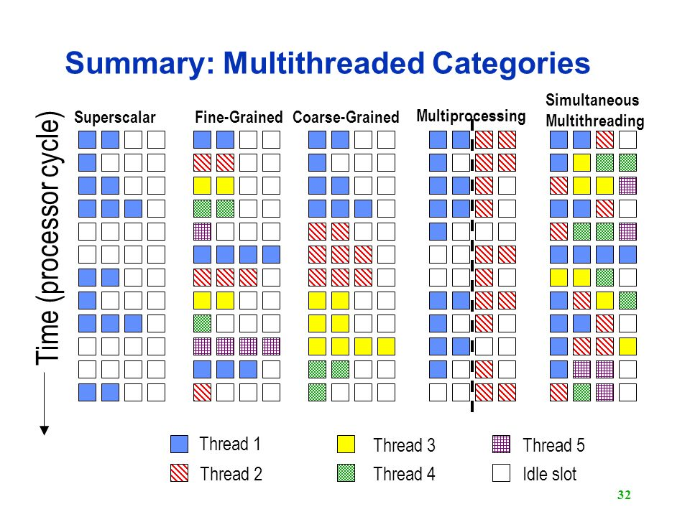
Multithreaded Categories

Slide 88
Parallel Loops
Serial execution:
for (int i=0; i<100; i++) {
…
}
Parallel Execution:
for (int i=0; i<25; i++) { … } | for (int i=25; i<50; i++) { … } | for (int i=50; i<75; i++) { … } | for (int i=75; i<100; i++) { … }

Slide 89
Parallel for in OpenMP
#include <omp.h>
#pragma omp parallel for
for (int i=0; i<100; i++) {
…
}

Slide 90
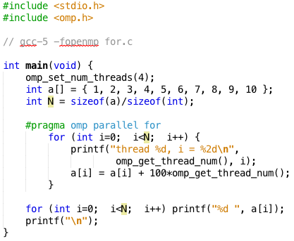
OpenMP Example
$ gcc-5 -fopenmp for.c;./a.out
thread 0, i = 0
thread 1, i = 3
thread 2, i = 6
thread 3, i = 8
thread 0, i = 1
thread 1, i = 4
thread 2, i = 7
thread 3, i = 9
thread 0, i = 2
thread 1, i = 5
01 02 03 14 15 16 27 28 39 40

Slide 91
OpenMP
C extension: no new language to learn
Multi-threaded, shared-memory parallelism
Compiler Directives, #pragma
Runtime Library Routines, #include <omp.h>
#pragma
Ignored by compilers unaware of OpenMP
Same source for multiple architectures
E.g., same program for 1 & 16 cores
Only works with shared memory

Slide 92
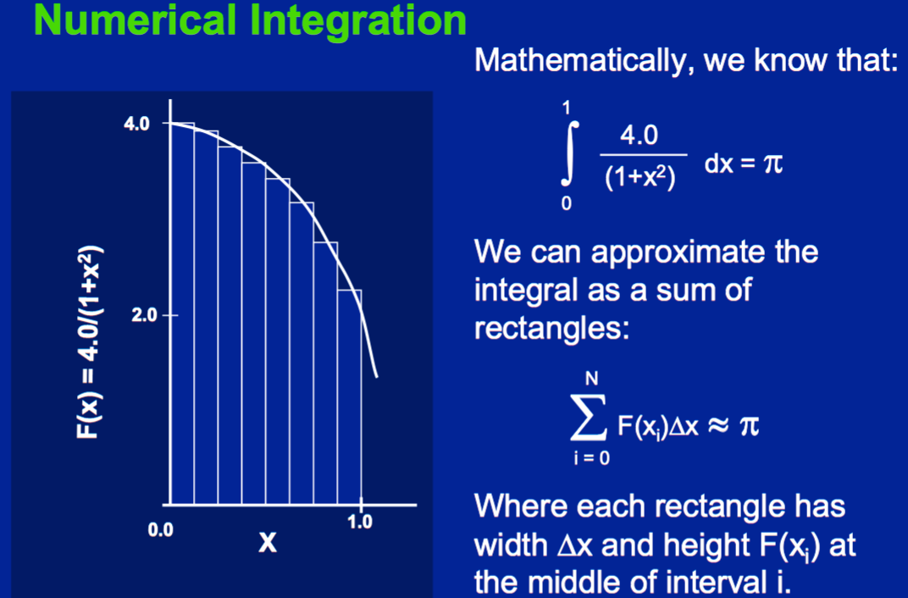
Example 2: Computing π
http://openmp.org/mp-documents/omp-hands-on-SC08.pdf

Slide 93
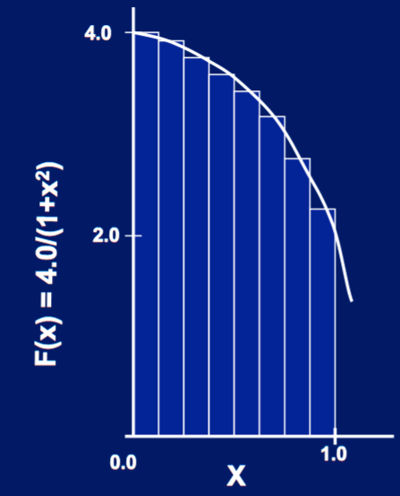
Parallelize (2) …
Compute
sum[0] and sum[1]
in parallel
Compute
sum = sum[0] + sum[1]
sequentially
sum[0]
sum[1]

Slide 94
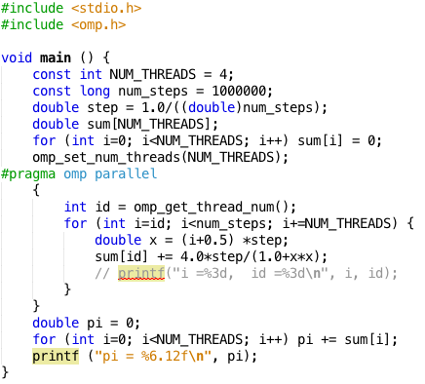
Parallel π
Scale up: num_steps = 10⁶
pi = 3.141592653590
You verify how many digits are correct …

Slide 95
OpenMP Reduction
double avg, sum=0.0, A[MAX]; int i;
#pragma omp parallel for private ( sum )
for (i = 0; i <= MAX ; i++) sum += A[i];
avg = sum/MAX; // bug
Problem is that we really want sum over all threads!
Reduction: specifies that 1 or more variables that are private to each thread are subject of reduction operation at end of parallel region: reduction(operation:var) where
Operation: operator to perform on the variables (var) at the end of the parallel region
Var: One or more variables on which to perform scalar reduction.
double avg, sum=0.0, A[MAX]; int i;
#pragma omp for reduction(+ : sum)
for (i = 0; i <= MAX ; i++) sum += A[i];
avg = sum/MAX;

Slide 96
Version 2: parallel for, reduction
#include <omp.h>
#include <stdio.h>
/static long num_steps = 100000;
double step;
void main ()
{ int i; double x, pi, sum = 0.0;
step = 1.0/(double) num_steps;
#pragma omp parallel for private(x) reduction(+:sum)
for (i=1; i<= num_steps; i++){
x = (i-0.5)*step;
sum = sum + 4.0/(1.0+x*x);
}
pi = sum;
printf ("pi = %6.8f\n", pi);
}
Notes:
我们在#pragma omp parallel for 后面加上了 reduction(+:sum)，它的意思是告诉编译器：下面的for循环你要分成多个线程跑，但每个线程都要保存变量sum的拷贝，循环结束后，所有线程把自己的sum累加起来作为最后的输出。

Slide 97
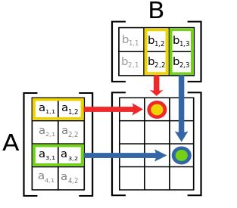
Matrix Multiply in OpenMP
// C[M][N] = A[M][P] × B[P][N]
start_time = omp_get_wtime();
#pragma omp parallel for private(tmp, j, k)
for (i=0; i<M; i++){
for (j=0; j<N; j++){
tmp = 0.0;
for (k=0; k<P; k++){
/* C(i,j) = sum(over k) A(i,k) * B(k,j)*/
tmp += A[i][k] * B[k][j];
}
C[i][j] = tmp;
}
}
run_time = omp_get_wtime() - start_time;
Outer loop spread across N threads; inner loops inside a single thread

Slide 98
Multiprocessor Caches
Memory is a performance bottleneck even with one processor
Use caches to reduce bandwidth demands on main memory
Each core has a local private cache holding data it has accessed recently
Only cache misses have to access the shared common memory
Processor
Processor
Processor
Cache
Cache
Cache
Interconnection Network
Memory
I/O

Slide 99
Shared Memory and Caches
What if?
Processors 1 and 2 read Memory[1000] (value 20)
Processor 0
Processor 1
Processor 2
1000
1000
Cache
Cache
Cache
1000
1000
Interconnection Network
20
Memory
20
I/O

Slide 100
Shared Memory and Caches
Now:
Processor 0 writes Memory[1000] with 40
1000
Processor 0
Processor 1
Processor 2
Cache
Cache
Cache
1000 40
1000 20
1000 20
Interconnection Network
Memory
1000 40
I/O
Problem?

Slide 101
Keeping Multiple Caches Coherent
Architect’s job: shared memory => keep cache values coherent
Idea: When any processor has cache miss or writes, notify other processors via interconnection network
If only reading, many processors can have copies
If a processor writes, invalidate any other copies
Write transactions from one processor, other caches “snoop” the common interconnect checking for tags they hold
Invalidate any copies of same address modified in other cache

Slide 102
Snoopy Cache, Goodman 1983
Idea: Have cache watch (or snoop upon) other memory transactions, and then “do the right thing”
Snoopy cache tags are dual-ported
Used to drive Memory Bus
when Cache is Bus Master
A
A
Snoopy read port
attached to Memory
Bus
Tags and
State
Proc.
R/W
R/W
Data
(lines)
D
Cache

Slide 103
How Does HW Keep $ Coherent?
Each cache tracks state of each block in cache:
Shared: up-to-date data, other caches may have a copy
Modified: up-to-date data, changed (dirty), no other cache has a copy, OK to write, memory out-of-date
Exclusive: up-to-date data, no other cache has a copy, OK to write, memory up-to-date
Avoids writing to memory if block replaced
Supplies data on read instead of going to memory
Owner: up-to-date data, other caches may have a copy (they must be in Shared state)
Only cache that supplies data on read instead of going to memory
Two Optional Performance Optimizations of Cache Coherency via New States

Slide 104
Cache State-Transition Diagram The MSI protocol
Each cache line has state bits
M: Modified
S: Shared
I: Invalid
Address tag
state
bits
Write miss
(P1 gets line from memory)
P₁ reads
or writes
M
Other processor reads
(P₁ writes back)
Read miss
(P1 gets line from memory)
P₁ intent to write
Other processor
intent to write (P₁ writes back)
S
I
Read by any
processor
Other processor
intent to write
Cache state in processor P₁

Slide 105
Two-Processor Example (Reading and writing the same cache line)
P₁ reads
P₁
P₁ reads
or writes
P₂ reads,
P₁ writes back
M
P₁ writes
P₂ reads
Write miss
P₂ writes
P₁ intent to write
P₂ intent to write
P₁ reads
P₁ writes
Read
miss
P₂ writes
S
I
P₁ writes
P₂ intent to write
P₂
P₂ reads
or writes
P₁ reads,
P₂ writes back
M
Write miss
P₂ intent to write
P₁ intent to write
Read
miss
S
I
P₁ intent to write

Slide 106
MESI: An Enhanced MSI protocol increased performance for private data
Each cache line has a tag
M: Modified Exclusive
E: Exclusive but unmodified
S: Shared
I: Invalid
Address tag
state
bits
Write miss
P₁ write
P₁ read
P₁ write
or read
M
E
Read miss, not shared
Other processor
reads
P₁ intent to write
Other processor reads
P₁ writes back
Other processor
intent to write
Other processor intent to write, P1 writes back
Read miss,
shared
S
I
Read by any
processor
Other processor
intent to write
Cache state in processor P₁

Slide 107
Shared Memory and Caches
Example, now with cache coherence
Processors 1 and 2 read Memory[1000]
Processor 0 writes Memory[1000] with 40
1000
Processor 0
Processor 1
Processor 2
Cache
Cache
1000 20
1000 40
1000 20
Cache
Processor 0
Write
Invalidates
Other Copies
Interconnection Network
Memory
1000 40
I/O

Slide 108
Read miss, to uncached or shared line
CPU
Load request at head of CPU->Cache queue.
Update cache tag and data and return load data to CPU.
1
9
Load misses in cache.
Cache
2
ShRep arrives at cache.
Send ShReq message to directory.
8
3
Interconnection Network
Message received at directory controller.
Send ShRep message with contents of cache line.
7
4
Directory Controller
Update directory by setting bit for new processor sharer.
DRAM Bank
6
Access state and directory for line. Line’s state is R, with zero or more sharers.
5
Notes:
Delay is a fact of life
Serialization by directory, no longer the bus
SC not guarantied

Slide 109
Write miss, to read shared line
Multiple sharers
CPU
CPU
CPU
CPU
Store request at head of CPU->Cache queue.
Update cache tag and data, then store data from CPU
1
Invalidate cache line. Send InvRep to directory.
12
Store misses in cache.
Cache
Cache
2
Cache
ExRep arrives at cache
Cache
InvReq arrives at cache.
Send ExReq message to directory.
3
11
8
7
Interconnection Network
ExReq message received at directory controller.
When no more sharers, send ExRep to cache.
10
4
InvRep received. Clear down sharer bit.
9
Directory Controller
Send one InvReq message to each sharer.
6
DRAM Bank
Access state and directory for line. Line’s state is R, with some set of sharers.
5
Notes:
Delay is a fact of life
Serialization by directory, no longer the bus
SC not guarantied

Slide 110
Directory Operation
Example: load with no sharers
Line state
Sharing vector
Memory
P0
Load
0
10
0 | 0 | 10
4
L1
Line state
0
10
4
Value
Miss
P1
L1
Line state
0
0
P2
L1
Line state
0
0
Cache states: 00 = invalid
01 = shared
10 = modified
Dir. states:
00 = not cached 01 = shared
10 = modified

Slide 111
Directory Operation
Example: load with sharers
Line state
Sharing vector
Memory
P0
0 | 10 | 1
L1
0
1
4
Line state
0
1
4
Load
Line state
P1
L1
Value
0
10
4
P2
L1
Line state
0
0
Cache states: 00 = invalid
01 = shared
10 = modified
Dir. states:
00 = not cached 01 = shared
10 = modified
Miss

Slide 112
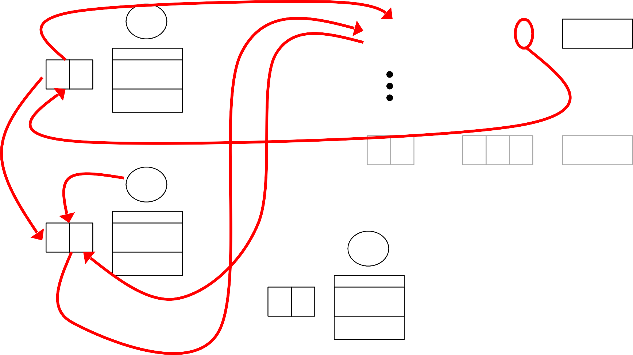
Directory Operation
Example: store with sharers
Acknowledge
Line state
Sharing vector
Memory
P0
0 | 1 | 01
Acknowledge
Line state 0 01
L1
10
01
4
4
Invalidate
Store
Line state 10 01
P1
Reply
L1
64
P2
Line state 0 0
L1
Cache states: 00 = invalid
01 = shared
10 = modified
Dir. states:
00 = not cached 01 = shared
10 = modified
Miss

Slide 113
Directory Operation
Example: load with owner
Line state
Sharing vector
Memory
P0
46
L1
01
10
10
1
0
Line state
0
0
4
Forward
Miss
P1
L1
Line state
Acknowledge+Value
01
10
6
Load
Line state
P2
L1
0
10
6
Cache states: 00 = invalid
01 = shared
10 = modified
Dir. states:
00 = not cached 01 = shared
10 = modified
Value

Slide 114
Directory Coherence Protocol
Snooping coherence
Global state of a memory line is the collection of its state in all caches, and there is no summary state anywhere
All cache controllers monitor all other caches’ activities and maintain the state of their lines
Requires a broadcast shared medium (e.g., bus or ring) that also maintains a total order of all transactions
Bus acts as a serialization point to provide ordering
Directory coherence
Global state of a memory line is the collection of its state in all caches, but there is a summary state at the directory
Cache controllers do not observe all activity, but interact only with directory
Can be implemented on scalable networks, where there is no total order and no simple broadcast, but only one-to-one communication
Directory acts as a serialization point to provide ordering

Slide 115
False Sharing
state line addr data0 data1 ... dataN
A cache line contains more than one word
Cache-coherence is done at the line-level and not word-level
Suppose M1 writes wordi and M2 writes wordk and i ≠ k but both words have the same line address.
What can happen?

Slide 116
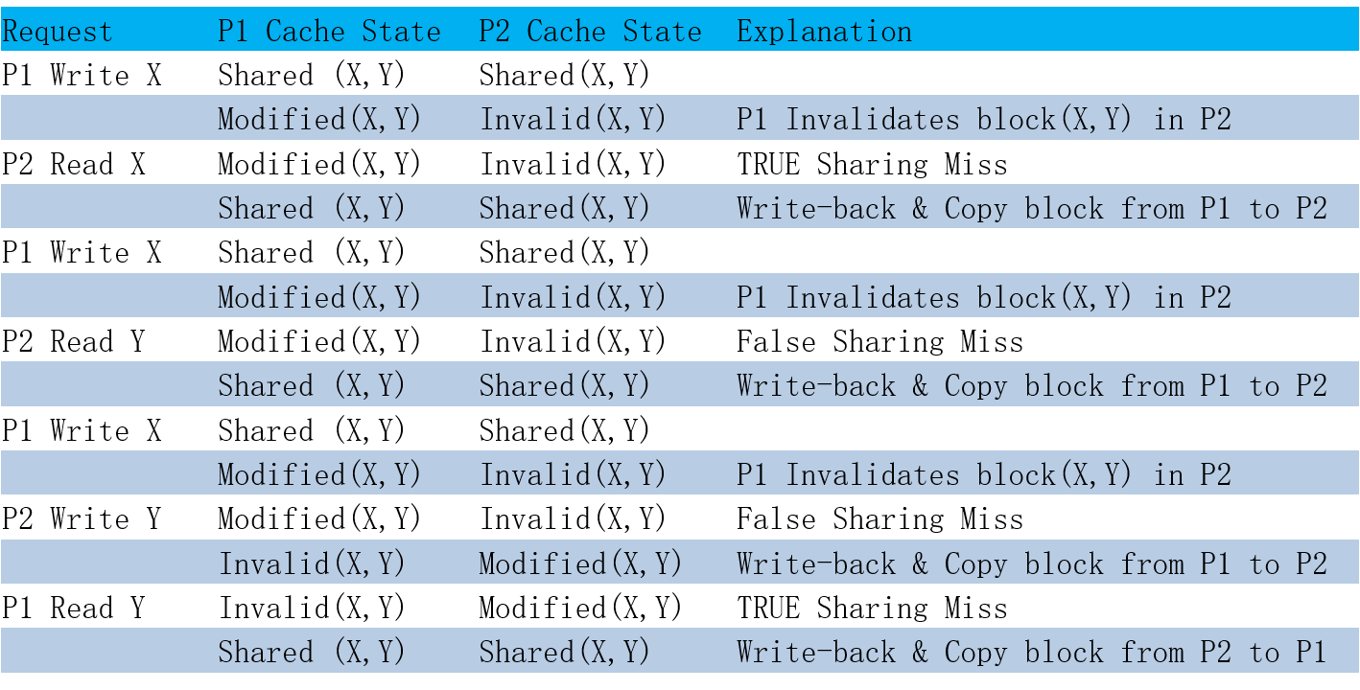
Example: True v. False Sharing v. Hit?
Assume X and Y in same cache line. P1 and P2 both read X and Y before.

Slide 117
Issues in Complex Pipeline Control
Structural conflicts at the execution stage if some FPU or memory unit is not pipelined and takes more than one cycle
Structural conflicts at the write-back stage due to variable latencies of different functional units
Out-of-order write hazards due to variable latencies of different functional units
How to handle exceptions?
ALU
Mem
IF
ID
Issue
WB
Fadd
GPRs
FPRs
Fmul
Fdiv

Slide 118
Types of Data Hazards
Consider executing a sequence of
r_{k} ← r_{i} op r_{j}
type of instructions
Data-dependence
r₃ ← r₁ op r₂ Read-after-Write
r₅ ← r₃ op r₄ (RAW) hazard
Anti-dependence
r₃ ← r₁ op r₂ Write-after-Read
r₁ ← r₄ op r₅ (WAR) hazard
Output-dependence
r₃ ← r₁ op r₂ Write-after-Write
r₃ ← r₆ op r₇ (WAW) hazard

Slide 119
A Data Structure for Correct Issues Keeps track of the status of Functional Units
Name Busy Op Dest Src1 Src2
Int
Mem
Add1
Add2
Add3
Mult1
Mult2
Div
The instruction i at the Issue stage consults this table
FU available? check the busy column
RAW? search the dest column for i’s sources
WAR? search the source columns for i’s destination
WAW? search the dest column for i’s destination
An entry is added to the table if no hazard is detected;
An entry is removed from the table after Write-Back

Slide 120
Scoreboard for In-order Issues
Busy[FU#] : a bit-vector to indicate FU’s availability.
(FU = Int, Add, Mult, Div)
These bits are hardwired to FU's.
WP[reg#] : a bit-vector to record the registers for which writes are pending.
These bits are set by Issue stage and cleared by WB stage
Issue checks the instruction (opcode dest src1 src2)
against the scoreboard (Busy & WP) to dispatch
FU available?
RAW?
WAR?
WAW?
Busy[FU#]
WP[src1] or WP[src2]
cannot arise
WP[dest]

Slide 121
Scoreboard Dynamics
Functional Unit Status Registers Reserved
Int(1) Add(1) Mult(3) Div(4) WB for Writes
t0 I₁ f6 f6
t1 I₂ f2 f6 f6, f2
t2 f6 f2 f6, f2 I₂
t3 I₃ f0 f6 f6, f0
t4 f0 f6 f6, f0 I₁
t5 I₄ f0 f8 f0, f8
t6 f8 f0 f0, f8 I₃
t7 I₅ f10 f8 f8, f10
t8 f8 f10 f8, f10 I₅
t9 f8 f8 I₄
t10 I₆ f6 f6
t11 f6 f6 I₆
I₁ FDIV.D f6, f6, f4
I₂ FLD f2, 45(x3)
I₃ FMULT.D f0, f2, f4
I₄ FDIV.D f8, f6, f2
I₅ FSUB.D f10, f0, f6
I₆ FADD.D f6, f8, f2

Slide 122
Out-of-order Completion In-order Issue
Latency
I₁ FDIV.D f6, f6, f4 4
I₂ FLD f2, 45(x3) 1
I₃ FMULT.D f0, f2, f4 3
I₄ FDIV.D f8, f6, f2 4
I₅ FSUB.D f10, f0, f6 1
I₆ FADD.D f6, f8, f2 1
in-order comp 1 2
out-of-order comp 1 2
1 2 3 4 3 5 4 6 5 6
2 3 1 4 3 5 5 4 6 6

Slide 123
In-Order Issue Limitations: an example
latency
1
2
1 | LD | F2, | 34(R2) |  | 1
2 | LD | F4, | 45(R3) |  | long
3 | MULTD | F6, | F4, | F2 | 3
4 | SUBD | F8, | F2, | F2 | 1
5 | DIVD | F4, | F2, | F8 | 4
6 | ADDD | F10, | F6, | F4 | 1
4
3
5
6
In-order: 1 (2,1) . . . . . . 2 3 4 4 3 5 . . . 5 6 6
Out-of-order: 1 (2,1) 4 4 . . . . 2 3 . . 3 5 . . . 5 6 6
Out-of-order execution did not allow any significant improvement!

Slide 124
Issue Limitations: In-Order and Out-of-Order
latency
1
2
1 | LD | F2, | 34(R2) |  |  | 1
2 | LD | F4, | 45(R3) |  |  | long
3 | MULTD | F6, | F4, |  | F2 | 3
4 | SUBD | F8, | F2, |  | F2 | 1
5 | DIVD | F4’, | F2, |  | F8 | 4
6 | ADDD | F10, | F6, |  | F4’ | 1
In-order: |  | 1 (2,1) . . . . . |  | . 2 3 4 4 3 5 .
Out-of-order: |  | 1 (2,1) 4 4 5 . . |  | . 2 (3,5) 3 6 6
4
3
X
5
6
. . 5 6 6
Any antidependence can be eliminated by renaming. (renaming ⇒ additional storage)
Can it be done in hardware?
yes!

Slide 125
Register Renaming
Decode does register renaming and adds instructions to the issue stage reorder buffer (ROB)
renaming makes WAR or WAW hazards impossible
Any instruction in ROB whose RAW hazards have been satisfied can be dispatched.
Out-of-order or dataflow execution
ALU
Mem
IF
ID
Issue
WB
Fadd
Fmul

Slide 126
Renaming & Out-of-order Issue An example
Renaming table Reorder buffer
p data Ins# use exec op p1 src1 p2 src2
F1 F2 F3 F4 F5 F6 F7 F8
t₁ t₂
.
.
.
data / t_{i}
1
2
3
4
5
6
LD
F2,
34(R2)
45(R3) F4, F2
F2, F2
F4, F2, F8
F10, F6, F4
LD F4,
When are names in sources replaced by data?
Whenever an FU produces data
When can a name be reused?
Whenever an instruction completes
MULTD F6, SUBD F8,
DIVD ADDD

Slide 127
Reorder Buffer Management
Ins# use exec op p1 src1 p2 src2
ptr₂
next to
deallocate
t₁
t₂
.
.
.
t_{n}
Destination registers are renamed to the instruction’s slot tag
ptr₁
next
available
ROB managed circularly
“exec” bit is set when instruction begins execution
When an instruction completes its “use” bit is marked free
ptr₂ is incremented only if the “use” bit is marked free
Instruction slot is candidate for execution when:
It holds a valid instruction (“use” bit is set)
It has not already started execution (“exec” bit is clear)
Both operands are available (p1 and p2 are set)

Slide 128
Renaming & Out-of-order Issue
An example
Renaming table
Reorder buffer
p data
f1
f2
f3
f4
f5
f6
f7
f8
Ins# use exec op p1 src1 p2 src2
1 1 1 LD
t₁
t₂
t₃
t₄
t₅
.
.
1 0
1 1 0 LD
v1
2 1 1 LD
t1
2 1 0 LD
2 0
3 1 0 MUL 0 t2 1 v1
3 1 0 MUL 1 v2 1 v1
4 0
t5
4 1 0 SUB 1 v1 1 v1
t2
4 1 1 SUB 1 v1 1 v1
5 1 0 DIV 1 v1 0 t4
5 1 0 DIV 1 v1 1 v4
t3
v4
t4
data / t_{i}
1 FLD f2, 34(x2)
2 FLD f4, 45(x3)
3 FMULT.D f6, f4, f2
4 FSUB.D f8, f2, f2
5 FDIV.D f4, f2, f8
6 FADD.D f10, f6, f4
When are tags in sources
replaced by data?
When can a name be reused?
Whenever an FU produces data
Whenever an instruction completes

Slide 129
In-Order Commit for Precise Exceptions
In-order Out-of-order
In-order
Fetch Decode
Commit
Reorder Buffer
Kill
Kill
Kill
Execute
Inject handler PC
Exception?
Instructions fetched and decoded into instruction reorder buffer in-order
Execution is out-of-order ( ⇒ out-of-order completion)
Commit (write-back to architectural state, i.e., regfile & memory, is in-order
Temporary storage needed to hold results before commit (shadow registers and store buffers)

Slide 130

Extensions for Precise Exceptions
Inst# use exec op p1 src1 p2 src2 pd dest data cause
ptr₂ next to commit
ptr₁ next available
Reorder buffer
add <pd, dest, data, cause> fields in the instruction template
commit instructions to reg file and memory in program order ⇒ buffers can be maintained circularly
on exception, clear reorder buffer by resetting ptr₁=ptr₂
(stores must wait for commit before updating memory)

Slide 131
Control-Flow Penalty
Next fetch started
PC
I-cache
Fetch
Modern processors may have > 10 pipeline stages between next PC calculation and branch resolution !
Fetch Buffer
Decode
Issue
Buffer
How much work is lost if pipeline doesn’t follow correct instruction flow?
Execute
Func.
Units
~ Loop length x pipeline width + buffers
Result
Buffer
Branch executed
Commit
Arch.
State

Slide 132
Reducing Control-Flow Penalty
Software solutions
Eliminate branches - loop unrolling
Increases the run length
Reduce resolution time - instruction scheduling
Compute the branch condition as early as possible (of limited value because branches often in critical path through code)
Hardware solutions
Find something else to do (delay slots)
Replaces pipeline bubbles with useful work (requires software cooperation) – quickly see diminishing returns
Speculate, i.e., branch prediction
Speculative execution of instructions beyond the branch
Many advances in accuracy, widely used

Slide 133
Branch Prediction
Motivation:
Branch penalties limit performance of deeply pipelined processors
Modern branch predictors have high accuracy
(>95%) and can reduce branch penalties significantly
Required hardware support:
Prediction structures:
Branch history tables, branch target buffers, etc.
Mispredict recovery mechanisms:
Keep result computation separate from commit
Kill instructions following branch in pipeline
Restore state to that following branch

Slide 134
Static Branch Prediction
Overall probability a branch is taken is ~60-70% but:
backward
90%
forward
50%
ISA can attach preferred direction semantics to branches, e.g., Motorola MC88110
bne0 (preferred taken) beq0 (not taken)
ISA can allow arbitrary choice of statically predicted direction, e.g., HP PA-RISC, Intel IA-64 typically reported as ~80% accurate

Slide 135
Dynamic Branch Prediction learning based on past behavior
Temporal correlation
The way a branch resolves may be a good predictor of the way it will resolve at the next execution
Spatial correlation
Several branches may resolve in a highly correlated manner (a preferred path of execution)

Slide 136
Branch Prediction Bits
Assume 2 BP bits per instruction
Change the prediction after two consecutive mistakes!
¬take
wrong
¬ taken
taken
taken
taken
¬ taken
take
right
¬take
right
taken
¬ taken
¬ taken
take
wrong
BP state:
(predict take/¬take) x (last prediction right/wrong)

Slide 137
Branch History Table (BHT)
Fetch PC
0
0
I-Cache
k
2^{k}-entry
BHT,
2 bits/entry
BHT Index
Instruction
Opcode
offset
+
Branch?
Target PC
Taken/¬Taken?
4K-entry BHT, 2 bits/entry, ~80-90% correct predictions

Slide 138
Two-Level Branch Predictor
Pentium Pro uses the result from the last two branches
to select one of the four sets of BHT bits (~95% correct)
0
0
Fetch PC
k
2-bit global branch history shift register
Shift in Taken/¬Taken results of each branch
Taken/¬Taken?

Slide 139
Limitations of BHTs
Only predicts branch direction. Therefore, cannot redirect fetch stream until after branch target is determined.
Correctly predicted
taken branch penalty
A
PC Generation/Mux
P
Instruction Fetch Stage 1
F
Instruction Fetch Stage 2
B
Branch Address Calc/Begin Decode
I
Complete Decode
Jump Register penalty
J
Steer Instructions to Functional units
R
Register File Read
E
Integer Execute
Remainder of execute pipeline
(+ another 6 stages)
UltraSPARC-III fetch pipeline

Slide 140
Branch Target Buffer (BTB)
I-Cache
2^{k}-entry direct-mapped BTB
(can also be associative)
PC
Entry PC
Valid
predicted
target PC
k
=
match
valid
target
Keep both the branch PC and target PC in the BTB
PC+4 is fetched if match fails
Only taken branches and jumps held in BTB
Next PC determined before branch fetched and decoded

Slide 141
Combining BTB and BHT
BTB entries are considerably more expensive than BHT, but can redirect fetches at earlier stage in pipeline and can accelerate indirect branches (JR)
BHT can hold many more entries and is more accurate
A
PC Generation/Mux
BTB
P
Instruction Fetch Stage 1
F
Instruction Fetch Stage 2
BHT in later pipeline stage corrects when BTB misses a predicted taken branch
BHT
B
Branch Address Calc/Begin Decode
I
Complete Decode
J
Steer Instructions to Functional units
R
Register File Read
E
Integer Execute
BTB/BHT only updated after branch resolves in E stage

Slide 142
Mispredict Recovery
t
v
Rename
Snapshots
Register File
Rename
Table
t
v
t
v
r₁
t
v
r₂
Ptr₂ next to commit
Ins# use exec op p1 src1 p2 src2 pd dest data
t₁
t₂
.
.
t_{n}
rollback next available
Ptr₁ next available
Reorder
Buffer
Commit
Load
Unit
FU
FU
Store
Unit
FU
< t, result >
Take snapshot of register rename table at each predicted branch, recover earlier snapshot if branch mispredicted

Slide 143
Unified Physical Register File (MIPS R10K, Alpha 21264, Intel Pentium 4 & Sandy/Ivy Bridge)
Rename all architectural registers into a single physical register file during decode, no register values read
Functional units read and write from single unified register file holding committed and temporary registers in execute
Commit only updates mapping of architectural register to physical register, no data movement
Decode Stage Register Mapping
Unified Physical Register File
Committed Register Mapping
Read operands at issue
Write results at completion
Functional Units

Slide 144
Physical Register Management
Rename Table
Physical Regs
Free List
P0
P0
x0
P1
P1
x1
P2
ld x1, 0(x3)
addi x3, x1, #4
sub x6, x7, x6
add x3, x3, x6
ld x6, 0(x1)
P8
P3
x2
P3
P2
x3
P7
P4
P4
x4
P5
<x6>
p
x5
P6
<x7>
p
x6
P5
P7
<x3>
p
x7
P6
P8
<x1>
p
Pn
ROB
use
ex
op
p1
PR1
p2
PR2
Rd
LPRd
PRd
(LPRd requires third read port on Rename Table for each instruction)

Slide 145
Physical Register Management
Rename Table
Physical Regs
Free List
P0
P0
x0
P1
P1
x1
P0
P2
ld x1, 0(x3)
addi x3, x1, #4
sub x6, x7, x6
add x3, x3, x6
ld x6, 0(x1)
P8
P3
x2
P3
P2
x3
P7
P4
P4
x4
P5
<x6>
p
x5
P6
<x7>
p
x6
P5
P7
<x3>
p
x7
P6
P8
<x1>
p
Pn
ROB
use
ex
op
p1
PR1
p2
PR2
Rd
LPRd
PRd
x ld p P7 x1 P0
P8

Slide 146
Physical Register Management
Rename Table
Physical Regs
Free List
P0
P0
x0
P1
P1
x1
P0
P2
ld x1, 0(x3)
addi x3, x1, #4
sub x6, x7, x6
add x3, x3, x6
ld x6, 0(x1)
P8
P3
x2
P3
P2
x3
P1
P4
P7
P4
x4
P5
<x6>
p
x5
P6
<x7>
p
x6
P5
P7
<x3>
p
x7
P6
P8
<x1>
p
Pn
ROB
use
ex
op
p1
PR1
p2
PR2
Rd
LPRd
PRd
x ld p P7 x1 P0
P8
x addi P0 x3 P1
P7

Slide 147
Physical Register Management
Rename Table
Physical Regs
Free List
P0
P0
x0
P1
P1
x1
P0
P2
ld x1, 0(x3)
addi x3, x1, #4
sub x6, x7, x6
add x3, x3, x6
ld x6, 0(x1)
P8
P3
x2
P3
P2
x3
P1
P4
P7
P4
x4
P5
<x6>
p
x5
P6
<x7>
p
x6
P3
P7
P5
<x3>
p
x7
P6
P8
<x1>
p
Pn
ROB
use
ex
op
p1
PR1
p2
PR2
Rd
LPRd
PRd
x ld p P7 x1 P0
P8
x addi P0 x3 P1
P7
x sub p P6 p P5 x6 P3
P5

Slide 148
Physical Register Management
Rename Table
Physical Regs
Free List
P0
P0
x0
P1
P1
x1
P0
P2
ld x1, 0(x3)
addi x3, x1, #4
sub x6, x7, x6
add x3, x3, x6
ld x6, 0(x1)
P8
P3
x2
P3
P2
x3
P1
P2
P4
P7
P4
x4
P5
<x6>
p
x5
P6
<x7>
p
x6
P3
P7
P5
<x3>
p
x7
P6
P8
<x1>
p
Pn
ROB
use
ex
op
p1
PR1
p2
PR2
Rd
LPRd
PRd
x ld p P7 x1 P0
P8
x addi P0 x3 P1
P7
x sub p P6 p P5 x6 P3
P5
x add P1 P3 x3 P2
P1

Slide 149
Physical Register Management
Rename Table
Physical Regs
Free List
P0
P0
x0
P1
P1
x1
P0
P2
ld x1, 0(x3)
addi x3, x1, #4
sub x6, x7, x6
add x3, x3, x6
ld x6, 0(x1)
P8
P3
x2
P3
P2
x3
P1
P2
P4
P7
P4
x4
P5
<x6>
p
x5
P6
<x7>
p
x6
P3
P4
P7
P5
<x3>
p
x7
P6
P8
<x1>
p
Pn
ROB
use
ex
op
p1
PR1
p2
PR2
Rd
LPRd
PRd
x ld p P7 x1 P0
P8
x addi P0 x3 P1
P7
x sub p P6 p P5 x6 P3
P5
x add P1 P3 x3 P2
P1
x ld P0 x6 P4
P3

Slide 150
Physical Register Management
Rename Table
Physical Regs
Free List
P0
<x1>
p
P0
x0
P1
P1
x1
P0
P2
ld x1, 0(x3)
addi x3, x1, #4
sub x6, x7, x6
add x3, x3, x6
ld x6, 0(x1)
P8
P3
x2
P3
P2
x3
P1
P2
P4
P7
P4
x4
P5
<x6>
p
P8
x5
P6
<x7>
p
x6
P3
P4
P7
P5
<x3>
p
x7
P6
P8
<x1>
p
Pn
ROB
use
ex
op
p1
PR1
p2
PR2
Rd
LPRd
PRd
Execute & Commit
x ld p P7 x1 P0
x ld p P7 x1 P0
x
P8
p
x addi P0 x3 P1
P7
x sub p P6 p P5 x6 P3
P5
x add P1 P3 x3 P2
P1
p
x ld P0 x6 P4
P3

Slide 151
Physical Register Management
Rename Table
Physical Regs
Free List
P0
<x1>
p
P0
x0
P1
<x3>
p
P1
x1
P0
P2
ld x1, 0(x3)
addi x3, x1, #4
sub x6, x7, x6
add x3, x3, x6
ld x6, 0(x1)
P8
P3
x2
P3
P2
x3
P1
P2
P4
P7
P4
x4
P5
<x6>
p
P8
x5
P6
<x7>
p
P7
x6
P3
P4
P7
P5
<x3>
p
x7
P6
P8
Pn
ROB
use
ex
op
p1
PR1
p2
PR2
Rd
LPRd
PRd
x x ld p P7 x1 P0
P8
Execute & Commit
p
x addi P0 x3 P1
x addi P0 x3 P1
x
P7
x sub p P6 p P5 x6 P3
P5
p
x add P1 P3 x3 P2
P1
p
x ld P0 x6 P4
P3

Slide 152
In-Order versus Out-of-Order Phases
Instruction fetch/decode/rename always in-order
Need to parse ISA sequentially to get correct semantics
Proposals for speculative OoO instruction fetch, e.g., Multiscalar. Predict control flow and data dependencies across sequential program segments fetched/decoded/executed in parallel, fixup if prediction wrong
Dispatch (place instruction into machine buffers to wait for issue) also always in-order
Some use “Dispatch” to mean “Issue”, but not in these lectures

Slide 153
In-Order Versus Out-of-Order Issue
In-order issue:
Issue stalls on RAW dependencies or structural hazards, or possibly WAR/WAW hazards
Instruction cannot issue to execution units unless all preceding instructions have issued to execution units
Out-of-order issue:
Instructions dispatched in program order to reservation stations (or other forms of instruction buffer) to wait for operands to arrive, or other hazards to clear
While earlier instructions wait in issue buffers, following instructions can be dispatched and issued out-of-order

Slide 154
In-Order versus Out-of-Order Completion
All but the simplest machines have out-of-order completion, due to different latencies of functional units and desire to bypass values as soon as available
Classic RISC 5-stage integer pipeline just barely has in-order completion
Load takes two cycles, but following one-cycle integer op completes at same time, not earlier
Adding pipelined FPU immediately brings OoO completion

Slide 155
In-Order versus Out-of-Order Commit
In-order commit supports precise traps, standard today
Some proposals to reduce the cost of in-order commit by retiring some instructions early to compact reorder buffer, but this is just an optimized in-order commit
Out-of-order commit was effectively what early OoO machines implemented (imprecise traps) as completion irrevocably changed machine state
i.e., complete == commit in these machines

Slide 156
Bytes, Words, Blocks, Pages
E.g.: 16 KiB DRAM, 4 KiB Pages (for VM), 128 B blocks (for caches), 4 B words (for lw/sw)
1 of 4 Pages per Memory
1 of 32 Blocks per Page
Block 31
Word 31
1 of 1 Memory
Page 3
Page 2
Page 1
Page 0
Can think of a page as:
32 Blocks, or
1024 Words
Can think of memory as:
4 Pages, or
128 Blocks, or
4096 Words, or
16,384 Bytes
16 KiB
Block 0
Word 0

