Slide 1
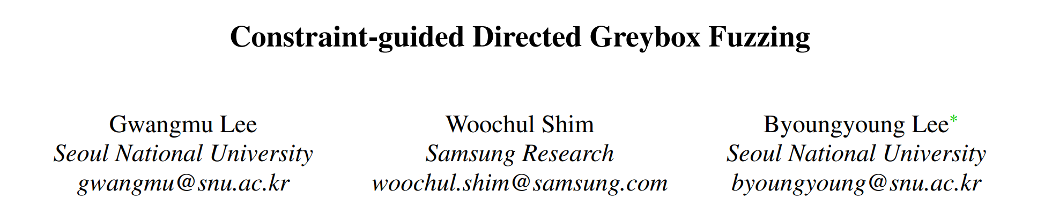
林洁芳

Slide 2
Summary
1）We present the constraint-guided directed greybox fuzzing (CDGF), which augments the conventional DGF with the ordered target sites and the data conditions.
2）We automatically generate the constraints with the given additional information sources, namely crash dumps and patch changelogs, that support seven crash types and four changelog types in total.
3）We implement CAFL, the prototype fuzzing system with CDGF, and demonstrate the superior performance in exposing the targeted crash compared to the representative DGF system AFLGo under various real-world crashes.

Slide 3

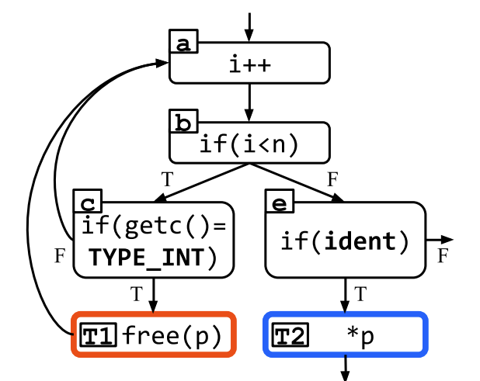
Background
What is DGF:
An augmented fuzzing technique intended for the targeted usages such as crash reproduction and proof-of-concept generation, which gives directedness to fuzzing by driving the seeds toward the designated program locations called target sites.
The target sites are the preferred program locations where the seeds are driven to reach, usually set to the crash and its relevant locations.
First defines the distance of each basic block as the harmonic mean of the shortest path length to each target.
Generally, the seed distance gets shorter when a seed covers more target sites, but it adversely increases if it takes a longer execution path without reaching additional target sites.
1
4/5
1
d:0
f:0

Slide 4
Application of DGF:
1）Static Analyzer Verification
High false alarm rate.
2）Crash Reproduction
May not certain that the root cause has been fixed.
3）PoC Generation
Utilize DGF to generate PoC inputs for the unpatched system.

Slide 5
Problem
However, we find that directed greybox fuzzing can still suffer from the long fuzzing time before exposing the targeted crash, because it does not consider the ordered target sites and the data conditions.
DGF does not consider the data conditions required for the targeted crash and overlook the seeds that satisfy such data conditions. DGF is not aware of the data conditions, it is likely to falsely prioritize the seeds with the control-flow based distance, which may adversely affect seed scheduling.
DGF assumes that the target sites are independent to each other, implying that it does not consider order dependency between multiple target sites.

Slide 6
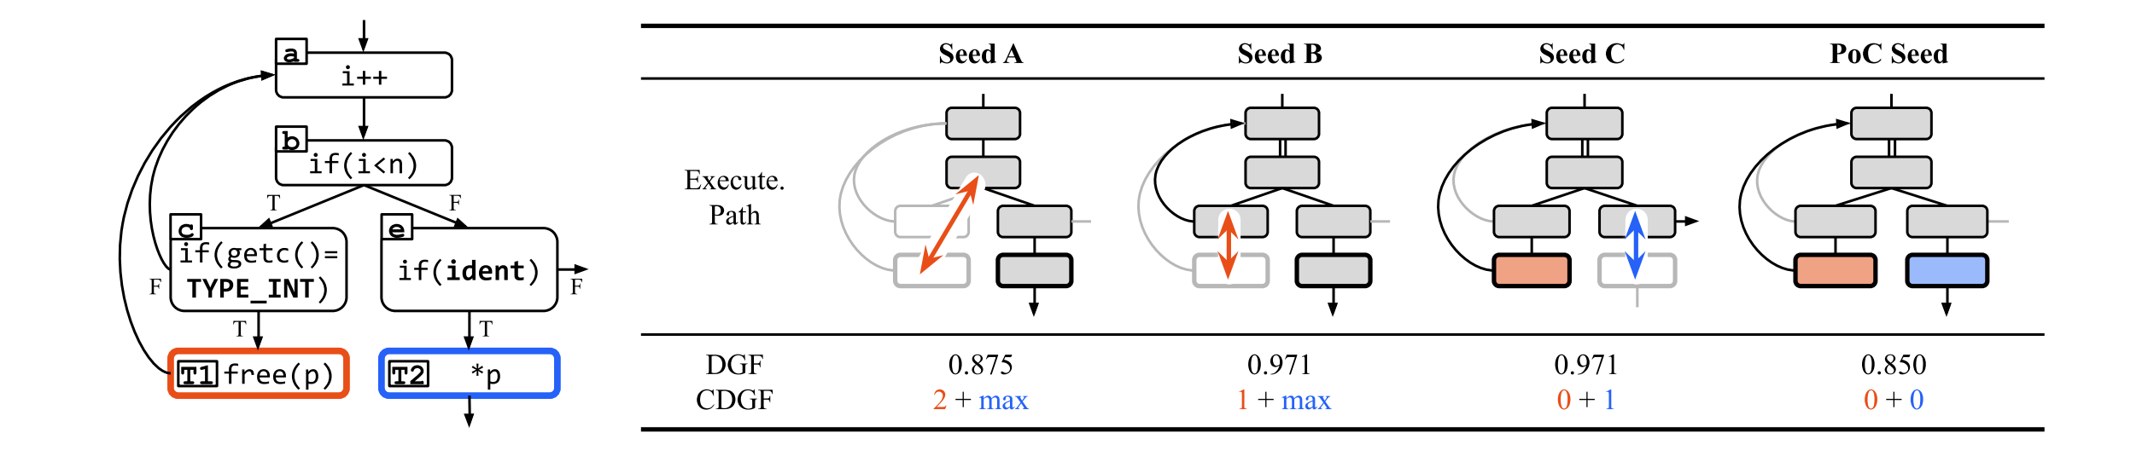
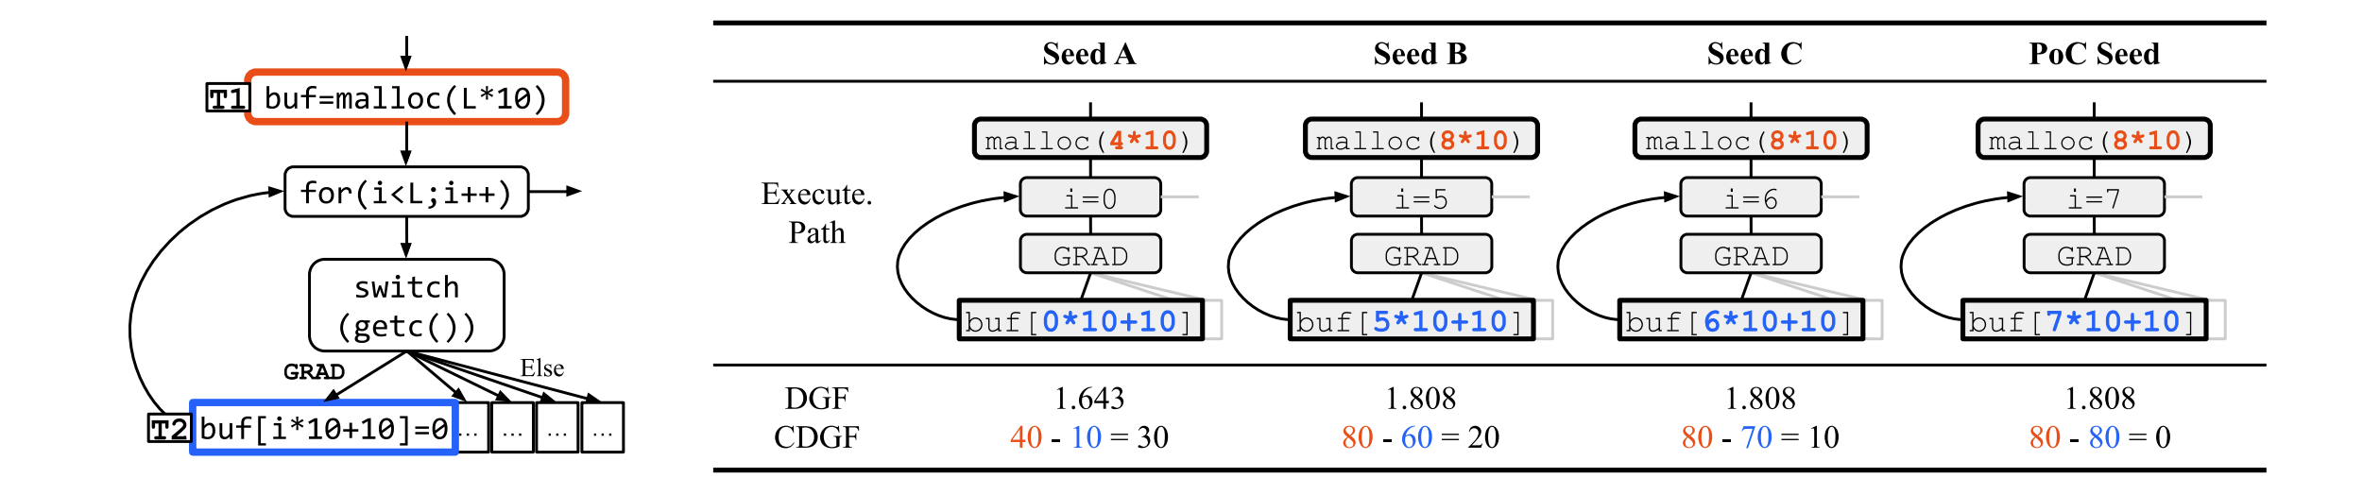
Use-after-free Vulnerability:
[a,b,c,d]
[a,b,c,a,b,e,f]
[a,b,c,d,a,b,e]
[a,b,c,d,a,b,e,f]
Buffer Overflow Vulnerability:
At i = L-1, more possible.

Slide 7
What can improve?
1）Ordered target sites
2）Data conditions

Slide 8
Solution
What is “constraint-guided” ？
This paper presents constraint-guided directed greybox fuzzing that aims to satisfy a sequence of constraints rather than merely reaching a set of target sites. Constraint-guided greybox fuzzing defines a constraint as the combination of a target site and the data conditions, and drives the seeds to satisfy the constraints in the specified order.
How about constraints generation？
We automatically generate the constraints with seven types of crash dumps and four types of patch changelogs.

Slide 9
Seed Choice
if it satisfies more number of constraints
if it is closer to satisfy the first unsatisfied constraint than another
How to generate constraints?
Variable capturing
Once the target site is reached, the constraint captures the variables used at the target site.
2）Data condition
A data condition is a boolean expression between captured variables and a comparison operator that needs to be satisfied at the target site.
3）Orderedness
Constraints may be specified more than one.

Slide 10
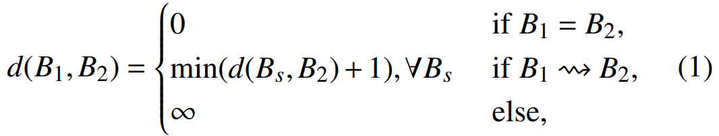

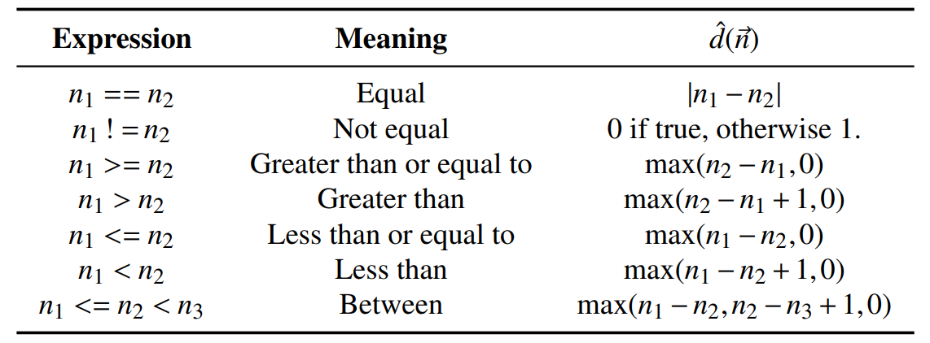

What is the definition of distance?
1）Target site distance
Block distance
2）Data condition distance
Distance of an individual data condition:

Slide 11

Distance of multiple data conditions
3）Constraint Distance
constraint distance = target site distance + data condition distance
4）Total Distance
The distance of a constraint sequence, or the total distance, is the serial combination of the distance of each individual constraint.
5）Seed Distance

Slide 12
The generation of constraint
Design constraint generation for two such sources: crash dumps from memory error detectors and patch changelogs.
Crash Dump:
1）Multiple Target Sites (nT)
The nT template with multiple target sites handles use-after-free, double-free, and use-of-uninitialized-value.
2）Two Target Sites with Data Conditions (2T+D)
2T+D template with two target sites and data conditions handles stack-buffer overflow and heap-buffer-overflow
3）One Target Site with Data Conditions (1T+D)
1T+D template with one target site and data conditions handles assertion-failure and divide-by-zero.
Patch Changelog:
Constraint generation for patch changelogs uses the 1T+D constraint template.

Slide 13
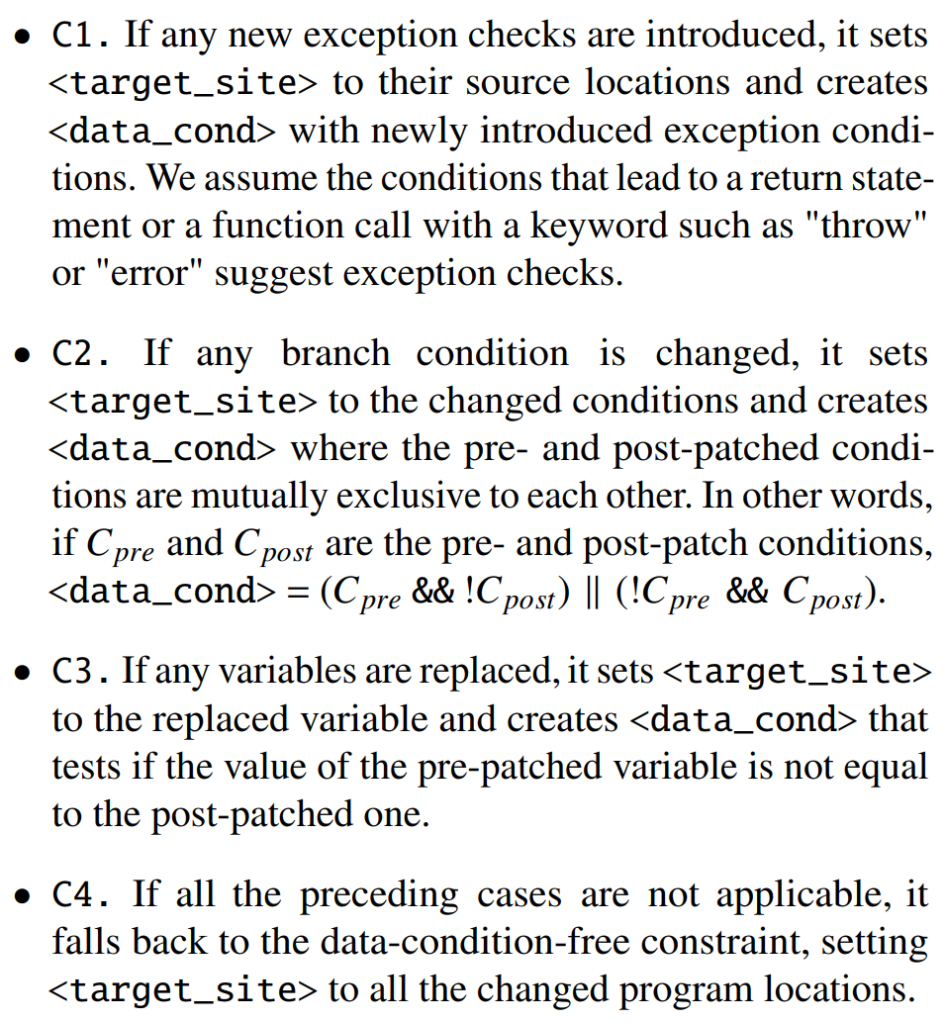






Slide 14
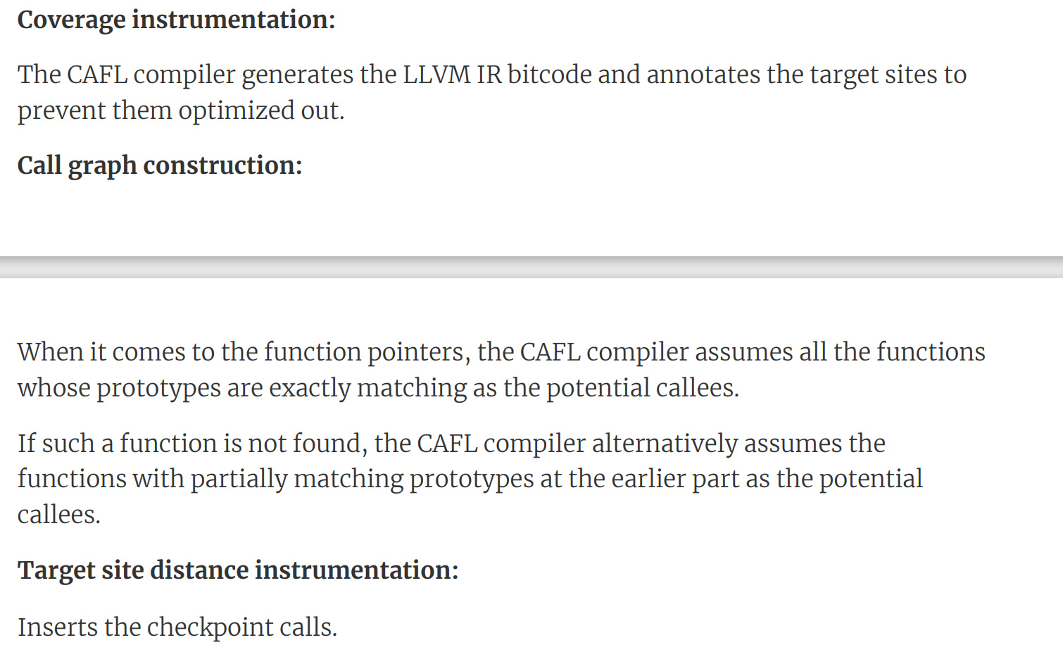

CAFL Compiler

Slide 15
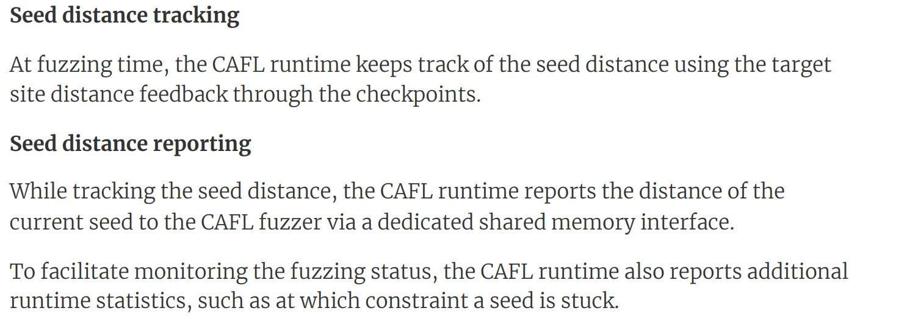
CAFL Runtime

Slide 16
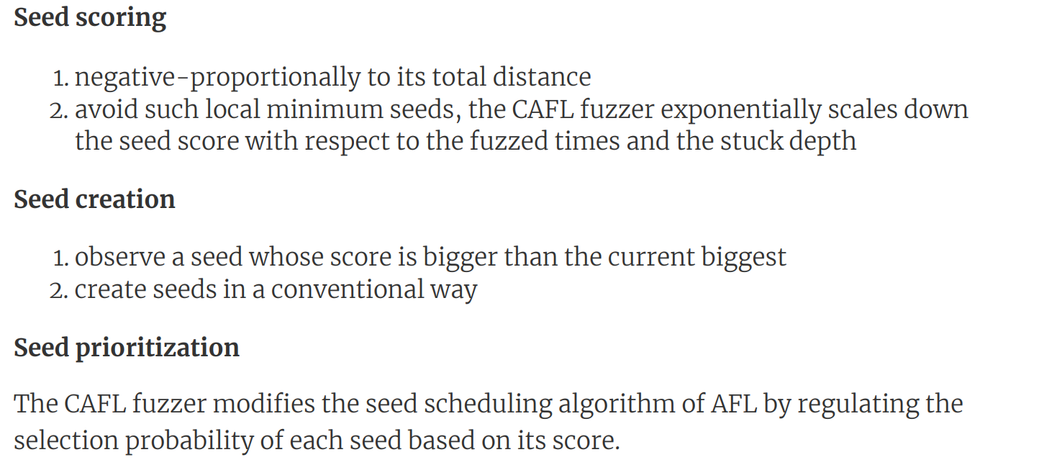
CAFL Fuzzer

Slide 17
Evaluation
We evaluate the prototype system CAFL against the representative directed greybox fuzzing system AFLGo with 47 real-world crashes and 12 patch changelogs.
The evaluation shows CAFL outperforms AFLGo by 2.88x for crash reproduction, and better performs in PoC (Proof of Concept) generation as the constraints get explicit.

Slide 18
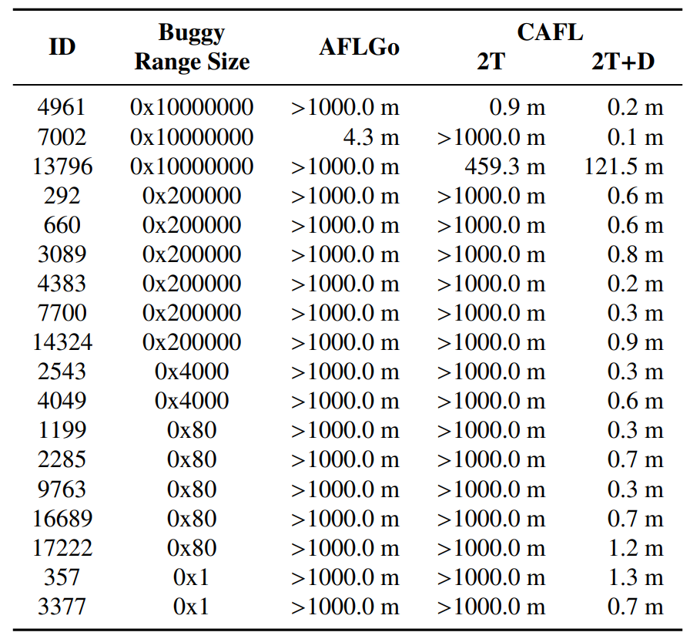
Microbenchmark: LAVA-1

Slide 19
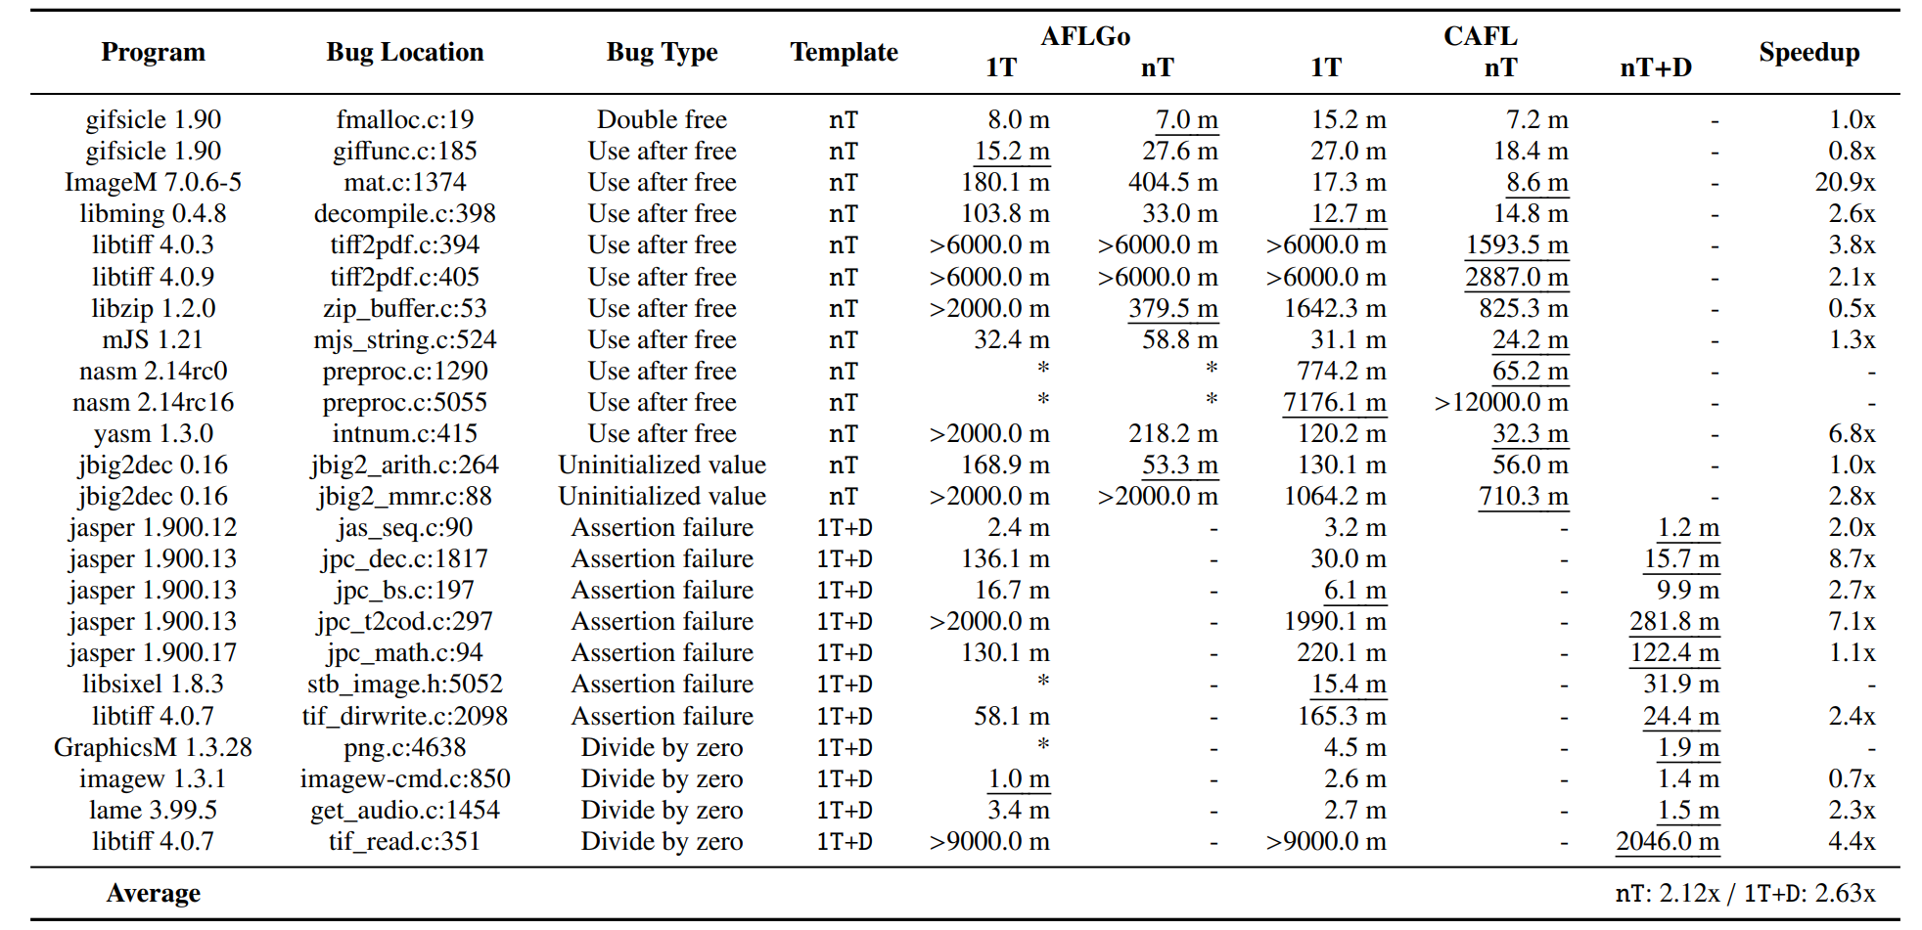
Crash Reproduction

Slide 20
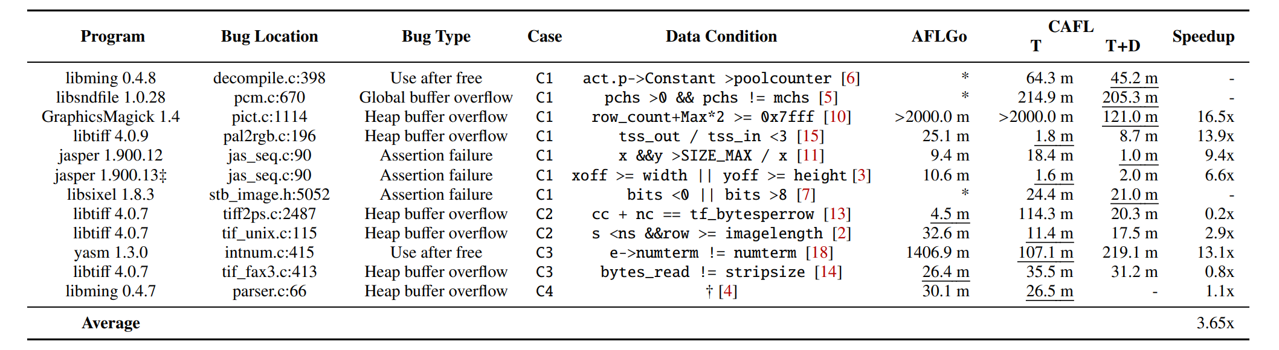
PoC Generation

Slide 21
Summary
1）We present the constraint-guided directed greybox fuzzing (CDGF), which augments the conventional DGF with the ordered target sites and the data conditions.
2）We automatically generate the constraints with the given additional information sources, namely crash dumps and patch changelogs, that support seven crash types and four changelog types in total.
3）We implement CAFL, the prototype fuzzing system with CDGF, and demonstrate the superior performance in exposing the targeted crash compared to the representative DGF system AFLGo under various real-world crashes.

