Slide 1
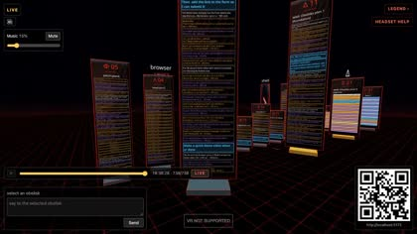
cEverything
Your AI agents, as a room you walk through
The Lokust · MOLTEN 2026 · Open track
Notes:
cEverything turns every AI agent session into a monolith in a WebXR room you can walk through.

Slide 2




One room for every agent you run
Chats are monoliths
Tools are pylons
Hands and voice act
Laptops join in
Each Hermes or Claude Code chat stands as a stack of its messages
Every tool call flies as a spark to a browser, file, shell or other pylon
Pinch to fork a chat or pipe a message, hold to talk
Others watch, scrub the timeline and type from a laptop or phone

Slide 3



Why a room: memory is spatial
Place cells
So the room is built for it
Hippocampal neurons fire when you stand at one spot. A stable place becomes a memory address.
Every chat keeps a fixed place, so you remember where it lives
One aisle with walls and pylons gives clear boundaries
Walking and turning to read engage your sense of place
Returning to a spot cues what that agent was doing, like a memory palace
Boundary cells
Neurons near the hippocampus fire at set distances from walls and edges, anchoring that map.
Consolidation
The hippocampus binds each episode to where it happened, then replays it in rest and sleep into long-term cortical memory.
“It’s just easier to keep track of your chats if they are somewhere in your room.”
O'Keefe and Dostrovsky 1971 · Lever et al. 2009 · Squire and Alvarez 1995 · Dresler et al. 2017
Notes:
Place cells (O'Keefe and Dostrovsky, 1971) fire at specific locations. Boundary vector cells in the subiculum (Lever et al., 2009) and border cells in entorhinal cortex (Solstad et al., 2008) fire relative to walls. The hippocampus binds episodes to place and, through replay during rest and sleep, supports systems consolidation into neocortex (Squire and Alvarez, 1995; Wilson and McNaughton, 1994). Memory-palace training improves recall (Dresler et al., 2017). The claim for cEverything is a design hypothesis: fixed places for agents should make their state easier to recall. We have not measured it.

Slide 4
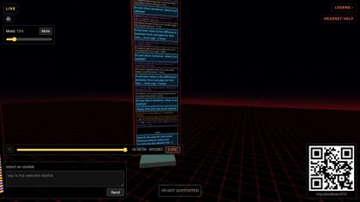
Walk the aisle, live
Notes:
43-second laptop-view recording: walking the aisle, a pipe between chats, a live Hermes reply, the legend and the timeline.

Slide 5
Built in one day by a team of AI agents
812M
tokens processed
5,712
model calls
21
agent sessions
42
PRs merged
229
tests passing
Notes:
Counted from every Claude Code transcript of this chat and its 20 sub-sessions, one entry per API call. Most tokens are cache reads: long sessions re-reading their own context. Local Hermes (qwen3:8b) tokens are not included.

Slide 6

One more thing
youtube.com/watch?v=6LXrfWtKSlg

