Slide 1
Vue-Exercise-Sandbox
Made by: Љубомир Илиевски

Slide 2
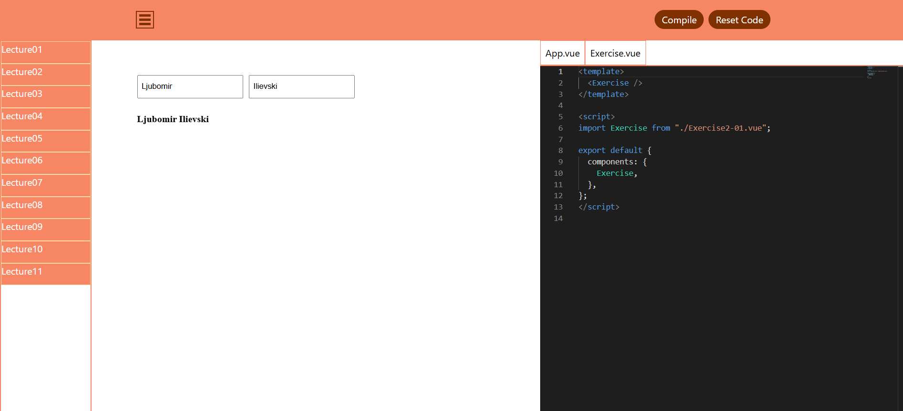
Application With Exercise Strings
Everything except the place where the exercise is represented.

Slide 3
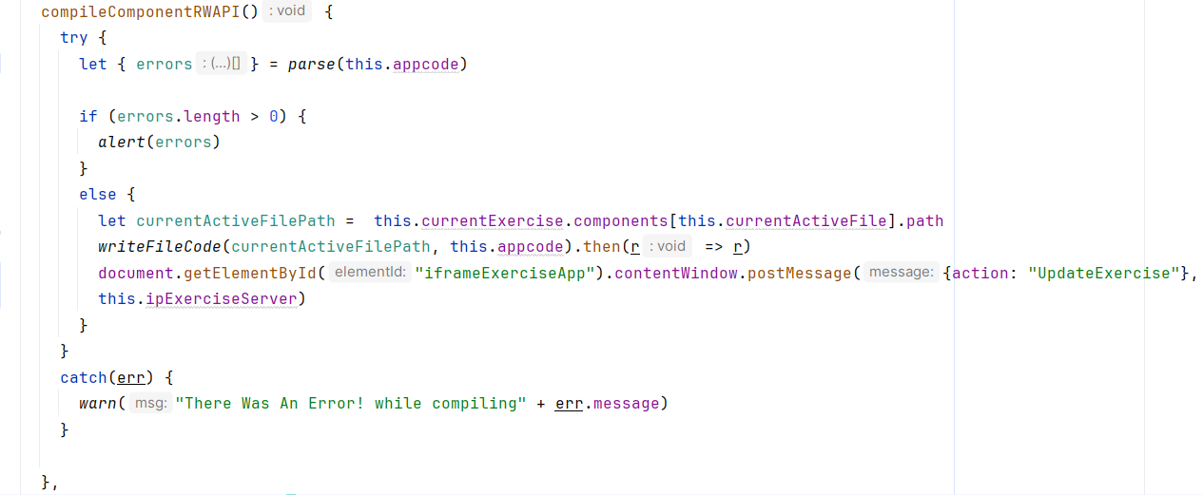
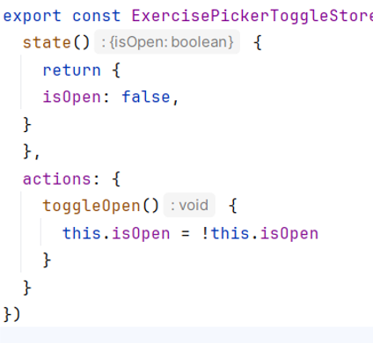
NavBar
Similar to compileComponentRWAPI. Difference is using default code to call the backend.
Cross-document messaging communication, with other Vue App
Where You Compile the New Code

Slide 4
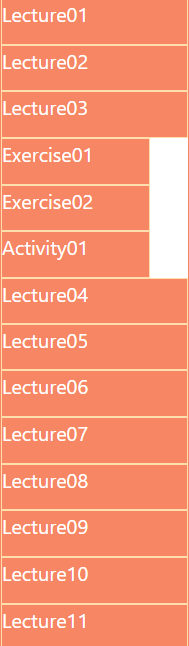
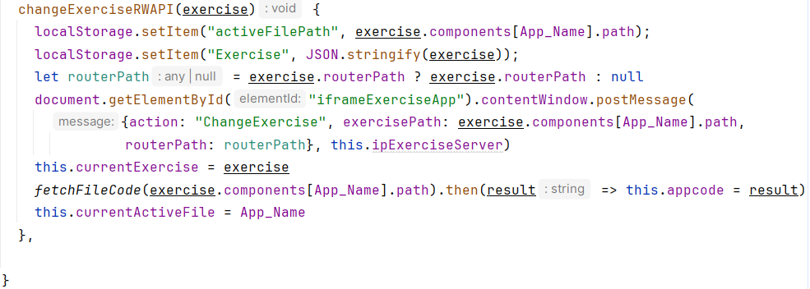
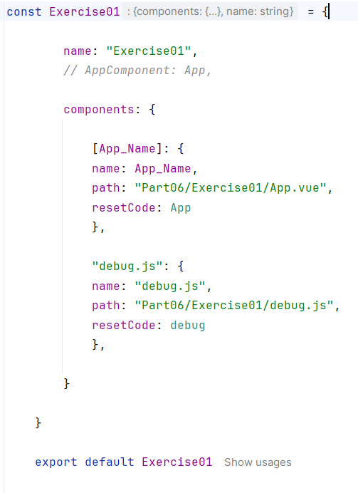
Exercise Picker
Exercise Object
Where you Pick the respected exercise from the respected Lecture.

Slide 5

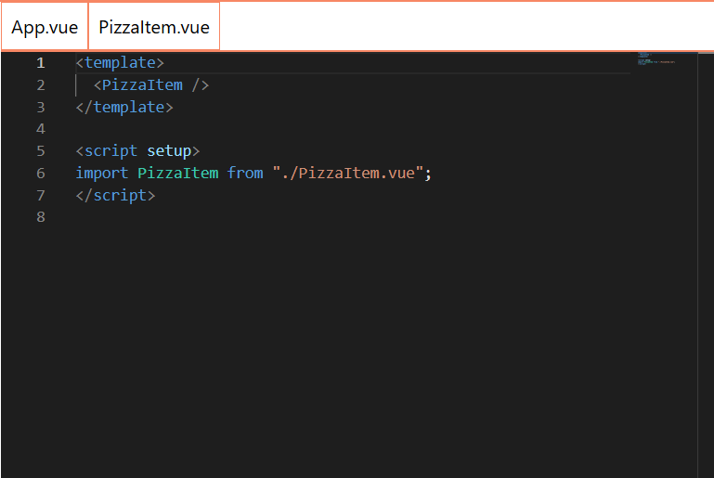
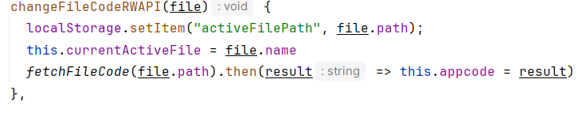
Monaco Code Editor
Representation of File object
appcode variable used to represent the code in the editor. Mapped with modal for user input
Where you edit your code from the respected file.

Slide 6
Vue Application that represents the exercises
The Exercise content in the middle.

Slide 7
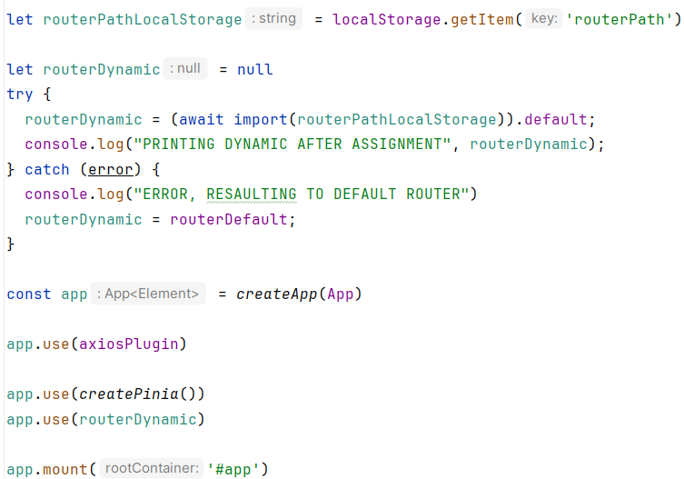
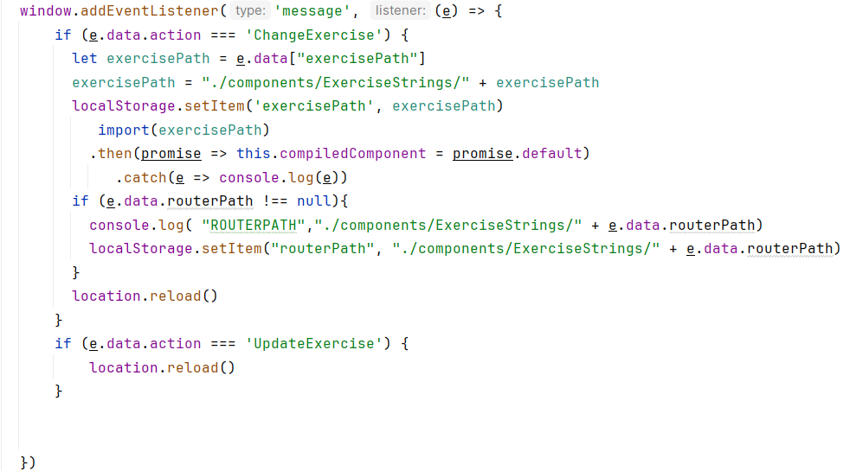
Responses from Cross-Document Communications
ain.js file
How this app responds to the other Vue app requests through Cross-Document Communication.

Slide 8
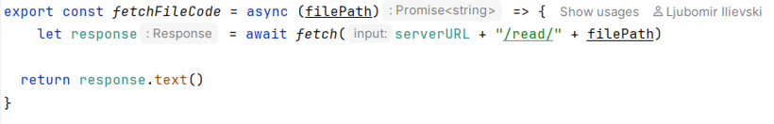
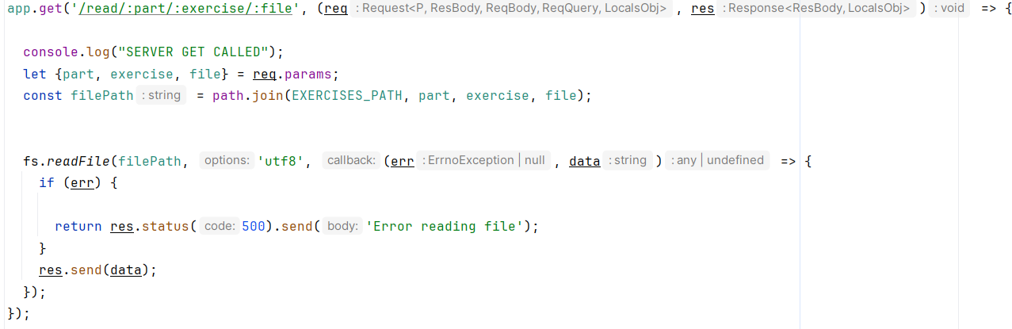
Vue-App / node.js express server communication
Reading the code from the application.

Slide 9
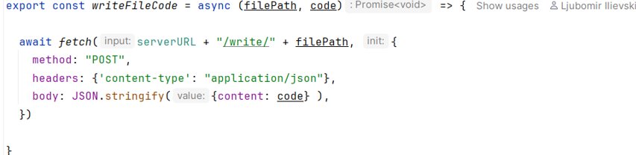
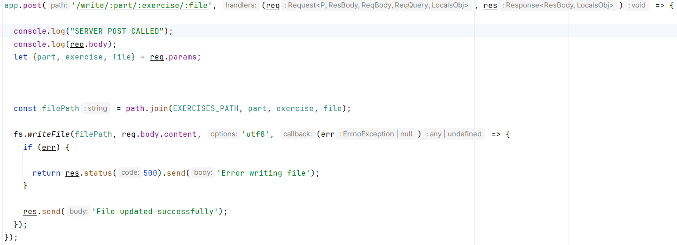

Slide 10
The Finished Product
Project at https://github.com/Ljubomir-Ilievski/Vue-Exercise-Sandbox

