Slide 1

YouTube Trending Video Analysis
Jiexin Lan, Qihui Sun, Xinyue Dong

Slide 2
Agenda
Introduction
Goals
Data Preparation
Data Model
Analysis Report
Category Part
Channel and Video Part
Summary

Slide 3
Introduction

Slide 4
Goals
Analyze factors that make video popular on YouTube
Give recommendations to uploader about how to get their videos popular on YouTube
Give recommendations to YouTube about what kinds of videos will be most likely popular.

Slide 5
Data Preparation
Dataset provider Mitchell J.
Reduced data size to 100.
Added new related data:
-Channel name
-Channel followers
-Category name

Slide 6
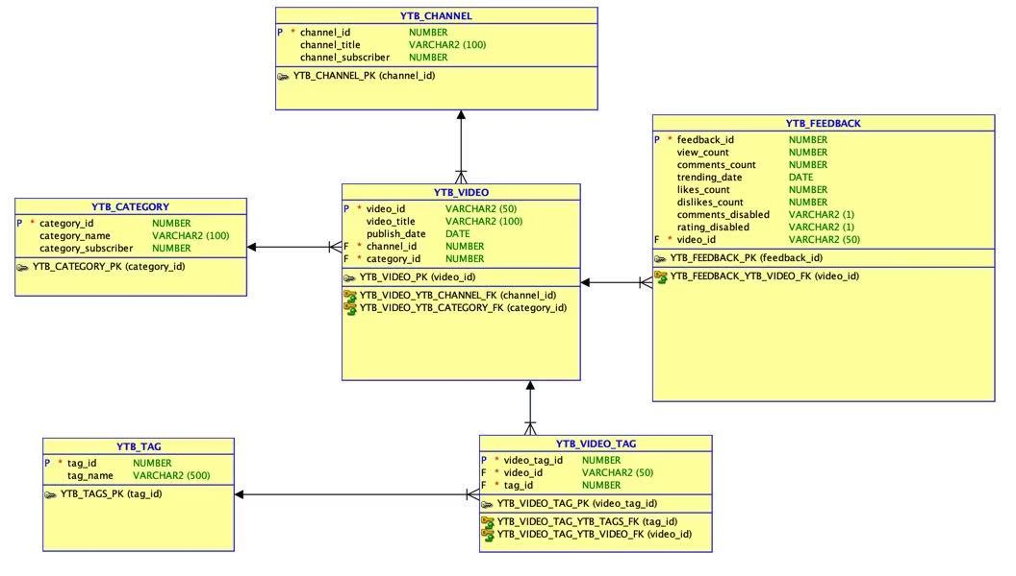
Data Model
Notes:
View: YouTube's definition of a view is a viewer initiated intentional play of a video. In the early years of YouTube a view count would increase whenever the video was loaded. After 300, YouTube database is set up to freeze the view count at 301 until YouTube employees can manually verify whether or not the views have been obtained legitimately.Not view in the same computer in many times
Likes dislikes: each account can only choose like or dislike in each video, it’s cancellable
Comments: every account can have as many comments as they want
Comments disabled: someone may delete their comments
Rating disabled: to cancel dislike or like
Channel: uploader

Slide 7
Analysis Report

Slide 8
Category Part

Slide 9
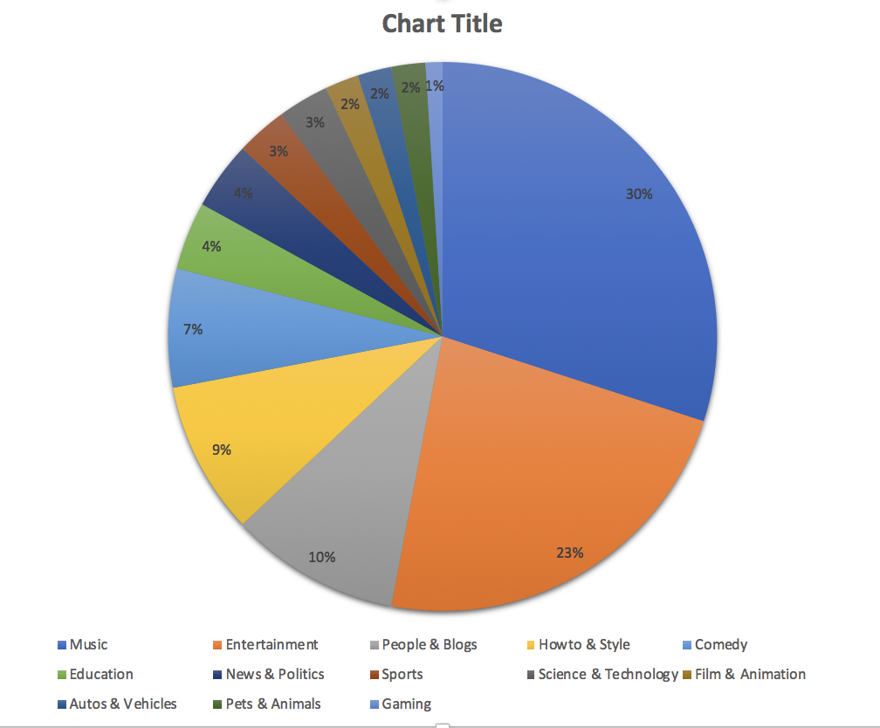
Which Category Has the Most Number of Trending Videos?
Science & Technology
Music

Slide 10
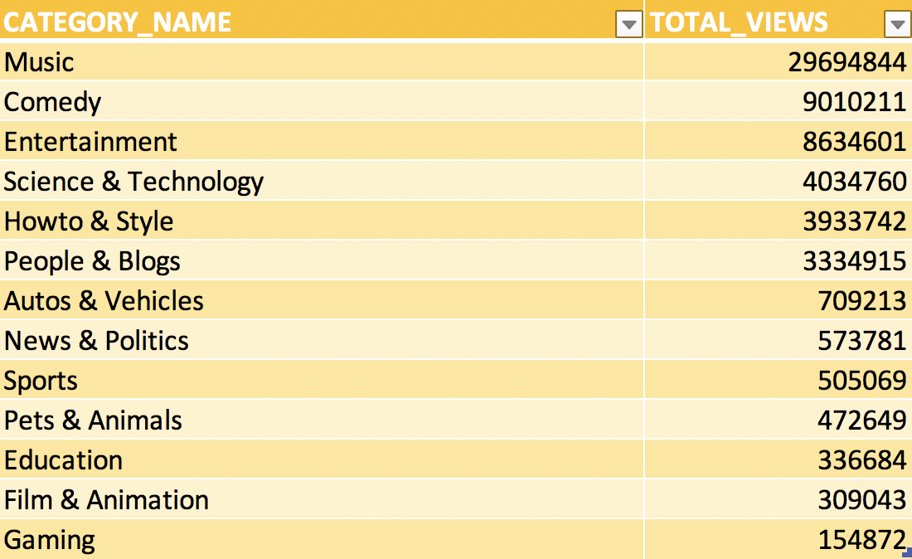
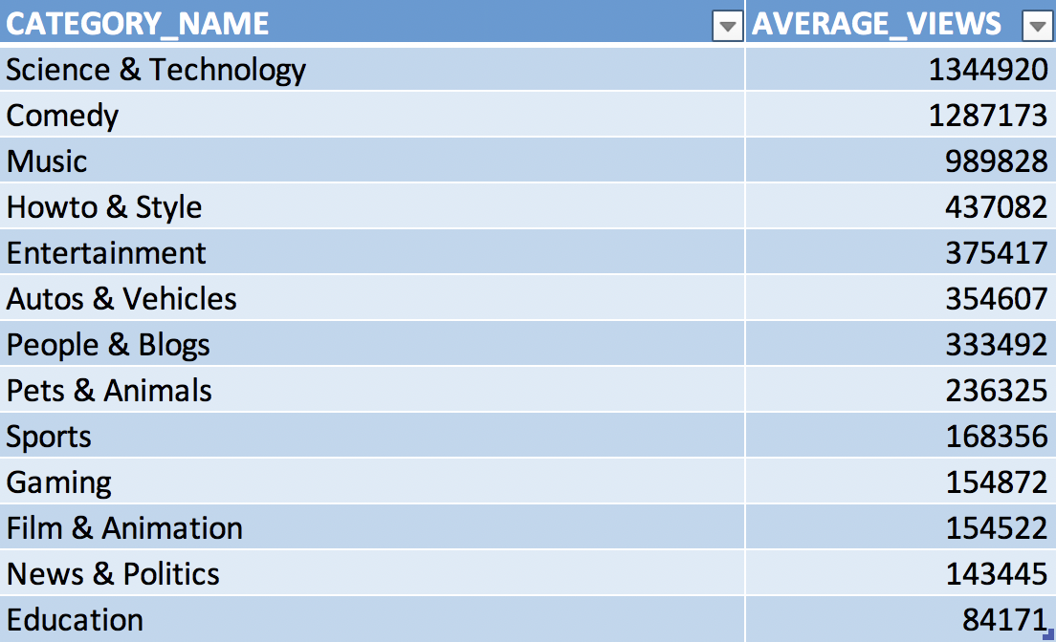
Which Category Has the Highest Total Views and Average Views?

Slide 11
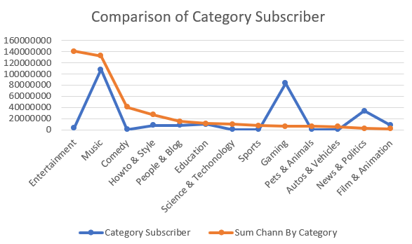
Relationship between Category Subscriber and Sum of Channel Subscriber for Each Category
Notes:
Shows that even category is not so popular, if the channel has many subscribers, the video can also be in great views, and get into trending list.

Slide 12
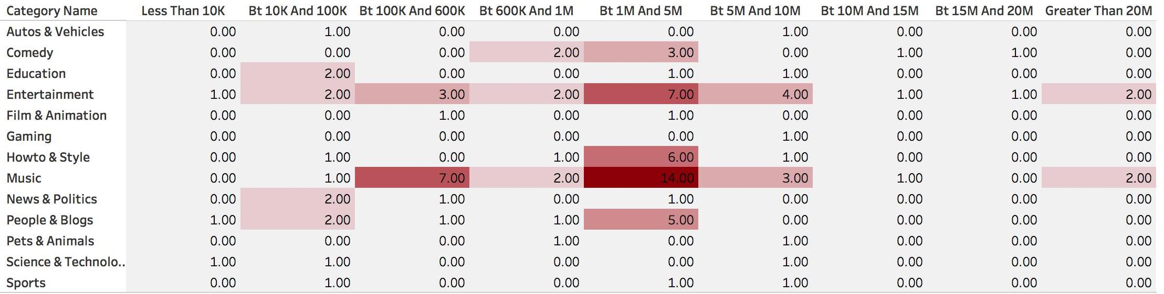
Channel Subscriber Frequency in Different Range for Each Category

Slide 13
Channel and Video Part

Slide 14
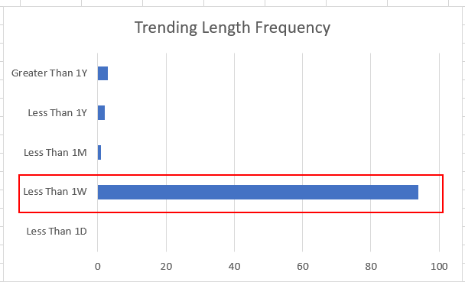
Trending Length Frequency

Slide 15
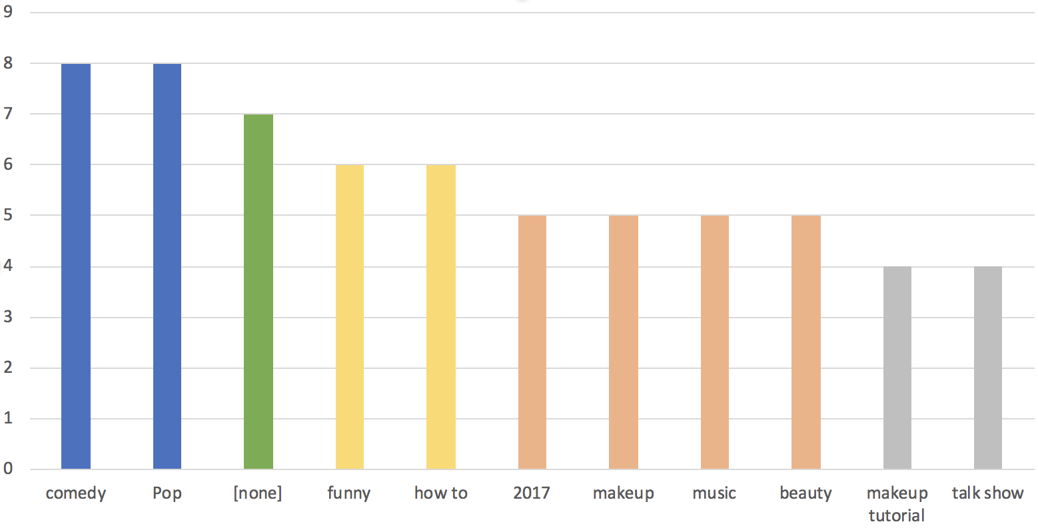
What Tags Are Popular?
Notes:
Greater than 3 appearance
Tag comedy from Category: Comedy and entertainment, Comedy is most
Tag Pop from Category: Music

Slide 16
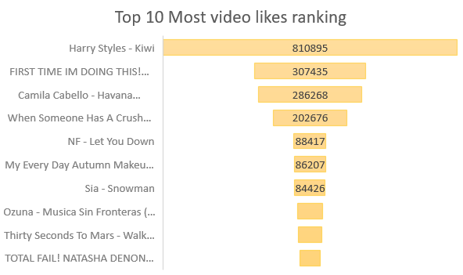
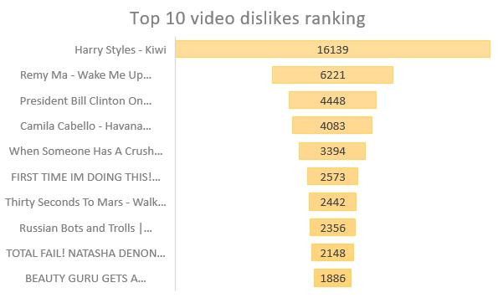
Top 10 Most Video Likes and Dislikes Ranking

Slide 17
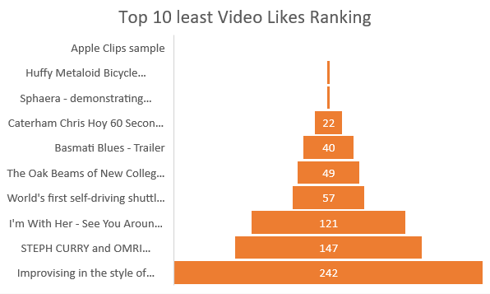
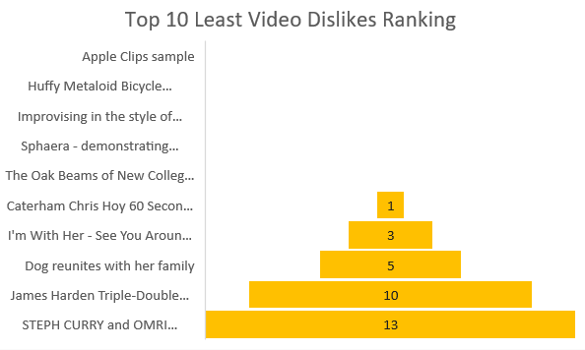
Top 10 Least Video Likes and Dislikes Ranking

Slide 18
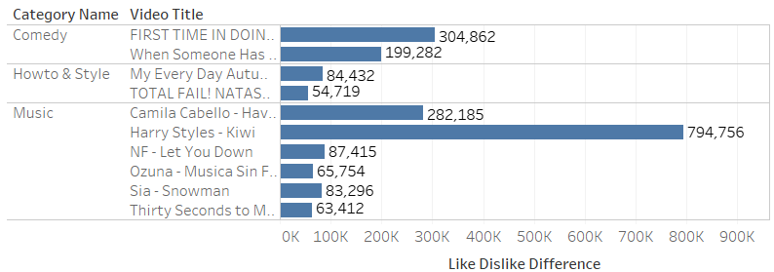
Top 10 Popular Video
Difference = Like - Dislike

Slide 19
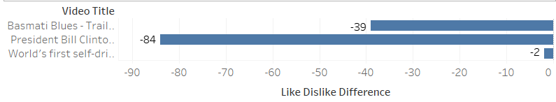
“Unpopular Video”
Film & Animation
Entertainment
News & Politics

Slide 20
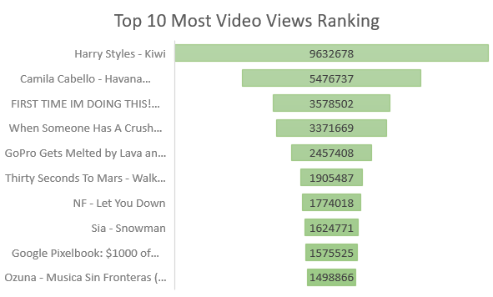
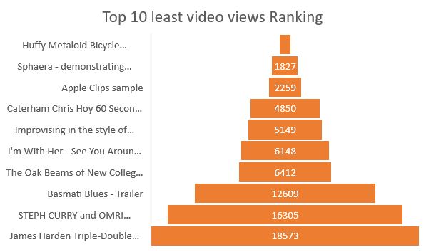
Top 10 Most and Least Video Views Ranking

Slide 21
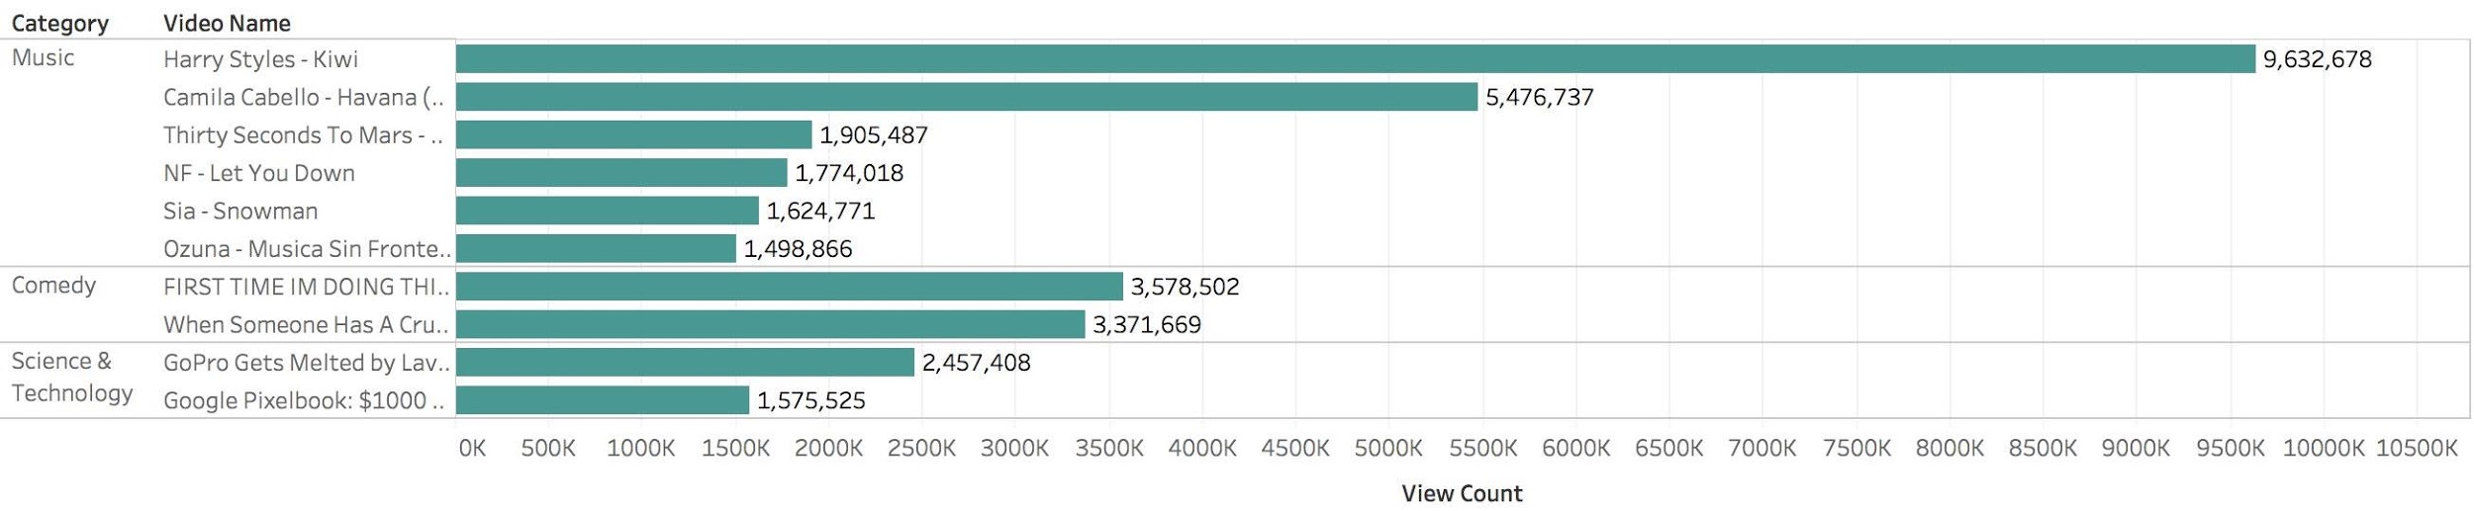
Top 10 Video within Category

Slide 22
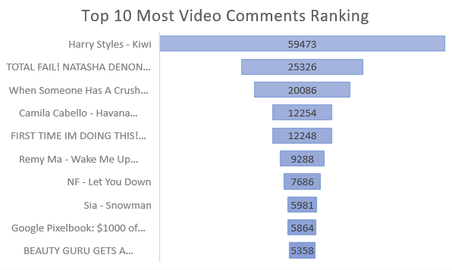
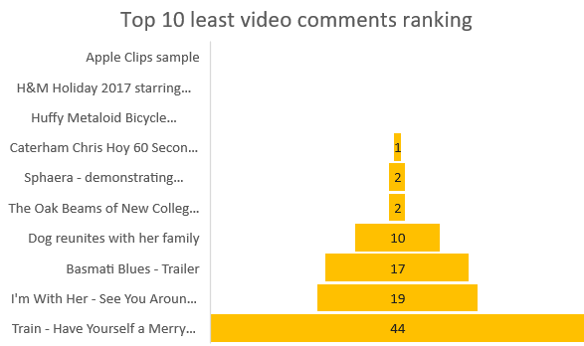
Top 10 Most and Least Video Comments Ranking

Slide 23
Summary

Slide 24
Summary Example

Slide 25
What Factors Make Video Trending on YouTube?
Trending aims to balance all of these considerations. To achieve this goal, Trending considers many factors, including (but not limited to):
View count
Likes count
Dislikes count
Comment count
Category of video
Who is the uploader
...
Notes:
“Trending shows you what’s happening on YouTube and in the world. Trending aims to surface videos that a wide range of viewers would find interesting. Some trends are predictable, like a new song from a popular artist or a new movie trailer. Others are surprising, like a viral video.
We combine these signals to produce a list of videos that showcases what’s happening on YouTube. We want to be relevant to our viewers and reflective of the content on the platform. So, the video with the highest view count on a given day may not be #1 on Trending.Also, videos with more views may be shown below videos with fewer views. “

Slide 26
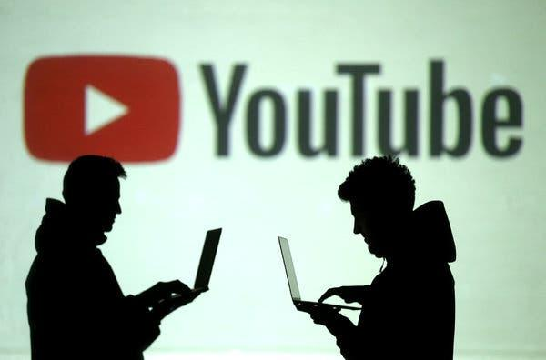
How to Get Your YouTube Video Popular?
Load up Your Video Tags with Rich Keywords, such as Pop or Comedy
Insert popular keywords to your video title
“Dislikes” doesn’t mean unpopular
Upload Video in most popular Category: Music or Comedy
Be a popular Youtuber helps
Don’t simply try entertainment video
Notes:
(though video in entertainment has the most view and last the longest trending length, it’s hard to easily make a critically acclaimed video. For reason that, viewer may have different preference)

Slide 27
Thank You!

