Slide 1
Visitor Counter with Automatic Light Switch
Lukas Kaas Andersen

Slide 2
Description
Counts and keeps track of how many people are coming in, leaving, and currently in a room
Uses an entrance and an exit gate
Switches a light off if there are currently no people in the room
Displays information on mobile device

Slide 3
Sensors
2 ultrasonic sensors
Larger measuring range
It can be used in dark environments
Detects distance object is from the sensor
Can control them individually
Don’t use a lot of energy
Doesn’t take effect to possible external factors (smoke, light etc.)

Slide 4
Connectivity
Wi-Fi connection
The ESP32 could be positioned differently depending on room
Wi-Fi is needed to cover a longer range
Works very well with Blynk to display data needed

Slide 5
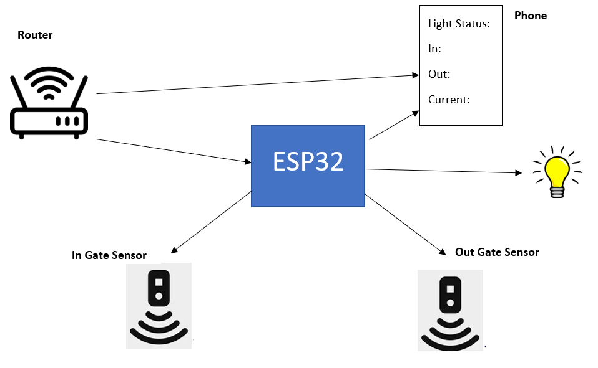
Initial Design

Slide 6
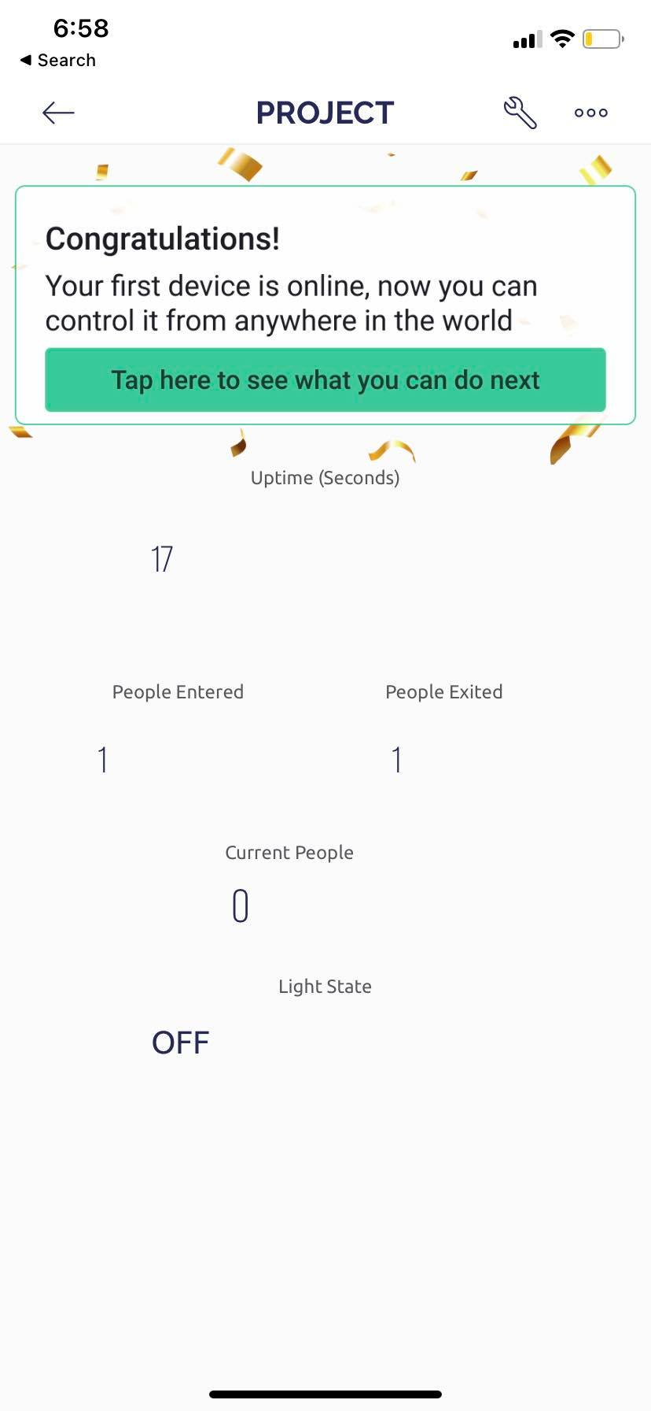
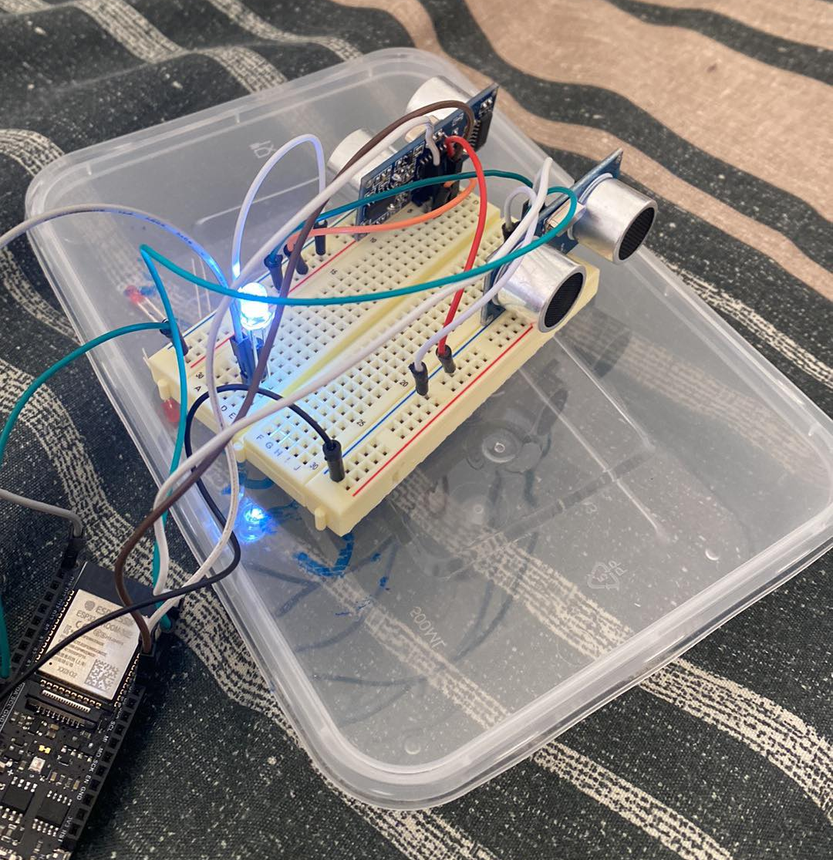
End Product

Slide 7
Real World Environment
Sensors would be on the doors/gates instead connected with longer wires.
The light source would depend on the room
Supermarkets, Museums, any room with specific entrance/exit

Slide 8
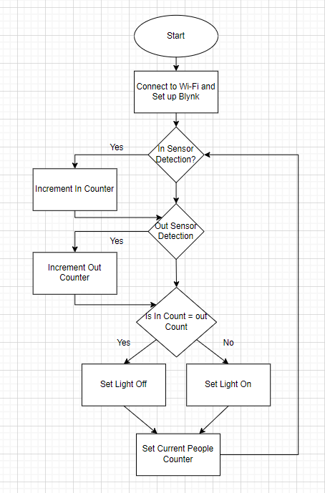
Flowchart
Sets up Wi-Fi Connection and Blynk Connection
Checks if In sensor has detected
Checks if out sensor has detected
Checks if the In Count is the same as the Out Count
Changes light accordingly

Slide 9
Video Demonstration

Slide 10
If I had more time…
Would add features using Blynk to track people coming in and out over time
Better sensing to remove any potential real world errors
Allow it to work for exit and entrance being the same door

