Slide 1
Procesual Hito 2
Estudiante: Maria Bernarda Serrano Larrea
Materia: Programacion de Dispositivos Moviles

Slide 2
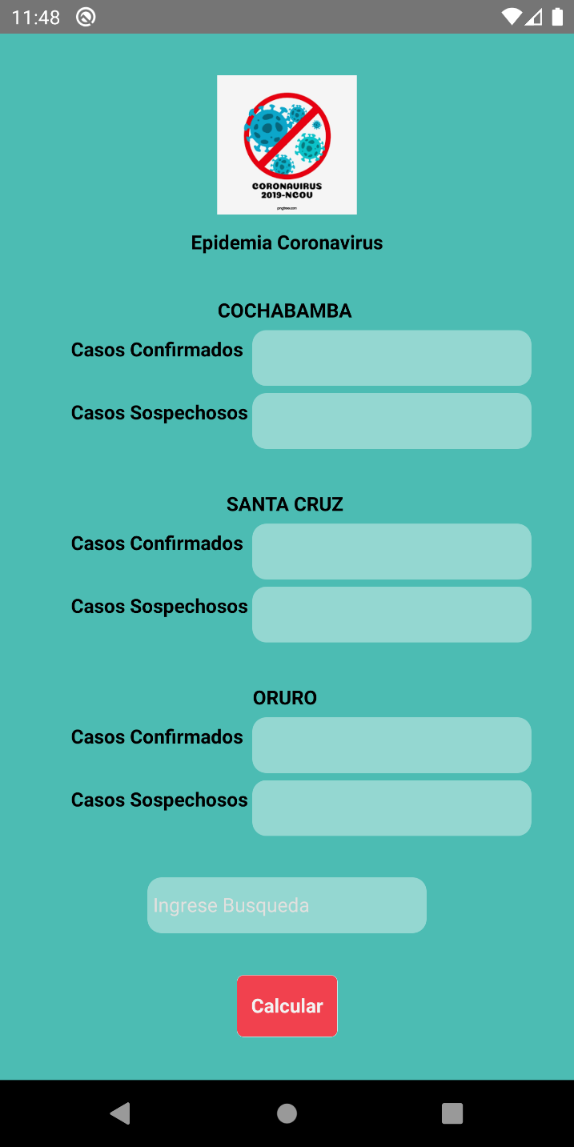
CVLogo
const styles=StyleSheet.create({
img:{
width:100,
height:100,
resizeMode:'contain',
},
contenedor:{
alignItems: 'center',
paddingTop: 30,
},
texto:{
paddingTop:10,
fontWeight:'bold',
},
});
export default CVLogo;
import React, {Component} from 'react';
import {Text, View, Image,StyleSheet } from 'react-native';
import Img from '../img/img.png'; class CVLogo extends Component{
render(){
return(
<>
<View style={styles.contenedor} >
<Image source={Img} style={styles.img} />
<Text style={styles.texto}>Epidemia Coronavirus</Text>
</View>
</>
);
}
}

Slide 3
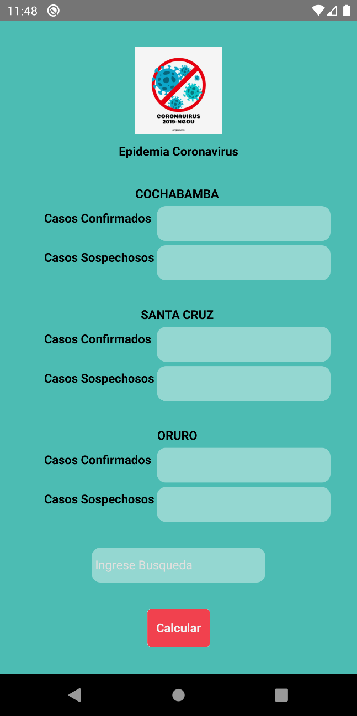
CVCasos
CVCasos.propTypes = {
onChangeText: PropTypes.func.isRequired,
placeholder:PropTypes.string.isRequired,
autoCorrect:PropTypes.bool,
secureTextEntry:PropTypes.bool
};
const styles = StyleSheet.create({
contenedor: {
alignItems: 'center',
paddingTop: 5,
paddingLeft: 150
},
texto: {
fontWeight: 'bold',
position: 'absolute',
height: 50,
left: 20,
top: 9,
},
input: {
backgroundColor: 'rgba(255, 255, 255, 0.4)',
alignItems: 'center',
height: 40,
width: 200,
borderRadius: 10,
borderColor: Colors.silver,
},
});
export default CVCasos;
import React, { Component } from 'react';
import { Text, View, StyleSheet, TextInput } from 'react-native';
import Colors from '../config/colors';
import PropTypes from 'prop-types';
const CVCasos = (props) => {
const { typeCase, plaholder,onChangeText,secureTextEntry,autoCorrect } = props;
return (
<>
<View style={styles.contenedor} >
<Text style={styles.texto}>{typeCase}</Text>
<TextInput
style={styles.input}
underlineColorAndroid="transparent"
onChangeText={onChangeText}
placeholder={plaholder}
secureTextEntry={secureTextEntry}
autoCorrect={autoCorrect}
placeholderTextColor={Colors.black}
selectionColor={Colors.blue}
/>
</View>
</>
);
};

Slide 4
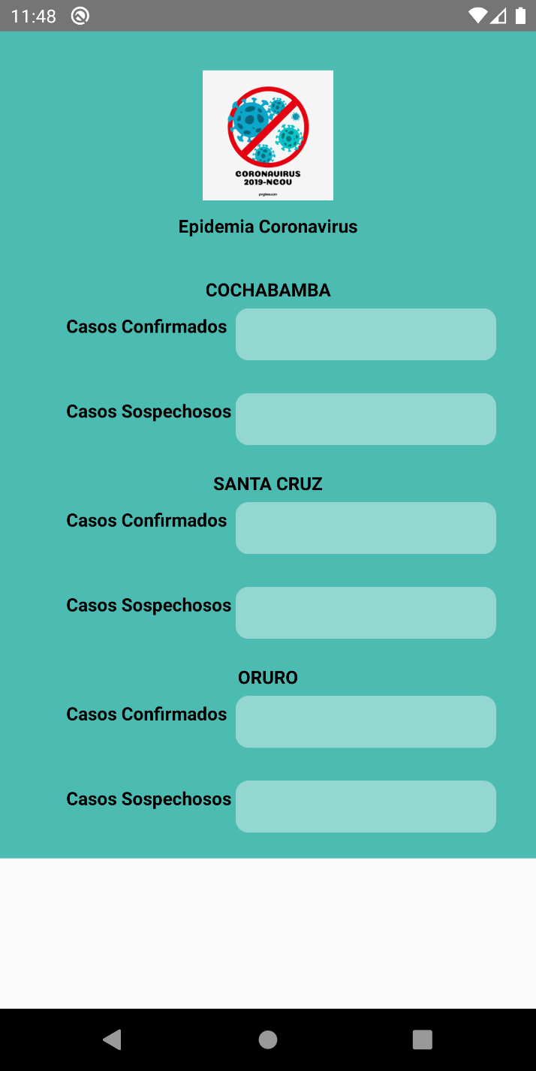
CVCiudad
import React, { Component } from 'react';
import { Text, View, StyleSheet, TextInput } from 'react-native';
//configuracion
import Colors from '../config/colors';
import Constants from '../config/constants';
//componentes
import Casos from './CVCasos'
import CVCasos from './CVCasos';
const CVCiudad = (props) => {
const {ciudad,onChangeTextConf,onChangeTextSo } = props;
return (
<View style={styles.contenedor}>
<Text style={styles.texto}>{ciudad} </Text>
<CVCasos
typeCase={Constants.T1}
onChangeText={onChangeTextConf}
placeholder={Constants.PLACEHOLDER}
autoCorrect={false}
secureTextEntry={false}
/>
<CVCasos
typeCase={Constants.T2}
onChangeText={onChangeTextSo}
placeholder={Constants.PLACEHOLDER}
autoCorrect={false}
secureTextEntry={false}
/>
</View>
);
};
const styles = StyleSheet.create({
contenedor: {
alignItems: 'center',
paddingTop: 30,
},
texto: {
fontWeight: 'bold',
},
});
export default CVCiudad;

Slide 5

Buton
const stylesButton = StyleSheet.create({
container: {
width: '100%',
alignItems: 'center',
justifyContent: 'center',
backgroundColor: Colors.rosado,
marginBottom: 12,
paddingVertical: 12,
borderRadius: 5,
borderWidth: StyleSheet.hairlineWidth,
borderColor: 'rgba(255,255,255,0.7)',
},
text: {
color: Colors.white,
textAlign: 'center',
height: 20,
fontWeight: 'bold',
paddingLeft: 10,
paddingRight: 10,
},
});
button.propTypes = {};
export default button;
import React, { Component } from 'react';
import PropTypes from 'prop-types';
import { StyleSheet, View, TouchableOpacity, Text } from 'react-native';
import Colors from '../config/colors';
class button extends Component {
constructor(props) {
super(props);
}
render() {
return (
<View>
<TouchableOpacity style={stylesButton.container} onPress={this.props.onPress}>
<Text style={stylesButton.text}>{this.props.titleButton}</Text>
</TouchableOpacity>
</View>
);
}
}

Slide 6
CVScreen
render() {
return (
<>
<View style={styles.contenedor} >
<Logo />
<View style={styles.espacio}>
<CVCiudad
ciudad={Constants.CB}
onChangeTextConf={this._onChangeTextConfCB}
onChangeTextSo={this._onChangeTextSoCB}
secureTextEntry={false}
autoCorrect={false}
/>
<CVCiudad
ciudad={Constants.SC}
onChangeTextConf={this._onChangeTextConfSC}
onChangeTextSo={this._onChangeTextSoSC}
secureTextEntry={false}
autoCorrect={false}
/>
<CVCiudad
ciudad={Constants.OR}
onChangeTextConf={this._onChangeTextConfOR}
onChangeTextSo={this._onChangeTextSoOR}
secureTextEntry={false}
autoCorrect={false}
/>
</View>
<View style={styles.espacio}>
<TextInput
style={styles.input}
onChangeText={this._onChangeTextInputSearch}
selectionColor={Colors.blue}
placeholder={Constants.BUSQUEDA}
secureTextEntry={false}
autoCorrect={false}
placeholderTextColor={Colors.plomo3}
underlineColorAndroid="transparent"
>
</TextInput>
</View>
<ButtonLogin
onPress={this._onPress}
titleButton={Constants.TITLE_BUTTON}
/>
</View>
</>
);
}
}
this._onChangeTextInputSearch=this._onChangeTextInputSearch.bind(this);
this._onPress = this._onPress.bind(this);
}
_onChangeTextConfCB(confCB) {
this.setState({
confCB: confCB,
});
}
_onChangeTextSoCB(soCB) {
this.setState({
soCB: soCB,
});
}
_onChangeTextConfSC(confSC) {
this.setState({
confSC: confSC,
});
}
_onChangeTextSoSC(soSC) {
this.setState({
soSC: soSC,
});
}
_onChangeTextConfOR(confOR) {
this.setState({
confOR: confOR,
});
}
_onChangeTextSoOR(soOR) {
this.setState({
soOR: soOR,
});
}
_onChangeTextInputSearch(search) {
this.setState({
search: search,
});
}
_onPress() {
console.log('Presionado');
let n1CB,n2SC,n3OR, busqueda;
if(this.state.search=='CONFIRMADOS')
{
n1CB=parseInt(this.state.confCB);
n2SC=parseInt(this.state.confSC);
n3OR=parseInt(this.state.confOR);
}
if(this.state.search=='SOSPECHOSOS')
{
n1CB=parseInt(this.state.soCB);
n2SC=parseInt(this.state.soSC);
n3OR=parseInt(this.state.soOR);
}
let mayor =Math.max(n1CB,n2SC,n3OR);
console.log("El indice mas alto de casos "+ this.state.search +" es: "+mayor);
}
import React, { Component } from 'react';
import { Text, View, StyleSheet, TouchableHighlight, TextInput } from 'react-native';
//Color
import Colors from '../config/colors';
import Constants from '../config/constants';
//Vistas
import Logo from '../components/CVLogo';
import CVCiudad from '../components/CVCiudad';
import ButtonLogin from '../components/button'; class CVScreen extends Component {
constructor(props) {
super(props);
this.state = {
confCB: 0,
soCB: 0,
confSC: 0,
soSC: 0,
confOR: 0,
soOR: 0,
search: ''};
this._onChangeTextConfCB = this._onChangeTextConfCB.bind(this);
this._onChangeTextSoCB = this._onChangeTextSoCB.bind(this);
this._onChangeTextConfSC = this._onChangeTextConfSC.bind(this);
this._onChangeTextSoSC = this._onChangeTextSoSC.bind(this);
this._onChangeTextConfOR = this._onChangeTextConfOR.bind(this);
this._onChangeTextSoOR = this._onChangeTextSoOR.bind(this);

Slide 7
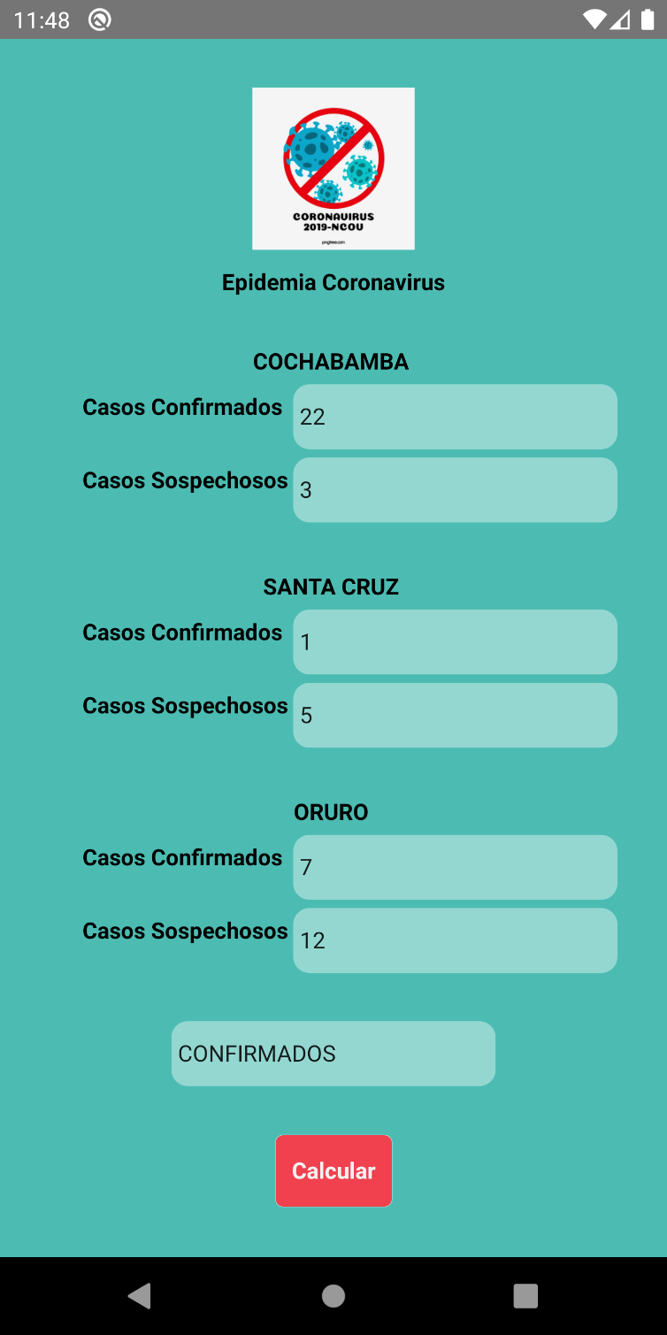
const styles = StyleSheet.create({
contenedor: {
backgroundColor: Colors.green,
alignItems: 'center',
height: '100%'
},
text: {
color: Colors.black,
textAlign: 'center',
height: 20,
fontWeight: 'bold'
},
input: {
alignItems: 'center',
backgroundColor: 'rgba(255, 255, 255, 0.4)',
height: 40,
width: 200,
borderRadius: 10,
borderColor: Colors.silver,
},
espacio: {
marginBottom: 30
},
boton: {
marginTop: 20
}
});
export default CVScreen;

Slide 8
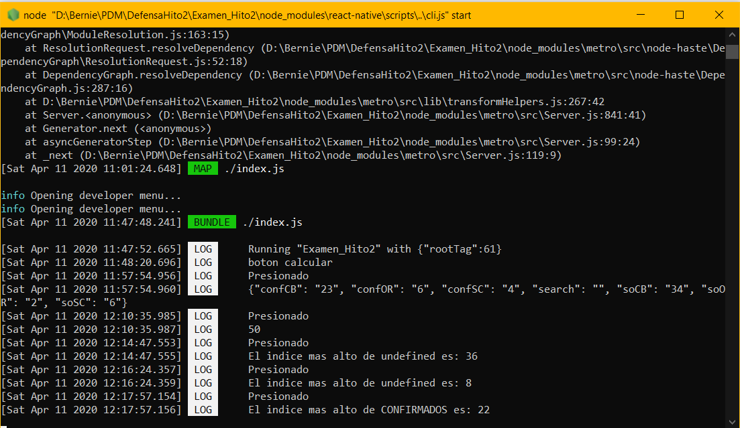
Resultados

