Slide 1
Fundamentals of High Discipline Test Driven Development

Slide 2
Learning Objectives
Be able to justify TDD
Understand the fundamentals of TDD
Use TDD to write maintainable and self documenting code
Understand how TDD aids in software design
Learn how to build a system from the top, downwards
Use TDD to grow the design of a system organically
Use tests for fast feedback
Be exposed to complimentary XP practices

Slide 3
TDD Experience
What experience have you had with TDD?
What would you like to gain from the training?

Slide 4
Why TDD?
Guard against regression
Enable fearless refactoring
Executable documentation
Short feedback loops
Avoid scope creep – identify when work is complete
Reduced use of the debugger
Facilitates team members to work on code simultaneously

Slide 5
TDD Encourages Simple Code
Small classes focused on one thing
Test small increments of code
Encourages:
Low coupling
Tightly coupled systems are difficult to evolve
A change in one area often triggers undesired changes in a different area
High cohesion
Placing related concepts and components near each other
Aids in the readability of the design
Reduces error because it aids in readability

Slide 6
Preparing for TDD
Cyclic dependency rules:
Test Code:
must be able to depend on production code
must be able to depend on testing libraries
Production Code:
must not be able to reference test code
must not be able to reference testing libraries
IDE and build tools can enforce these rules

Slide 7
Test Directory Structure
Separate test and production code
Make it difficult to deploy test code
Ensures running all tests is easy
One production class per file

Slide 8
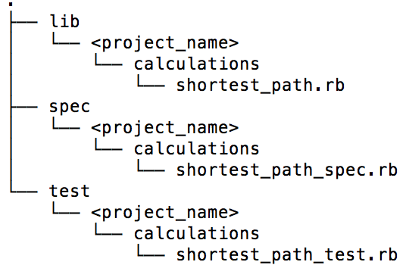
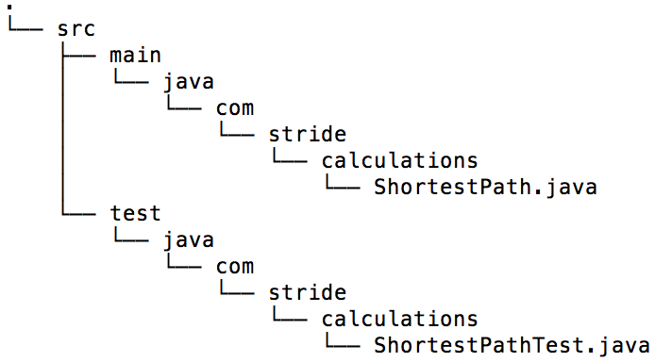
Example Directory Structures
Ruby
Apache Maven Standard for Java

Slide 9
Task the functionality out
On index cards create a list of tasks needed to complete the exercise
Tasks to consider:
Boundary cases:
Null inputs
Empty strings
Invalid strings
Values above or below a certain amount (e.g. is -50 miles per hour valid)
Tasks required for completion
Need not be exhaustive yet
Create new tasks as work continues

Slide 10
Test Driven Development Cycle
Add a test
Red
Green
Commit
Refactor

Slide 11
Add a test
Add a test
Red
Green
From your list of tasks choose the simplest task
Write the simplest, tiniest, test possible
Test naming
Name tests from perspective of business functionality
Avoid restating in words the body of the test
Prefer: “Require An Umbrella When There Is Rain” instead of: “Return True When Rain Is”
Make a note that test names should be refactored too
Prior to running the test, make the code runnable:
Static languages: ensure the tests compile
Dynamic languages: you can likely just run the test
Commit
Refactor

Slide 12
Red
Add a test
Red
Green
Run the test, ensure it fails
At this stage a failing test is good
Ensures there exists a test that can be made to pass
Commit
Refactor

Slide 13
Green
Add a test
Red
Green
Write the obvious implementation
Add only enough code to solve problem at hand
Implementation does not need to be production quality
If possible, consider a hard coded value
Commit
Refactor

Slide 14
Commit
Add a test
Red
Green
Frequent, small commits reduce lost effort when new functionality does not work and code needs reverting
Review the diff of all work before committing
Commit all files, not doing so runs the risk of build/test failures
Check the passing test into version control
Destroy task if code is production quality – unlikely at this stage
Commit
Refactor

Slide 15
Refactor
Add a test
Red
Green
“…is a disciplined technique for restructuring an existing body of code, altering its internal structure without changing its external behavior.” – refactoring.com
We will look at:
Data duplication
Code duplication, later
Commit
Refactor

Slide 16
YAGNI
You Aint Gonna Need It - YAGNI
Add only enough code to make the new test pass
Avoid Big Design Upfront
Allow your tasks to guide what is needed
Don’t add features in anticipation of what may come
…for it might not

Slide 17
New Tasks
Reduce context switching and multi-tasking
Capture new ideas on index cards as tasks when they come to mind
Avoid distracting yourself with new tasks during a task
If you must take on a distraction, allow only a single distraction

Slide 18
Add a test - Triangulation
Add a test
Red
Green
Assuming your previous test was hard coded: triangulate
First documented by Kent Beck
Drawn from Radar Triangulation
Definition: http://encyclopedia2.thefreedictionary.com/radar+triangulation
Triangulation works as follows:
Start with obvious implementation
Follow up with a general implementation
Pushes original implementation toward production quality code
Potentially monotonous, useful for ambiguous implementations
Commit
Refactor

Slide 19
Red
Add a test
Red
Green
Run the test, ensuring it fails
If it doesn’t fail, change it so it does
If you’re still unable to: identify what you’re trying to test
Devise a new test that does fail
Test is to result in a small increment of new functionality
Commit
Refactor

Slide 20
Green
Add a test
Red
Green
Make a small change to pass the failing test
If triangulating, you’ll likely remove previous hard coding
Commit
Refactor

Slide 21
Commit
Add a test
Red
Green
Small commits are the goal
Destroy the current task if code is production ready
Commit
Refactor

Slide 22
Refactor
Add a test
Red
Green
As a system evolves, test semantics may change, such tests require renaming
At this point there is likely to be little code to refactor
Commit
Refactor

Slide 23
Add a test
Add a test
Red
Green
Find the next simple task
Write the simplest failing test you can think of
Make it compilable or runnable
Commit
Refactor

Slide 24
Red
Add a test
Red
Green
Ensure the test fails
Commit
Refactor

Slide 25
Green
Add a test
Red
Green
Make the test pass
Commit
Refactor

Slide 26
Commit
Add a test
Red
Green
Time to create the baseline
Destroy the task card if the task is complete
Commit
Refactor

Slide 27
Refactor
Add a test
Red
Green
Don’t tolerate duplicate code
Two types of duplication:
Code duplication
Data duplication
Commit
Refactor

Slide 28
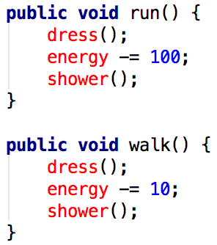
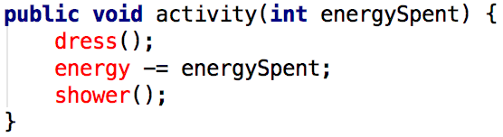
Refactor – Code Duplication
Add a test
Red
Green
Duplication of code patterns
e.g.
Commit
Refactor

Slide 29
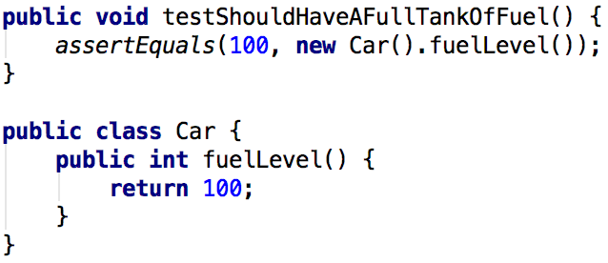
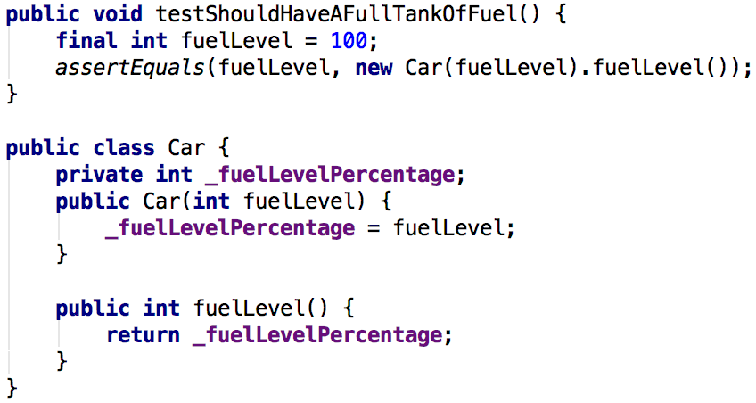
Refactor – Data duplication
Add a test
Red
Green
Commonly found between a test and production code
Helpful in determining the next test to write
e.g.
Commit
Refactor

Slide 30
Green
Add a test
Red
Green
Ensure all tests still pass, after having performed a refactoring
No matter how small the refactoring, ensure all tests pass
Commit
Refactor

Slide 31
Commit
Add a test
Red
Green
Commit, so as to lock the refactoring in
Destroy the card of the task you are presently working on
Commit
Refactor

Slide 32
Test Driven Development Cycle
Add a test
Red
Green
Commit
Refactor

Slide 33
Object Mother

