Slide 1
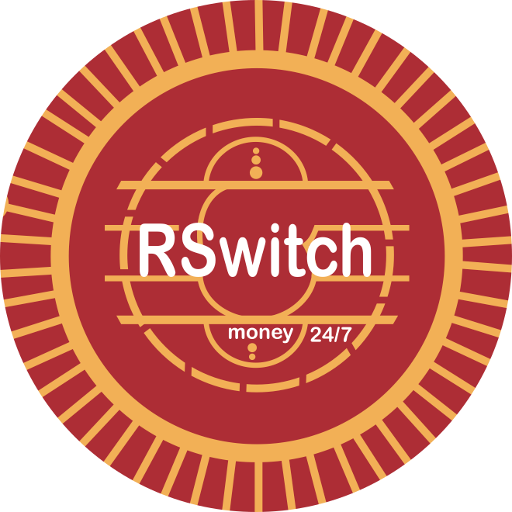
RDIP
AUCA · FINAL YEAR PROJECT · 2026
RSwitch Data Intelligence Platform
One place to see how every bank, mobile money provider, microfinance institution and SACCO on RSwitch is doing.
Presented by the RDIP Project Team
Adventist University of Central Africa · November 2026
Notes:
Good morning. Our project is RDIP, the RSwitch Data Intelligence Platform.
RSwitch runs Rwanda's national payment switch: the system that lets banks, mobile money providers, microfinance institutions and SACCOs move money between each other.
We built RDIP with RSwitch as our case study. Their staff reviewed what we planned and gave us feedback along the way.
I'll explain what RDIP is and the problem it solves, how it works, three highlights, and what comes next.

Slide 2









What is RDIP, and what does it solve?
RDIP › 01 WHAT IS RDIP?
RDIP is a secure website where RSwitch staff see, in one place, how every bank, mobile money provider, microfinance institution and SACCO on Rwanda's national payment switch is doing.
THE PROBLEM TODAY
HOW RDIP SOLVES IT
Missing reports are noticed late
See right away when reports stop arriving
Deadlines chased by hand and email
Automatic reminders and follow-up
No early warning of struggling institutions
Early warnings and a clear risk score
Board papers scattered across folders
Board decisions and actions in one place
Notes:
So, what is RDIP? It's a secure website for RSwitch staff. It shows, in one place, how every bank, mobile money provider, microfinance institution and SACCO connected to the national payment switch is doing.
It solves four problems.
Today, when an institution stops sending its reports, nobody notices quickly. RDIP shows it right away.
Deadlines are chased by hand and by email. RDIP sends the reminders and follows up automatically.
There's no early warning when an institution starts to struggle. RDIP gives early warnings and a clear risk score for each institution.
And board papers sit in scattered folders. RDIP keeps board decisions and action items in one place.

Slide 3
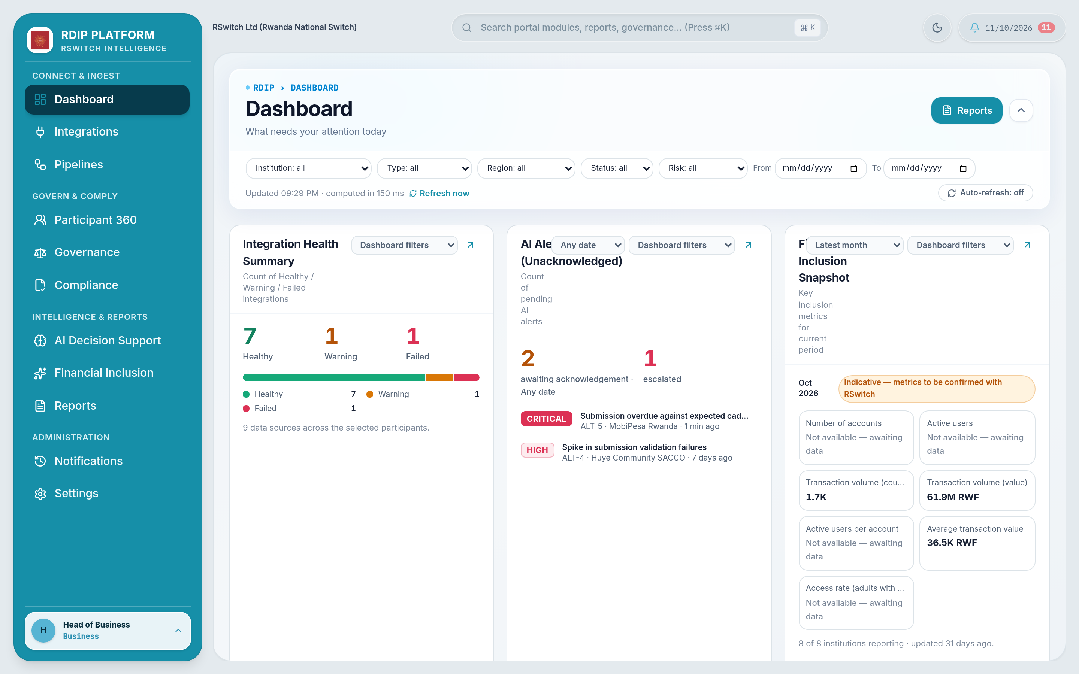



One shared platform for RSwitch staff
RDIP › 02 WHO USES IT
Each team sees the information it needs, and nothing more. Sensitive pages stay with the right people.
Compliance team
Deadlines, document checks and incidents
Business team
Reports, financial inclusion, governance, early warnings
Technical team
Keeps institutions connected, manages user accounts
Notes:
RDIP is one website that RSwitch staff sign in to.
Each of RSwitch's three teams gets its own home page. The compliance team sees deadlines, document checks and incidents. The business team sees reports, financial-inclusion figures, governance and early warnings. The technical team keeps institutions connected and manages user accounts.
People only see what their job needs. The institutions themselves don't sign in: RDIP is an internal tool for RSwitch.

Slide 4








Collect, comply and decide in one place
RDIP › 03 WHAT IT DOES
1
COLLECT THE DATA
2
STAY COMPLIANT
3
DECIDE WITH CONFIDENCE
Data connections
Participant 360
Early warnings
See which institutions are sending reports on time
Everything about one institution on one page
Unusual patterns flagged for staff to review
Report tracker
Compliance
Financial inclusion
Follow each report as it is checked and accepted
Deadlines, documents, reminders and follow-up
Access to finance by institution type and region
Report formats
Governance
Reports
Accept each institution's own report layout
Board papers, decisions and action items
Ready-made reports in PDF and Excel
Notes:
RDIP does three jobs.
First, it collects the data: it shows which institutions are sending their reports on time, follows each report as it is checked, and accepts each institution's own report layout.
Second, it keeps everyone compliant: one page per institution with everything about it, automatic deadline tracking, and one home for board papers and decisions.
Third, it helps RSwitch decide: early warnings about unusual patterns, financial-inclusion figures, and ready-made reports.

Slide 5





From report to decision in four steps
RDIP › 04 HOW IT WORKS
1
2
3
4
Institutions report
RDIP checks
RDIP keeps watch
Staff act
Institutions upload their reports, or RDIP collects them automatically.
Missing or wrong information is caught the moment a report arrives.
Deadlines, risk scores and early warnings update on their own.
Each team sees what needs attention on its own home page.
What data does RDIP receive?
Transaction reports, financial-inclusion figures and quarterly regulatory returns. These are institution-level figures only: no customer names, phone numbers or account numbers.
Notes:
Here is how RDIP works, in four steps.
One: institutions send their reports, either by uploading a file or, for institutions that are ready, automatically.
Two: RDIP checks every report as soon as it arrives, so missing or wrong information is caught straight away.
Three: RDIP keeps watch, updating deadlines, risk scores and early warnings on its own.
Four: each team sees what needs attention on its own home page, and acts on it.
As for the data itself: transaction reports, financial-inclusion figures and quarterly regulatory returns. These are figures about institutions, not about people. RDIP holds no customer names, phone numbers or account numbers.

Slide 6



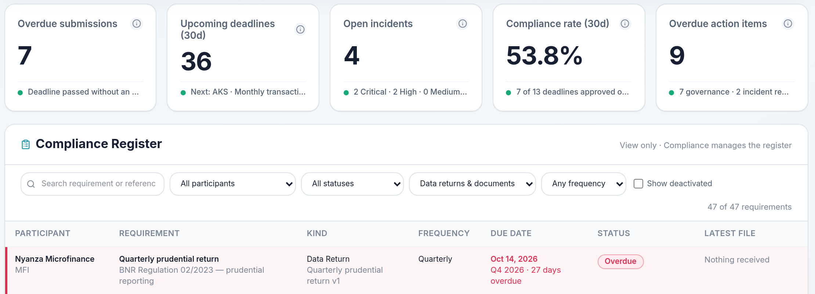


Deadlines that chase themselves
RDIP › 05 COMPLIANCE
14 days before
7 days and 1 day before
Deadline passes
Every week after
Reminder to Compliance and the institution's contact
Follow-ups until a valid report arrives
Marked Overdue and Compliance is alerted
Raised with senior Compliance staff until resolved
No reminder overload
Each reminder goes out once, only while a report is still missing.
Easy to adjust
An administrator can change the reminder timing at any time.
Notes:
Compliance is where RDIP saves the most manual work.
Every institution has documents and reports it must send by certain dates. RDIP sends reminders 14, 7 and 1 day before each deadline, to our compliance team and to the institution's contact, but only while the report is still missing.
If the deadline passes, RDIP marks it Overdue and alerts the team. After that, it raises the issue with senior compliance staff every week until it's resolved.
Nobody gets the same reminder twice, and an administrator can change the timing whenever they need to.

Slide 7
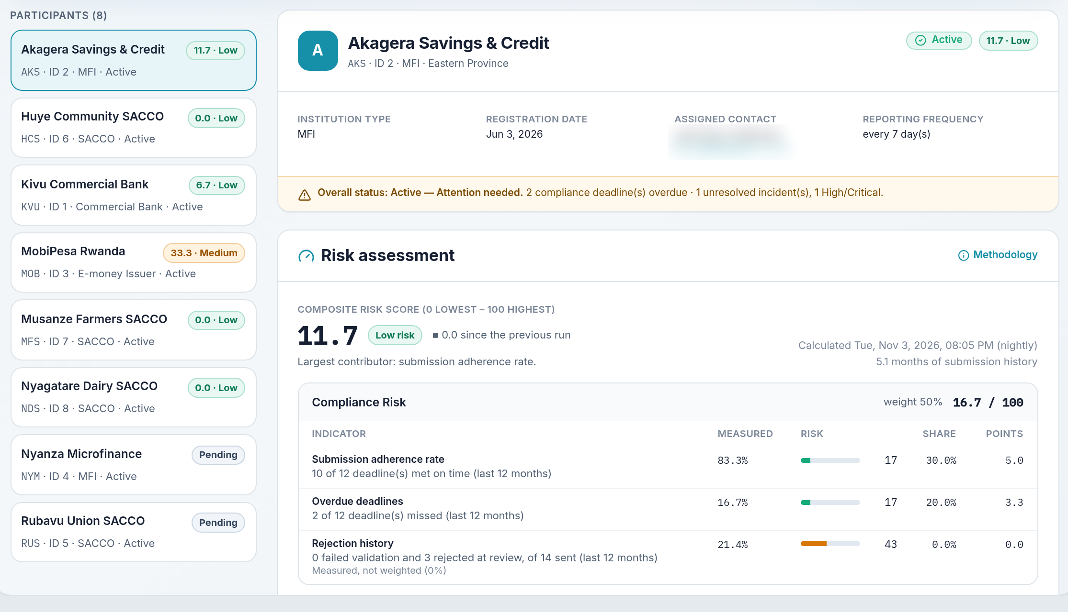

One page per institution, one clear score
RDIP › 06 INSTITUTION PROFILES
Risk score from 0 to 100
Compliance 50%
Data delivery 30%
Incidents 20%
Built from nine real measures, never guesses
Updated automatically every night
New institutions show “score pending” until there is enough history
Notes:
Participant 360 puts everything about one institution on a single page: whether its reports arrive, its deadlines, its incidents, and a risk score.
The score runs from 0, low risk, to 100, high risk. Half of it comes from how well the institution meets its compliance deadlines, 30% from how reliably its data arrives, and 20% from incidents.
It is built from nine real measures, so staff can see exactly why a score is high. It updates every night, and new institutions show 'score pending' until there is enough history to be fair.
(We blurred the contact person's details in this screenshot.)

Slide 8
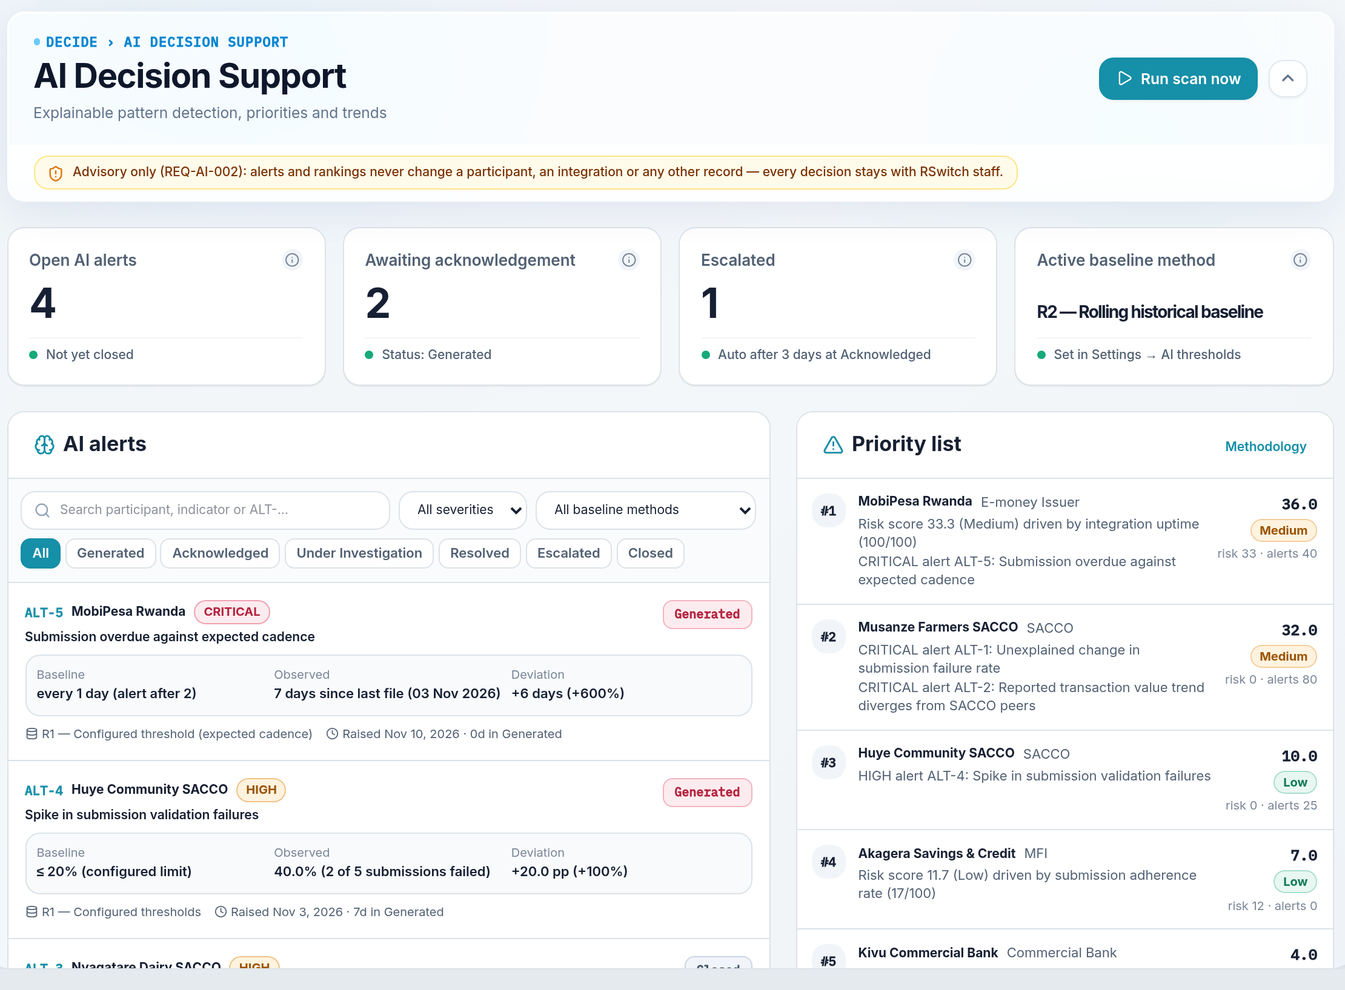


Early warnings; people make the decisions
RDIP › 07 EARLY WARNINGS
RDIP compares each institution with what is normal for it, and flags anything unusual:
Agreed limits
e.g. more than 1 in 5 reports rejected
Its own track record
Compared with its previous six months
Similar institutions
Compared with others of the same type
Suggestions only. RDIP never changes anything by itself. Every decision stays with RSwitch staff.
Notes:
RDIP also gives early warnings, for example when an institution suddenly has many reports rejected, or stops reporting altogether.
It does this by comparing each institution with what is normal: limits RSwitch has agreed, the institution's own last six months, and other institutions of the same type.
Each warning shows what was expected and what actually happened, so staff can see why it was raised.
And it only suggests: RDIP never changes anything on its own. People make every decision.

Slide 9

Safe to use and thoroughly tested
RDIP › 08 TRUST AND SECURITY
169
9
How RDIP keeps data safe
Two-step sign-in with a one-time code
automatic tests run on every change, all passing
tools in one platform
Automatic sign-out when left idle
Account locks after 5 wrong passwords
3
4
Passwords and access keys stored safely
People see only what their role allows
staff teams, each with its own view
kinds of financial institutions covered
Every important action is recorded
Notes:
We tested RDIP thoroughly: 169 automatic tests check the system every time we change it, and all of them pass.
It brings nine tools together for RSwitch's three teams, covering all four kinds of financial institutions on the switch.
On safety: signing in needs a password plus a one-time code. Idle sessions sign out automatically. Accounts lock after five wrong passwords. Passwords and access keys are never stored in readable form. People only see what their role allows, and every important action is recorded so it can be reviewed later.

Slide 10
Thank you
Questions and live demo
Presented by the RDIP Project Team
Adventist University of Central Africa · November 2026
Notes:
To close: RDIP gives RSwitch one place to see how every institution on the switch is doing.
Thank you. We're happy to take questions, and we can show you a live demo.

