Slide 1



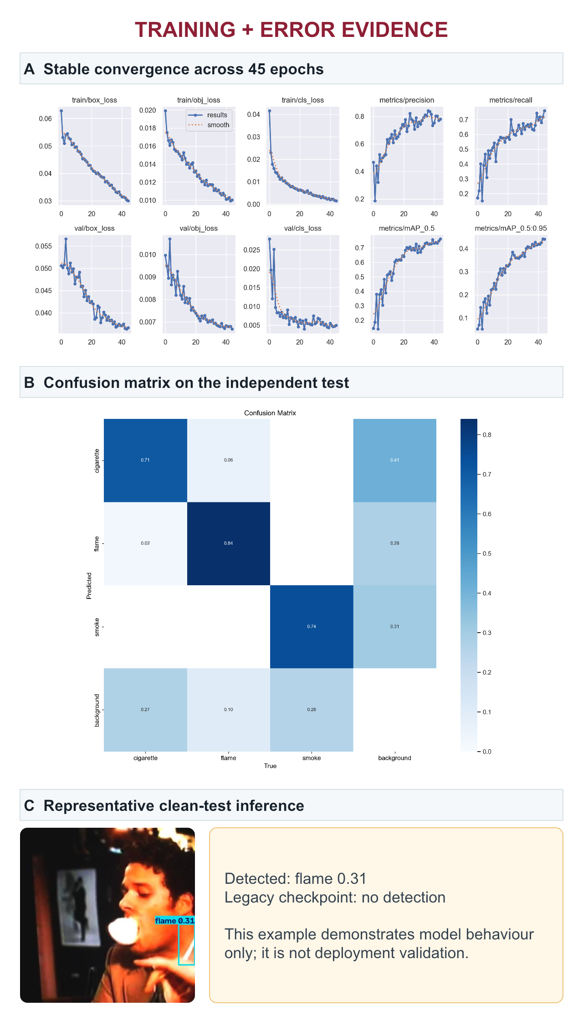
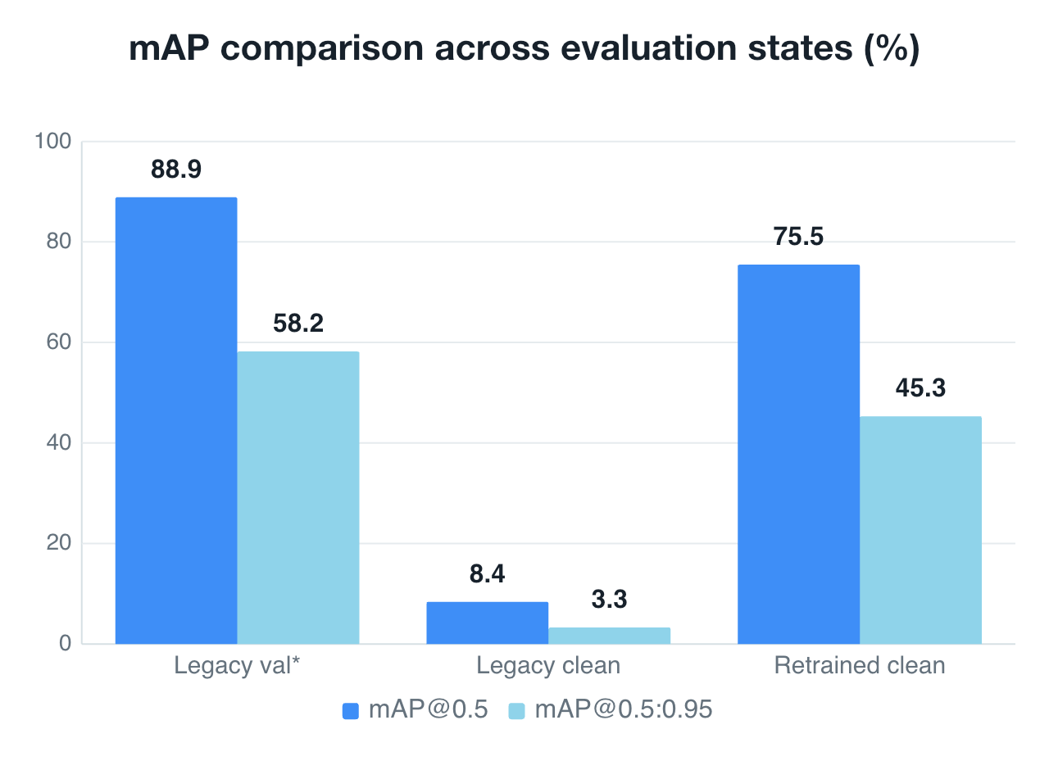
AI Fireguard: An AI-Driven Fire Prevention System
with Advanced Monitoring, Data Analytics and Computer Vision
Student: YUAN Haoming | Department: DSAI
Chief Supervisor: TSANG Yuen Hong | Department: AP | URIS P0053535 | TAG3
TAKE-HOME RESULT | legacy clean-test mAP@0.5 0.084 → leakage-safe retraining 0.755 (+0.671)
I. Introduction
IV. Findings
VISUAL EVIDENCE | CLEAN EXPERIMENT
Discarded cigarettes, nascent flame and delayed smoke can precede serious fires. AI Fireguard investigates whether a compact vision detector can localise these hazards early enough to support human-verified alerts and future response planning.
0.841
0.680
Precision
Recall
II. Objectives
0.755
0.453
mAP@0.5
mAP@0.5:0.95
• Build a clean 3-class YOLOv5 pipeline.
• Remove split leakage and label mismatch.
• Compare the legacy and retrained checkpoints on one frozen test.
• Quantify class errors, speed and local-compute cost.
• Define evidence needed before deployment.
III. Methodology
1
Group sources
Retain background-only negatives
2
Deduplicate
Source name · SHA-256 · pHash ≤ 4
3
Freeze clean split
1,511 train · 188 val · 188 test
*Legacy validation used an old split and old class definition; it is shown only to explain the original claim. Clean-test bars use the same 188 images.
4
Fine-tune YOLOv5s
45 epochs · 640² · batch 8 · MPS
INDEPENDENT TEST BY CLASS
188 images · 171 objects · 11.3 ms/image (batch 8)
CIGARETTE n=82 | P .794 | R .634 | AP50 .717 | AP50–95 .404
FLAME n=50 | P .812 | R .740 | AP50 .763 | AP50–95 .360
SMOKE n=39 | P .919 | R .667 | AP50 .786 | AP50–95 .595
Improvement vs legacy clean test
+.380 P | +.575 R | +.671 AP50 | +.421 AP50–95
Retrained AP50 = 85% of the legacy validation headline (0.755 / 0.889).
5
Independent test
Both checkpoints · same 188 images
ERROR ANALYSIS + NEXT EXPERIMENTS
1 SMALL / OCCLUDED CIGARETTES
Add close-range and hand-occlusion examples; tune class-specific confidence and IoU thresholds.
2 FIRE-LIKE HARD NEGATIVES
Add lights, sunsets, reflections, fog, steam and low-light backgrounds; report false alarms per hour.
3 TEMPORAL + DOMAIN VALIDATION
Test frame-to-frame consistency, unseen buildings and cameras; measure alert latency and sustained-event recall.
4 SAFE SYSTEM INTEGRATION
Only human-verified detections should trigger the escape-route prototype; keep certified alarms as the primary safety layer.
DATASET + LEAKAGE AUDIT
1,887 cleaned image-label pairs
Train 1,511 (276 bg) | Val 188 (34 bg) | Test 188 (34 bg)
Test set: 188 images · 171 labelled objects
0 source-name, exact SHA-256 or perceptual-hash overlaps
Class 1 corrected: face-cigarette-smoking → flame
V. Conclusion
REPRODUCIBLE LOCAL TRAINING
WHAT CHANGED
• Leakage auditing changed the scientific conclusion: the legacy checkpoint fell from an apparent validation AP50 of 0.889 to 0.084 on the independent clean test.
WHAT WORKED
• Retraining recovered AP50 to 0.755 and AP50–95 to 0.453 without cross-split leakage.
• Smoke achieved the strongest precision (0.919) and strict AP (0.595).
WHAT REMAINS
• Cigarette recall (0.634) is limited by small size and hand occlusion.
• Flame AP50–95 (0.360) indicates localisation error despite 0.740 recall.
• Missed targets dominate more than cross-class confusion.
DECISION
The detector is promising for human-verified early alerts. It is not ready for safety-critical autonomy until class calibration, temporal validation and unseen-building tests are completed.
YOLOv5s · 7.02M parameters · legacy best.pt initialisation · all layers unfrozen
45 epochs | 640 × 640 | batch 8 | MPS | workers 2 | seed 0
2 h 04 min training | 2.82 GB max RSS | ~13.1 GB unified-memory footprint | 0 swaps | 14 MB model | 11.3 ms/image at batch 8
SYSTEM CONCEPT
CCTV / edge video → cigarette, flame and smoke boxes → confidence filtering → human verification → alert and route-planning interface.
EVIDENCE POLICY
Report split-integrity checks and independent-test metrics together. Do not treat the legacy validation artifact or a single inference image as deployment evidence.
Scope: detector evaluation only; escape-route integration remains a prototype concept.
VI. References
[1] Jocher, G. et al. (2020). ultralytics/yolov5. Zenodo.
[2] URIS Progress Report P0053535 (2025).
[3] Leakage-safe dataset audit and 45-epoch clean experiment (11 Aug 2026).
[4] Independent evaluations: baseline_clean_test and full_clean_test.
[5] GitHub repository:
github.com/Llleeeo/Smoke-and-Fire-detection-model-and-implementation-
All headline results are independent-test values unless marked legacy val*. Source paths and provenance are embedded in the PowerPoint notes.
23099168D@connect.polyu.hk | Research prototype — complements, not replaces, certified fire-safety systems
Notes:
[Sources]
- /Users/littleblueleo/Library/Containers/com.tencent.xinWeChat/Data/Documents/xwechat_files/wxid_th27ayixjr522_1e18/msg/file/2026-07/E-poster Guideline.pdf (mandatory format and required sections)
- /Users/littleblueleo/Downloads/Eposter.pptx (official template structure and PolyU / Graduate School / CURI logos)
- /Users/littleblueleo/Documents/ChatGPT/URIS/docs/Undergraduate Research and Innovation Scheme.pdf (registered title, project identity, objectives and context)
- /Users/littleblueleo/Documents/ChatGPT/URIS/training/leakage_safe_yolov5/EXPERIMENT_RESULTS.md (dataset, test metrics, class metrics, timing and resource use)
- /Users/littleblueleo/Documents/ChatGPT/URIS/training/leakage_safe_yolov5/audit/verification.json (zero cross-split overlaps)
- /Users/littleblueleo/Documents/ChatGPT/URIS/training/leakage_safe_yolov5/original_model_reference/results.csv (legacy validation artifact)
- /Users/littleblueleo/Documents/ChatGPT/URIS/training/leakage_safe_yolov5/runs/full_clean_45e/results.csv and results.png (training trajectory)
- /Users/littleblueleo/Documents/ChatGPT/URIS/training/leakage_safe_yolov5/runs/full_clean_test/ (independent evaluation and confusion matrix)
- /Users/littleblueleo/Documents/ChatGPT/URIS/training/leakage_safe_yolov5/runs/full_clean_inference/ (representative inference)
- https://github.com/Llleeeo/Smoke-and-Fire-detection-model-and-implementation- (repository)
[/Sources]

