Slide 1
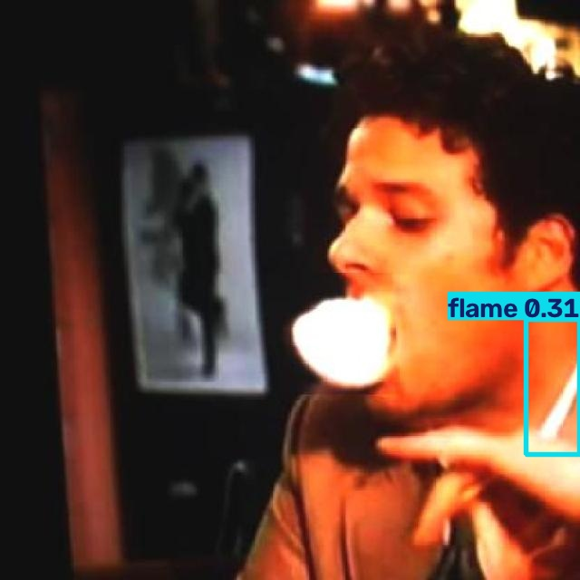
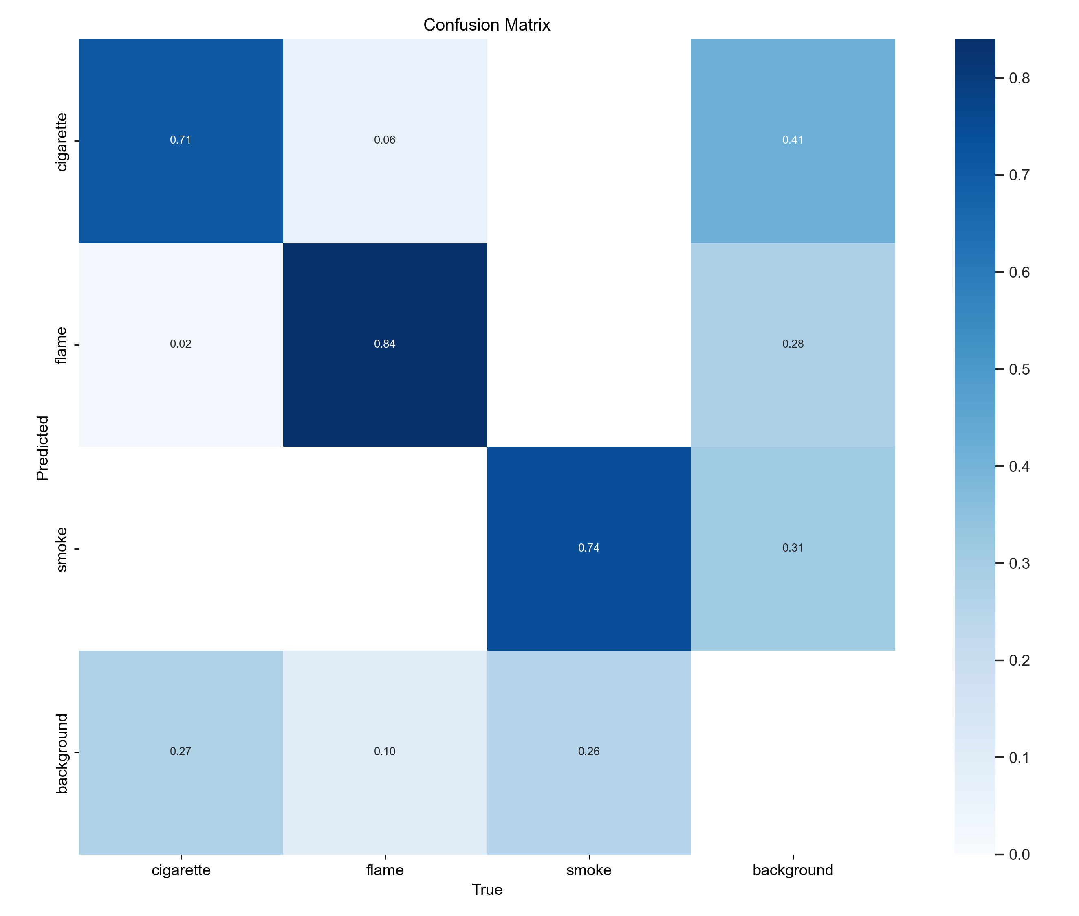
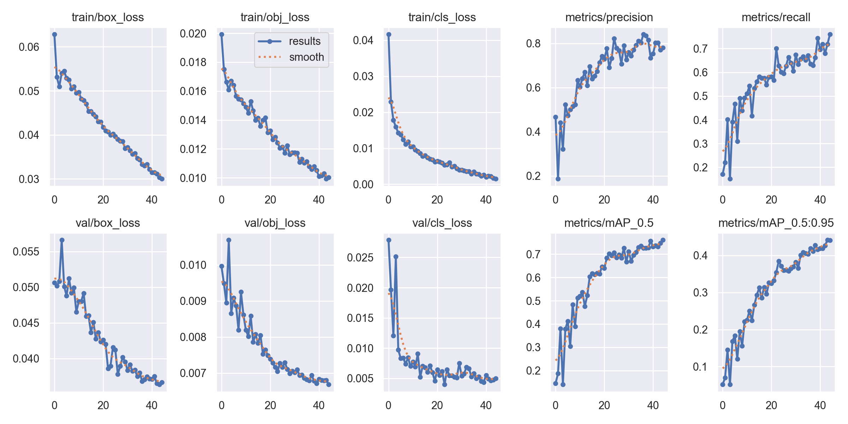
AI FIREGUARD | URIS P0053535 | WORK PROGRAMME TAG3
Yuan Haoming, DSAI | Chief Supervisor: Tsang Yuen Hong
Leakage-Safe Fire & Smoke Detection with YOLOv5
A clean evaluation split exposed a failing legacy checkpoint - retraining recovered independent-test mAP@0.5 from 0.084 to 0.755.
Why this project matters
A fair test exposed the legacy gap
Performance is strongest on smoke
Qualitative evidence
Discarded cigarettes, smouldering material and delayed smoke recognition can turn small ignition events into major incidents. AI Fireguard investigates camera-based detection that can support earlier alerts and later connect to evacuation planning.
The legacy run looked strong on its own validation artifact, but the same checkpoint collapsed on the non-overlapping clean test. The drop is diagnostic evidence of evaluation leakage and label mismatch - not a model regression.
Detection targets: CIGARETTE / FLAME / SMOKE
The audit changed the conclusion
Left: single-image flame detection (0.31). Right: normalized clean-test confusion matrix.
1,511 / 188 / 188
What the errors mean
train validation independent test
Class Precision Recall Instances
1,887 cleaned image-label pairs; backgrounds retained as negative samples.
Cigarette 0.794 0.634 82
Flame 0.812 0.740 50
Smoke 0.919 0.667 39
Smoke leads: precision 0.919 and AP@0.5:0.95 0.595.
0 source-name, exact SHA-256 or perceptual-hash overlaps across splits.
Cigarette recall remains 0.634: small targets and hand occlusion still matter.
*Legacy validation is not directly comparable: old split and old class definition.
Flame recall is 0.740, but AP@0.5:0.95 is 0.360: localization needs improvement.
Class 1 corrected from face-cigarette-smoking to flame.
Training remained stable
Missed targets dominate more than cross-class confusion on the clean test.
0.755
0.453
Raw export
Source groups
Deduplicate
Clean split
independent test mAP@0.5
independent test mAP@0.5:0.95
Deployment and next steps
Reproducible local training
Retraining recovered 85% of the legacy artifact's mAP@0.5 while using a genuinely independent test split.
Add small-cigarette, low-light, occlusion, fog and steam hard negatives.
YOLOv5s | 45 epochs | 640 x 640
Batch 8 | Apple MPS | 2 workers | seed 0
Initialization: legacy best.pt; all layers unfrozen
Calibrate confidence per class and test temporal consistency on video.
Independent test summary
Validate on unseen buildings before safety-critical deployment.
Connect verified alerts to the escape-route planning prototype.
2 h 04 min training | 0 swaps | 14 MB model
Precision 0.841 Recall 0.680
Trustworthy splitting changed the story: the detector now generalizes on a clean test instead of only scoring well on its own validation data.
188 images | 171 objects | 11.3 ms/image at batch 8
Losses declined while recall and both mAP measures continued to rise through the final epochs.
Sources: URIS progress report; leakage audit; full_clean_45e; independent clean test. Full methods and weights:
github.com/Llleeeo/Smoke-and-Fire-detection-model-and-implementation-
Notes:
[Sources]
- docs/Undergraduate Research and Innovation Scheme.pdf (project title, author, supervisor, motivation, original workflow)
- training/leakage_safe_yolov5/EXPERIMENT_RESULTS.md (clean dataset, test metrics, class metrics, resource usage)
- training/leakage_safe_yolov5/audit/verification.json (zero cross-split overlaps)
- training/leakage_safe_yolov5/original_model_reference/results.csv (legacy validation artifact)
- training/leakage_safe_yolov5/runs/full_clean_45e/results.csv and results.png (training trajectory)
- training/leakage_safe_yolov5/runs/full_clean_test/confusion_matrix.png (clean-test confusion matrix)
- training/leakage_safe_yolov5/runs/full_clean_inference/000017_jpg.rf.89254c89fc5700eff8d14d33bc9cc307.jpg (inference example)
- https://github.com/Llleeeo/Smoke-and-Fire-detection-model-and-implementation- (repository)
[/Sources]

