Slide 1



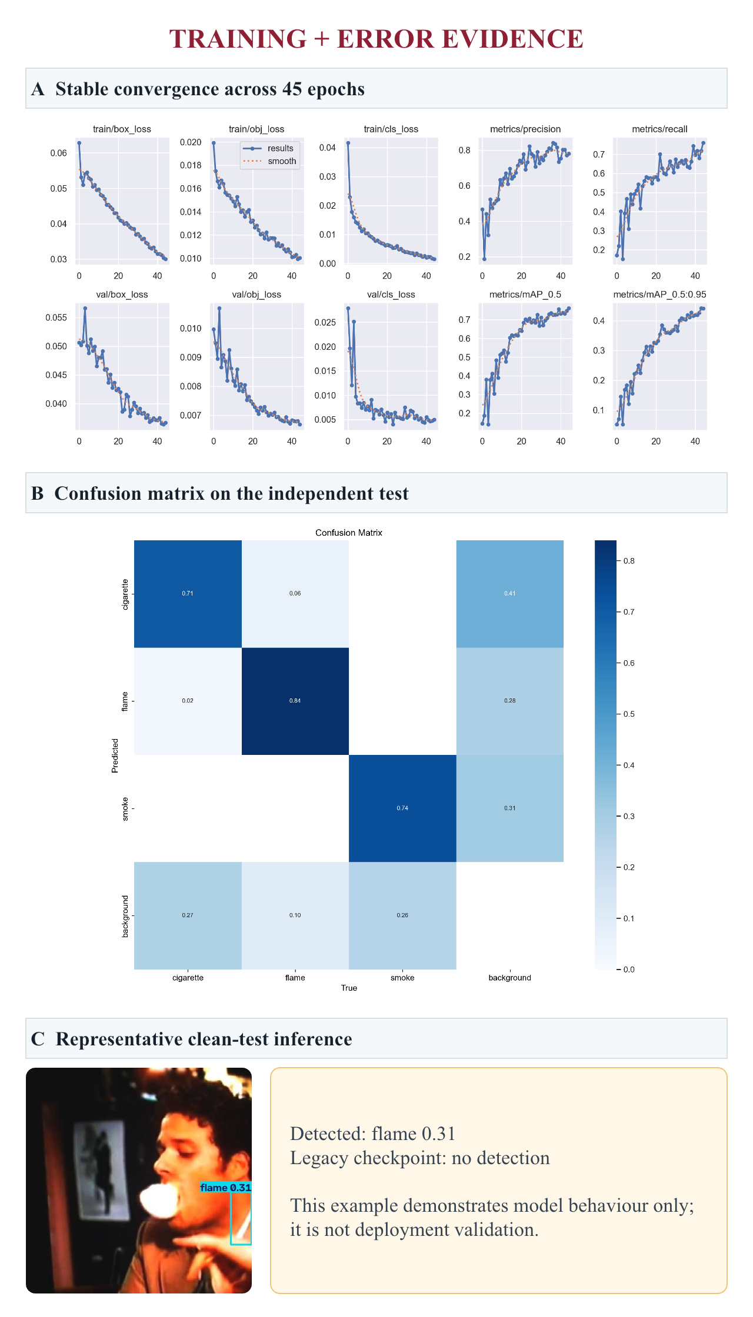
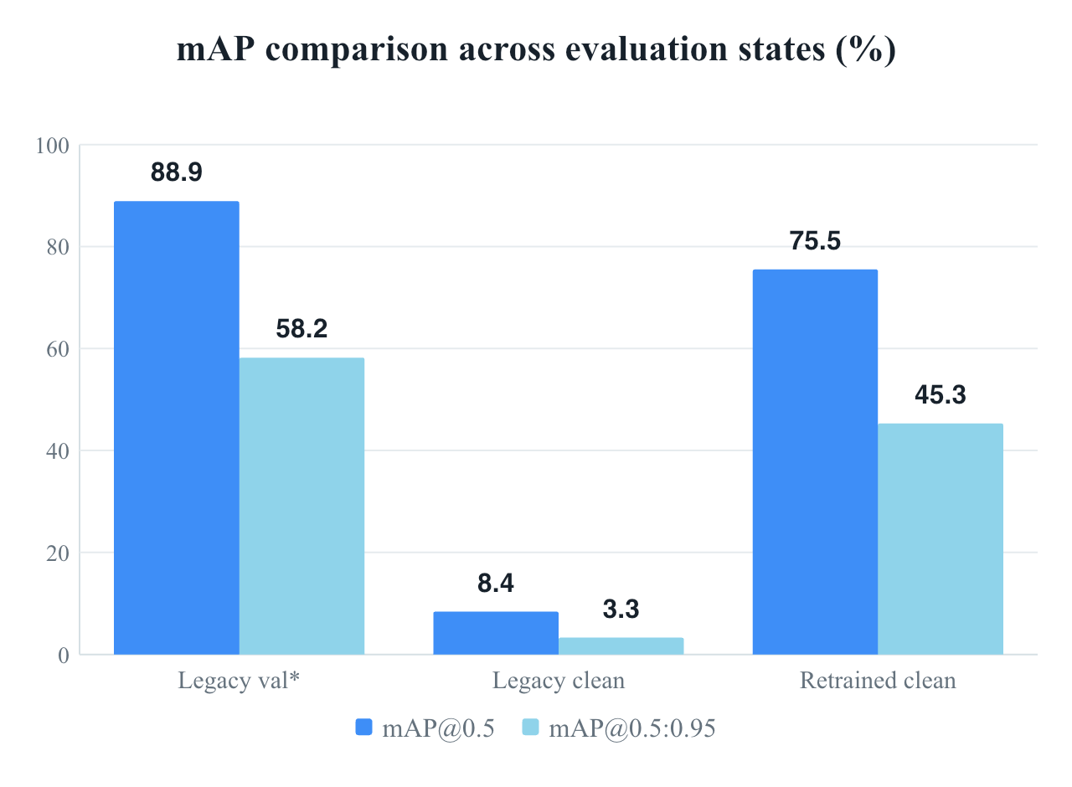
Computer Vision Based Fire-Prone Objects Detection Device
and Real-Time Escape Route Planning System
Student: YUAN Haoming | Department: DSAI
Chief Supervisor: TSANG Yuen Hong | Department: PM | URIS P0053535 | TAG3
TAKE-HOME RESULT | legacy clean-test mAP@0.5 0.084 → leakage-safe retraining 0.755 (+0.671)
I. Introduction
IV. Findings
VISUAL EVIDENCE
Discarded cigarettes, early flame and delayed smoke can precede serious fires. AI Fireguard tests a compact detector for human-verified alerts and response planning.
0.841
0.680
Precision
Recall
II. Objectives
0.755
0.453
• Build clean three-class YOLOv5.
• Remove leakage and label mismatch.
• Compare checkpoints on one frozen test.
• Measure errors, speed, compute and pre-deployment evidence.
mAP@0.5
mAP@0.5:0.95
III. Methodology
1
Group sources
Keep background negatives
2
Deduplicate
Name · SHA-256 · pHash ≤ 4
3
Freeze clean split
1,511 train · 188 val · 188 test
*Legacy val used an old split/class definition and is contextual only. Clean-test bars use the same 188 images.
4
Fine-tune YOLOv5s
45 epochs · 640² · batch 8 · MPS
INDEPENDENT TEST BY CLASS
188 images · 171 objects · 11.3 ms/image
CIGARETTE n=82 | P .794 | R .634
AP50 .717 | AP50–95 .404
FLAME n=50 | P .812 | R .740
AP50 .763 | AP50–95 .360
SMOKE n=39 | P .919 | R .667
AP50 .786 | AP50–95 .595
Δ VS LEGACY CLEAN TEST
P +.380 | R +.575 | AP50 +.671 | AP50–95 +.421
5
Independent test
Both checkpoints · same test
DATASET + LEAKAGE AUDIT
1,887 cleaned image-label pairs
Train 1,511 (276 bg) | Val 188 (34 bg) | Test 188 (34 bg)
Test: 188 images · 171 objects
0 source-name, exact SHA-256 or pHash overlaps
Class 1 corrected to flame
ERROR ANALYSIS + NEXT EXPERIMENTS
1 SMALL / OCCLUDED CIGARETTES
Add close-range and occlusion samples; tune class confidence and IoU.
2 FIRE-LIKE HARD NEGATIVES
Add lights, sunsets, reflections, fog, steam and low-light scenes; measure false alarms/hour.
3 TEMPORAL + DOMAIN VALIDATION
Test consistency, latency and sustained-event recall on unseen buildings/cameras.
4 SAFE SYSTEM INTEGRATION
Send only human-verified detections to the route prototype; certified alarms remain primary.
REPRODUCIBLE LOCAL TRAINING
V. Conclusion
YOLOv5s · 7.02M parameters · legacy best.pt initialisation · all layers unfrozen
45 epochs | 640 × 640 | batch 8 | MPS | workers 2 | seed 0
2 h 04 min | 2.82 GB max RSS | ~13.1 GB unified-memory footprint | 0 swaps | 14 MB model | 11.3 ms/image
SYSTEM CONCEPT
CCTV / edge video → detection → confidence filter → human verification → alert and route-planning interface.
EVIDENCE POLICY
Interpret split-integrity checks and independent-test metrics together. Legacy validation and one inference image are not deployment evidence.
Scope: detector evaluation only; route integration remains a prototype concept.
WHAT CHANGED
• Leakage auditing changed the conclusion: legacy AP50 fell from 0.889 (old validation) to 0.084 on the independent clean test.
WHAT WORKED
• Retraining reached AP50 0.755 and AP50–95 0.453 with no cross-split leakage.
• Smoke led precision (0.919) and strict AP (0.595).
WHAT REMAINS
• Small/occluded cigarettes limit recall (0.634).
• Flame AP50–95 (0.360) shows localisation error.
• Missed targets dominate cross-class confusion.
DECISION
Promising for human-verified early alerts; not ready for safety-critical autonomy until calibrated and validated temporally in unseen buildings.
VI. References
[1] Jocher, G. et al. (2020). ultralytics/yolov5. Zenodo.
[2] URIS Progress Report P0053535 (2025).
[3] Leakage-safe audit and 45-epoch clean experiment (11 Aug 2026).
[4] Independent evaluations: baseline_clean_test; full_clean_test.
[5] github.com/Llleeeo/Smoke-and-Fire-detection-model-and-implementation-
Headline results use the independent test unless marked legacy val*. Full provenance is embedded in the PowerPoint notes.
23099168D@connect.polyu.hk | Research prototype — complements, not replaces, certified fire-safety systems
Notes:
[Sources]
- GS CURI email, 13 Aug 2026: Department of Applied Physics (AP) retitled Department of Physics and Materials (PM); supervisor department updated accordingly.
[/Sources]

