Slide 1







PROGRAM RECOMMENDATION SYSTEM

Slide 2





EXECUTIVE SUMMARY
The National Career Assessment Examination or NCAE is a test taken by high school students in the Philippines that determines their strengths in different career fields. It was first given in January 2007 and replaces the former National College Entrance Examination. The purpose of the NCAE is to help students determine which courses they should study in college and what sort of career they are best suited for. Like many standardized tests, the NCAE measures students' general scholastic knowledge. However, the NCAE also tests vocational aptitude, occupational preferences and entrepreneurial skills (Lissab, 2020). This examination is traditionally held in a face to face class which every student in a school should take.
However, the National Career Assessment Examination (NCAE) was only for enrolled students in a school. It is performed in a traditional way in which they use pen and paper and has rules and regulations for both students and teachers to execute it properly. In the current age, where digital is the theme, this is not a timely solution for gathering information because it does not have fast circular returning and responding from the respondents. Other issues such as cost, time and effectiveness are also within considerations.
This being said, our team would like to propose a course recommendation system, a browser-based system that creates a type of questionnaire wherein, depending on the scores and answers that the user provides, it identifies the most suitable course depending on the specialization of knowledge that the user inhibits. Also, we added a university admissions program that Caloocan residents can apply to.

Slide 3
OBJECTIVE
To develop a system, A course recommendation website which contains questionnaires that can help users decide on which path or course they would like to take in college.

Slide 4





COLLEGE RETURNEE
SCOPE
CAREER CHANGE
COLLEGE APPLICANTS
SENIOR HIGH FRESH GRADUATE

Slide 5
DELIMITATION
RESIDING ADDRESS
FIRM DECISION

Slide 6

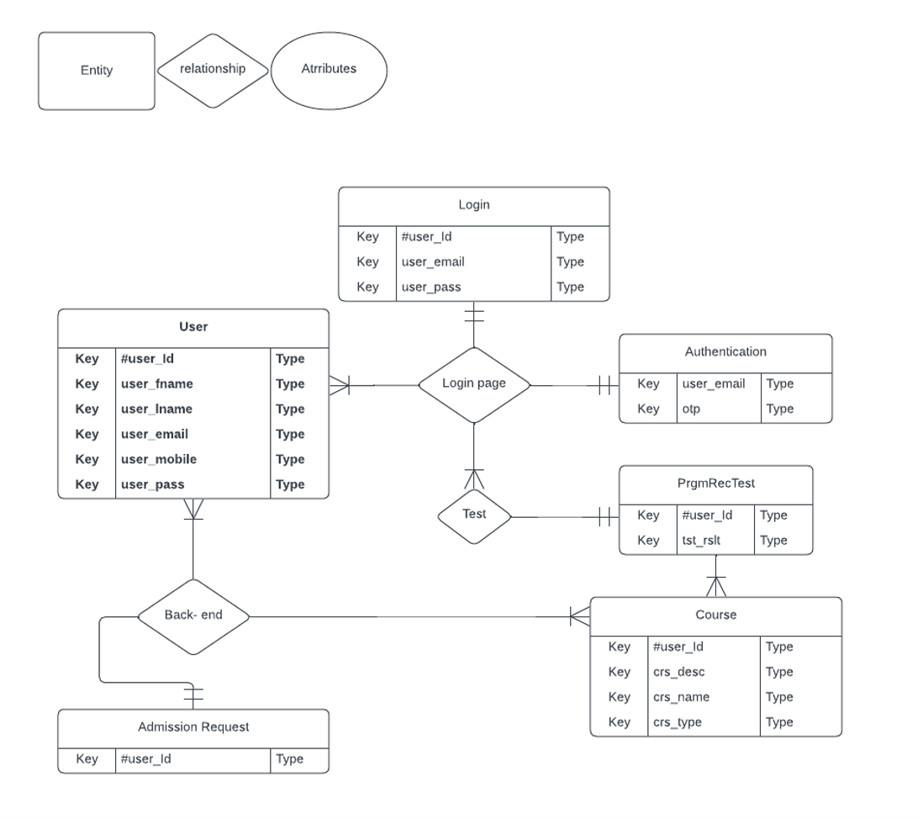
ERD

Slide 7
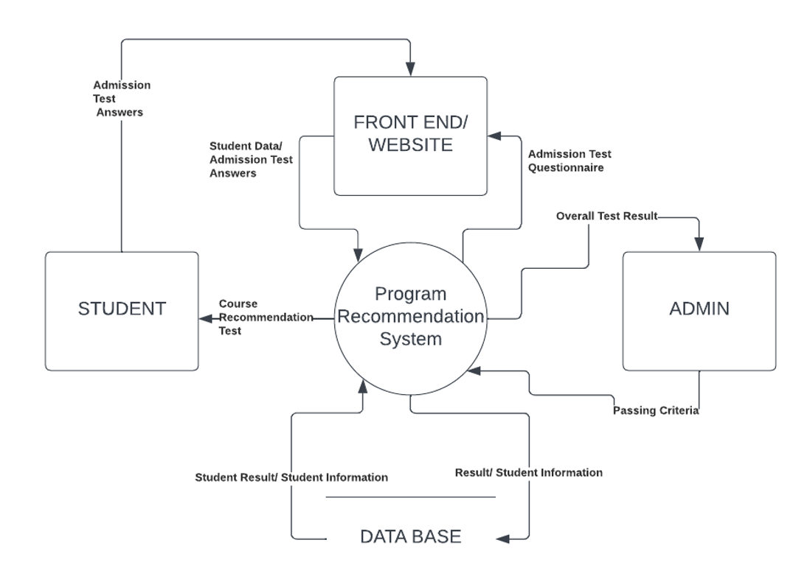
DFD

Slide 8
THANKYOU!

