Slide 1
DC-7 Field Trial: Q3 Review
Northwind Irrigation Cooperative
Operations team, October 2026
Notes:
Ten minutes, then questions.

Slide 2
23.1% less water
48 controllers, 4 sites, 12 weeks
Every site beat its 2025 baseline
Notes:
Dunmore did best because its plots are on sandy soil, where fixed timers over-watered the most.

Slide 3
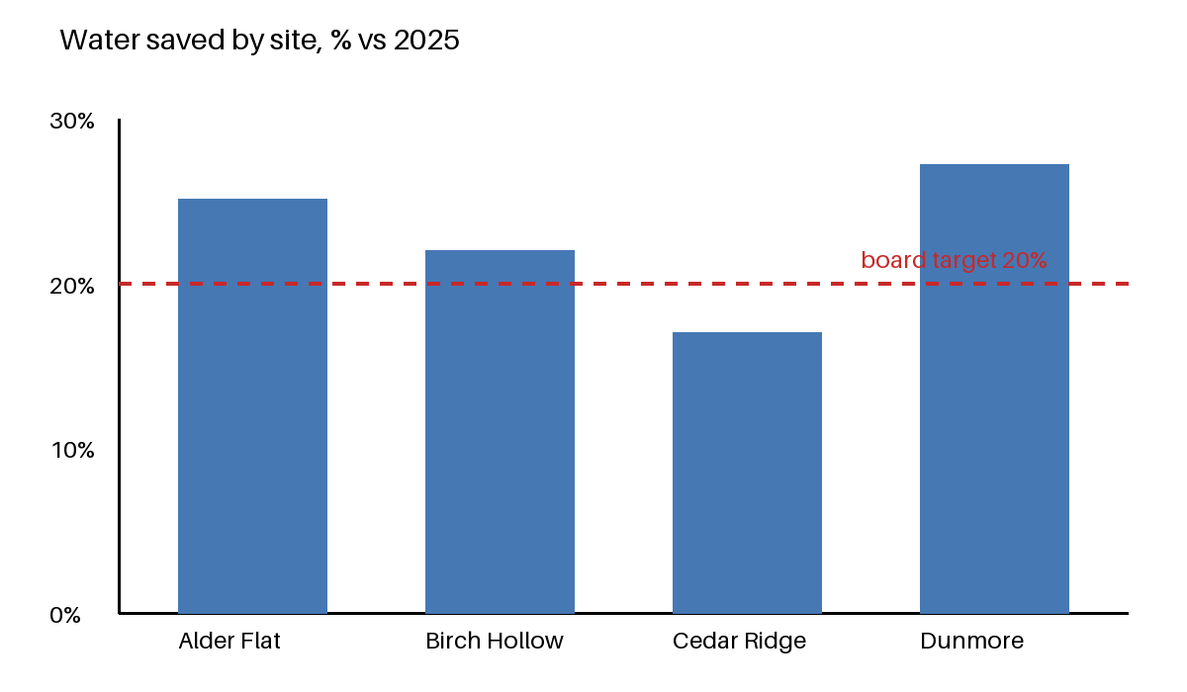
Results by site
Notes:
The dashed line is the target the board set in the spring.

Slide 4
What went wrong
Valve stiction at Cedar Ridge: 5 of 12 units, hard-water scale
Clock drift in firmware 2.3.1, fixed by 2.3.4
Notes:
The filter retrofit is quoted by Tallis Supply at $38 per unit, three weeks lead time.

Slide 5
The 2027 ask
200 controllers at $260: $52,000
Inline filters at $38: $7,600
Installation: $1,800
Total: $61,400
Notes:
Installation is low because site stewards do it; the $1,800 is tools and travel.

Slide 6
Timeline
Board vote: 12 November 2026
Procurement: January 2027
Install: March 2027, before planting
Notes:
If the board defers, the earliest install slips to the 2028 season because of the planting calendar.

Slide 7
Questions
Notes:
Spreadsheet and report are in the same folder.

