Slide 1
Creature art review — drag a creature into the band you want
One slide per biome cluster. PROTOTYPE: the 3 largest of 57 clusters · register built 2026-09-05T16:56:05Z
KEEP ART
the shipping art is good enough — no work queued
REGENERATE
art must be redrawn; the size on the map is right
REGEN + RESCALE
redraw AND change drawSize — it renders at the wrong scale
CUT
the creature leaves the planet entirely (Cherry Picker)
• HOW TO USE IT — drag a creature's tile from the band it is in into the band you want. That drag IS the decision; nothing else needs typing.
• DELETING a tile (select it, press Delete) also means CUT — same as dropping it in the CUT band.
• A RED-OUTLINED tile with a ✂ on its name is ALREADY cut from the live game by Cherry Picker. That is the current state, not a ruling — leave it where it sits to keep it, or move it like any other tile.
• Each tile is one grouped object: the picture and its name move together. Within a band, left → right runs smallest → largest at true in-game draw size, so the size ladder stays readable.
• A big cluster runs over several slides — every page carries all four bands, so a drag never needs a slide change.
• Tiles start in the band matching the CURRENT decision, so an untouched deck reads back unchanged. 577 creatures across 3 cluster(s) on this deck.
• Read it back with: python3 design/Jawa/worldbuilding/review/deck/read_creature_deck.py <your.pptx>

Slide 2















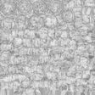

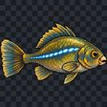
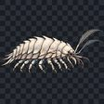
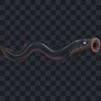
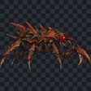




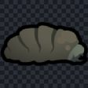





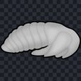





















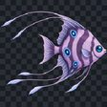















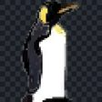











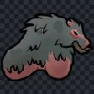









No biome (reserve) (1/7) 96 creatures on this page of 491 in the cluster · drag between bands to decide
KEEP ART — the shipping art is good enough — no work queued (76 here)
✂ crow
✂ bluebird
✂ kangaroo rat
✂ mouse
bloodrop larvae
moss grub
✂ kiwi
larva
✂ chickenffalo
chicken
✂ chickencat
✂ chickenwolf
✂ sparrow
✂ yorkshire terrier
✂ chickenbear
sandworm
mee scalefish
faa scalefish
pale yobshrimp
silt lamprey
rust nipper
spidermine
wardrone
✂ catman
✂ cat
megaphorid maggot
blitzkrieg
crystalline caterpillar
DUM Repair Droid
astronaut
bloodrop pupa
crystalback pupa
foundry pupa
jewel pupa
moss pupa
royal rhino pupa
shatterjaw pupa
turbocleaner
cleansweeper
✂ mink
✂ porcupine
✂ swan
agrihand
constructoid
fabricor
guttersnipe
lifter
war urchin
bovine grub
crystalback grub
jewel grub
royal rhino grub
shatterjaw grub
foundry grub
✂ prairie dog
✂ silver mole
✂ arctic owlcat
✂ forest owlcat
laa scalefish
✂ jellybird
✂ otter
carrier dryad
militor
paramedic
GNK Power Droid
✂ rabbit
✂ macaw
✂ badger
✂ flamingo
✂ flamingo phoenix
goose
✂ heron
✂ peafowl
✂ turkeyman
✂ penguin
fx-7 medical droid
REGENERATE — art must be redrawn; the size on the map is right (19 here)
wasp
hunter drone
immature dryad
MSE Repair Droid
fingerspike
fleshmass nucleus
metalhorror
toughspike
pikeman
centurion
chimera
cow
termite
centipede blaster
centipede burner
centipede gunner
bulbfreak
diabolus
devourer
REGEN + RESCALE — redraw AND change drawSize — it renders at the wrong scale (1 here)
trispike
CUT — the creature leaves the planet entirely (Cherry Picker) (0 here)

Slide 3













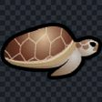












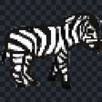








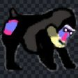
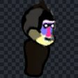













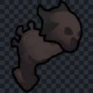

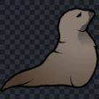
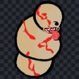



















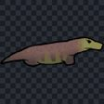

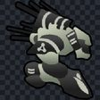







No biome (reserve) (2/7) 84 creatures on this page of 491 in the cluster · drag between bands to decide
KEEP ART — the shipping art is good enough — no work queued (76 here)
facet pupa
smog pupa
✂ fennec fox
✂ toxafox
sentry drone
mecha-rat
✂ phoenix owlcat
✂ cobra
ysalamir
✂ alphabeaver
✂ avian paragon
✂ devil sheep
salvage assist droid
✂ sea turtle
✂ tortoise
✂ armadillo
barkskin dryad
berrymaker dryad
clawer dryad
gaumaker dryad
medicinemaker dryad
woodmaker dryad
Astromech Droid
✂ capybara
✂ dogman
✂ seal
✂ zebra
artilleron
bellicor
✂ alligator man
✂ black bear man
✂ glarral penguin
hunter
lancer
legionary
✂ mandrill
✂ mandrill man
✂ neanderthal
scyther
summoned scyther
tesseron
✂ emu
✂ rose flamingo
✂ flatworm hound
✂ labrador retriever
cinnabar caterpillar
sandpillar
aaroxis dendoria pupa
pig
✂ gazelle
✂ carbuncle
sightstealer
Muckraker Crab Droid
✂ sea lion
Abomination
✂ mansquirrel
sheep
✂ crystalline caracal
✂ bog hound
corellian hound
✂ husky
lux
munifex
optio
sagittarius
polychoron
✂ cassowary
cyclops
✂ hydrazoa
✂ ostrich
scorcher
tunneler
✂ walrus
✂ molehorse
✂ monitor lizard
culinarius
REGENERATE — art must be redrawn; the size on the map is right (8 here)
goliath
pristine slurrypede
thrumbo
thrumboman
thrumhorse
Row boat
the Long Hunger
Balloon
REGEN + RESCALE — redraw AND change drawSize — it renders at the wrong scale (0 here)
CUT — the creature leaves the planet entirely (Cherry Picker) (0 here)

Slide 4






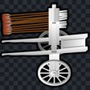





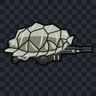





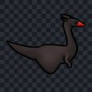


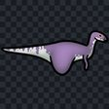
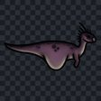
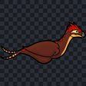




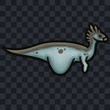





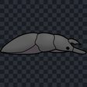


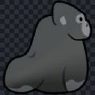

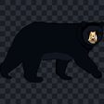
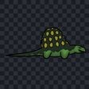
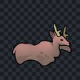
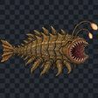

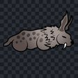





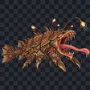

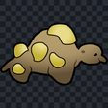






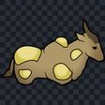

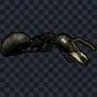


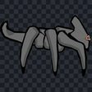



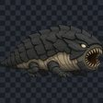






No biome (reserve) (3/7) 76 creatures on this page of 491 in the cluster · drag between bands to decide
KEEP ART — the shipping art is good enough — no work queued (76 here)
geneticor
✂ boomachicken
mecha-chicken
Charley
Destroyer Droid
Dirtbike
Hwacha
Rickshaw
Wheelbarrow
apocriton
bovine pupa
✂ chocobo
mecha-mime
mechaturtle
noctol
revenant
✂ wolfsnake
✂ wasteboar
✂ Adalia
✂ Halszkaraptor
✂ Holcorobeus
✂ Hylonomus
✂ Parksosaurus
✂ Valdosaurus
✂ Yi
✂ boomwolf
✂ karrik
✂ lizardman
✂ ssvek
✂ sszhal
gorehulk
✂ hemolope
✂ humanoid paragon
nociosphere
✂ waste hound
shatterjaw beetle
✂ scimitar cat
✂ wolfchicken
✂ gorilla
✂ neutrolope
✂ black bear
✂ sszhakar
✂ wastedeer
opee sea killer
✂ tiger
✂ rabbitcat
✂ toxlion
✂ sserrik
✂ sshaggan
✂ ssorrak
✂ muskox
crimson opee
daggersnout
✂ booman
mechacat
✂ alligator
mechawolf
✂ panda
✂ wolffalo
✂ feline paragon
✂ boomhorse
✂ cathorse
giant ant
✂ manchicken
✂ hippo
bulwark
✂ jakkir
aura
✂ chickenlodon
shale gorger
✂ grand carbuncle
✂ cow
✂ equine paragon
mecha-horse
✂ manehound
✂ Compsognathus
REGENERATE — art must be redrawn; the size on the map is right (0 here)
REGEN + RESCALE — redraw AND change drawSize — it renders at the wrong scale (0 here)
CUT — the creature leaves the planet entirely (Cherry Picker) (0 here)

Slide 5
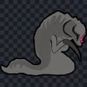



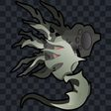





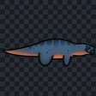


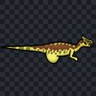






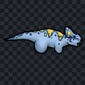
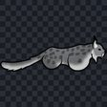
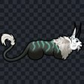
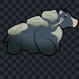

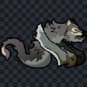






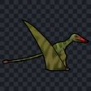




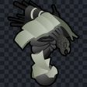





































No biome (reserve) (4/7) 76 creatures on this page of 491 in the cluster · drag between bands to decide
KEEP ART — the shipping art is good enough — no work queued (76 here)
no art
prowler
✂ wolfalope
✂ wolfbeaver
✂ beaverwolf
apoptosis
✂ canine paragon
flesh flies
pristine strider
✂ wolfbear
✂ wolfcat
Frog
✂ Psittacosaurus
meadow lizard
mechalope
✂ ssbik
✂ wooly Wolf
✂ Simbakub
✂ grondik
✂ muffalochicken
✂ muffalocat
✂ Lycaenops
✂ Protoceratops
✂ frost lynx
✂ genix
mechabear
✂ muffalowolf
✂ wolf shrimp
yooka
✂ thrumwolf
✂ giant tardigrade
✂ wasteffalo
✂ Tupandactylus
✂ muffalobear
✂ vhikk
astropede
ironclad
✂ muffalohorse
mace drake
legate
✂ Gallimimus
✂ Homalocephale
✂ Staurikosaurus
✂ toxbear
war queen
thornback colo
✂ Simbakub Alpha
✂ dhakar
✂ korrik
✂ krondar
✂ bearchicken
✂ moose
✂ vekka
✂ Capryak
✂ toxscorpion
✂ ssborrak
colo claw fish
✂ pestigator
✂ deer
✂ catrabbit
✂ catbear
✂ catffalo
✂ catwolf
blizzarisk clutch mother
dunealisk clutch mother
feralisk clutch mother
✂ scarodon
✂ Pachycephalosaurus
demolisher
goldilox
siegebreaker
siegemelter
starfire
✂ rannak
rock troll
bilious varog
✂ harpeagle
REGENERATE — art must be redrawn; the size on the map is right (0 here)
REGEN + RESCALE — redraw AND change drawSize — it renders at the wrong scale (0 here)
CUT — the creature leaves the planet entirely (Cherry Picker) (0 here)

Slide 6












































































No biome (reserve) (5/7) 76 creatures on this page of 491 in the cluster · drag between bands to decide
KEEP ART — the shipping art is good enough — no work queued (76 here)
✂ borrak
✂ duskhorn
✂ gigantopithecus
abyssal colo
✂ grondrak
✂ bearwolf
✂ obbak
✂ Antarctopelta
✂ Abrictosaurus
✂ Drinker
✂ sskarr
✂ ursine paragon
✂ lussik
✂ furpotamus
✂ direhorse
Toad
phalanx
fireworm
Mechanical Cockroach
✂ Udanoceratops
dewback chariot
mechaspider
Prowler
✂ Termitotron
✂ aurochs
✂ Edaphosaurus
✂ Ophiacodon
Roadkill
✂ Tanystropheus
✂ Dracorex
✂ Oviraptor
✂ chalicotherium
✂ megalochelys
✂ Scutosaurus
✂ Styracosaurus
dreadmeld
✂ ssgrondak
war empress
mecha-muffalo
✂ sserrakoth
✂ dunbear
✂ ssvarrak
pristine assembler
nighthrumbo
Crystal scythe
Harbinger
Havoc
Palanquin
dewback war chariot
✂ ssdarr
✂ sskorrak
✂ Deinonychus
✂ Dromaeosaurus
✂ Stygimoloch
✂ Troodon
✂ Velociraptor
infernus
✂ woolly stegosaurus
✂ mastodon
✂ ssorrakoth
✂ megalania
✂ gigantophis
✂ titanoboa
✂ Plastemmoth
teramantis
titantick
✂ vhorbantha
Scytheman
✂ sslek
Outrigger Canoe
Dinghy
✂ krissh
Highwayman
Traveller
Bang Bus
Bunsen
REGENERATE — art must be redrawn; the size on the map is right (0 here)
REGEN + RESCALE — redraw AND change drawSize — it renders at the wrong scale (0 here)
CUT — the creature leaves the planet entirely (Cherry Picker) (0 here)

Slide 7












































































No biome (reserve) (6/7) 76 creatures on this page of 491 in the cluster · drag between bands to decide
KEEP ART — the shipping art is good enough — no work queued (76 here)
✂ Desmatosuchus
✂ Kaprosuchus
Mule
✂ Ornithosuchus
Wagon
king toad
✂ Coahuilaceratops
✂ Indoraptor
✂ Kentrosaurus
✂ Kosmoceratops
✂ Nasutoceratops
✂ Pachyrhinosaurus
✂ Triceratops
✂ Zalmoxes
mechathrumbo
archocentipede
patriarch
✂ boomnotherium
✂ deinotherium
ronto wagon
bantha cart
✂ ssorrbantha
Mosquito
Devourer
Judgment
Roadrunner
Snatcher
Trawler
✂ Albertosaurus
✂ Baryonyx
✂ Becklespinax
✂ Ceratosaurus
✂ Cryolophosaurus
✂ Gasosaurus
✂ Nanuqsaurus
✂ Suchomimus
Bulldog
✂ Enigmosaurus
✂ Segnosaurus
Tango
✂ Therizinosaurus
✂ Ankylosaurus
✂ Mochlodon
✂ Stegosaurus
Warbird
✂ Carnotaurus
✂ Metriacanthosaurus
✂ Rajasaurus
✂ sskorrath
✂ paraceratherium
storm sando
eopie sled
✂ Prestosuchus
Wisent
✂ Camptosaurus
✂ Rhabdodon
✂ Tenontosaurus
Smuggler
sando aqua monster
✂ Yutyrannus
✂ Corythosaurus
✂ Deinosuchus
✂ Edmontosaurus
✂ Parasaurolophus
✂ Sarcosuchus
✂ Acrocanthosaurus
✂ Allosaurus
✂ Carcharodontosaurus
✂ Yangchuanosaurus
elder sando
✂ Saltasaurus
✂ Indominus rex
✂ Apatosaurus
✂ Argentinosaurus
✂ Camarasaurus
✂ Giganotosaurus
REGENERATE — art must be redrawn; the size on the map is right (0 here)
REGEN + RESCALE — redraw AND change drawSize — it renders at the wrong scale (0 here)
CUT — the creature leaves the planet entirely (Cherry Picker) (0 here)

Slide 8






No biome (reserve) (7/7) 7 creatures on this page of 491 in the cluster · drag between bands to decide
KEEP ART — the shipping art is good enough — no work queued (7 here)
✂ Supersaurus
✂ Tyrannosaurus rex
brood lord
reefback
✂ Spinosaurus
starmaw
lanternwhale
REGENERATE — art must be redrawn; the size on the map is right (0 here)
REGEN + RESCALE — redraw AND change drawSize — it renders at the wrong scale (0 here)
CUT — the creature leaves the planet entirely (Cherry Picker) (0 here)

Slide 9















































arid shrubland 47 creatures on this page of 47 in the cluster · drag between bands to decide
KEEP ART — the shipping art is good enough — no work queued (43 here)
aerofleet
imperial toad
loth-cat
moss beetle
fungal ferret
igitz
sketto
gorg
frilled gorg
Pufferpig
truffle mole
karabal
Protovermes
longtail gorg
fungal weevil
terrorworm
urusai
massiff
wildpawn
Caihong
Diplocaulus
Meganeura
Qantassaurus
painted spat
barbslinger
eopie
pilgrim
sand lion
orray
dactillion
Jamel
jerbal
Bagaceratops
megatardi
iridonian reek
aberrant fleshbeast
Hellboar
mawvorr
uvak
lizardochs
zeer
sivatherium
Baseopsis
REGENERATE — art must be redrawn; the size on the map is right (4 here)
megavole
mudhorn
ronto
brezak
REGEN + RESCALE — redraw AND change drawSize — it renders at the wrong scale (0 here)
CUT — the creature leaves the planet entirely (Cherry Picker) (0 here)

Slide 10






































tropical rainforest 39 creatures on this page of 39 in the cluster · drag between bands to decide
KEEP ART — the shipping art is good enough — no work queued (32 here)
kowakian monkey-lizard
tach
woolamander
Borcatu
iriaz
monkey
stintaril
can-cell
whisperbird
cannok
insectomorph
panther
kinrath
giantala
acklay
Bernicia
gutkurr
mastiff phalone
vornskyr
devourer
Kwi
wyyyschokk
arthropleura
titanis
ithorian reek
vapaad
Manipulator
gelagrub
varactyl
corinathoth
katarn
harvester beetle
REGENERATE — art must be redrawn; the size on the map is right (6 here)
zarander
yippa
rhinoceros
elephant
Arthropleura
torton
REGEN + RESCALE — redraw AND change drawSize — it renders at the wrong scale (1 here)
zakkeg
CUT — the creature leaves the planet entirely (Cherry Picker) (0 here)

