Slide 1
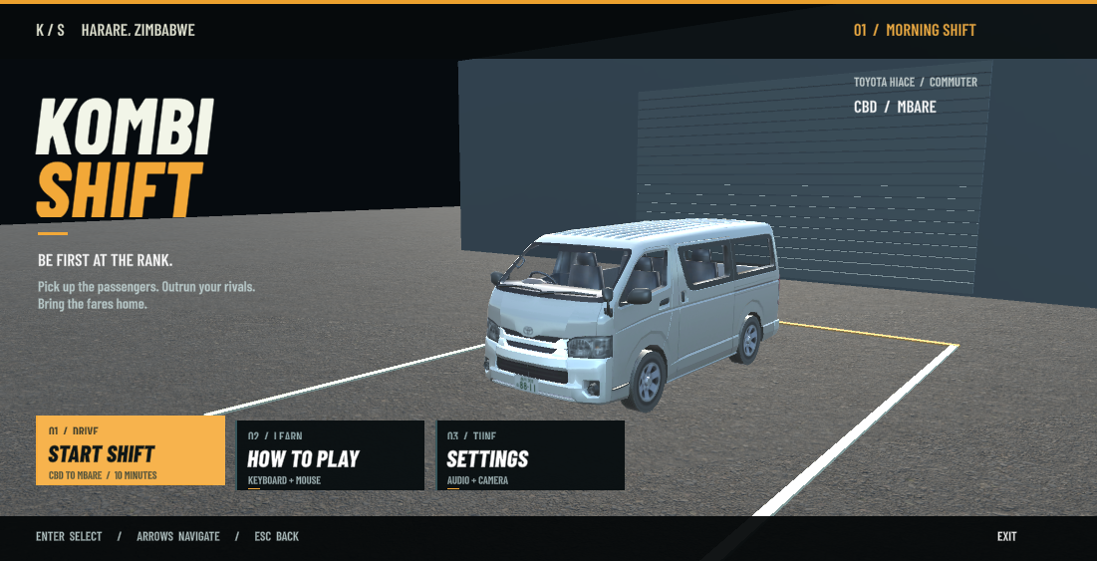
Kombi Shift 2
Group 6 | HAI311 | A Harare-inspired passenger driving game
Collect passengers before your rivals.
Deliver the stage target to Mbare.
Leroy Mapunzwana · Jayden Mapasure
Tadiwanashe Nzenze · Euclide Mtisi
Tendai Mapiko
01
Notes:
Pitch: player goal, audience and why the competition is readable. Screenshot is prior current-project technical evidence, not an external tester photograph.
Evidence root: BranchProjects/KombiShift2. This deck describes the 8 November current version. Human testing and personal contributions must be recorded honestly.

Slide 2
Audience and design decisions
Casual keyboard and mouse players aged 14+; personas are design hypotheses.
New player
Student player
Competitive player
Clear goal, automatic boarding,
How to Play and a forgiving stage.
Score improvement, short shifts,
adjustable camera and volume.
Faster rivals, shorter timer,
a higher target in Rush Hour.
02
Notes:
Sources: current report audience section; Schell Games https://schellgames.com/art-of-game-design. Explain design rationale as a hypothesis requiring real players; do not claim textbook editions not read.
Evidence root: BranchProjects/KombiShift2. This deck describes the 8 November current version. Human testing and personal contributions must be recorded honestly.

Slide 3
The player journey
A complete loop with visible feedback and an ending.
1
Choose stage
2
Drive to stop
3
Stop and board
4
Follow route
5
Deliver at Mbare
6
Result and replay
Pause → resume / restart / menu | Morning success → Rush Hour
03
Notes:
Current storyboard: Docs/Assessment/STORYBOARD.html. This records final design, not fabricated early feedback. Demonstrate pause and return path.
Evidence root: BranchProjects/KombiShift2. This deck describes the 8 November current version. Human testing and personal contributions must be recorded honestly.

Slide 4
Two stages change the challenge
One city route; two deliberate rule configurations. Initial tuning awaits authentic player feedback.
Rule | Morning Shift | Rush Hour
Time | 600 seconds | 420 seconds
Delivery target | 1+ passengers | 6+ passengers
Rival speed | 6 m/s | 9 m/s
Rival head start | 45 sec + stagger | 8 sec + stagger
Same controls and fares let players recognise the increase in time pressure and competition.
04
Notes:
Source: Scripts/Gameplay/KombiChallenge.cs. Selector F2 or button on title. Morning success offers Next: Rush Hour. A menu scene is not a second level.
Evidence root: BranchProjects/KombiShift2. This deck describes the 8 November current version. Human testing and personal contributions must be recorded honestly.

Slide 5
Scoring and outcomes
Rules are intentionally simple and visible.
$2
Success
Deliver the stage target before timeout.
Bonus = round(seconds left × 0.08).
Best successful earnings save per stage.
when a passenger reaches a seat
Failure: timeout or insufficient passengers at the terminal.
05
Notes:
Source: KombiShiftGameDirector.Board, DropOff, Finish; KombiChallenge.SaveBest. Terminal delivery count and timeout tested in both stages.
Evidence root: BranchProjects/KombiShift2. This deck describes the 8 November current version. Human testing and personal contributions must be recorded honestly.

Slide 6
One owner for each gameplay responsibility
Trace one real boarding interaction through the source.
Director → Station → Passenger → Fare callback → Director
Director: timer, active stop, manifest and outcome
Station: reservations and distinct free seats
Passenger: walking, sitting, returning and alighting
Events: fare earned, pause changed, shift finished
06
Notes:
Sources: Gameplay/KombiShiftGameDirector.cs, PassengerStation.cs, StationPassenger.cs, UI/KombiNavigationHud.cs. New events: OnFareEarned, OnPauseChanged, OnShiftFinished.
Evidence root: BranchProjects/KombiShift2. This deck describes the 8 November current version. Human testing and personal contributions must be recorded honestly.

Slide 7
Rivals make explicit decisions
Waypoint navigation and shared station reservations make competition observable.
Cruise → ChasePassenger → PullIn → Boarding → Depart
Choose an unreserved station with waiting passengers.
Follow route points, then pull into the service point.
Wait behind detected vehicles; do not teleport through them.
A full cabin departs; finished shifts stop the rivals.
07
Notes:
Source: Scripts/Traffic/RivalKombiAI.cs. Current states are not the older Block/Flee design. Cruise/Depart now move along route. A full rival cruises away; no general road pathfinder is claimed.
Evidence root: BranchProjects/KombiShift2. This deck describes the 8 November current version. Human testing and personal contributions must be recorded honestly.

Slide 8
Physics and passenger animation
Explain integration clearly: RCC provides vehicle physics; our scripts configure and connect it.
Vehicle
Passengers
Rigidbody + WheelColliders
Smoothed controls and all-wheel parking
Gradual 95–105 km/h governor
Ground and obstacle raycasts
Seated → walking → onboard
Driving away returns unfinished boarders
Procedural humanoid pose blending
Ending waits for terminal seating
08
Notes:
Sources: Vehicle/RccHiaceTestBootstrap.cs, KombiPowertrain.cs, KombiVehicleStability.cs; Gameplay/StationPassenger.cs. Imported rig is procedurally posed after Animator rig setup. No Animator graph or downloaded motion clips are claimed.
Evidence root: BranchProjects/KombiShift2. This deck describes the 8 November current version. Human testing and personal contributions must be recorded honestly.

Slide 9
Both stage integration suites pass
17 checks in Morning and 17 in Rush Hour; staged automated integration, not human playtesting.
Verified in the current source
Still needs people
Distinct rules and rival tuning
Pause/resume and fare events
Six separate occupied seats
Success, empty delivery and timeout
Clean replay and menu return
3 authentic testers
Severity analysis
3 feedback fixes
Same-task retests
09
Notes:
Sources: Docs/Validation/Assessment/integration-Morning.json and integration-RushHour.json. Cars are positioned at stops, rivals isolated for service tests; separate prior suite covers movement. Never describe this as a human-driven full shift.
Evidence root: BranchProjects/KombiShift2. This deck describes the 8 November current version. Human testing and personal contributions must be recorded honestly.

Slide 10
Traffic queries reuse hit buffers
Current scene: 10 traffic vehicles; 120 samples per mode; 20 repetitions per sample.
480 KiB
0 observed
summed baseline used-heap increase
buffered used-heap increase
with identical query hit counts
Controlled editor fixture. Runtime falls back to full queries if a hit buffer fills. No general FPS claim.
10
Notes:
Sources: Docs/Validation/Assessment/traffic-query-results.json and traffic-query-samples.csv; Editor/Validation/AssessmentBuild.cs. Method is Mono used-heap delta after forced collection, not exact per-thread allocation (counter returned zero) and not whole-game FPS. One editor shutdown signal is disclosed. Unity API: https://docs.unity.com/en-us/engine/6000.3/script-reference/unityengine/physics/raycastnonalloc
Evidence root: BranchProjects/KombiShift2. This deck describes the 8 November current version. Human testing and personal contributions must be recorded honestly.

Slide 11
Builds and evidence must match the source
Unity 6000.6.2f1 | Built-In pipeline | Current release tools target Linux, Windows and WebGL.
Package
Verify
Report + current Unity source
Screenshots, checks and profiler CSV
Slides + Group 6 details
Playable releases and startup guide
PC launch and both stages
Browser download, render and input
Audio, pause, replay and results
A fresh extraction on another machine
11
Notes:
Sources: Editor/Validation/AssessmentBuild.cs and Submission2026/03 Evidence. Update with build logs and device results. A successful export is not an actual platform test; Wine is not native Windows.
Evidence root: BranchProjects/KombiShift2. This deck describes the 8 November current version. Human testing and personal contributions must be recorded honestly.

Slide 12
Defence and honest remaining work
Every member must explain personally claimed work and make a panel-selected change.
Rehearse
Complete with real evidence
Show both challenge states
Trace passenger → callback → earnings
Change stage time or rival speed
Explain one real fix and its test
Authentic feedback and retests
Member contributions and understanding
Actual assigned-book reading
Asset source hand-in permissions
12
Notes:
Prepared checklist: Docs/Assessment/LEARN_AND_DEFEND.md. 5 min concept + 3 demo + 5 source/change + 5 questions = 18 listed minutes inside stated 20-minute session. Do not invent tester sessions, permissions or contributions.
Evidence root: BranchProjects/KombiShift2. This deck describes the 8 November current version. Human testing and personal contributions must be recorded honestly.

Slide 13
References and ownership
Credit the sources actually used; retain notices and record human review.
Schell Games — The Art of Game Design overview
Eric Zimmerman — Meaningful play author essay
Unity — Physics.RaycastNonAlloc API
Included RCC, EasyRoads, art and font notices
OpenAI Codex — assisted code, integration, checks and documents
The team must add editions and sections actually read. Source redistribution permissions remain a separate review.
13
Notes:
Assignment: HAI311 Final Project & Assessment Guideline. Full report includes source URLs and remaining prescribed-book review fields.
Evidence root: BranchProjects/KombiShift2. This deck describes the 8 November current version. Human testing and personal contributions must be recorded honestly.

