Slide 1
4.1.1.8-4.1.1.9

Slide 2
Starter
What is the next number in the sequence? 2, 3, 5, 9, 17, _
33. The pattern: Double the previous number and subtract 1.

Slide 3
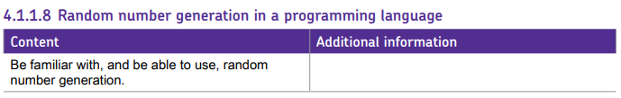
Spec points
Add to your notes what you already know about the random module.
Today we will be looking at additional features we could use in our programs.

Slide 4
randomisation
4.1.1.8 Random number generation in a programming language
Don’t forget import random
Code | What it does | Example use
random.randint(1,20)
random.choice(["1”,”2”,”3"])
random.random()
random.uniform(2,40)
random.randrange(0,20,2)
a=["1","2","3"] random.shuffle(a)
a=["1","2","3"] random.sample(a, k=2)

Slide 5
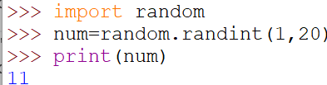




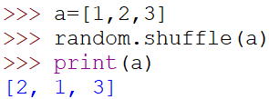
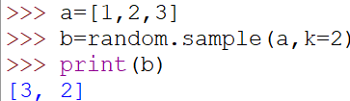
Don’t forget import random
Code | What it does | Example use
random.randint(1,20)
random.choice(["1”,”2”,”3"])
random.random()
random.uniform(2,40)
random.randrange(0,20,2)
a=["1","2","3"] random.shuffle(a)
a=["1","2","3"] b=random.sample(a, k=2) print(b)
Picks a random number between 1 and 20 inclusive
Picks a random value from the list provided
Picks a random number between 0 and 1 with any amount of decimal places
Picks a random float value of any length between 2 and 40
Picks a random even number between 0 and 20
Shuffles the values in the list into different positions
Randomly picks k items from the list with no repetition

Slide 6
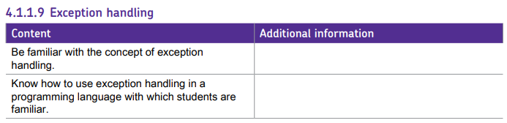
Spec points

Slide 7

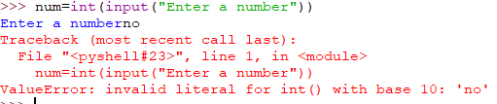
starter
What type of python errors do you know?
Which ones do you know how to avoid?

Slide 8
starter
Task 1 - Error types and fixes:
Runtime Errors - A problem that is encountered when a program is being executed
Index Errors – Trying to access a position that doesn’t exist
Value Errors – Incorrect data types being entered
Type Error – Trying to perform an operation to an incorrect data type
Zero Division Error – Trying to divide a value by zero
File Not Found Error – Accessing a file that doesn’t exist
Name Errors – Accessing a variable that doesn’t exist

Slide 9






Type command – good for problem solving, not for exception handling
Task 2 – type command
Code | What it does
type(“a”)
type(2)
type(2.5)
type(a)
type(b)
type(c)
a=“hello”
b=4.6
c=10

Slide 10
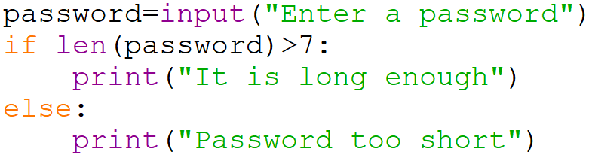
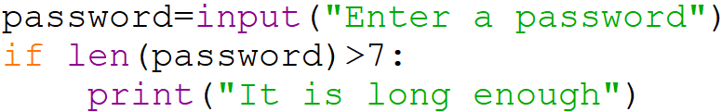
If statements – always finish them
IF example
A very simple way to validate our programs is always making sure that the user knows what went wrong. Something as simple as finishing off an IF statement can tell the user what has happened and how to fix it going forward.

Slide 11
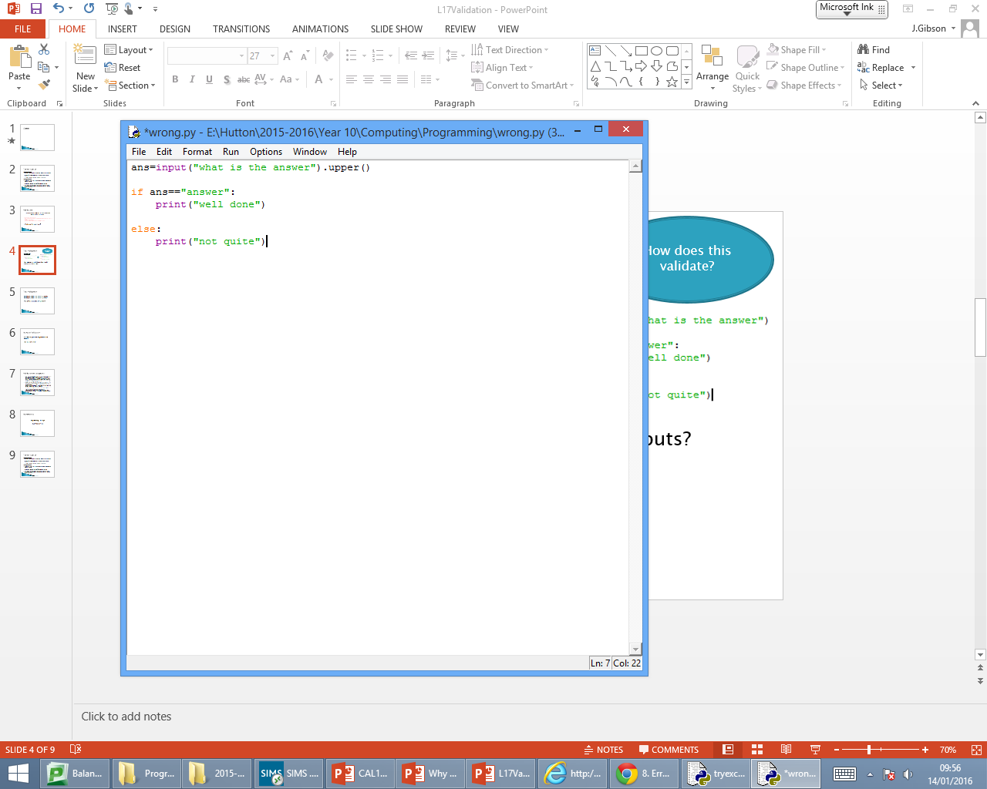
Inputs – sanitise them
In this example, the user has converted their input to upper case.
They have then compared their answer to the lowercase version of the word meaning even if the user types the answer in 100% correctly, they can never get the answer right.
Always make use of:
.upper()
.lower()
.title()
Where case sensitivity is not an issue.
NOTE: This would not work for passwords as an example as we need a mix of upper/lower case, but any other inputs can be validated in this way.
.lower()

Slide 12
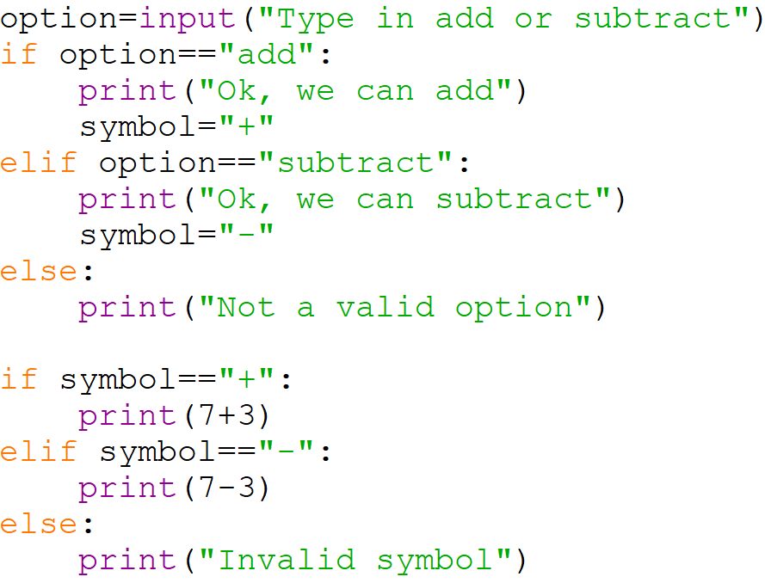
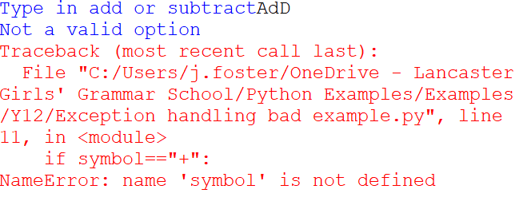
Is this validated?
This may seem validated with the use of ELSE but it crashes as if I did not type “add” or “subtract” in, the symbol variable never gets created meaning it cannot be compared in the next IF statement.
See the next slide for an idea to solve this problem.

Slide 13
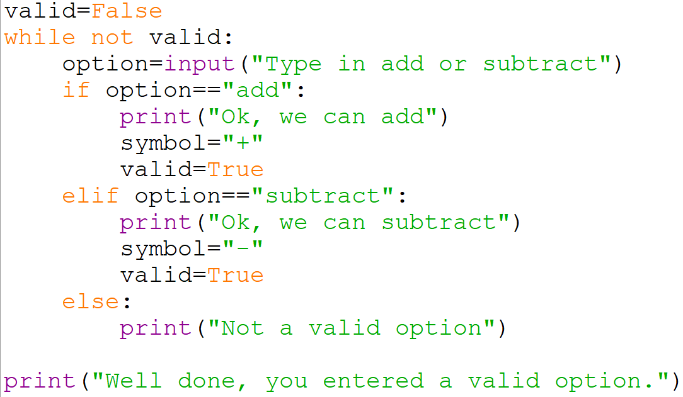
Use of loops to control flow
In this example, the user cannot break out of this loop and continue with the rest of the code until they have made a correct selection of either “add” or “subtract”.
If they type anything else in, the loop will not break and they will be stuck in the loop until a valid input is entered.
This will stop any errors later in the code when trying to use the option variable if it does not exist.

Slide 14
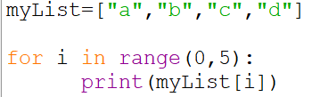
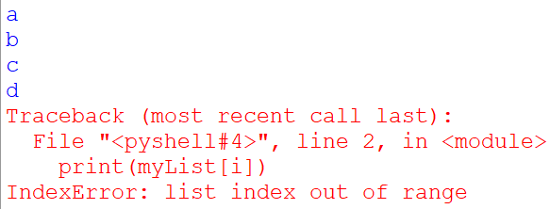
Runtime errors
A runtime error will cause a program to crash – i.e. exit with a very unfriendly error message
What could cause this code to crash?

Slide 15
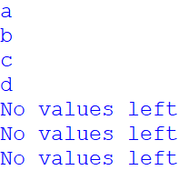
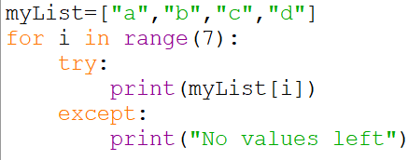
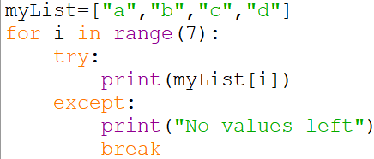
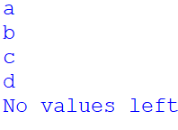
Index errors
Task 1 - Error types and fixes:
The use of try except here would mean it tries to print the index position but if it can’t, instead of crashing it will print the except message (but too many times as we can see!)
Using the break command or a Boolean value to break out of the loop means if it gets to the exception once, it will stop the loop execution and will not continue to print the except message.

Slide 16
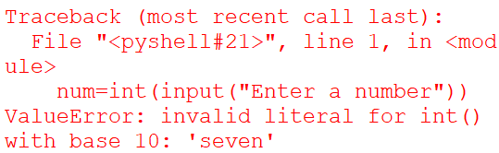

Value errors
Using exception handling statements, you can intercept and handle exceptions so that your program does not crash – it will do what the programmer specifies.

Slide 17
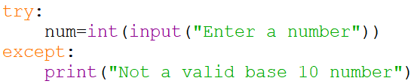

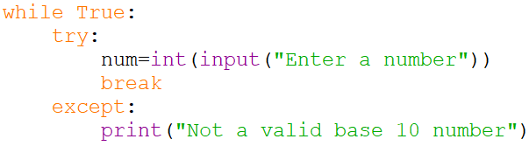
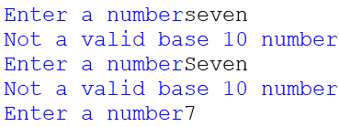
Value errors
Task 1 - Error types and fixes:
This will still not fix the issue as num will not exist but it will avoid an unfriendly error message appearing to the user.
The use of a loop here will enforce that they keep on trying until a valid number is entered, avoiding the unfriendly error message later when a variable is not declared.

Slide 18
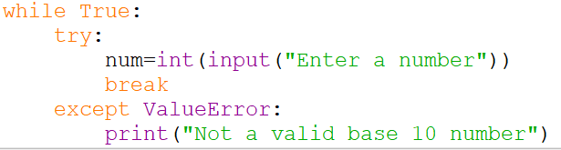
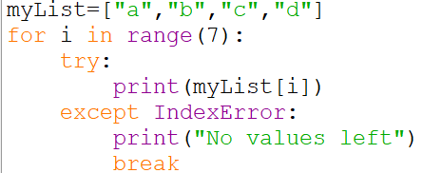
Specifying error types
By using the “except” command, we are telling Python if it is about to produce an unfriendly error message of any kind, do the “except” part instead.
We can specify to tell Python exactly which type of error it should be looking for.
This also allows us to deal with multiple exceptions at once with different error messages to the user depending on the issue.

Slide 19
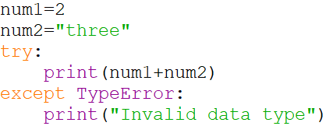
Type errors
Task 1 - Error types and fixes:
Very similar to a value error but if the values were not being typed in, a value error would not be the right type of error, instead this is a type error as this type of data cannot perform this type of operation (adding an integer to a string)

Slide 20
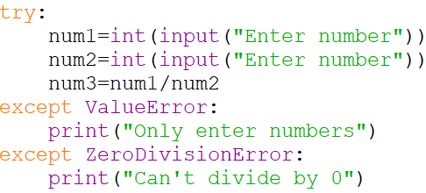


Multiple Exceptions handling
Task 1 - Error types and fixes:
You can use except multiple times for different types of error if there is more than one thing that could go wrong – this will be more user friendly to let the user know exactly what they have done wrong.

Slide 21
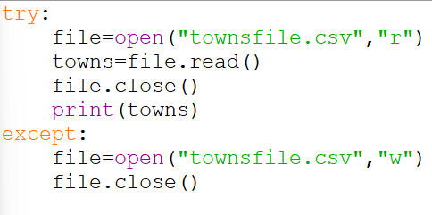
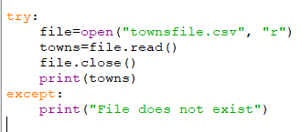
File Not Found Error
Task 1 - Error types and fixes:
File handling errors include:
Trying to open a file which is not in the specified or default folder
Reading past the end of the file
You could use the except here to make the file so it does not crash again – this is particularly useful for your projects as many of these will have external files needing to be read.

Slide 22
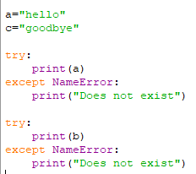
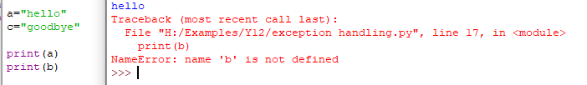
Name error
Task 1 - Error types and fixes:
I am in no way suggesting that you should be using the try command before using every variable but this does exist and could be used in some circumstances.
Realistically, we would just correct the variable name to “b” here!

Slide 23
Challenge
Task 3 - Error types and fixes:
Modify this pseudocode to accept only ages between 11 and 18
ageValid = False
WHILE ageValid = False
TRY
OUTPUT “Enter age”
age ← int(USERINPUT) #convert to integer
ageValid = True
EXCEPT ValueError
OUTPUT “Please enter an integer”
ENDEXCEPT
ENDWHILE

Slide 24
Challenge – Program this
age = 0
WHILE age < 11 or age > 18
age ← USERINPUT(“Enter age between 11 and 18”)
TRY
age ← int(age)
EXCEPT
OUTPUT “Please enter an integer”
age = 0
ENDEXCEPT
ENDWHILE

Slide 25
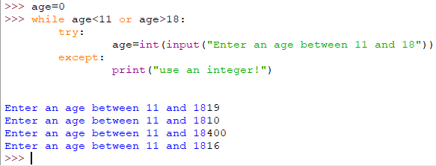
Challenge 2.0

Slide 26
Hashing explanation and code for task 4

Slide 27
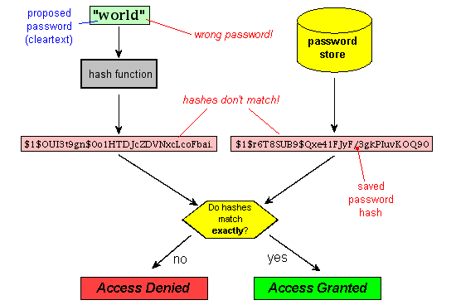
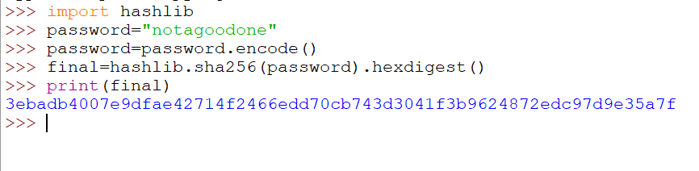
Hashing
Storing passwords in plain text is a bad idea because if a company is hacked, they have given away your password which you may use for multiple accounts.
The company would store a hashed version of your password in its database so if it was hacked, the original password could be obtained from the hashed version of the password
We will cover this more in Y13 but this is basic defensive design (something we look for in the projects) to try and keep users passwords safe.

Slide 28
Programming tasks

Slide 29
tasks
Task 1:
Create a list of words in your program. You should create a program that randomly chooses a word from this list. It should then randomly choose another word – your program should not randomly choose the same word twice and should output an error when it reaches the end of your list because there are no more random words left.

Slide 30
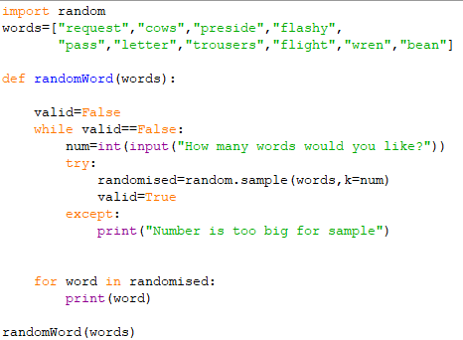
Task 1 Answer

Slide 31
tasks
Task 2:
The computer should generate a random 4 digit pin. You have to try and guess the pin by typing in a 4 digit number. The program should tell you how many numbers you have correct but NOT if they are in the correct place.
Example:
Random PIN = 9263
Guess = 2451
You have one number correct

Slide 32
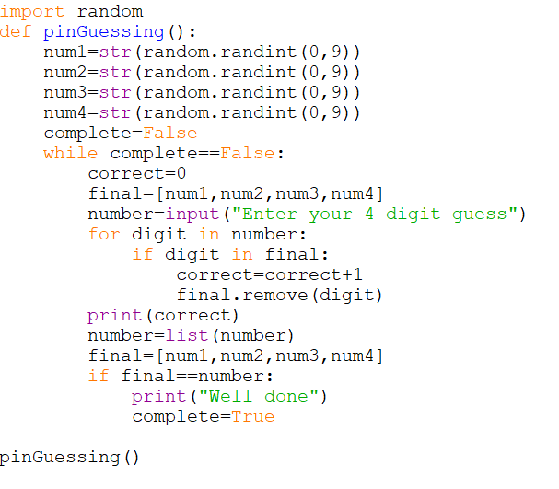
Task 2 Answer

Slide 33
tasks
Task 3:
Go to the page 4.3.5 Sorting Skeleton Code which should be shared with you. Answer the questions about the skeleton code and then fix the program so it works for the bubble and merge sort correctly.
Answers available on the 4.3.5 PowerPoint.

Slide 34
Exercise 2 Code
i = 0
j = 0
k = 0
while i < len(leftHalf) and j < len(rightHalf):
if leftHalf[i] < rightHalf[j]:
sortList[k] = leftHalf[i]
i = i + 1
else:
sortList[k] = rightHalf[j]
j = j + 1
k = k + 1
while i < len(leftHalf):
sortList[k] = leftHalf[i]
i = i + 1
k = k + 1
while j < len(rightHalf):
sortList[k] = rightHalf[j]
j = j + 1
k = k + 1
return sortList

Slide 35
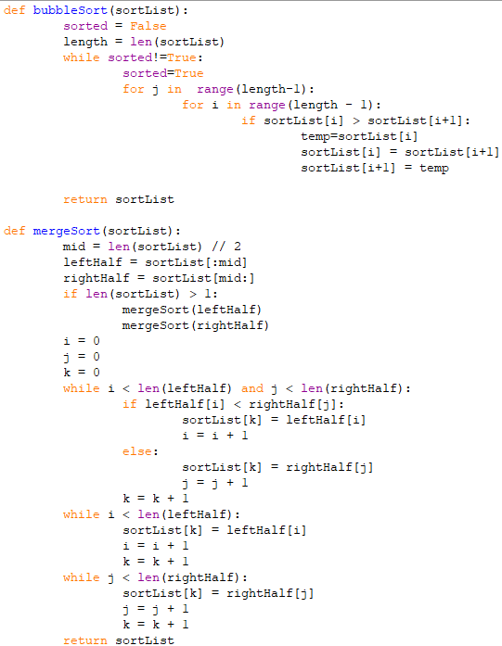
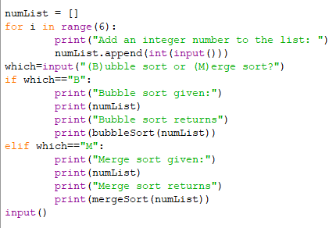

Slide 36
tasks
Task 4:
Create the password checker program. The password must be 8 to 15 characters with at least one upper case letter, one lower case letter, one number and one symbol – this program must repeat until the conditions are met AND typed in twice with matching results
Extend this program:
It is not a good idea to store passwords internally in your file – make a program that stores the passwords externally in an encrypted file (you choose the level of encryption based on your theory knowledge or maybe look into the hashing libraries in Python). It should give the user 3 attempts at getting the correct password from then block them from the system.

Slide 37
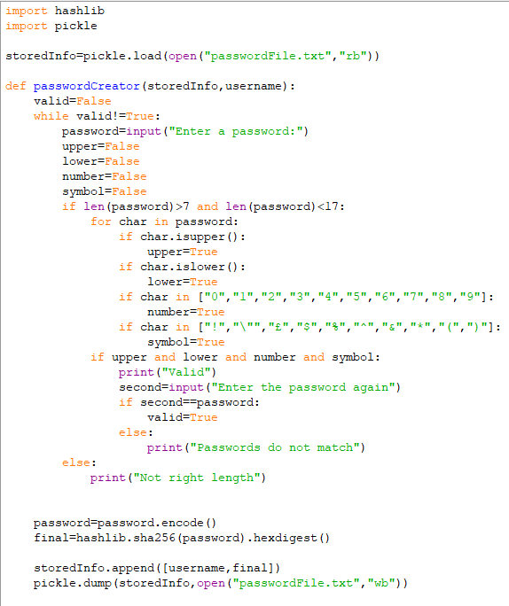
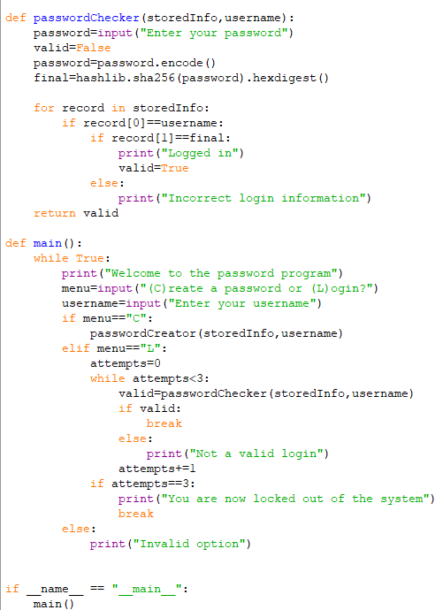

Slide 38
challenges

Slide 39
4.1.1.8 Randomisation challenges
*If you have finished the 1-6 tasks and your notes, challenge yourself to complete some of these*
R@nd0m P@ssw0rd generator
Have the programme create random strong passwords mixing upper and lower case, symbols and numbers.
Extension:
• Have the password also use ASCII characters
• Have the passwords stored in an external file
Events calendar
Create a menu driven program that allows the user to add or delete events from a list of dates and timings, just like a calendar. The program should warn you if any of the events overlap when entering them.
Extensions:
Make it so that none of the events are hard-coded into the program
Years in a Range
Write a program to count the number years in a range that has a repeated digit.
For example, 2012 has a repeated digit, but 2013 does not.
Name that Number
Telephone Keypads often have letters associated with each number. This means that 0141 117 2556 could be stored as 0141-CAT-DOOR. Create a program that can convert a phone number with “letters” into one that only contains digits.
Extensions:
1. Can you develop your program so that only words in the dictionary are allowed?

Slide 40
4.1.1.9 exception handling challenges
*If you have finished the 1-6 tasks and your notes, challenge yourself to complete some of these*
Hack-proof
Create a program that will only open a text document if the correct password is entered. The user should choose the username and password first and it should also verify the password before allowing it.
Extensions:
1. Create a random password first of at least 8 characters first as a suggested password
2. Create a random password that contains at least a lowercase, uppercase and special character of at least 8 characters in length
3. Verify that the password given by the user matches:
a. The limits in Extension 1 above
b. The limits in Extension 2 above
Palindromes
Write a program that checks if a string entered by the user is a palindrome. A palindrome is a word that reads the same forwards as backwards like “racecar”
Data Entry
Create a program that retrieves the membership details for a Rock Climbing Club. The program should take a range of details and then repeat them back, with headings, for confirmation. Once confirmed, the program stores these details; else it clears them and allows a new input.
Extensions:
1. Allow entry of more than one membership
2. Store membership details to a file
3. Retrieve details from a file
4. Allow searching for stored users
Fibbing
Create a program that will calculate the Fibonacci Sequence to 10 places.
Extensions:
1. Allow the user to specify the number of places generated
2. Print this in reverse order
3. Display the total of all the numbers shown

