Slide 1
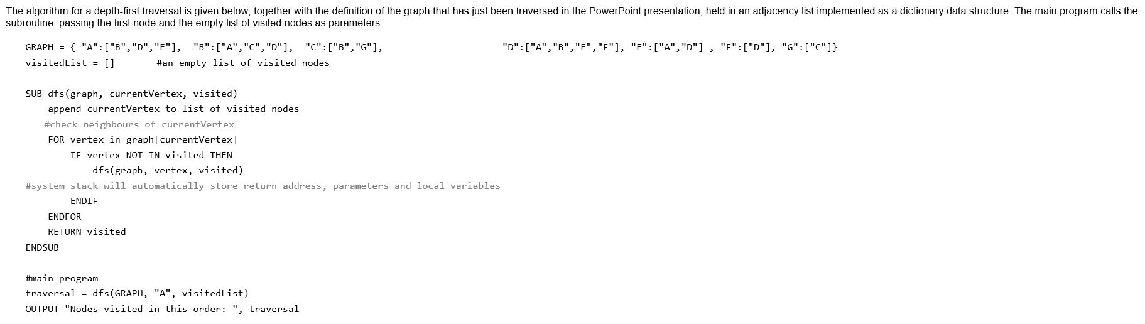
Recursive routine, 3 parameters.
If current vertex = A, visited becomes A
Loops through all the neighbours of the current node: A = B D E
If neighbour hasn’t been visited then: recursive call.
Go deeper into that neighbour and do DFS – go deep first.
Return visited – once all neighbours checked, recursion finishes and the function returns the full list.
Recursion:
Each call to dfs() remembers:
Which node it was on
Where in the neighbour list it was
What the visited list looked like.
When it reaches a dead end it automatically backtracks.
This graph reads as –
A: B, D, E
B: A, C, D
C: B, D etc.

Slide 2
FULL Traversal:
Visited =[]
Dfs(graph, ‘A’, visited)
Step 1 – visit A
Visited = [A]
Neighbours of A = B, D, E
Go to B

Slide 3
Step 2:
Visited = [A, B]
Neighbours = A, C, D
A is already visited so skip to C

Slide 4
Step 3 – visit c
Visited = [A, B, C]
Neighbours = B, G
B visited - skip
Go to G

Slide 5
Step 4 - visit G
Visited = [A,B,C,G]
Neighbours – C (already visited)
No more neighbours backtrack to C
Back at C – all neighbours done- backtrack to ?

Slide 6
Backtrack to B
Back at B, next unvisited neighbour = D
S0 STEP 5 = visit D

Slide 7
Step 5
Visit D
Visited = [A,B,C,G,D]
Neighbours= A, B, E, F
A, B visited
Go to E

Slide 8
Step 6
Visit E
Visited = [A,B,C,G,D,E]
Neighbours= A,D(both visited)
Backtrack to D
Back at D – next unvisited neighbour?

Slide 9
F – Visit F
Visited = [A,B,C,G,D,E,F]
Neighbours= D(already visited)
Backtrack – D – B- A
A,B,C,G,D,E,F – BECOMES THE FINAL ORDER.

Slide 10
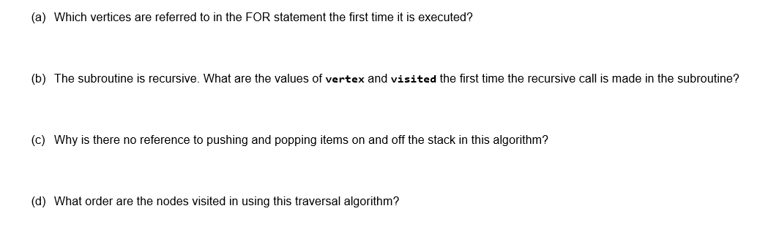
A) What are A’s neighbours?
B)A becomes visited so what is the first one after A - ?
C) We don’t need to write the push/pop command because recursion automatically uses the systems call stack.
D) Depth first search – always goes deep as it can before going sideways. (See previous slides for traversal answer.)

Slide 11
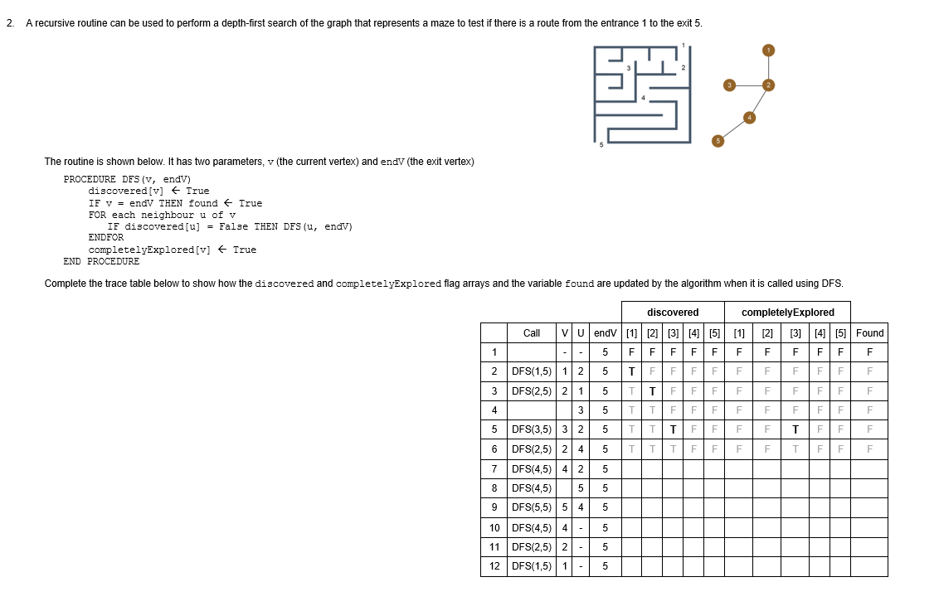

Slide 12
What is this algorithm doing?
Searching a maze graph to see if there is a path from 1 to 5
When we arrive at a node – discovered = True
When we are finished with a node = completely explored [node] = True
When we reach the target – found = True
Depth first is recursive – goes deep then unwinds back up.

Slide 13
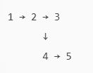
From 1 we can reach 2
From 2 we can reach?
From 3 we can reach?
From 4 we can reach 2, 5
From 5 we can reach 4

Slide 14
From 1 we can reach 2
From 2 we can reach 1,3,4
From 3 we can reach 2
From 4 we can reach 2, 5
From 5 we can reach 4

Slide 15
As this goes as deep as it can first:
1-2-3- dead end
Back track to 2 – 4 – 5
Trace table –
Discovered[x] = True when we first arrive at x
Completely explored[x] = When all its neighbours have been checked
Found = becomes true when we reach 5

Slide 16

Everything false because nothing has been discovered yet.
Arrived at node 1 so discovered 1 = true
1 is not equal to 5 yet so false and not been to any other nodes yet.
We now need to check neighbour of 1 – 2

Slide 17
Row 3 = We go deeper into node 2
Discovered[2] = True
Is 2 = 5? No
Neighbours are 1,3,4
We skip 1 as it is discovered and go to 3

Slide 18
Row 4 – checking neighbours of 3
This row just shows we have discovered 1 and 2 and about to visit 3.

Slide 19
Row 5 DFS(3,5)
Arrive at node 3
Discovered[3]= True
Is 3 = 5? No
Neighbour is 2 (Already discovered) – dead end
Completely explored = True

Slide 20
Row 6 = Back in DFS(2)
We return to node 2
2 has now tried neighbour 3
Next neighbour is 4
Discovered is still 1,2,3
Found is still False
Completely explored[3]= True from earlier.
Complete rows 7 onwards.

