Slide 1

Email Spam Filtering
Python Programming

Slide 2

Description
While the most widely recognized form of spam is email spam. The source and identity of the sender is anonymous and there is no option to cease receiving future e-mails. Spam e-mail is usually sent by spam bot, which is program that continually sends out email. Often spammers will create a virus that install a spam bot into unsuspecting users’ computers and will use their internet connection and computer to send spam. Also, spam e-mails are message randomly sent to multiple addressees by all sorts of groups, but mostly lazy advertisers and criminals who wish to lead you to phishing sites. The sites attempt to steal your personal, electronic, and financial information
The essence of incorporating only important mails in Inbox

Slide 3

Functionality
Set of advanced with great UX features
Preparing the Text data
Creating Word dictionary
Feature Extraction process
Training the classifier
Build the frontend for the model

Slide 4

Snapshots of the system
These snapshots are from the real output of the code and the analysis

Slide 5
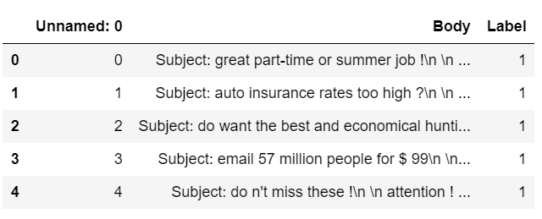
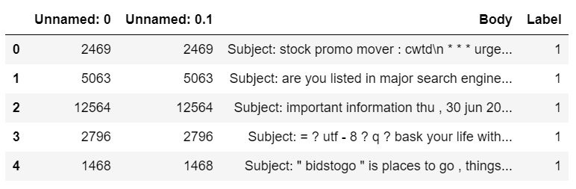
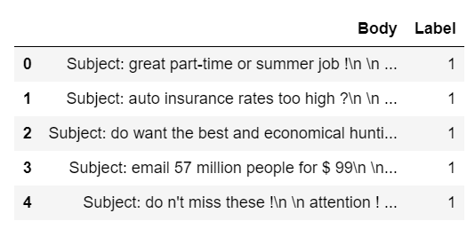
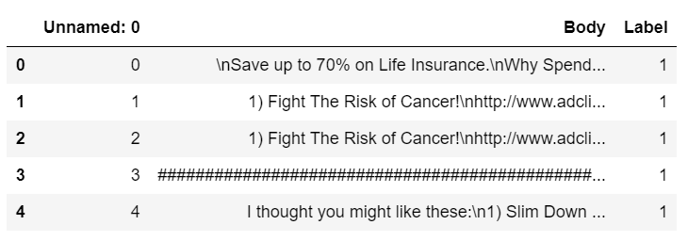
Concatenated Dataset
lingSpam.csv, enronSpamSubset.csv, completeSpamAssassin.csv

Slide 6
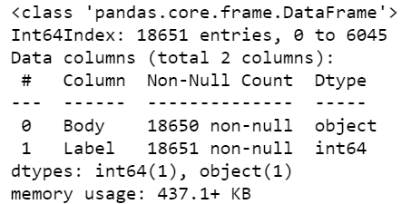

Data Info – Before and After Dropping NaN values

Slide 7
Exploratory Data Analysis
Using Seaborn and Matplotlib

Slide 8
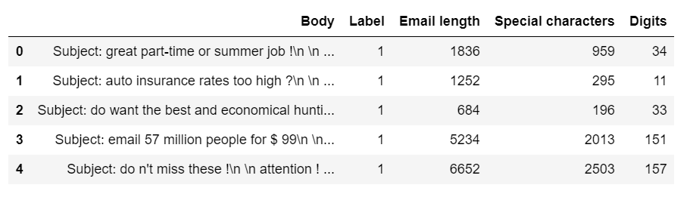
New Feature Engineering
Added columns containing Email length, sum of Special characters, sum of Digits

Slide 9
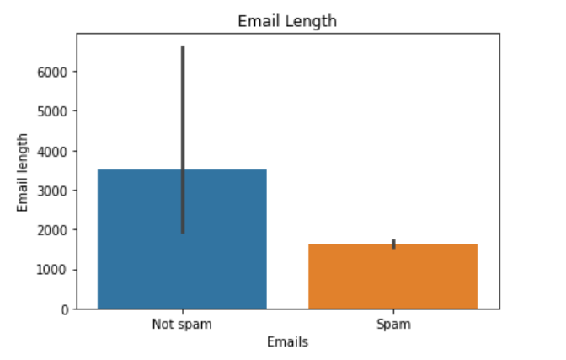
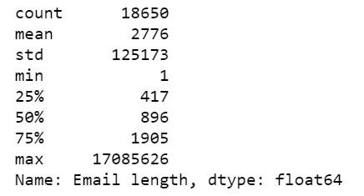
Email Length
Statistical Data and Graph

Slide 10
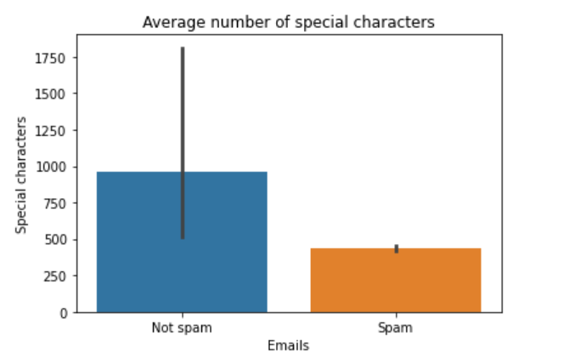
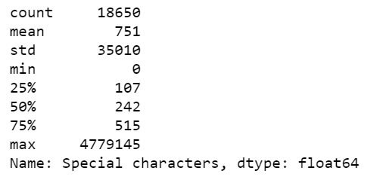
Special Characters
Statistical Data and Graph analysis

Slide 11
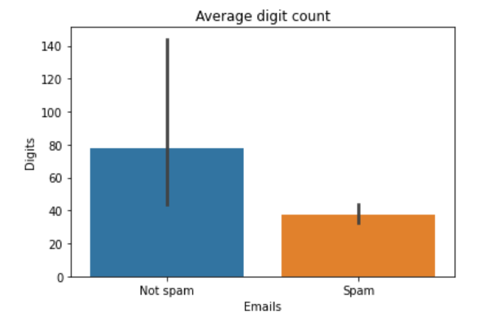
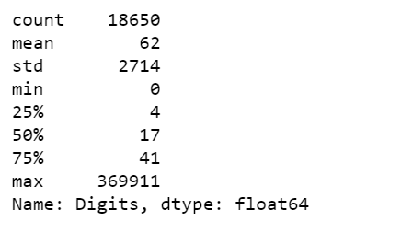
Digit Count
Statistical Data and Graph Analysis

Slide 12
Data Preprocessing
Removing Links, pattern matching, tokenizing, lemmetizing

Slide 13
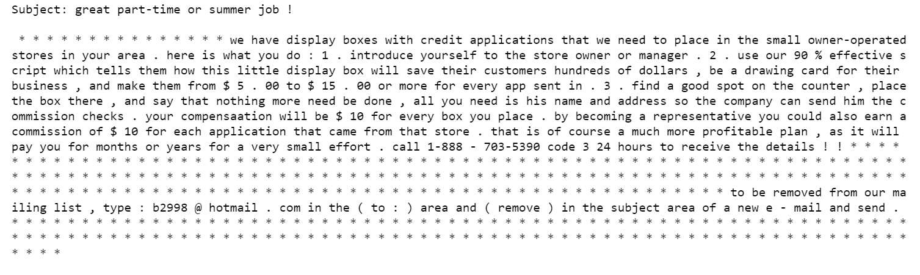
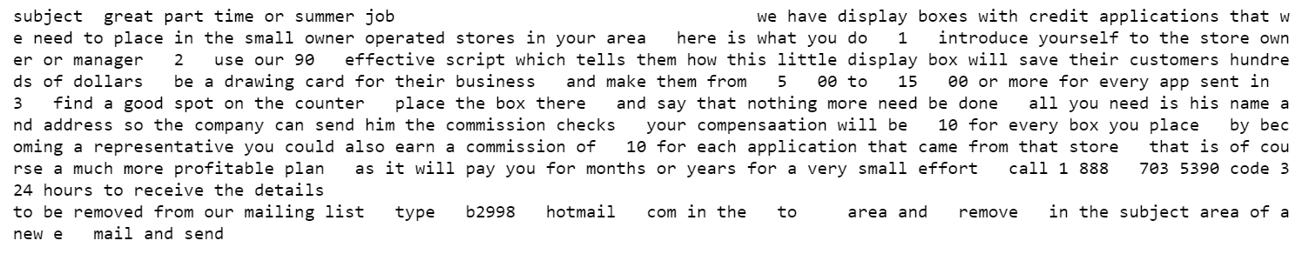
Removing Links (http:/…….)
Pattern matching (^a-zA-Z0-9)

Slide 14
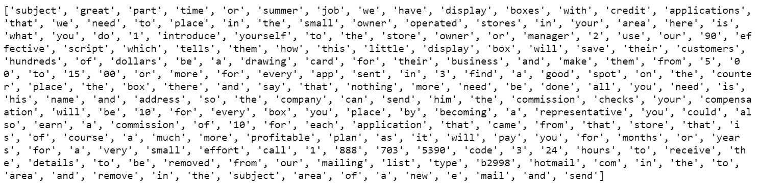
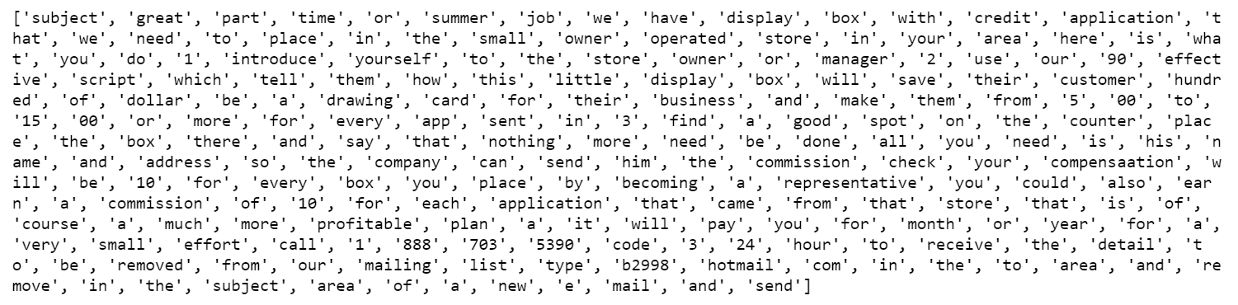
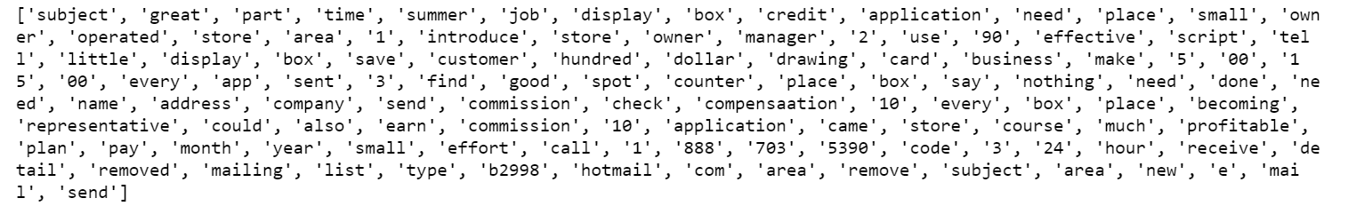
Tokenizing Each Word
Lemmetizing Words
Rmoving StopWords

Slide 15

Train Model
Split data in Train-Test, Fit the model

Slide 16
HeatMap of Prediction
…

Slide 17
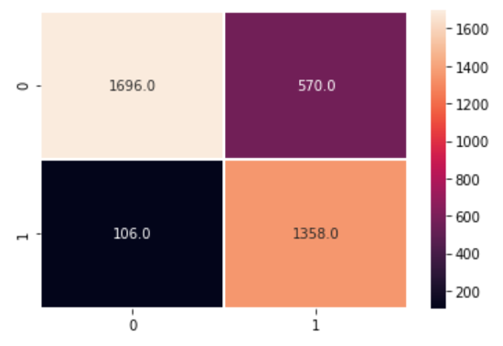

Slide 18
Real-Time Prediction
…

Slide 19
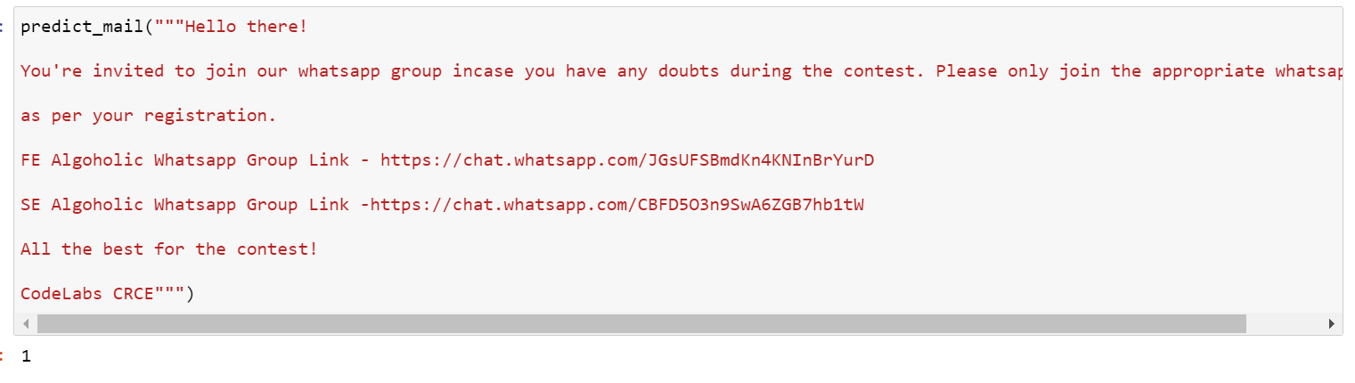
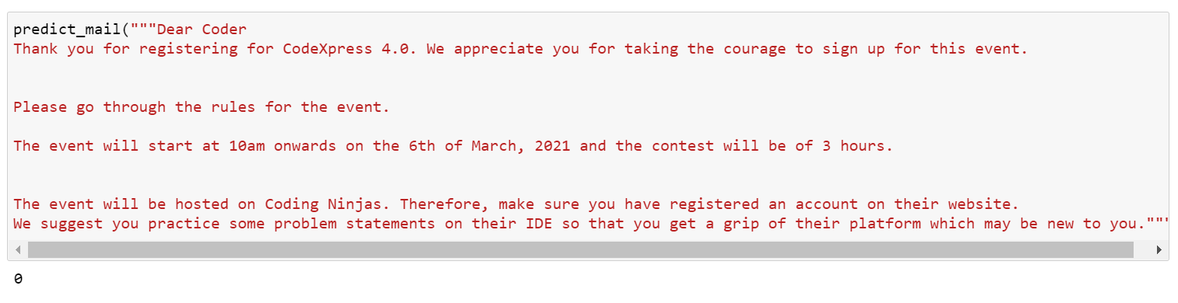

Slide 20
Frontend using - Streamlit
Web App created

Slide 21
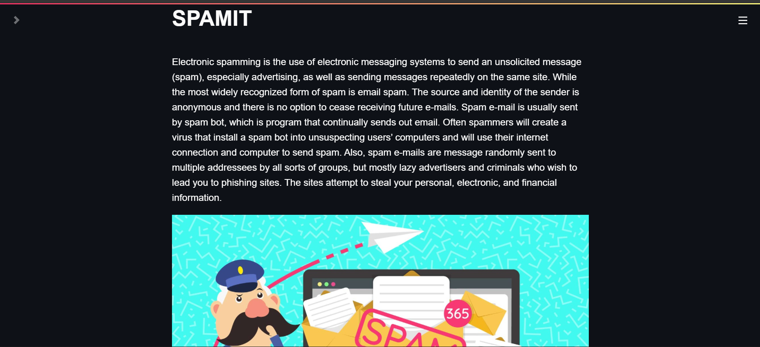

Slide 22
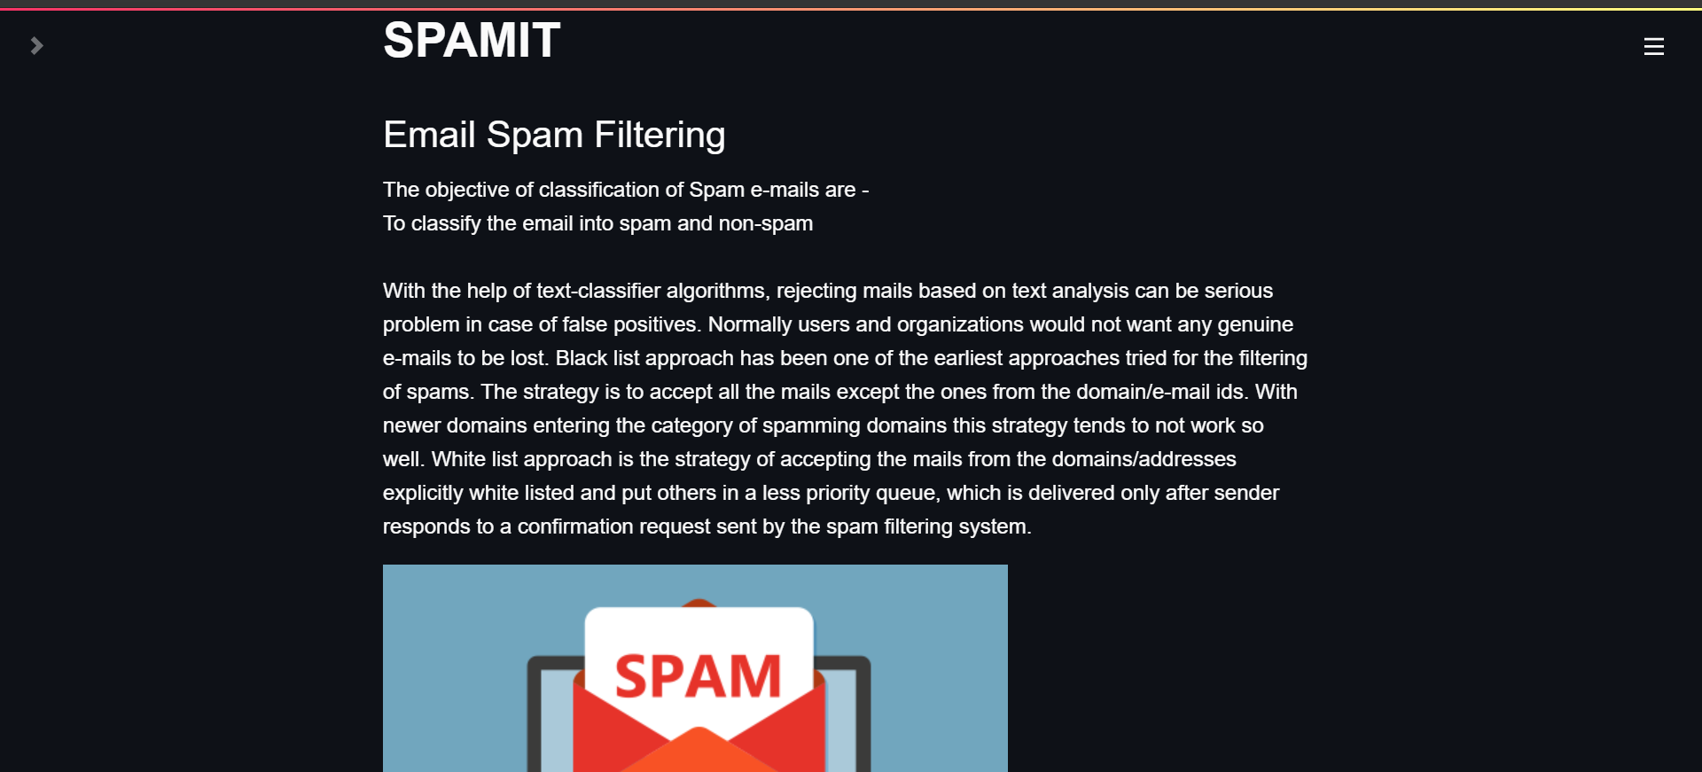

Slide 23
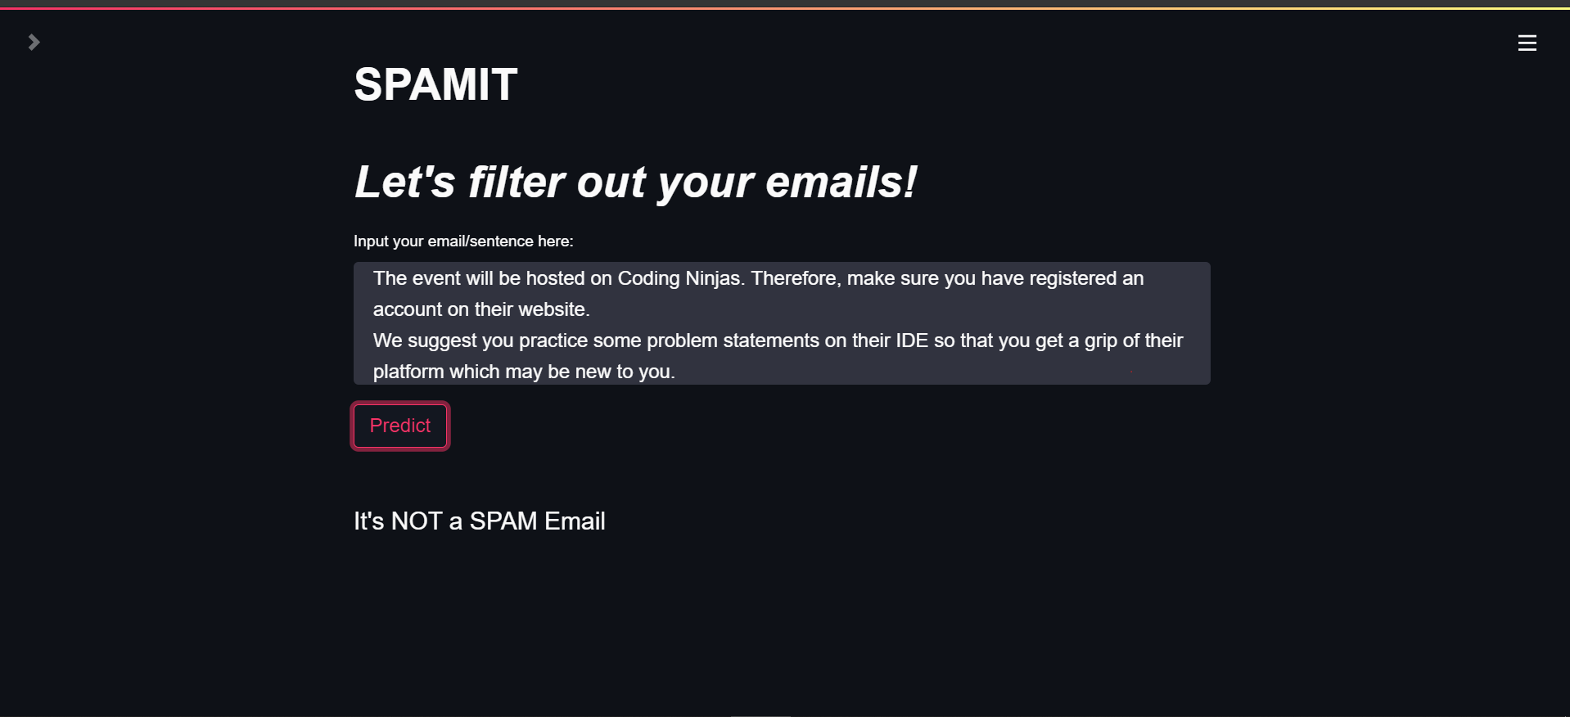

Slide 24
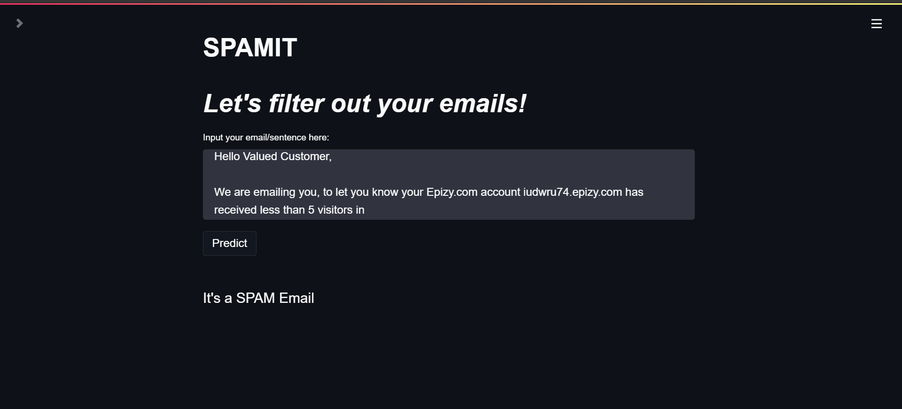

Slide 25

Thank You
Liny Mathew 8950
Warren Fernandes 8940
Yash Deshmukh 8931

